Slide 1
FORM 5
GEOGRAPHY
Lesson 48
Consequences of the Urbanisation Process
Notes:
Good morning, class, and welcome to our geography lesson. I am your geography teacher, Mr Kamdem. Today we are starting Lesson 48: Consequences of the Urbanisation Process.

Slide 2
CLASS INFO
Class, Chapter and Duration
Class | Form 5
Chapter | Module III: Management of Population Growth and Space Colonisation
Duration | 2 periods (2 × 50 minutes)
Notes:
This lesson is for Form 5. It belongs to Module III: Management of Population Growth and Space Colonisation. We shall need 2 periods to cover it.

Slide 3
IDENTIFICATION
Lesson Identification
Topic | The Development of Settlements and their Implications
Sub-topic | Urban Settlements and their Spheres of Influence
Lesson | Lesson 48: Consequences of the Urbanisation Process
Notions / Concepts | Ghettos, armed robbery, traffic jams, delinquencies.
Syllabus focus | Positive consequences; negative consequences; solutions.
Competence | Learners are able to assess the consequences of urbanisation and propose solutions.
Notes:
Our topic is The Development of Settlements and their Implications, and the sub-topic is Urban Settlements and their Spheres of Influence. The key notions we shall use today are: ghettos, armed robbery, traffic jams, delinquencies. At the end, you should be able to do this: learners are able to assess the consequences of urbanisation and propose solutions.

Slide 4

HOMEWORK CORRECTION
Correction of the Homework
Question (Lesson 47: Urbanisation):
Explain three reasons for the rapid growth of Garoua.
Notes:
Before we start the new lesson, let us correct the homework I gave you at the end of Lesson 47: Urbanisation. The question was: Explain three reasons for the rapid growth of Garoua. Take out your exercise books.

Slide 5
HOMEWORK CORRECTION
Correction: Possible Answer
Rural-urban migration from the North, regional administration, trade with Nigeria and Chad, and industries such as CICAM and SODECOTON.
Notes:
Here is a good answer. Rural-urban migration from the North, regional administration, trade with Nigeria and Chad, and industries such as CICAM and SODECOTON. Compare it with your own answer and correct your work in red.

Slide 6
LESSON PLAN
Lesson Plan
Correction of the homework
Objectives and recall
Real-life situation and action to take
Learning activities
Board summary
Evaluation, remediation and homework
Notes:
Here is the plan of our lesson today. First, we shall correct the homework. Then we shall look at the objectives and recall what you already know. After that, we shall study a situation from real life and the action to take, and do the learning activities. Finally, we shall copy the board summary, do the evaluation and the remediation, and I will give you the homework.

Slide 7
OBJECTIVES
Objectives
By the end of this lesson, you should be able to:
Explain the positive consequences of urbanisation.
Explain the negative consequences.
Propose solutions.
Notes:
By the end of this lesson, you should be able to do three things. Number 1: explain the positive consequences of urbanisation. Number 2: explain the negative consequences. Number 3: propose solutions.

Slide 8
PREVIOUS KNOWLEDGE
Previous Knowledge
Towns grow fast.
Towns have jobs and services.
Some quarters are unplanned.
Notes:
Let us first remember what you already know. Towns grow fast. Towns have jobs and services. Some quarters are unplanned. Keep this in mind, because we shall build on it today.

Slide 9
REAL-LIFE SITUATION
Situation in Real Life
In Douala, people find jobs and good hospitals, but traffic jams, floods, waste and armed robbery make life difficult in many quarters.
Notes:
Listen carefully to this situation from real life. In Douala, people find jobs and good hospitals, but traffic jams, floods, waste and armed robbery make life difficult in many quarters. Think about it, because I am going to ask you some questions.

Slide 10
REAL-LIFE SITUATION
Situation: Question 1
What is the problem in the situation?
Notes:
Question 1: What is the problem in the situation? Think for a moment, then raise your hand to answer.

Slide 11
REAL-LIFE SITUATION
Answer
Urbanisation has good and bad effects.
Notes:
Good. Urbanisation has good and bad effects.

Slide 12
REAL-LIFE SITUATION
Situation: Question 2
Give one positive effect.
Notes:
Question 2: Give one positive effect. Think for a moment, then raise your hand to answer.

Slide 13
REAL-LIFE SITUATION
Answer
Jobs (also hospitals).
Notes:
Good. Jobs (also hospitals).

Slide 14
REAL-LIFE SITUATION
Situation: Question 3
Give two negative effects.
Notes:
Question 3: Give two negative effects. Think for a moment, then raise your hand to answer.

Slide 15
REAL-LIFE SITUATION
Possible Answer
Traffic jams and armed robbery.
Notes:
Good. Traffic jams and armed robbery.

Slide 16
ACTION TO TAKE
Action to Take
Denounce delinquency and use waste bins.
Notes:
From this situation, the action we are working towards in this lesson is the following: denounce delinquency and use waste bins.

Slide 17
JUSTIFICATION
Justification of the Lesson
This lesson helps us to understand urban problems and their solutions.
Notes:
Why is this lesson important for you? This lesson helps us to understand urban problems and their solutions.

Slide 18

1. POSITIVE CONSEQUENCES
Activity 1
A city centre.
Notes:
Activity 1. Look carefully at this picture: a city centre. Observe every detail before I ask the question.

Slide 19
1. POSITIVE CONSEQUENCES
Activity 1: Question
Give two positive consequences of urbanisation.
Notes:
Here is the question for Activity 1: Give two positive consequences of urbanisation. Take one minute to think and write your answer in your rough notebook.

Slide 20
1. POSITIVE CONSEQUENCES
Activity 1: Answer
Jobs and better services (schools, hospitals, electricity).
Notes:
Let us check the answer together. Jobs and better services (schools, hospitals, electricity).

Slide 21

2. NEGATIVE: SOCIAL
Activity 2
A slum.
Notes:
Activity 2. Look carefully at this picture: a slum. Observe every detail before I ask the question.

Slide 22
2. NEGATIVE: SOCIAL
Activity 2: Question
Give two social problems of towns.
Notes:
Here is the question for Activity 2: Give two social problems of towns. Take one minute to think and write your answer in your rough notebook.

Slide 23
2. NEGATIVE: SOCIAL
Activity 2: Answer
Slums and ghettos, and crime such as armed robbery.
Notes:
Let us check the answer together. Slums and ghettos, and crime such as armed robbery.

Slide 24

2. NEGATIVE: TRANSPORT
Activity 3
A traffic jam.
Notes:
Activity 3. Look carefully at this picture: a traffic jam. Observe every detail before I ask the question.

Slide 25
2. NEGATIVE: TRANSPORT
Activity 3: Question
Give two transport problems.
Notes:
Here is the question for Activity 3: Give two transport problems. Take one minute to think and write your answer in your rough notebook.

Slide 26
2. NEGATIVE: TRANSPORT
Activity 3: Answer
Traffic jams and poor roads.
Notes:
Let us check the answer together. Traffic jams and poor roads.

Slide 27
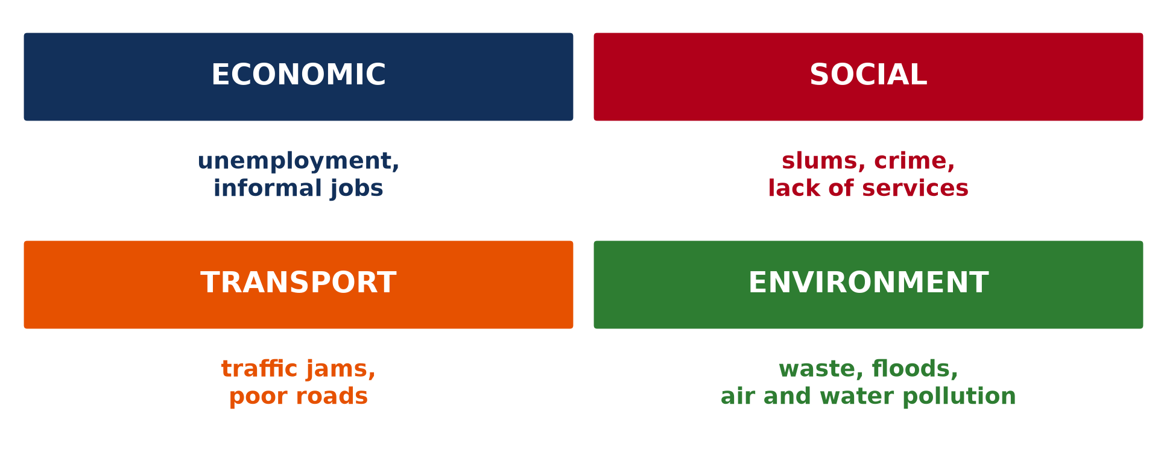
2. NEGATIVE: ENVIRONMENT
Activity 4
Urban problems.
Notes:
Activity 4. Look carefully at this diagram: urban problems. Observe every detail before I ask the question.

Slide 28
2. NEGATIVE: ENVIRONMENT
Activity 4: Question
Give two environmental problems.
Notes:
Here is the question for Activity 4: Give two environmental problems. Take one minute to think and write your answer in your rough notebook.

Slide 29
2. NEGATIVE: ENVIRONMENT
Activity 4: Answer
Waste and floods (also air and water pollution).
Notes:
Let us check the answer together. Waste and floods (also air and water pollution).

Slide 30
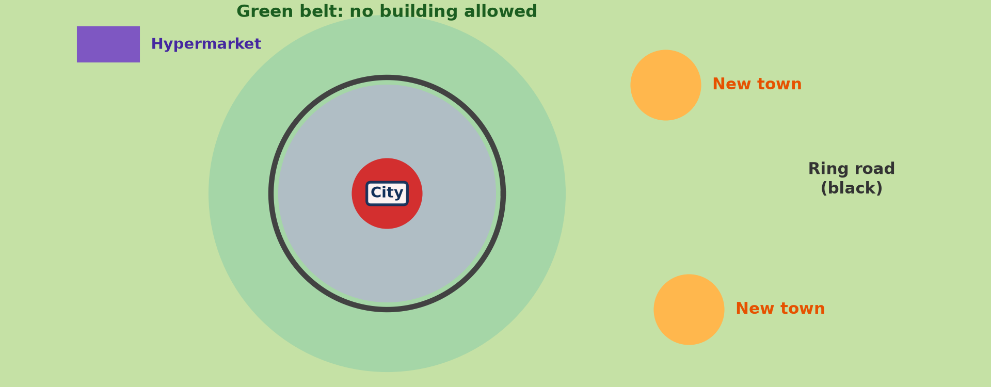
3. SOLUTIONS
Activity 5
Controlling urban growth.
Notes:
Activity 5. Look carefully at this diagram: controlling urban growth. Observe every detail before I ask the question.

Slide 31
3. SOLUTIONS
Activity 5: Question
Give three solutions.
Notes:
Here is the question for Activity 5: Give three solutions. Take one minute to think and write your answer in your rough notebook.

Slide 32
3. SOLUTIONS
Activity 5: Answer
Town planning, satellite towns and green belts (also waste facilities and renewal of old quarters).
Notes:
Let us check the answer together. Town planning, satellite towns and green belts (also waste facilities and renewal of old quarters).

Slide 33
BOARD SUMMARY
Board Summary
Topic: The Development of Settlements and their Implications
Sub-topic: Urban Settlements and their Spheres of Influence
Lesson 48: Consequences of the Urbanisation Process
Notes:
Now we are going to copy the board summary. Write the title and the headings neatly in your notebooks. I will give you enough time for each slide, so do not rush.

Slide 34
BOARD SUMMARY
1. Positive Consequences
Urbanisation has the following positive consequences:
Economic: Towns create jobs, markets and industries.
Social: Towns offer schools, hospitals, water and electricity.
Notes:
Let us copy Positive Consequences. Urbanisation has the following positive consequences. On this slide we have Economic and Social. Write each point on a new line, with the key term first, and explain it in your own words when we revise.

Slide 35
BOARD SUMMARY
2. Negative Consequences
Urbanisation has the following negative consequences:
Social: Slums, ghettos, unemployment, armed robbery and delinquency increase.
Transport: Traffic jams and accidents increase.
Notes:
Let us copy Negative Consequences. Urbanisation has the following negative consequences. On this slide we have Social and Transport. Write each point on a new line, with the key term first, and explain it in your own words when we revise. When you finish, we go to the next slide.

Slide 36
BOARD SUMMARY
2. Negative Consequences (continued)
Environment: Waste, floods and pollution spread.
Notes:
We continue with Negative Consequences. On this slide we have Environment. Write each point on a new line, with the key term first, and explain it in your own words when we revise.

Slide 37
BOARD SUMMARY
2. Negative Consequences
Illustration: urban problems
Notes:
Now draw this illustration in your notebook: urban problems. Give it a title and label it clearly.

Slide 38
BOARD SUMMARY
3. Solutions
Urban problems can be solved in the following ways:
Planning: Master plans, satellite towns and green belts control growth.
Services: Roads, waste facilities and low-cost housing should be provided.
Notes:
Let us copy Solutions. Urban problems can be solved in the following ways. On this slide we have Planning and Services. Write each point on a new line, with the key term first, and explain it in your own words when we revise. When you finish, we go to the next slide.

Slide 39
BOARD SUMMARY
3. Solutions (continued)
Renewal and rural development: Old quarters are renewed and villages are developed to reduce migration.
Notes:
We continue with Solutions. On this slide we have Renewal and rural development. Write each point on a new line, with the key term first, and explain it in your own words when we revise.

Slide 40
FORMATIVE EVALUATION
Evaluation 1
Give two positive consequences of urbanisation.
Notes:
Now let us check what you have understood. Question 1: Give two positive consequences of urbanisation. Answer in your exercise book.

Slide 41
FORMATIVE EVALUATION
Expected Answer
Jobs and services.
Notes:
The expected answer is: jobs and services. If you got it right, well done.

Slide 42
FORMATIVE EVALUATION
Evaluation 2
Give two negative consequences and two solutions.
Notes:
Now let us check what you have understood. Question 2: Give two negative consequences and two solutions. Answer in your exercise book.

Slide 43
FORMATIVE EVALUATION
Expected Answer
Slums and traffic jams; town planning and satellite towns.
Notes:
The expected answer is: slums and traffic jams; town planning and satellite towns. If you got it right, well done.

Slide 44
REMEDIATION
Remediation
Fill in the blanks:
Poor unplanned quarters are ______.
A belt of green land around a town is a green ______.
New towns built near a city are ______ towns.
Notes:
For those who need more practice, fill in the blanks in your exercise book. The answers are: number 1, slums (shanty towns); number 2, belt; number 3, satellite.

Slide 45
HOMEWORK
Homework
List three urban problems of your town and propose one solution for each.
Notes:
For your homework: List three urban problems of your town and propose one solution for each. We shall correct it at the beginning of our next lesson.

Slide 46
NEXT LESSON
Next Lesson
Our next lesson will be on:
Further Study 5: The Shanty Settlements (Ghettos/Slums) in the World
Notes:
Our next lesson will be on Further Study 5: The Shanty Settlements (Ghettos/Slums) in the World. Thank you for your attention, and see you next time.

Slide 47
BILINGUAL GAME
Bilingual Game (Jeu Bilingue)
English | Français
Ghetto | Le ghetto
Armed robbery | Le vol à main armée
Delinquency | La délinquance
Green belt | La ceinture verte
Satellite town | La ville satellite
Town planning | L'urbanisme
Notes:
Let us play the bilingual game. I say a word in English, and you give me the French word. Then we do the reverse.

Slide 48
LOGBOOK
Official Logbook (1/2)
Module / Topic | The Development of Settlements and their Implications
Lesson Title | Lesson 48: Consequences of the Urbanisation Process
Expected Learning Outcomes | Explain the positive consequences of urbanisation. Explain the negative consequences. Propose solutions.
Competence | Learners are able to assess the consequences of urbanisation and propose solutions.
Notes:
I record this information in the official logbook of the class after the lesson.

Slide 49
LOGBOOK
Official Logbook (2/2)
Matter Taught | Positive Consequences; Negative Consequences; Solutions.
Evaluation | Formative evaluation and remediation exercise.
Homework | List three urban problems of your town and propose one solution for each.
Enrolment / Present / Absent | ____ / ____ / ____
Achievement | To be completed after the lesson.
Notes:
I complete the second page of the logbook: the matter taught, the evaluation, the homework and the attendance.

Slide 50
TEACHER'S NOTE
Teacher's Note
Timing: Homework correction, plan, objectives 8 min | Recall, situation, action 10 min | 5 activities 30 min | Board summary (copying) 30 min | Evaluation, remediation 10 min | Homework, next lesson 5 min | Logbook 7 min
Without the projector (Activity 1): discuss.
Without the projector (Activity 2): discuss.
Without the projector (Activity 3): discuss.
Without the projector (Activity 4): discuss.
Without the projector (Activity 5): list.
Notes:
This slide is for me, the teacher: it gives the timing of the lesson and what to do if the projector is not available.

Slide 51
REFERENCES
References
Geography Syllabus, Forms I–V, MINESEC (2023) — Form 5, Module III: Management of Population Growth and Space Colonisation.
Photo, Activity 1: “Central Business District” by alantankenghoe, CC BY 2.0, via Flickr (https://www.flickr.com/photos/57785759@N06/5548938771)
Photo, Activity 2: “Mathare” by Book Aid International, CC BY-NC-ND 2.0, via Flickr (https://www.flickr.com/photos/45024905@N07/4135561707)
Photo, Activity 3: “Nairobi Traffic Jam” by rogiro, CC BY-NC 2.0, via Flickr (https://www.flickr.com/photos/43132185@N00/48712135)
Diagrams and animations: drawn for this lesson (Geography Department).
Notes:
These are the references and picture credits used to prepare this lesson.

