Slide 1
FORM 5
GEOGRAPHY
Lesson 53
Urban Spheres of Influence in Cameroon
Notes:
Good morning, class, and welcome to our geography lesson. I am your geography teacher, Mr Kamdem. Today we are starting Lesson 53: Urban Spheres of Influence in Cameroon.

Slide 2
CLASS INFO
Class, Chapter and Duration
Class | Form 5
Chapter | Module III: Management of Population Growth and Space Colonisation
Duration | 2 periods (2 × 50 minutes)
Notes:
This lesson is for Form 5. It belongs to Module III: Management of Population Growth and Space Colonisation. We shall need 2 periods to cover it.

Slide 3
IDENTIFICATION
Lesson Identification
Topic | Human Characteristics of Cameroon
Sub-topic | Development of Settlements in Cameroon
Lesson | Lesson 53: Urban Spheres of Influence in Cameroon
Notions / Concepts | Urban fields, sphere of influence.
Syllabus focus | Identification and description of major urban spheres of influence; reasons why they serve as spheres of influence.
Competence | Learners are able to identify the urban spheres of influence of Cameroon and explain them.
Notes:
Our topic is Human Characteristics of Cameroon, and the sub-topic is Development of Settlements in Cameroon. The key notions we shall use today are: urban fields, sphere of influence. At the end, you should be able to do this: learners are able to identify the urban spheres of influence of Cameroon and explain them.

Slide 4

HOMEWORK CORRECTION
Correction of the Homework
Question (Lesson 52: Settlements in Cameroon):
Rank six towns of Cameroon by size and give one function for each.
Notes:
Before we start the new lesson, let us correct the homework I gave you at the end of Lesson 52: Settlements in Cameroon. The question was: Rank six towns of Cameroon by size and give one function for each. Take out your exercise books.

Slide 5
HOMEWORK CORRECTION
Correction: Possible Answer
Douala (port, industry), Yaoundé (administration), Garoua (regional capital, trade), Bamenda (commerce), Maroua (administration, trade), Bafoussam (commerce, agriculture).
Notes:
Here is a good answer. Douala (port, industry), Yaoundé (administration), Garoua (regional capital, trade), Bamenda (commerce), Maroua (administration, trade), Bafoussam (commerce, agriculture). Compare it with your own answer and correct your work in red.

Slide 6
LESSON PLAN
Lesson Plan
Correction of the homework
Objectives and recall
Real-life situation and action to take
Learning activities
Board summary
Evaluation, remediation and homework
Notes:
Here is the plan of our lesson today. First, we shall correct the homework. Then we shall look at the objectives and recall what you already know. After that, we shall study a situation from real life and the action to take, and do the learning activities. Finally, we shall copy the board summary, do the evaluation and the remediation, and I will give you the homework.

Slide 7
OBJECTIVES
Objectives
By the end of this lesson, you should be able to:
Identify the major urban spheres of influence in Cameroon.
Describe their extent.
Notes:
Take your time to copy this part; we will continue together.

Slide 8
OBJECTIVES
Objectives (continued)
Explain why they serve as spheres of influence.
Notes:
By the end of this lesson, you should be able to do three things. Number 1: identify the major urban spheres of influence in Cameroon. Number 2: describe their extent. Number 3: explain why they serve as spheres of influence.

Slide 9
PREVIOUS KNOWLEDGE
Previous Knowledge
An urban field is the area a town serves.
Douala has the main port.
Garoua serves the North.
Notes:
Let us first remember what you already know. An urban field is the area a town serves. Douala has the main port. Garoua serves the North. Keep this in mind, because we shall build on it today.

Slide 10
REAL-LIFE SITUATION
Situation in Real Life
Traders from Chad and the Central African Republic buy goods in Douala, students from all regions study in Yaoundé, and herders of the North sell cattle in Garoua and Ngaoundéré.
Notes:
Listen carefully to this situation from real life. Traders from Chad and the Central African Republic buy goods in Douala, students from all regions study in Yaoundé, and herders of the North sell cattle in Garoua and Ngaoundéré. Think about it, because I am going to ask you some questions.

Slide 11
REAL-LIFE SITUATION
Situation: Question 1
What is the problem in the situation?
Notes:
Question 1: What is the problem in the situation? Think for a moment, then raise your hand to answer.

Slide 12
REAL-LIFE SITUATION
Answer
Towns of Cameroon influence large areas.
Notes:
Good. Towns of Cameroon influence large areas.

Slide 13
REAL-LIFE SITUATION
Situation: Question 2
Which town attracts traders from Chad?
Notes:
Question 2: Which town attracts traders from Chad? Think for a moment, then raise your hand to answer.

Slide 14
REAL-LIFE SITUATION
Answer
Douala.
Notes:
Good. Douala.

Slide 15
REAL-LIFE SITUATION
Situation: Question 3
Which town attracts students?
Notes:
Question 3: Which town attracts students? Think for a moment, then raise your hand to answer.

Slide 16
REAL-LIFE SITUATION
Possible Answer
Yaoundé.
Notes:
Good. Yaoundé.

Slide 17
ACTION TO TAKE
Action to Take
Use the services of regional towns to reduce pressure on big cities.
Notes:
From this situation, the action we are working towards in this lesson is the following: use the services of regional towns to reduce pressure on big cities.

Slide 18
JUSTIFICATION
Justification of the Lesson
This lesson helps us to understand the role of our towns in the country and beyond.
Notes:
Why is this lesson important for you? This lesson helps us to understand the role of our towns in the country and beyond.

Slide 19

1. IDENTIFICATION
Activity 1
Main towns of Cameroon.
Notes:
Activity 1. Look carefully at this diagram: main towns of Cameroon. Observe every detail before I ask the question.

Slide 20
1. IDENTIFICATION
Activity 1: Question
Name three major spheres of influence in Cameroon.
Notes:
Here is the question for Activity 1: Name three major spheres of influence in Cameroon. Take one minute to think and write your answer in your rough notebook.

Slide 21
1. IDENTIFICATION
Activity 1: Answer
Douala, Yaoundé and Garoua (also Bamenda, Bafoussam and Ngaoundéré).
Notes:
Let us check the answer together. Douala, Yaoundé and Garoua (also Bamenda, Bafoussam and Ngaoundéré).

Slide 22

2. DOUALA
Activity 2
A port.
Notes:
Activity 2. Look carefully at this picture: a port. Observe every detail before I ask the question.

Slide 23
2. DOUALA
Activity 2: Question
Describe the sphere of influence of Douala.
Notes:
Here is the question for Activity 2: Describe the sphere of influence of Douala. Take one minute to think and write your answer in your rough notebook.

Slide 24
2. DOUALA
Activity 2: Answer
It covers all Cameroon and reaches Chad and the Central African Republic through its port.
Notes:
Let us check the answer together. It covers all Cameroon and reaches Chad and the Central African Republic through its port.

Slide 25

2. YAOUNDÉ
Activity 3
Yaoundé.
Notes:
Activity 3. Look carefully at this picture: yaoundé. Observe every detail before I ask the question.

Slide 26
2. YAOUNDÉ
Activity 3: Question
Describe the sphere of influence of Yaoundé.
Notes:
Here is the question for Activity 3: Describe the sphere of influence of Yaoundé. Take one minute to think and write your answer in your rough notebook.

Slide 27
2. YAOUNDÉ
Activity 3: Answer
It covers the whole country for administration, universities and embassies.
Notes:
Let us check the answer together. It covers the whole country for administration, universities and embassies.

Slide 28
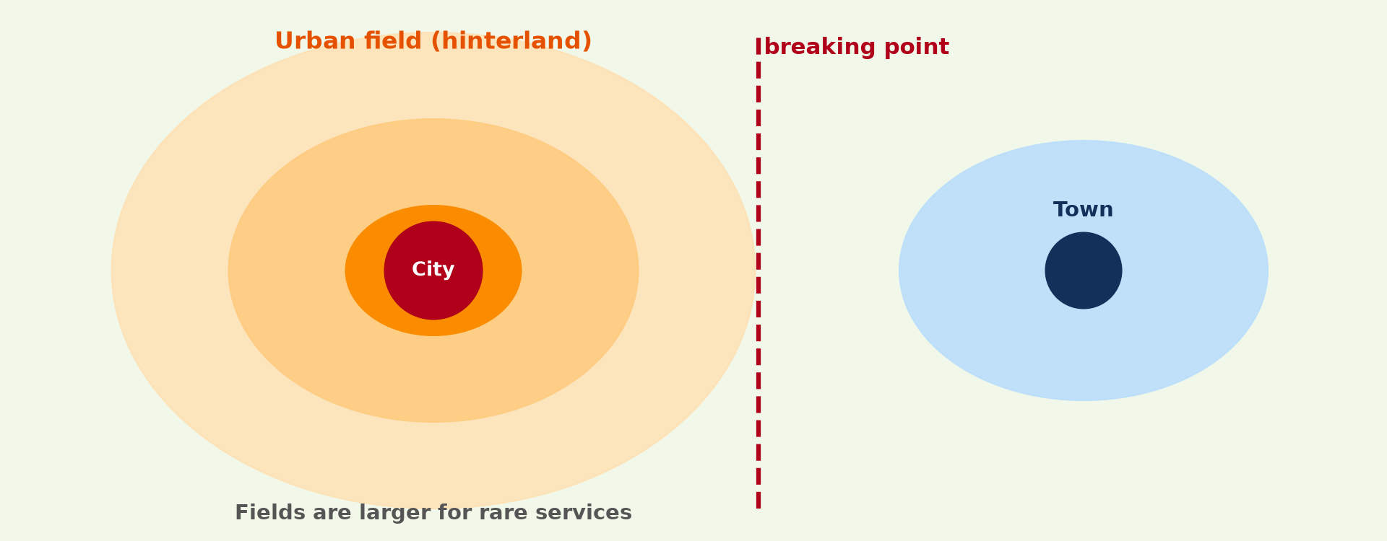
2. REGIONAL TOWNS
Activity 4
Urban fields.
Notes:
Activity 4. Look carefully at this diagram: urban fields. Observe every detail before I ask the question.

Slide 29
2. REGIONAL TOWNS
Activity 4: Question
Describe the sphere of Garoua.
Notes:
Here is the question for Activity 4: Describe the sphere of Garoua. Take one minute to think and write your answer in your rough notebook.

Slide 30
2. REGIONAL TOWNS
Activity 4: Answer
It serves the North Region and parts of Chad and Nigeria through trade.
Notes:
Let us check the answer together. It serves the North Region and parts of Chad and Nigeria through trade.

Slide 31
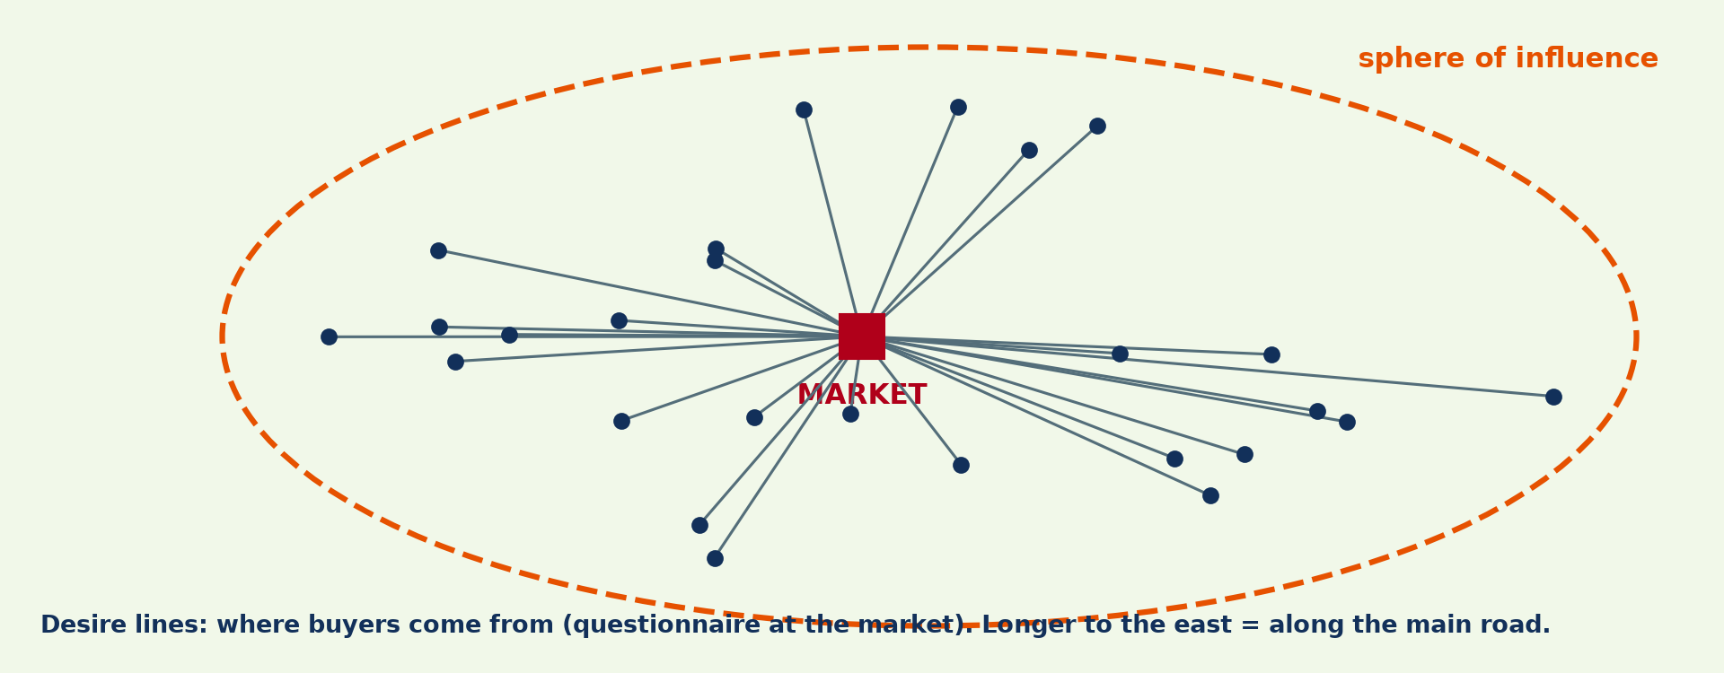
3. REASONS
Activity 5
Sphere of influence.
Notes:
Activity 5. Look carefully at this diagram: sphere of influence. Observe every detail before I ask the question.

Slide 32
3. REASONS
Activity 5: Question
Give three reasons why towns serve as spheres of influence.
Notes:
Here is the question for Activity 5: Give three reasons why towns serve as spheres of influence. Take one minute to think and write your answer in your rough notebook.

Slide 33
3. REASONS
Activity 5: Answer
Administrative functions, markets and services, and transport links.
Notes:
Let us check the answer together. Administrative functions, markets and services, and transport links.

Slide 34
BOARD SUMMARY
Board Summary
Topic: Human Characteristics of Cameroon
Sub-topic: Development of Settlements in Cameroon
Lesson 53: Urban Spheres of Influence in Cameroon
Notes:
Now we are going to copy the board summary. Write the title and the headings neatly in your notebooks. I will give you enough time for each slide, so do not rush.

Slide 35
BOARD SUMMARY
1. Major Urban Spheres of Influence
The major spheres of influence in Cameroon are the following:
Douala: It serves all Cameroon, Chad and the Central African Republic through its port and trade.
Yaoundé: It serves the whole country through administration, universities and embassies.
Notes:
Let us copy Major Urban Spheres of Influence. The major spheres of influence in Cameroon are the following. On this slide we have Douala and Yaoundé. Write each point on a new line, with the key term first, and explain it in your own words when we revise. When you finish, we go to the next slide.

Slide 36
BOARD SUMMARY
1. Major Urban Spheres of Influence (continued)
Regional towns: Garoua, Bamenda, Bafoussam and Ngaoundéré serve their regions.
Notes:
We continue with Major Urban Spheres of Influence. On this slide we have Regional towns. Write each point on a new line, with the key term first, and explain it in your own words when we revise.

Slide 37
BOARD SUMMARY
1. Major Urban Spheres of Influence
Illustration: main towns of Cameroon
Notes:
Now draw this illustration in your notebook: main towns of Cameroon. Give it a title and label it clearly.

Slide 38
BOARD SUMMARY
2. Reasons
Towns serve as spheres of influence for the following reasons:
Administration: They host ministries, regional offices and courts.
Commerce and services: They have markets, banks, hospitals and schools.
Notes:
Let us copy Reasons. Towns serve as spheres of influence for the following reasons. On this slide we have Administration and Commerce and services. Write each point on a new line, with the key term first, and explain it in your own words when we revise. When you finish, we go to the next slide.

Slide 39
BOARD SUMMARY
2. Reasons (continued)
Transport: They are ports, railway stations and road junctions.
Industry: Their factories employ and supply people of the region.
Notes:
We continue with Reasons. On this slide we have Transport and Industry. Write each point on a new line, with the key term first, and explain it in your own words when we revise.

Slide 40
FORMATIVE EVALUATION
Evaluation 1
Name two national spheres of influence.
Notes:
Now let us check what you have understood. Question 1: Name two national spheres of influence. Answer in your exercise book.

Slide 41
FORMATIVE EVALUATION
Expected Answer
Douala and Yaoundé.
Notes:
The expected answer is: douala and Yaoundé. If you got it right, well done.

Slide 42
FORMATIVE EVALUATION
Evaluation 2
Give two reasons why Douala has a wide sphere.
Notes:
Now let us check what you have understood. Question 2: Give two reasons why Douala has a wide sphere. Answer in your exercise book.

Slide 43
FORMATIVE EVALUATION
Expected Answer
Its port and industries.
Notes:
The expected answer is: its port and industries. If you got it right, well done.

Slide 44
REMEDIATION
Remediation
Fill in the blanks:
The sphere of Douala reaches ______ and CAR.
Yaoundé attracts people for ______.
Garoua serves the ______ Region.
Notes:
For those who need more practice, fill in the blanks in your exercise book. The answers are: number 1, Chad; number 2, administration (universities); number 3, North.

Slide 45
HOMEWORK
Homework
Draw a sketch map showing the spheres of influence of Douala, Yaoundé and Garoua.
Notes:
For your homework: Draw a sketch map showing the spheres of influence of Douala, Yaoundé and Garoua. We shall correct it at the beginning of our next lesson.

Slide 46
NEXT LESSON
Next Lesson
Our next lesson will be on:
Further Study 6: Site and Situation of Douala
Notes:
Our next lesson will be on Further Study 6: Site and Situation of Douala. Thank you for your attention, and see you next time.

Slide 47
BILINGUAL GAME
Bilingual Game (Jeu Bilingue)
English | Français
Sphere of influence | La sphère d'influence
Neighbouring country | Le pays voisin
Embassy | L'ambassade
University | L'université
Junction | Le carrefour
Region | La région
Notes:
Let us play the bilingual game. I say a word in English, and you give me the French word. Then we do the reverse.

Slide 48
LOGBOOK
Official Logbook (1/2)
Module / Topic | Human Characteristics of Cameroon
Lesson Title | Lesson 53: Urban Spheres of Influence in Cameroon
Expected Learning Outcomes | Identify the major urban spheres of influence in Cameroon. Describe their extent. Explain why they serve as spheres of influence.
Competence | Learners are able to identify the urban spheres of influence of Cameroon and explain them.
Notes:
I record this information in the official logbook of the class after the lesson.

Slide 49
LOGBOOK
Official Logbook (2/2)
Matter Taught | Major Urban Spheres of Influence; Reasons.
Evaluation | Formative evaluation and remediation exercise.
Homework | Draw a sketch map showing the spheres of influence of Douala, Yaoundé and Garoua.
Enrolment / Present / Absent | ____ / ____ / ____
Achievement | To be completed after the lesson.
Notes:
I complete the second page of the logbook: the matter taught, the evaluation, the homework and the attendance.

Slide 50
TEACHER'S NOTE
Teacher's Note
Timing: Homework correction, plan, objectives 8 min | Recall, situation, action 10 min | 5 activities 30 min | Board summary (copying) 30 min | Evaluation, remediation 10 min | Homework, next lesson 5 min | Logbook 7 min
Without the projector (Activity 1): use the map.
Without the projector (Activity 2): describe.
Without the projector (Activity 3): describe.
Without the projector (Activity 4): describe.
Without the projector (Activity 5): discuss.
Notes:
This slide is for me, the teacher: it gives the timing of the lesson and what to do if the projector is not available.

Slide 51
REFERENCES
References
Geography Syllabus, Forms I–V, MINESEC (2023) — Form 5, Module III: Management of Population Growth and Space Colonisation.
Photo, Activity 2: “JAXPORT Welcomes Largest Container Ship To Date” by JAXPORT, CC BY-NC 2.0, via Flickr (https://www.flickr.com/photos/24847875@N05/17069054628)
Photo, Activity 3: “Yaoundé” by wili_hybrid, CC BY-NC 2.0, via Flickr (https://www.flickr.com/photos/62223880@N00/5677034246)
Diagrams and animations: drawn for this lesson (Geography Department).
Notes:
These are the references and picture credits used to prepare this lesson.

