Slide 1
FORM 5
GEOGRAPHY
Further Study 6
Site and Situation of Douala
Notes:
Good morning, class, and welcome to our geography lesson. I am your geography teacher, Mr Kamdem. Today we are starting Further Study 6: Site and Situation of Douala.

Slide 2
CLASS INFO
Class, Chapter and Duration
Class | Form 5
Chapter | Module III: Management of Population Growth and Space Colonisation
Duration | 2 periods (2 × 50 minutes)
Notes:
This lesson is for Form 5. It belongs to Module III: Management of Population Growth and Space Colonisation. We shall need 2 periods to cover it.

Slide 3
IDENTIFICATION
Lesson Identification
Topic | Human Characteristics of Cameroon
Sub-topic | Development of Settlements in Cameroon
Lesson | Further Study 6: Site and Situation of Douala
Notions / Concepts | Site, situation, estuary, bridging point, port.
Syllabus focus | Diagrams; description; how site and situation have influenced the growth of the settlement (the syllabus allows Douala or Yaoundé; Douala is treated here).
Competence | Learners are able to describe the site and situation of Douala and explain its growth.
Notes:
Our topic is Human Characteristics of Cameroon, and the sub-topic is Development of Settlements in Cameroon. The key notions we shall use today are: site, situation, estuary, bridging point, port. At the end, you should be able to do this: learners are able to describe the site and situation of Douala and explain its growth.

Slide 4

HOMEWORK CORRECTION
Correction of the Homework
Question (Lesson 53: Urban Spheres of Influence in Cameroon):
Draw a sketch map showing the spheres of influence of Douala, Yaoundé and Garoua.
Notes:
Before we start the new lesson, let us correct the homework I gave you at the end of Lesson 53: Urban Spheres of Influence in Cameroon. The question was: Draw a sketch map showing the spheres of influence of Douala, Yaoundé and Garoua. Take out your exercise books.

Slide 5
HOMEWORK CORRECTION
Correction: Possible Answer
A map of Cameroon with circles or zones: Douala (whole country and neighbours), Yaoundé (whole country), Garoua (North Region and borders), with a key.
Notes:
Here is a good answer. A map of Cameroon with circles or zones: Douala (whole country and neighbours), Yaoundé (whole country), Garoua (North Region and borders), with a key. Compare it with your own answer and correct your work in red.

Slide 6
LESSON PLAN
Lesson Plan
Correction of the homework
Objectives and recall
Real-life situation and action to take
Learning activities
Board summary
Evaluation, remediation and homework
Notes:
Here is the plan of our lesson today. First, we shall correct the homework. Then we shall look at the objectives and recall what you already know. After that, we shall study a situation from real life and the action to take, and do the learning activities. Finally, we shall copy the board summary, do the evaluation and the remediation, and I will give you the homework.

Slide 7
OBJECTIVES
Objectives
By the end of this lesson, you should be able to:
Draw a diagram of the site and situation of Douala.
Describe the site and situation.
Notes:
Take your time to copy this part; we will continue together.

Slide 8
OBJECTIVES
Objectives (continued)
Explain how they influenced the growth of Douala.
Notes:
By the end of this lesson, you should be able to do three things. Number 1: draw a diagram of the site and situation of Douala. Number 2: describe the site and situation. Number 3: explain how they influenced the growth of Douala.

Slide 9
PREVIOUS KNOWLEDGE
Previous Knowledge
Site is the land a town is built on.
Situation is the position in the region.
Douala is the economic capital.
Notes:
Let us first remember what you already know. Site is the land a town is built on. Situation is the position in the region. Douala is the economic capital. Keep this in mind, because we shall build on it today.

Slide 10
REAL-LIFE SITUATION
Situation in Real Life
Douala grew from fishing villages on the Wouri estuary into the largest city and port of Central Africa. The teacher asks why it grew there.
Notes:
Listen carefully to this situation from real life. Douala grew from fishing villages on the Wouri estuary into the largest city and port of Central Africa. The teacher asks why it grew there. Think about it, because I am going to ask you some questions.

Slide 11
REAL-LIFE SITUATION
Situation: Question 1
What is the problem in the situation?
Notes:
Question 1: What is the problem in the situation? Think for a moment, then raise your hand to answer.

Slide 12
REAL-LIFE SITUATION
Answer
We want to explain the growth of Douala.
Notes:
Good. We want to explain the growth of Douala.

Slide 13
REAL-LIFE SITUATION
Situation: Question 2
On which estuary is Douala?
Notes:
Question 2: On which estuary is Douala? Think for a moment, then raise your hand to answer.

Slide 14
REAL-LIFE SITUATION
Answer
The Wouri estuary.
Notes:
Good. The Wouri estuary.

Slide 15
REAL-LIFE SITUATION
Situation: Question 3
What is Douala today?
Notes:
Question 3: What is Douala today? Think for a moment, then raise your hand to answer.

Slide 16
REAL-LIFE SITUATION
Possible Answer
The largest city and port of Central Africa.
Notes:
Good. The largest city and port of Central Africa.

Slide 17
ACTION TO TAKE
Action to Take
Keep drains clean and avoid building in flood-prone areas of the city.
Notes:
From this situation, the action we are working towards in this lesson is the following: keep drains clean and avoid building in flood-prone areas of the city.

Slide 18
JUSTIFICATION
Justification of the Lesson
This further study helps us to apply site and situation to a real city.
Notes:
Why is this lesson important for you? This further study helps us to apply site and situation to a real city.

Slide 19
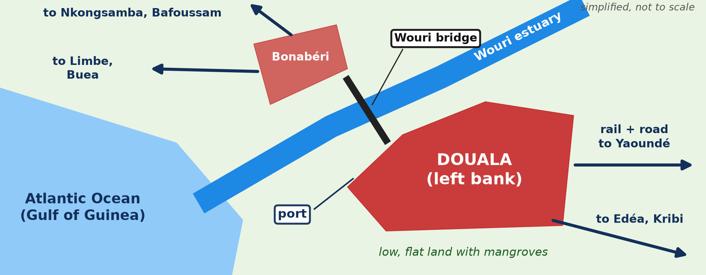
1. DIAGRAM
Activity 1
Site and situation of Douala (simplified).
Notes:
Activity 1. Look carefully at this diagram: site and situation of Douala (simplified). Observe every detail before I ask the question.

Slide 20
1. DIAGRAM
Activity 1: Question
Name the main elements of the diagram.
Notes:
Here is the question for Activity 1: Name the main elements of the diagram. Take one minute to think and write your answer in your rough notebook.

Slide 21
1. DIAGRAM
Activity 1: Answer
The Wouri estuary, the port, the bridge, Bonabéri and the main roads and railway.
Notes:
Let us check the answer together. The Wouri estuary, the port, the bridge, Bonabéri and the main roads and railway.

Slide 22
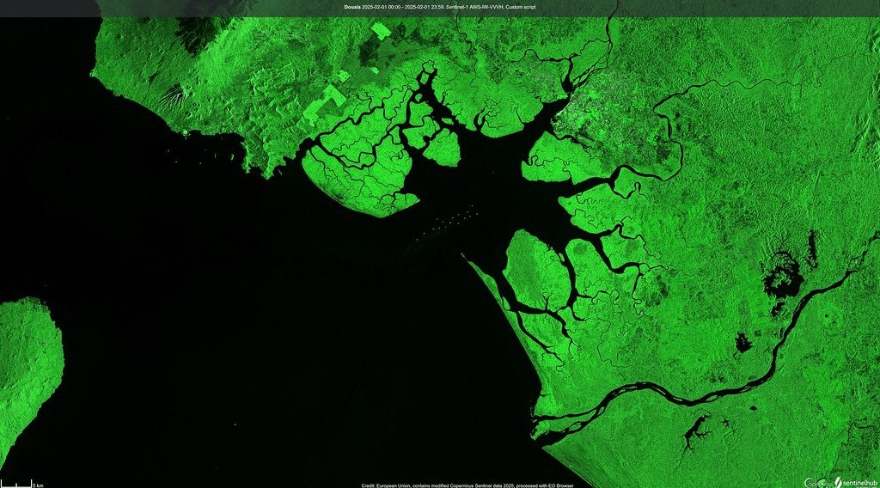
2. SITE
Activity 2
The Wouri estuary from space.
Notes:
Activity 2. Look carefully at this picture: the Wouri estuary from space. Observe every detail before I ask the question.

Slide 23
2. SITE
Activity 2: Question
Describe the site of Douala.
Notes:
Here is the question for Activity 2: Describe the site of Douala. Take one minute to think and write your answer in your rough notebook.

Slide 24
2. SITE
Activity 2: Answer
Low, flat land on both banks of the Wouri estuary, with mangroves and swamps.
Notes:
Let us check the answer together. Low, flat land on both banks of the Wouri estuary, with mangroves and swamps.

Slide 25

2. SITUATION
Activity 3
Transport network.
Notes:
Activity 3. Look carefully at this diagram: transport network. Observe every detail before I ask the question.

Slide 26
2. SITUATION
Activity 3: Question
Describe the situation of Douala.
Notes:
Here is the question for Activity 3: Describe the situation of Douala. Take one minute to think and write your answer in your rough notebook.

Slide 27
2. SITUATION
Activity 3: Answer
On the Gulf of Guinea, at the start of routes and the railway to the interior and neighbouring countries.
Notes:
Let us check the answer together. On the Gulf of Guinea, at the start of routes and the railway to the interior and neighbouring countries.

Slide 28

3. INFLUENCE ON GROWTH: POSITIVE
Activity 4
A port.
Notes:
Activity 4. Look carefully at this picture: a port. Observe every detail before I ask the question.

Slide 29
3. INFLUENCE ON GROWTH: POSITIVE
Activity 4: Question
How did the site and situation favour growth?
Notes:
Here is the question for Activity 4: How did the site and situation favour growth? Take one minute to think and write your answer in your rough notebook.

Slide 30
3. INFLUENCE ON GROWTH: POSITIVE
Activity 4: Answer
The sheltered estuary gave a port, and routes made Douala the gateway of Cameroon and its neighbours.
Notes:
Let us check the answer together. The sheltered estuary gave a port, and routes made Douala the gateway of Cameroon and its neighbours.

Slide 31

3. INFLUENCE ON GROWTH: PROBLEMS
Activity 5
A flooded street.
Notes:
Activity 5. Look carefully at this picture: a flooded street. Observe every detail before I ask the question.

Slide 32
3. INFLUENCE ON GROWTH: PROBLEMS
Activity 5: Question
What problems does the site cause?
Notes:
Here is the question for Activity 5: What problems does the site cause? Take one minute to think and write your answer in your rough notebook.

Slide 33
3. INFLUENCE ON GROWTH: PROBLEMS
Activity 5: Answer
Floods, swamps and silting of the port channel.
Notes:
Let us check the answer together. Floods, swamps and silting of the port channel.

Slide 34
BOARD SUMMARY
Board Summary
Topic: Human Characteristics of Cameroon
Sub-topic: Development of Settlements in Cameroon
Further Study 6: Site and Situation of Douala
Notes:
Now we are going to copy the board summary. Write the title and the headings neatly in your notebooks. I will give you enough time for each slide, so do not rush.

Slide 35
BOARD SUMMARY
1. Site and Situation of Douala
Douala has the following site and situation:
Site: It lies on low, flat land on both banks of the Wouri estuary, with mangroves around.
Bridging point: The Wouri bridge links Douala to Bonabéri on the right bank.
Notes:
Let us copy Site and Situation of Douala. Douala has the following site and situation. On this slide we have Site and Bridging point. Write each point on a new line, with the key term first, and explain it in your own words when we revise. When you finish, we go to the next slide.

Slide 36
BOARD SUMMARY
1. Site and Situation of Douala (continued)
Situation: It lies on the Gulf of Guinea at the start of roads and the railway to the interior.
Notes:
We continue with Site and Situation of Douala. On this slide we have Situation. Write each point on a new line, with the key term first, and explain it in your own words when we revise.

Slide 37
BOARD SUMMARY
1. Site and Situation of Douala
Illustration: site and situation of Douala
Notes:
Now draw this illustration in your notebook: site and situation of Douala. Give it a title and label it clearly.

Slide 38
BOARD SUMMARY
2. Influence on the Growth of Douala
The site and situation influenced growth as follows:
Port: The sheltered estuary made Douala the main port of Cameroon, Chad and the CAR.
Industry and trade: The port attracted factories, banks and trading companies.
Notes:
Let us copy Influence on the Growth of Douala. The site and situation influenced growth as follows. On this slide we have Port and Industry and trade. Write each point on a new line, with the key term first, and explain it in your own words when we revise. When you finish, we go to the next slide.

Slide 39
BOARD SUMMARY
2. Influence on the Growth of Douala (continued)
Routes: Roads and the railway made Douala the gateway to the interior.
Problems: Floods, swamps and the silting of the channel limit growth.
Notes:
We continue with Influence on the Growth of Douala. On this slide we have Routes and Problems. Write each point on a new line, with the key term first, and explain it in your own words when we revise.

Slide 40
FORMATIVE EVALUATION
Evaluation 1
Describe the site of Douala.
Notes:
Now let us check what you have understood. Question 1: Describe the site of Douala. Answer in your exercise book.

Slide 41
FORMATIVE EVALUATION
Expected Answer
Low, flat land on the banks of the Wouri estuary.
Notes:
The expected answer is: low, flat land on the banks of the Wouri estuary. If you got it right, well done.

Slide 42
FORMATIVE EVALUATION
Evaluation 2
Give two ways the situation helped Douala grow.
Notes:
Now let us check what you have understood. Question 2: Give two ways the situation helped Douala grow. Answer in your exercise book.

Slide 43
FORMATIVE EVALUATION
Expected Answer
Its port and its routes to the interior.
Notes:
The expected answer is: its port and its routes to the interior. If you got it right, well done.

Slide 44
REMEDIATION
Remediation
Fill in the blanks:
Douala is on the ______ estuary.
Douala on the right bank is called ______.
The main problem of the site is ______.
Notes:
For those who need more practice, fill in the blanks in your exercise book. The answers are: number 1, Wouri; number 2, Bonabéri; number 3, floods (swamps).

Slide 45
HOMEWORK
Homework
Draw a labelled diagram of the site and situation of Douala.
Notes:
For your homework: Draw a labelled diagram of the site and situation of Douala. We shall correct it at the beginning of our next lesson.

Slide 46
BILINGUAL GAME
Bilingual Game (Jeu Bilingue)
English | Français
Estuary | L'estuaire
Bank | La rive
Mangrove | La mangrove
Gateway | La porte d'entrée
Channel | Le chenal
Economic capital | La capitale économique
Notes:
Let us play the bilingual game. I say a word in English, and you give me the French word. Then we do the reverse.

Slide 47
LOGBOOK
Official Logbook (1/2)
Module / Topic | Human Characteristics of Cameroon
Lesson Title | Further Study 6: Site and Situation of Douala
Expected Learning Outcomes | Draw a diagram of the site and situation of Douala. Describe the site and situation. Explain how they influenced the growth of Douala.
Competence | Learners are able to describe the site and situation of Douala and explain its growth.
Notes:
I record this information in the official logbook of the class after the lesson.

Slide 48
LOGBOOK
Official Logbook (2/2)
Matter Taught | Site and Situation of Douala; Influence on the Growth of Douala.
Evaluation | Formative evaluation and remediation exercise.
Homework | Draw a labelled diagram of the site and situation of Douala.
Enrolment / Present / Absent | ____ / ____ / ____
Achievement | To be completed after the lesson.
Notes:
I complete the second page of the logbook: the matter taught, the evaluation, the homework and the attendance.

Slide 49
TEACHER'S NOTE
Teacher's Note
Timing: Homework correction, plan, objectives 8 min | Recall, situation, action 10 min | 5 activities 30 min | Board summary (copying) 30 min | Evaluation, remediation 10 min | Homework, next lesson 5 min | Logbook 7 min
Without the projector (Activity 1): draw the diagram.
Without the projector (Activity 2): describe.
Without the projector (Activity 3): use the map.
Without the projector (Activity 4): discuss.
Without the projector (Activity 5): discuss.
Notes:
This slide is for me, the teacher: it gives the timing of the lesson and what to do if the projector is not available.

Slide 50
REFERENCES
References
Geography Syllabus, Forms I–V, MINESEC (2023) — Form 5, Module III: Management of Population Growth and Space Colonisation.
Photo, Activity 2: “Duala, Camerún (Douala, Cameroon)” by migmasat, Public domain 1.0, via Flickr (https://www.flickr.com/photos/197415759@N06/54386998088)
Photo, Activity 4: “JAXPORT Welcomes Largest Container Ship To Date” by JAXPORT, CC BY-NC 2.0, via Flickr (https://www.flickr.com/photos/24847875@N05/17069054628)
Photo, Activity 5: “Vicenza flooding Nov.1, 2010” by US Army Africa, CC BY 2.0, via Flickr (https://www.flickr.com/photos/36281822@N08/5157191333)
Diagrams and animations: drawn for this lesson (Geography Department).
Notes:
These are the references and picture credits used to prepare this lesson.

