Slide 1
LOWER SIXTH ARTS
GEOGRAPHY
Lesson 11
Forms of Condensation and Precipitation
Notes:
Good morning, class, and welcome to our geography lesson. I am your geography teacher, Mr Kamdem. Today we are starting Lesson 11: Forms of Condensation and Precipitation.

Slide 2
CLASS INFO
Class, Chapter and Duration
Class | Lower Sixth Arts
Chapter | Module 1: Understanding and managing atmospheric and hydrological phenomena and hazards across the world in general and Cameroon in particular
Duration | 2 periods (2 × 50 minutes)
Notes:
This lesson is for Lower Sixth Arts. It belongs to Module 1: Understanding and managing atmospheric and hydrological phenomena and hazards across the world in general and Cameroon in particular. We shall need 2 periods to cover it.

Slide 3
IDENTIFICATION
Lesson Identification
Topic | Moisture in the Atmosphere
Sub-topic | Precipitation
Lesson | Lesson 11: Forms of Condensation and Precipitation
Notions / Concepts | Condensation, dew point, condensation nuclei, cumulus, cumulonimbus, stratus, cirrus, fog, mist, dew, drizzle, rain, hail, snow, frost, convectional, orographic and frontal rainfall.
Syllabus focus | Forms of condensation (clouds and their classification, fog and mist); forms of precipitation (liquid and solid); types of rainfall.
Competence | Learners are able to identify clouds and forms of precipitation and explain the types of rainfall, especially the thunderstorms of Garoua.
Notes:
Our topic is Moisture in the Atmosphere, and the sub-topic is Precipitation. The key notions we shall use today are: condensation, dew point, condensation nuclei, cumulus, cumulonimbus, stratus, cirrus, fog, mist, dew, drizzle, rain, hail, snow, frost, convectional, orographic and frontal rainfall. At the end, you should be able to do this: learners are able to identify clouds and forms of precipitation and explain the types of rainfall, especially the thunderstorms of Garoua.

Slide 4

HOMEWORK CORRECTION
Correction of the Homework
Question (Lesson 10: Nature of Moisture):
Name three types of clouds.
Notes:
Before we start the new lesson, let us correct the homework I gave you at the end of Lesson 10: Nature of Moisture. The question was: Name three types of clouds. Take out your exercise books.

Slide 5
HOMEWORK CORRECTION
Correction: Possible Answer
Cumulus, cumulonimbus, stratus and cirrus (any three).
Notes:
Here is a good answer. Cumulus, cumulonimbus, stratus and cirrus (any three). Compare it with your own answer and correct your work in red.

Slide 6
LESSON PLAN
Lesson Plan
Correction of the homework
Objectives and recall
Real-life situation and action to take
Learning activities
Board summary
Evaluation, remediation and homework
Notes:
Here is the plan of our lesson today. First, we shall correct the homework. Then we shall look at the objectives and recall what you already know. After that, we shall study a situation from real life and the action to take, and do the learning activities. Finally, we shall copy the board summary, do the evaluation and the remediation, and I will give you the homework.

Slide 7
OBJECTIVES
Objectives
By the end of this lesson, you should be able to:
Define condensation and precipitation.
Classify the main types of clouds and their weather.
Distinguish fog and mist.
Notes:
Take your time to copy this part; we will continue together.

Slide 8
OBJECTIVES
Objectives (continued)
Describe liquid and solid precipitation.
Explain convectional, orographic and frontal rainfall.
Notes:
By the end of this lesson, you should be able to do five things. Number 1: define condensation and precipitation. Number 2: classify the main types of clouds and their weather. Number 3: distinguish fog and mist. Number 4: describe liquid and solid precipitation. Number 5: explain convectional, orographic and frontal rainfall.

Slide 9
PREVIOUS KNOWLEDGE
Previous Knowledge
Relative humidity rises when air cools.
Aerosols act as condensation nuclei.
Rising air expands and cools.
Notes:
Let us first remember what you already know. Relative humidity rises when air cools. Aerosols act as condensation nuclei. Rising air expands and cools. Keep this in mind, because we shall build on it today.

Slide 10
REAL-LIFE SITUATION
Situation in Real Life
On a hot July afternoon in Garoua, the sky is blue with a few white, puffy clouds.
During the afternoon, you watch them grow upwards like mountains, and their bases become dark grey.
Notes:
Take your time to copy this part; we will continue together.

Slide 11
REAL-LIFE SITUATION
Situation in Real Life (continued)
Thunder rumbles, and within an hour a heavy rain floods the streets before stopping as suddenly as it began.
You ask: "How does invisible vapour become clouds, and how can a sunny day turn into such a storm?"
Notes:
Listen carefully to this situation from real life. On a hot July afternoon in Garoua, the sky is blue with a few white, puffy clouds. During the afternoon, you watch them grow upwards like mountains, and their bases become dark grey. Thunder rumbles, and within an hour a heavy rain floods the streets before stopping as suddenly as it began. You ask: "How does invisible vapour become clouds, and how can a sunny day turn into such a storm?" Think about it, because I am going to ask you some questions.

Slide 12
REAL-LIFE SITUATION
Situation: Question 1
What is the problem in the situation?
Notes:
Question 1: What is the problem in the situation? Think for a moment, then raise your hand to answer.

Slide 13
REAL-LIFE SITUATION
Answer
The learner does not know how clouds and rain form.
Notes:
Good. The learner does not know how clouds and rain form.

Slide 14
REAL-LIFE SITUATION
Situation: Question 2
What turns vapour into cloud droplets?
Notes:
Question 2: What turns vapour into cloud droplets? Think for a moment, then raise your hand to answer.

Slide 15
REAL-LIFE SITUATION
Answer
Condensation.
Notes:
Good. Condensation.

Slide 16
REAL-LIFE SITUATION
Situation: Question 3
What type of rain is this storm?
Notes:
Question 3: What type of rain is this storm? Think for a moment, then raise your hand to answer.

Slide 17
REAL-LIFE SITUATION
Possible Answer
Convectional rainfall from a cumulonimbus cloud.
Notes:
Good. Convectional rainfall from a cumulonimbus cloud.

Slide 18
ACTION TO TAKE
Action to Take
Observe the clouds to anticipate storms and shelter from lightning.
Notes:
From this situation, the action we are working towards in this lesson is the following: observe the clouds to anticipate storms and shelter from lightning.

Slide 19
JUSTIFICATION
Justification of the Lesson
This lesson helps us to read the sky and to understand the rains on which farming in the North depends.
Notes:
Why is this lesson important for you? This lesson helps us to read the sky and to understand the rains on which farming in the North depends.

Slide 20
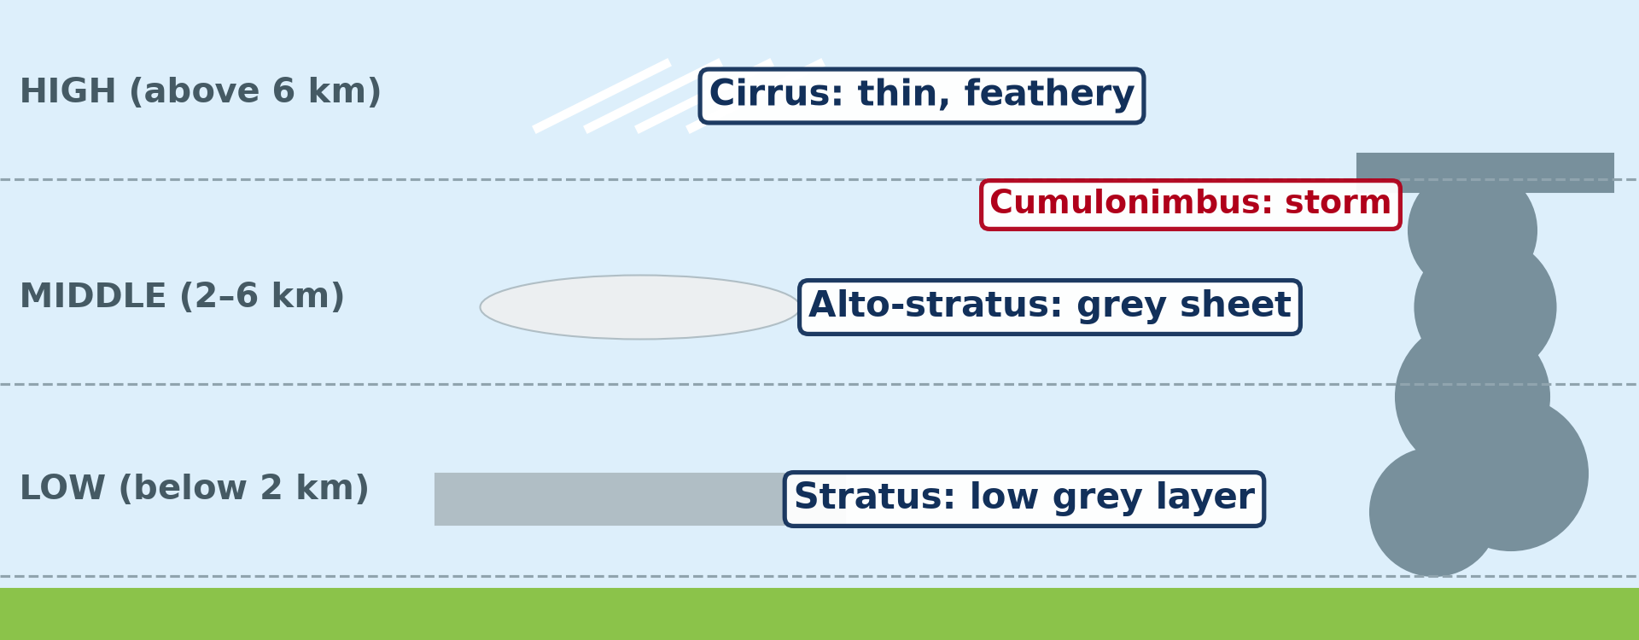
1. CLOUDS
Activity 1
The main types of clouds.
Notes:
Activity 1. Look carefully at this diagram: the main types of clouds. Observe every detail before I ask the question.

Slide 21
1. CLOUDS
Activity 1: Question
Which cloud brings thunderstorms?
Notes:
Here is the question for Activity 1: Which cloud brings thunderstorms? Take one minute to think and write your answer in your rough notebook.

Slide 22
1. CLOUDS
Activity 1: Answer
The cumulonimbus.
Notes:
Let us check the answer together. The cumulonimbus.

Slide 23
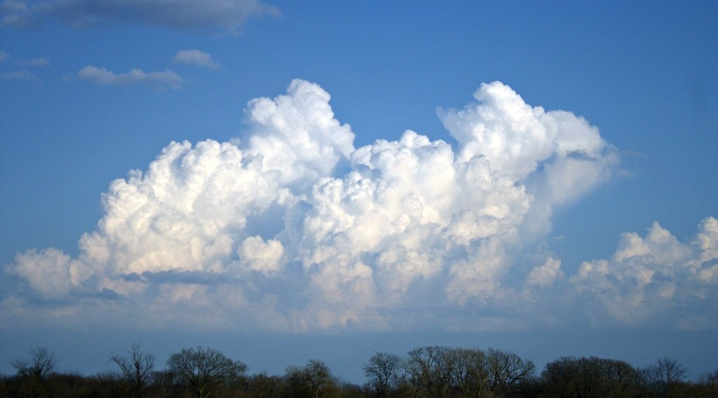
1. CLOUDS
Activity 2
Cumulus clouds.
Notes:
Activity 2. Look carefully at this picture: cumulus clouds. Observe every detail before I ask the question.

Slide 24
1. CLOUDS
Activity 2: Question
What weather do small cumulus clouds usually indicate?
Notes:
Here is the question for Activity 2: What weather do small cumulus clouds usually indicate? Take one minute to think and write your answer in your rough notebook.

Slide 25
1. CLOUDS
Activity 2: Answer
Fair weather.
Notes:
Let us check the answer together. Fair weather.

Slide 26

2. PRECIPITATION
Activity 3
Dew on grass.
Notes:
Activity 3. Look carefully at this picture: dew on grass. Observe every detail before I ask the question.

Slide 27
2. PRECIPITATION
Activity 3: Question
Is dew a form of precipitation?
Notes:
Here is the question for Activity 3: Is dew a form of precipitation? Take one minute to think and write your answer in your rough notebook.

Slide 28
2. PRECIPITATION
Activity 3: Answer
No, it is condensation on cool surfaces.
Notes:
Let us check the answer together. No, it is condensation on cool surfaces.

Slide 29
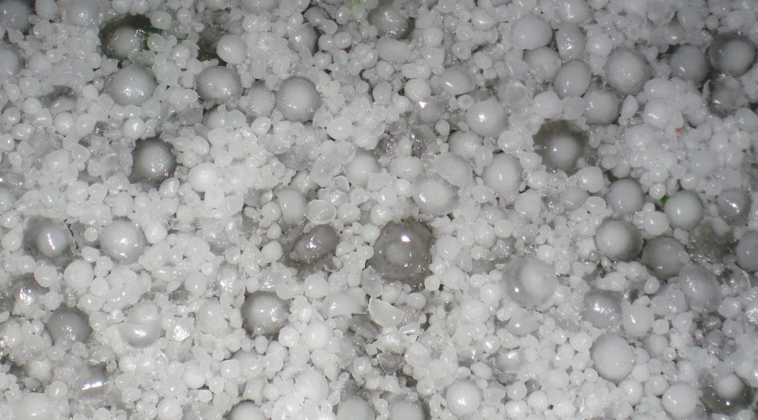
2. PRECIPITATION
Activity 4
Hailstones.
Notes:
Activity 4. Look carefully at this picture: hailstones. Observe every detail before I ask the question.

Slide 30
2. PRECIPITATION
Activity 4: Question
In which cloud do hailstones form?
Notes:
Here is the question for Activity 4: In which cloud do hailstones form? Take one minute to think and write your answer in your rough notebook.

Slide 31
2. PRECIPITATION
Activity 4: Answer
In cumulonimbus clouds during violent storms.
Notes:
Let us check the answer together. In cumulonimbus clouds during violent storms.

Slide 32

3. TYPES OF RAINFALL
Activity 5
Three types of rainfall.
Notes:
Activity 5. Look carefully at this diagram: three types of rainfall. Observe every detail before I ask the question.

Slide 33
3. TYPES OF RAINFALL
Activity 5: Question
What is the dry side of a mountain called?
Notes:
Here is the question for Activity 5: What is the dry side of a mountain called? Take one minute to think and write your answer in your rough notebook.

Slide 34
3. TYPES OF RAINFALL
Activity 5: Answer
The rain shadow (leeward side).
Notes:
Let us check the answer together. The rain shadow (leeward side).

Slide 35
BOARD SUMMARY
Board Summary
Topic: Moisture in the Atmosphere
Sub-topic: Precipitation
Lesson 11: Forms of Condensation and Precipitation
Notes:
Now we are going to copy the board summary. Write the title and the headings neatly in your notebooks. I will give you enough time for each slide, so do not rush.

Slide 36
BOARD SUMMARY
DEFINITIONS
The key terms of this lesson are defined as follows:
Condensation: It is the change of water vapour into liquid water when air cools to its dew point.
Notes:
Let us copy the definitions. The key terms of this lesson are defined as follows. On this slide we have Condensation. Write each point on a new line, with the key term first, and explain it in your own words when we revise. When you finish, we go to the next slide.

Slide 37
BOARD SUMMARY
DEFINITIONS (continued)
Condensation nuclei: They are tiny particles of dust, salt or smoke on which droplets form.
Precipitation: It is any form of water, liquid or solid, that falls from clouds to the ground.
Notes:
We continue with the definitions. On this slide we have Condensation nuclei and Precipitation. Write each point on a new line, with the key term first, and explain it in your own words when we revise. When you finish, we go to the next slide.

Slide 38
BOARD SUMMARY
DEFINITIONS (continued)
Rain shadow: It is the dry leeward side of a mountain.
Notes:
We continue with the definitions. On this slide we have Rain shadow. Write each point on a new line, with the key term first, and explain it in your own words when we revise.

Slide 39
BOARD SUMMARY
1. Forms of Condensation
Condensation takes the following forms:
Clouds: Rising moist air expands and cools, and vapour condenses on nuclei into tiny droplets or ice crystals.
Illustration: the main types of clouds
Notes:
Let us copy Forms of Condensation. Condensation takes the following forms. Copy the point on Clouds on the left, then draw the diagram on the right: the main types of clouds. Give it a title and label it clearly.

Slide 40
BOARD SUMMARY
1. Forms of Condensation
Cumulus: Puffy clouds with flat bases, usually with fair weather.
Illustration: cumulus clouds
Notes:
Copy the point on Cumulus on the left, then draw the diagram on the right: cumulus clouds. Give it a title and label it clearly.

Slide 41

BOARD SUMMARY
1. Forms of Condensation
Cumulonimbus: Huge, tall, dark clouds with heavy rain, thunder, lightning and sometimes hail, very common in Garoua in the rainy season.
Illustration: a cumulonimbus
Notes:
Copy the point on Cumulonimbus on the left, then draw the diagram on the right: a cumulonimbus. Give it a title and label it clearly.

Slide 42
BOARD SUMMARY
1. Forms of Condensation
Stratus: Grey layers covering the sky, with drizzle or light, steady rain.
Cirrus: Thin, feathery clouds of ice crystals very high in the sky, a sign of fair weather.
Fog and mist: Clouds at ground level; fog reduces visibility below 1 km, mist less.
Notes:
We continue with Forms of Condensation. On this slide we have Stratus, Cirrus and Fog and mist. Write each point on a new line, with the key term first, and explain it in your own words when we revise.

Slide 43
BOARD SUMMARY
2. Forms of Precipitation
Precipitation takes the following forms:
Dew: Droplets on cool surfaces at night; it is condensation, not precipitation.
Illustration: dew
Notes:
Let us copy Forms of Precipitation. Precipitation takes the following forms. Copy the point on Dew on the left, then draw the diagram on the right: dew. Give it a title and label it clearly.

Slide 44
BOARD SUMMARY
2. Forms of Precipitation
Drizzle: Very small drops, less than 0.5 mm.
Rain: Drops larger than 0.5 mm, formed when cloud droplets grow heavy enough to fall.
Notes:
We continue with Forms of Precipitation. On this slide we have Drizzle and Rain. Write each point on a new line, with the key term first, and explain it in your own words when we revise.

Slide 45
BOARD SUMMARY
2. Forms of Precipitation
Hail: Balls of ice formed in cumulonimbus clouds during violent storms.
Illustration: hailstones
Notes:
Copy the point on Hail on the left, then draw the diagram on the right: hailstones. Give it a title and label it clearly.

Slide 46
BOARD SUMMARY
2. Forms of Precipitation
Snow and frost: Snow is ice crystals falling in cold climates; frost is ice crystals formed on cold surfaces.
Notes:
We continue with Forms of Precipitation. On this slide we have Snow and frost. Write each point on a new line, with the key term first, and explain it in your own words when we revise.

Slide 47
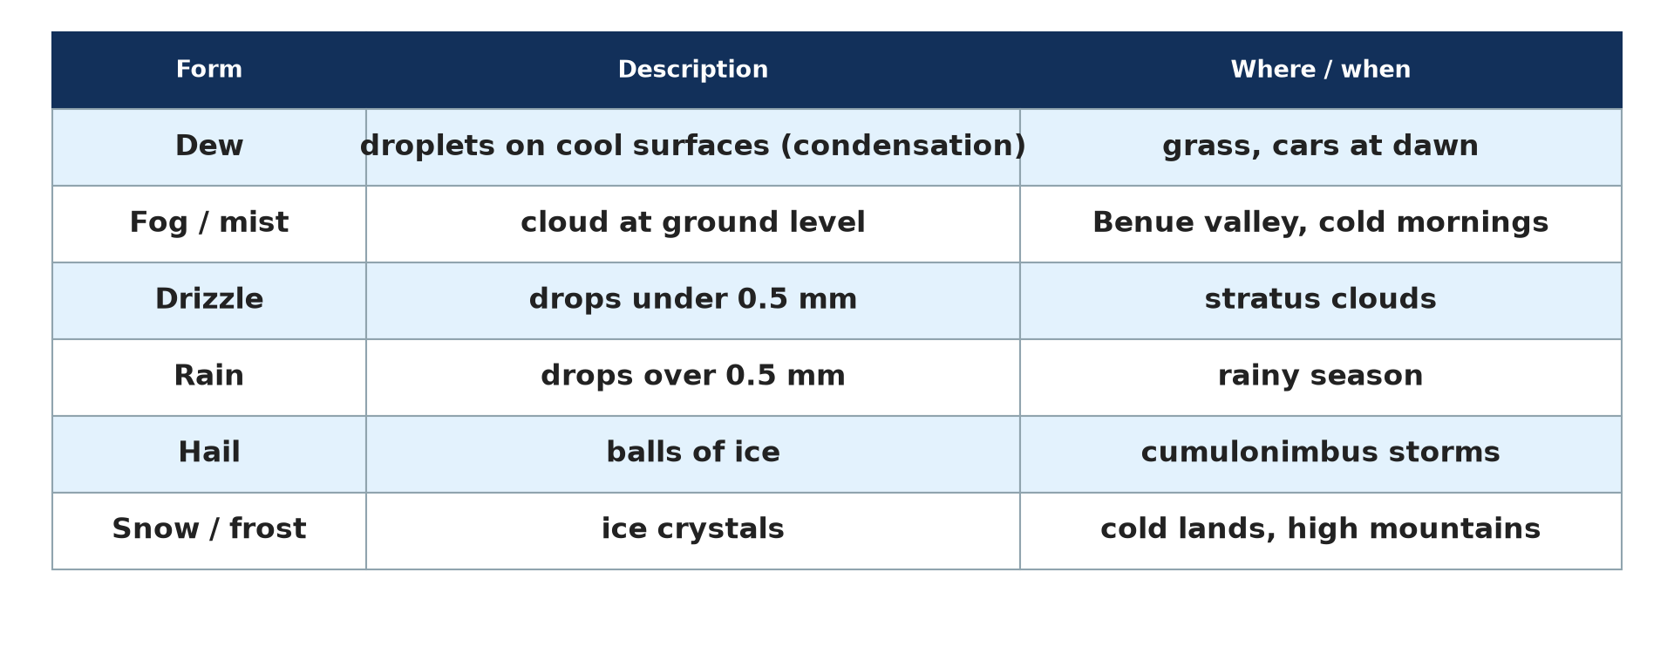
BOARD SUMMARY
2. Forms of Precipitation
Summary: The forms of condensation and precipitation can be compared in a table.
Illustration: forms of precipitation
Notes:
Copy the point on Summary on the left, then draw the diagram on the right: forms of precipitation. Give it a title and label it clearly.

Slide 48
BOARD SUMMARY
3. Types of Rainfall
The main types of rainfall are the following:
Convectional rainfall: Intense heating makes moist air rise quickly and form cumulonimbus clouds, giving short, heavy afternoon storms, as in Garoua and equatorial regions.
Illustration: three types of rainfall
Notes:
Let us copy Types of Rainfall. The main types of rainfall are the following. Copy the point on Convectional rainfall on the left, then draw the diagram on the right: three types of rainfall. Give it a title and label it clearly.

Slide 49
BOARD SUMMARY
3. Types of Rainfall
Orographic (relief) rainfall: Moist winds rise over mountains and give rain on the windward side, while the leeward side is a rain shadow, as around Mount Cameroon.
Frontal (cyclonic) rainfall: Warm air rises slowly over cold air where two air masses meet, giving long, steady rain.
Notes:
We continue with Types of Rainfall. On this slide we have Orographic (relief) rainfall and Frontal (cyclonic) rainfall. Write each point on a new line, with the key term first, and explain it in your own words when we revise.

Slide 50
FORMATIVE EVALUATION
Evaluation 1
Explain how a hot sunny day in Garoua can lead to a heavy afternoon storm.
Notes:
Now let us check what you have understood. Question 1: Explain how a hot sunny day in Garoua can lead to a heavy afternoon storm. Answer in your exercise book.

Slide 51
FORMATIVE EVALUATION
Expected Answer
The ground heats the air, which rises quickly, cools and condenses into a cumulonimbus that gives convectional rain.
Notes:
The expected answer is: the ground heats the air, which rises quickly, cools and condenses into a cumulonimbus that gives convectional rain. If you got it right, well done.

Slide 52
FORMATIVE EVALUATION
Evaluation 2
Distinguish dew from drizzle.
Notes:
Now let us check what you have understood. Question 2: Distinguish dew from drizzle. Answer in your exercise book.

Slide 53
FORMATIVE EVALUATION
Expected Answer
Dew is condensation on cool surfaces; drizzle is fine rain falling from clouds.
Notes:
The expected answer is: dew is condensation on cool surfaces; drizzle is fine rain falling from clouds. If you got it right, well done.

Slide 54
REMEDIATION
Remediation
Fill in the blanks:
Thunderstorm clouds are ______.
The dry side of a mountain is the rain ______.
Rain from warm air rising over cold air is ______ rain.
Notes:
For those who need more practice, fill in the blanks in your exercise book. The answers are: number 1, cumulonimbus; number 2, shadow; number 3, frontal (cyclonic).

Slide 55
HOMEWORK
Homework
Name the world's wettest belt of latitude.
Notes:
For your homework: Name the world's wettest belt of latitude. We shall correct it at the beginning of our next lesson.

Slide 56
NEXT LESSON
Next Lesson
Our next lesson will be on:
Lesson 12: Global Distribution of Precipitation
Notes:
Our next lesson will be on Lesson 12: Global Distribution of Precipitation. Thank you for your attention, and see you next time.

Slide 57
BILINGUAL GAME
Bilingual Game (Jeu Bilingue)
English | Français
Cloud | Le nuage
Rain | La pluie
Condensation | La condensation
Precipitation | Les précipitations
Thunderstorm | L'orage
Hail | La grêle
Notes:
Let us play the bilingual game. I say a word in English, and you give me the French word. Then we do the reverse.

Slide 58
LOGBOOK
Official Logbook (1/2)
Module / Topic | Moisture in the Atmosphere
Lesson Title | Lesson 11: Forms of Condensation and Precipitation
Expected Learning Outcomes | Define condensation and precipitation. Classify the main types of clouds and their weather. Distinguish fog and mist. Describe liquid and solid precipitation. Explain convectional, orographic and frontal rainfall.
Competence | Learners are able to identify clouds and forms of precipitation and explain the types of rainfall, especially the thunderstorms of Garoua.
Notes:
I record this information in the official logbook of the class after the lesson.

Slide 59
LOGBOOK
Official Logbook (2/2)
Matter Taught | DEFINITIONS; Forms of Condensation; Forms of Precipitation; Types of Rainfall.
Evaluation | Formative evaluation and remediation exercise.
Homework | Name the world's wettest belt of latitude.
Enrolment / Present / Absent | ____ / ____ / ____
Achievement | To be completed after the lesson.
Notes:
I complete the second page of the logbook: the matter taught, the evaluation, the homework and the attendance.

Slide 60
TEACHER'S NOTE
Teacher's Note
Timing: Homework correction, plan, objectives 8 min | Recall, situation, action 10 min | 5 activities 30 min | Board summary (copying) 30 min | Evaluation, remediation 10 min | Homework, next lesson 5 min | Logbook 7 min
Without the projector (Activity 1): draw the four cloud types.
Without the projector (Activity 2): look at today's sky.
Without the projector (Activity 3): look at grass at dawn.
Without the projector (Activity 4): describe a hailstorm.
Without the projector (Activity 5): draw orographic rainfall.
Notes:
This slide is for me, the teacher: it gives the timing of the lesson and what to do if the projector is not available.

Slide 61
REFERENCES
References
Geography Syllabus for Sixth Forms (Lower and Upper Sixth), MINESEC, 2019 — Module 1 (Meteorology, Climatology & Hydrology).
Teacher's course notes: Mr KAMDEM E., Meteorology (LSA), GBHS Garoua, 2026.
Photo, Activity 2: “Epic Cloud (Explored)” by Christina Ann VanMeter, CC BY-NC 2.0, via Flickr (https://www.flickr.com/photos/54129831@N02/6984912657)
Photo, Activity 3: “Dew drops on grass” by Ervins Strauhmanis, CC BY 2.0, via Flickr (https://www.flickr.com/photos/76523360@N03/9537409567)
Photo, Activity 4: “Hailstones (4 July 2010) (Limon, eastern Colorado, USA) 3” by James St. John, CC BY 2.0, via Flickr (https://www.flickr.com/photos/47445767@N05/15148092311)
Photo, board summary (Cumulonimbus): “06172012 Sunday evening pulse storms/cumulonimbi” by StormRider93 | Into the Storm, CC BY-NC-ND 2.0, via Flickr (https://www.flickr.com/photos/65232104@N04/7395715628)
Diagrams and animations: drawn for this lesson (Geography Department).
Notes:
These are the references and picture credits used to prepare this lesson.

