Slide 1
LOWER SIXTH ARTS
GEOGRAPHY
Lesson 16
Tropical Seasonal Winds: Monsoon and Harmattan
Notes:
Good morning, class, and welcome to our geography lesson. I am your geography teacher, Mr Kamdem. Today we are starting Lesson 16: Tropical Seasonal Winds: Monsoon and Harmattan.

Slide 2
CLASS INFO
Class, Chapter and Duration
Class | Lower Sixth Arts
Chapter | Module 1: Understanding and managing atmospheric and hydrological phenomena and hazards across the world in general and Cameroon in particular
Duration | 2 periods (2 × 50 minutes)
Notes:
This lesson is for Lower Sixth Arts. It belongs to Module 1: Understanding and managing atmospheric and hydrological phenomena and hazards across the world in general and Cameroon in particular. We shall need 2 periods to cover it.

Slide 3
IDENTIFICATION
Lesson Identification
Topic | Global and Local Atmospheric Circulation
Sub-topic | Mesoscale Winds
Lesson | Lesson 16: Tropical Seasonal Winds: Monsoon and Harmattan
Notions / Concepts | Monsoon, summer (wet) monsoon, winter (dry) monsoon, differential heating, Harmattan, West African monsoon, ITCZ.
Syllabus focus | Monsoon winds: meaning, causes, areas and effects (Asia, West Africa); the Harmattan: meaning, causes and effects in Cameroon.
Competence | Learners are able to explain the seasonal reversal of winds and adapt to the effects of the monsoon and the Harmattan in Garoua.
Notes:
Our topic is Global and Local Atmospheric Circulation, and the sub-topic is Mesoscale Winds. The key notions we shall use today are: monsoon, summer (wet) monsoon, winter (dry) monsoon, differential heating, Harmattan, West African monsoon, ITCZ. At the end, you should be able to do this: learners are able to explain the seasonal reversal of winds and adapt to the effects of the monsoon and the Harmattan in Garoua.

Slide 4

HOMEWORK CORRECTION
Correction of the Homework
Question (Lesson 15: Planetary Winds):
Name the dry wind that blows over Garoua in the dry season.
Notes:
Before we start the new lesson, let us correct the homework I gave you at the end of Lesson 15: Planetary Winds. The question was: Name the dry wind that blows over Garoua in the dry season. Take out your exercise books.

Slide 5
HOMEWORK CORRECTION
Correction: Possible Answer
The Harmattan (north-east trade wind from the Sahara).
Notes:
Here is a good answer. The Harmattan (north-east trade wind from the Sahara). Compare it with your own answer and correct your work in red.

Slide 6
LESSON PLAN
Lesson Plan
Correction of the homework
Objectives and recall
Real-life situation and action to take
Learning activities
Board summary
Evaluation, remediation and homework
Notes:
Here is the plan of our lesson today. First, we shall correct the homework. Then we shall look at the objectives and recall what you already know. After that, we shall study a situation from real life and the action to take, and do the learning activities. Finally, we shall copy the board summary, do the evaluation and the remediation, and I will give you the homework.

Slide 7
OBJECTIVES
Objectives
By the end of this lesson, you should be able to:
Define the monsoon and the Harmattan.
Explain the causes of the summer and winter monsoons.
Notes:
Take your time to copy this part; we will continue together.

Slide 8
OBJECTIVES
Objectives (continued)
Describe the areas and effects of monsoons.
Explain the positive and negative effects of the Harmattan.
Notes:
By the end of this lesson, you should be able to do four things. Number 1: define the monsoon and the Harmattan. Number 2: explain the causes of the summer and winter monsoons. Number 3: describe the areas and effects of monsoons. Number 4: explain the positive and negative effects of the Harmattan.

Slide 9
PREVIOUS KNOWLEDGE
Previous Knowledge
Land heats and cools faster than the sea.
The Harmattan is part of the north-east trade winds.
The ITCZ moves with the overhead sun.
Notes:
Let us first remember what you already know. Land heats and cools faster than the sea. The Harmattan is part of the north-east trade winds. The ITCZ moves with the overhead sun. Keep this in mind, because we shall build on it today.

Slide 10
REAL-LIFE SITUATION
Situation in Real Life
In mid-January in Garoua, a cool, dusty wind blows from the north, the sky is hazy, dust covers everything, lips crack and many people cough.
Notes:
Take your time to copy this part; we will continue together.

Slide 11
REAL-LIFE SITUATION
Situation in Real Life (continued)
Five months earlier, in August, the wind came from the south, the air was heavy with moisture and heavy rain fell almost every day.
You ask: "Why does the wind completely change its direction and character during the year?"
Notes:
Listen carefully to this situation from real life. In mid-January in Garoua, a cool, dusty wind blows from the north, the sky is hazy, dust covers everything, lips crack and many people cough. Five months earlier, in August, the wind came from the south, the air was heavy with moisture and heavy rain fell almost every day. You ask: "Why does the wind completely change its direction and character during the year?" Think about it, because I am going to ask you some questions.

Slide 12
REAL-LIFE SITUATION
Situation: Question 1
What is the problem in the situation?
Notes:
Question 1: What is the problem in the situation? Think for a moment, then raise your hand to answer.

Slide 13
REAL-LIFE SITUATION
Answer
The learner does not understand the seasonal reversal of winds.
Notes:
Good. The learner does not understand the seasonal reversal of winds.

Slide 14
REAL-LIFE SITUATION
Situation: Question 2
What is the dry, dusty wind of January called?
Notes:
Question 2: What is the dry, dusty wind of January called? Think for a moment, then raise your hand to answer.

Slide 15
REAL-LIFE SITUATION
Answer
The Harmattan.
Notes:
Good. The Harmattan.

Slide 16
REAL-LIFE SITUATION
Situation: Question 3
Why is the August wind wet?
Notes:
Question 3: Why is the August wind wet? Think for a moment, then raise your hand to answer.

Slide 17
REAL-LIFE SITUATION
Possible Answer
It comes from the Atlantic Ocean: it is the south-west monsoon.
Notes:
Good. It comes from the Atlantic Ocean: it is the south-west monsoon.

Slide 18
ACTION TO TAKE
Action to Take
Protect your health during the Harmattan (drink water, cover your nose, avoid bush fires) and prepare fields before the monsoon rains.
Notes:
From this situation, the action we are working towards in this lesson is the following: protect your health during the Harmattan (drink water, cover your nose, avoid bush fires) and prepare fields before the monsoon rains.

Slide 19
JUSTIFICATION
Justification of the Lesson
This lesson explains the rainy and dry seasons that control farming, health and daily life in Garoua.
Notes:
Why is this lesson important for you? This lesson explains the rainy and dry seasons that control farming, health and daily life in Garoua.

Slide 20
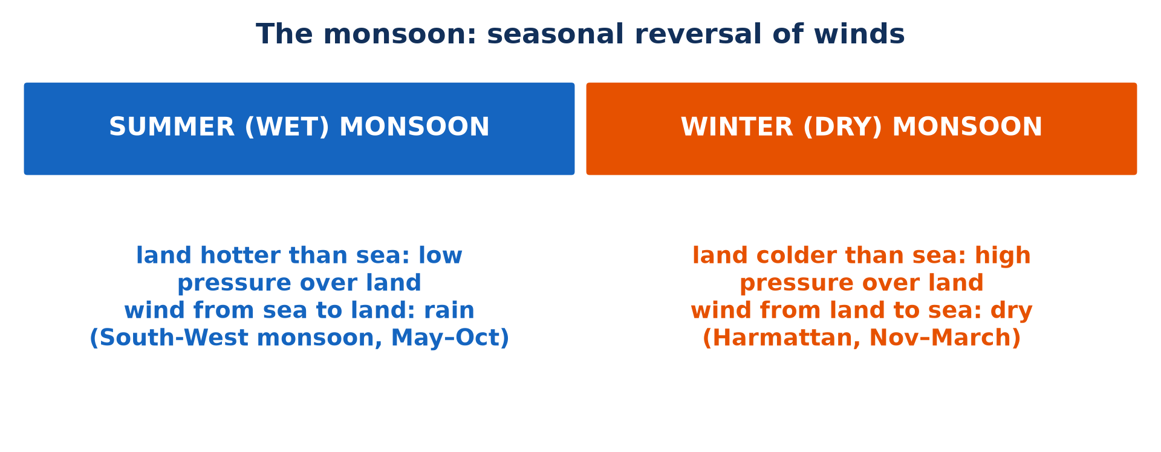
1. MONSOON
Activity 1
Summer and winter monsoons.
Notes:
Activity 1. Look carefully at this picture: summer and winter monsoons. Observe every detail before I ask the question.

Slide 21
1. MONSOON
Activity 1: Question
Why does the summer monsoon bring rain?
Notes:
Here is the question for Activity 1: Why does the summer monsoon bring rain? Take one minute to think and write your answer in your rough notebook.

Slide 22
1. MONSOON
Activity 1: Answer
It blows from the sea to the hot land and carries moisture.
Notes:
Let us check the answer together. It blows from the sea to the hot land and carries moisture.

Slide 23
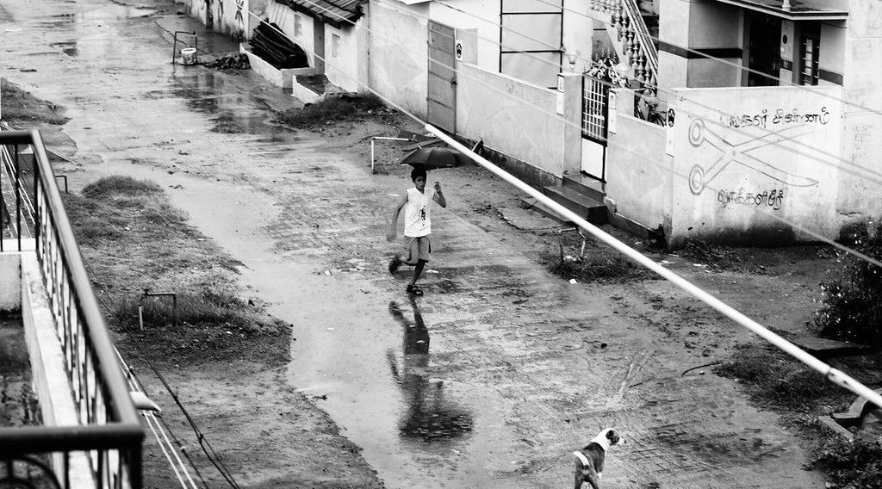
1. MONSOON
Activity 2
Monsoon rain in Asia.
Notes:
Activity 2. Look carefully at this picture: monsoon rain in Asia. Observe every detail before I ask the question.

Slide 24
1. MONSOON
Activity 2: Question
Give one negative effect of the Asian monsoon.
Notes:
Here is the question for Activity 2: Give one negative effect of the Asian monsoon. Take one minute to think and write your answer in your rough notebook.

Slide 25
1. MONSOON
Activity 2: Answer
Floods, landslides and loss of life.
Notes:
Let us check the answer together. Floods, landslides and loss of life.

Slide 26

1. WEST AFRICAN MONSOON
Activity 3
Animation: the rain belt moves during the year.
Notes:
Activity 3. Look carefully at this animation: animation: the rain belt moves during the year. Watch the animation to the end; it will play again.

Slide 27
1. WEST AFRICAN MONSOON
Activity 3: Question
When does the south-west monsoon reach Garoua?
Notes:
Here is the question for Activity 3: When does the south-west monsoon reach Garoua? Take one minute to think and write your answer in your rough notebook.

Slide 28
1. WEST AFRICAN MONSOON
Activity 3: Answer
From about May to September–October.
Notes:
Let us check the answer together. From about May to September–October.

Slide 29

2. HARMATTAN
Activity 4
Harmattan haze.
Notes:
Activity 4. Look carefully at this picture: harmattan haze. Observe every detail before I ask the question.

Slide 30
2. HARMATTAN
Activity 4: Question
Where does the Harmattan come from?
Notes:
Here is the question for Activity 4: Where does the Harmattan come from? Take one minute to think and write your answer in your rough notebook.

Slide 31
2. HARMATTAN
Activity 4: Answer
From the Sahara Desert.
Notes:
Let us check the answer together. From the Sahara Desert.

Slide 32
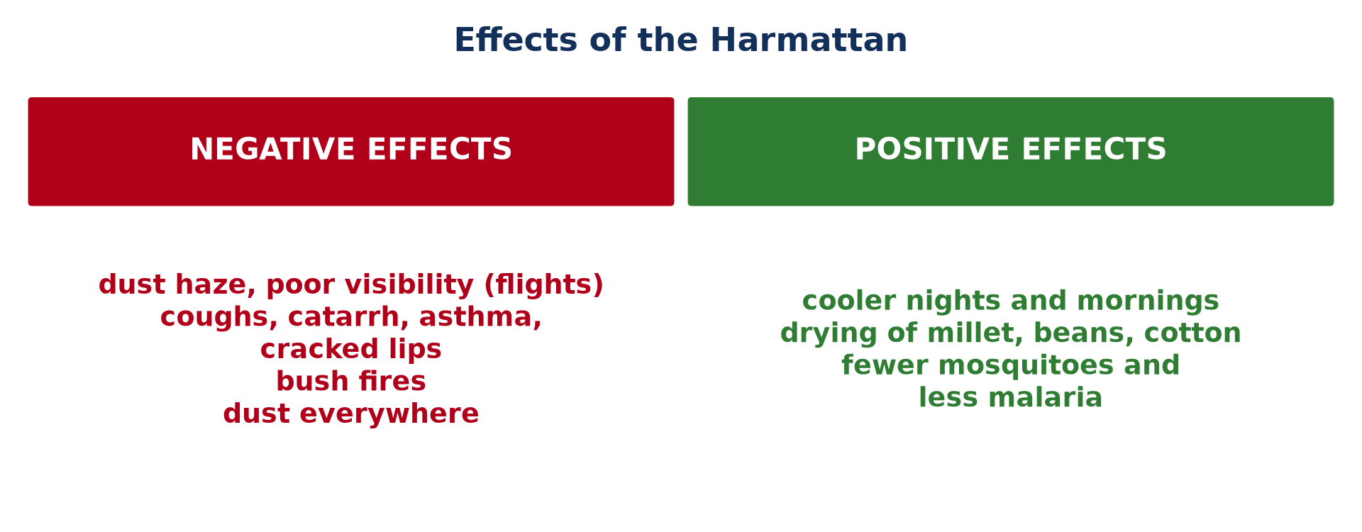
2. HARMATTAN
Activity 5
Effects of the Harmattan.
Notes:
Activity 5. Look carefully at this picture: effects of the Harmattan. Observe every detail before I ask the question.

Slide 33
2. HARMATTAN
Activity 5: Question
Give one positive effect of the Harmattan.
Notes:
Here is the question for Activity 5: Give one positive effect of the Harmattan. Take one minute to think and write your answer in your rough notebook.

Slide 34
2. HARMATTAN
Activity 5: Answer
Cool nights, drying of crops, or fewer mosquitoes.
Notes:
Let us check the answer together. Cool nights, drying of crops, or fewer mosquitoes.

Slide 35
BOARD SUMMARY
Board Summary
Topic: Global and Local Atmospheric Circulation
Sub-topic: Mesoscale Winds
Lesson 16: Tropical Seasonal Winds: Monsoon and Harmattan
Notes:
Now we are going to copy the board summary. Write the title and the headings neatly in your notebooks. I will give you enough time for each slide, so do not rush.

Slide 36
BOARD SUMMARY
DEFINITIONS
The key terms of this lesson are defined as follows:
Monsoon: It is a seasonal wind that reverses its direction between summer and winter.
Harmattan: It is the dry, dusty north-east wind that blows from the Sahara over West Africa in the dry season.
Notes:
Let us copy the definitions. The key terms of this lesson are defined as follows. On this slide we have Monsoon and Harmattan. Write each point on a new line, with the key term first, and explain it in your own words when we revise.

Slide 37
BOARD SUMMARY
1. Monsoon Winds
A) Meaning and Causes
Monsoon winds are caused as follows:
Differential heating: Land heats and cools faster than the sea, so pressure over land changes with the seasons.
Illustration: summer and winter monsoons
Notes:
Let us copy Meaning and Causes. Monsoon winds are caused as follows. Copy the point on Differential heating on the left, then draw the diagram on the right: summer and winter monsoons. Give it a title and label it clearly.

Slide 38
BOARD SUMMARY
1. Monsoon Winds
A) Meaning and Causes
Summer (wet) monsoon: The hot land forms low pressure; moist air blows from the sea to the land and brings heavy rain.
Winter (dry) monsoon: The cold land forms high pressure; dry air blows from the land to the sea.
Notes:
We continue with Meaning and Causes. On this slide we have Summer (wet) monsoon and Winter (dry) monsoon. Write each point on a new line, with the key term first, and explain it in your own words when we revise.

Slide 39
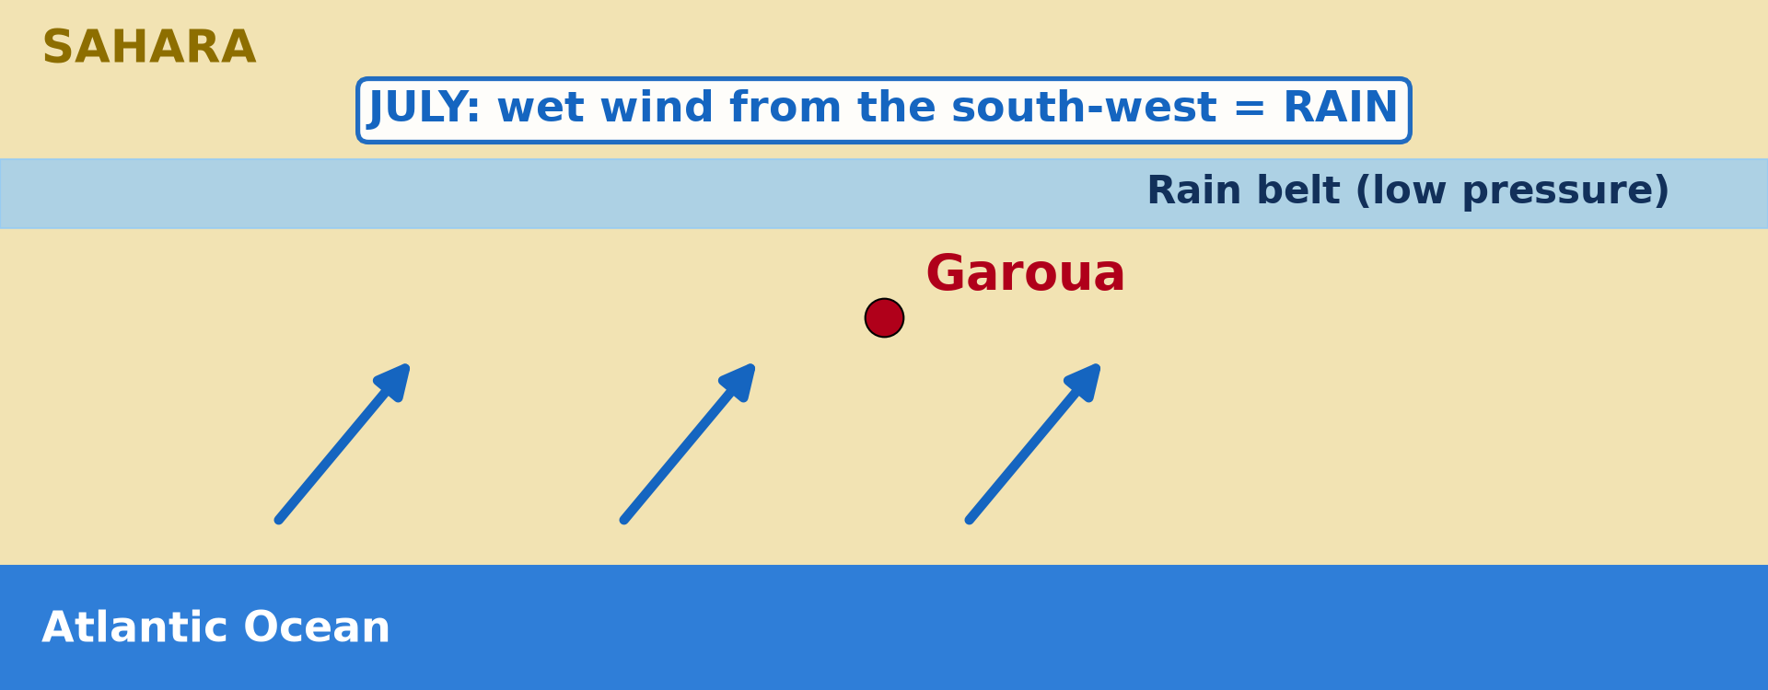
BOARD SUMMARY
1. Monsoon Winds
A) Meaning and Causes
Role of the ITCZ: The shift of the ITCZ with the overhead sun drives the reversal of winds.
Illustration: the ITCZ in July
Notes:
Copy the point on Role of the ITCZ on the left, then draw the diagram on the right: the ITCZ in July. Give it a title and label it clearly.

Slide 40
BOARD SUMMARY
1. Monsoon Winds
B) Areas and Effects
Monsoons occur in the following areas with the following effects:
South Asia (India, Bangladesh): The summer monsoon brings the rain needed for rice and fills rivers and reservoirs.
Illustration: monsoon rain
Notes:
Let us copy Areas and Effects. Monsoons occur in the following areas with the following effects. Copy the point on South Asia (India, Bangladesh) on the left, then draw the diagram on the right: monsoon rain. Give it a title and label it clearly.

Slide 41
BOARD SUMMARY
1. Monsoon Winds
B) Areas and Effects
Negative effects in Asia: Very heavy rains cause floods, landslides and loss of life.
Winter monsoon in Asia: It brings a long, dry and cool season, good for harvesting.
Notes:
We continue with Areas and Effects. On this slide we have Negative effects in Asia and Winter monsoon in Asia. Write each point on a new line, with the key term first, and explain it in your own words when we revise. When you finish, we go to the next slide.

Slide 42
BOARD SUMMARY
1. Monsoon Winds
B) Areas and Effects (continued)
West Africa and Cameroon: The moist south-west monsoon from the Atlantic brings the rainy season to Garoua (about May to October), for millet, sorghum, maize and cotton.
Notes:
We continue with Areas and Effects. On this slide we have West Africa and Cameroon. Write each point on a new line, with the key term first, and explain it in your own words when we revise.

Slide 43
BOARD SUMMARY
2. The Harmattan
The Harmattan is presented as follows:
Origin: It blows from the Sahara, where high pressure forms in the northern winter; it is the north-east trade wind and the winter monsoon of West Africa.
Illustration: Harmattan haze
Notes:
Let us copy The Harmattan. The Harmattan is presented as follows. Copy the point on Origin on the left, then draw the diagram on the right: harmattan haze. Give it a title and label it clearly.

Slide 44
BOARD SUMMARY
2. The Harmattan
Character: It is very dry and dusty, cool at night and in the morning, and hot in the afternoon.
Negative effects:
Dust haze and poor visibility that can disturb flights at Garoua airport.
Notes:
We continue with The Harmattan. On this slide we have Character and Negative effects. Write each point on a new line, with the key term first, and explain it in your own words when we revise. When you finish, we go to the next slide.

Slide 45
BOARD SUMMARY
2. The Harmattan (continued)
Coughs, catarrh, asthma, dry skin and cracked lips.
Dry vegetation and a high risk of bush fires.
Dust on houses, goods and food.
Notes:
We continue with The Harmattan. Copy this carefully. When you finish, we go to the next slide.

Slide 46
BOARD SUMMARY
2. The Harmattan (continued)
Positive effects:
Relief from heat with cool nights.
Dry air for harvesting and drying millet, beans and cotton.
Fewer mosquitoes and less malaria.
Notes:
We continue with The Harmattan. On this slide we have Positive effects. Write each point on a new line, with the key term first, and explain it in your own words when we revise.

Slide 47
BOARD SUMMARY
2. The Harmattan
Summary: The Harmattan is both a problem and a help.
Illustration: effects of the Harmattan
Notes:
Copy the point on Summary on the left, then draw the diagram on the right: effects of the Harmattan. Give it a title and label it clearly.

Slide 48
FORMATIVE EVALUATION
Evaluation 1
Why is the summer monsoon wet and the winter monsoon dry?
Notes:
Now let us check what you have understood. Question 1: Why is the summer monsoon wet and the winter monsoon dry? Answer in your exercise book.

Slide 49
FORMATIVE EVALUATION
Expected Answer
The summer monsoon blows from the sea and carries moisture; the winter monsoon blows from the land and is dry.
Notes:
The expected answer is: the summer monsoon blows from the sea and carries moisture; the winter monsoon blows from the land and is dry. If you got it right, well done.

Slide 50
FORMATIVE EVALUATION
Evaluation 2
Give two negative effects of the Harmattan in Garoua.
Notes:
Now let us check what you have understood. Question 2: Give two negative effects of the Harmattan in Garoua. Answer in your exercise book.

Slide 51
FORMATIVE EVALUATION
Expected Answer
Poor visibility, respiratory diseases, cracked lips and dry skin, bush fires (any two).
Notes:
The expected answer is: poor visibility, respiratory diseases, cracked lips and dry skin, bush fires (any two). If you got it right, well done.

Slide 52
REMEDIATION
Remediation
Fill in the blanks:
A wind that reverses with the seasons is a ______.
The Harmattan comes from the ______.
The rainy season wind of Garoua is the south-west ______.
Notes:
For those who need more practice, fill in the blanks in your exercise book. The answers are: number 1, monsoon; number 2, Sahara; number 3, monsoon.

Slide 53
HOMEWORK
Homework
Define a sea breeze.
Notes:
For your homework: Define a sea breeze. We shall correct it at the beginning of our next lesson.

Slide 54
NEXT LESSON
Next Lesson
Our next lesson will be on:
Lesson 17: Local Winds
Notes:
Our next lesson will be on Lesson 17: Local Winds. Thank you for your attention, and see you next time.

Slide 55
BILINGUAL GAME
Bilingual Game (Jeu Bilingue)
English | Français
Monsoon | La mousson
Harmattan | L'harmattan
Season | La saison
Dust | La poussière
Humidity | L'humidité
Bush fire | Le feu de brousse
Notes:
Let us play the bilingual game. I say a word in English, and you give me the French word. Then we do the reverse.

Slide 56
LOGBOOK
Official Logbook (1/2)
Module / Topic | Global and Local Atmospheric Circulation
Lesson Title | Lesson 16: Tropical Seasonal Winds: Monsoon and Harmattan
Expected Learning Outcomes | Define the monsoon and the Harmattan. Explain the causes of the summer and winter monsoons. Describe the areas and effects of monsoons. Explain the positive and negative effects of the Harmattan.
Competence | Learners are able to explain the seasonal reversal of winds and adapt to the effects of the monsoon and the Harmattan in Garoua.
Notes:
I record this information in the official logbook of the class after the lesson.

Slide 57
LOGBOOK
Official Logbook (2/2)
Matter Taught | DEFINITIONS; Meaning and Causes; Areas and Effects; The Harmattan.
Evaluation | Formative evaluation and remediation exercise.
Homework | Define a sea breeze.
Enrolment / Present / Absent | ____ / ____ / ____
Achievement | To be completed after the lesson.
Notes:
I complete the second page of the logbook: the matter taught, the evaluation, the homework and the attendance.

Slide 58
TEACHER'S NOTE
Teacher's Note
Timing: Homework correction, plan, objectives 8 min | Recall, situation, action 10 min | 5 activities 30 min | Board summary (copying) 30 min | Evaluation, remediation 10 min | Homework, next lesson 5 min | Logbook 7 min
Activity 3 is an animation (GIF): it plays automatically in slide-show mode.
Without the projector (Activity 1): draw arrows sea→land and land→sea.
Without the projector (Activity 2): locate India and Bangladesh.
Without the projector (Activity 3): draw the ITCZ in January and July.
Without the projector (Activity 4): draw the arrow from the Sahara.
Without the projector (Activity 5): list effects in two columns.
Notes:
This slide is for me, the teacher: it gives the timing of the lesson and what to do if the projector is not available.

Slide 59
REFERENCES
References
Geography Syllabus for Sixth Forms (Lower and Upper Sixth), MINESEC, 2019 — Module 1 (Meteorology, Climatology & Hydrology).
Teacher's course notes: Mr KAMDEM E., Meteorology (LSA), GBHS Garoua, 2026.
Photo, Activity 2: “Running in the rain” by VinothChandar, CC BY 2.0, via Flickr (https://www.flickr.com/photos/44345361@N06/10960940954)
Photo, Activity 4: “Bamenda sob a poeira do Harmattan” by carlosoliveirareis, CC BY-NC-SA 2.0, via Flickr (https://www.flickr.com/photos/54218923@N00/387054136)
Diagrams and animations: drawn for this lesson (Geography Department).
Notes:
These are the references and picture credits used to prepare this lesson.

