Slide 1
LOWER SIXTH ARTS
GEOGRAPHY
Lesson 18
Air Masses
Notes:
Good morning, class, and welcome to our geography lesson. I am your geography teacher, Mr Kamdem. Today we are starting Lesson 18: Air Masses.

Slide 2
CLASS INFO
Class, Chapter and Duration
Class | Lower Sixth Arts
Chapter | Module 1: Understanding and managing atmospheric and hydrological phenomena and hazards across the world in general and Cameroon in particular
Duration | 2 periods (2 × 50 minutes)
Notes:
This lesson is for Lower Sixth Arts. It belongs to Module 1: Understanding and managing atmospheric and hydrological phenomena and hazards across the world in general and Cameroon in particular. We shall need 2 periods to cover it.

Slide 3
IDENTIFICATION
Lesson Identification
Topic | Climates
Sub-topic | Air Masses and Effects on Climate
Lesson | Lesson 18: Air Masses
Notions / Concepts | Air mass, source region, continental, maritime, tropical, polar, arctic, equatorial, cT, mT, ITCZ, Harmattan, monsoon.
Syllabus focus | Meaning and characteristics of air masses; source regions; classification (c/m, T/P/A/E); the air masses affecting Cameroon and West Africa (cT and mT).
Competence | Learners are able to classify air masses and explain how the cT and mT air masses produce the seasons of Garoua.
Notes:
Our topic is Climates, and the sub-topic is Air Masses and Effects on Climate. The key notions we shall use today are: air mass, source region, continental, maritime, tropical, polar, arctic, equatorial, cT, mT, ITCZ, Harmattan, monsoon. At the end, you should be able to do this: learners are able to classify air masses and explain how the cT and mT air masses produce the seasons of Garoua.

Slide 4

HOMEWORK CORRECTION
Correction of the Homework
Question (Lesson 17: Local Winds):
Define an air mass.
Notes:
Before we start the new lesson, let us correct the homework I gave you at the end of Lesson 17: Local Winds. The question was: Define an air mass. Take out your exercise books.

Slide 5
HOMEWORK CORRECTION
Correction: Possible Answer
An air mass is a very large body of air with nearly the same temperature and humidity throughout.
Notes:
Here is a good answer. An air mass is a very large body of air with nearly the same temperature and humidity throughout. Compare it with your own answer and correct your work in red.

Slide 6
LESSON PLAN
Lesson Plan
Correction of the homework
Objectives and recall
Real-life situation and action to take
Learning activities
Board summary
Evaluation, remediation and homework
Notes:
Here is the plan of our lesson today. First, we shall correct the homework. Then we shall look at the objectives and recall what you already know. After that, we shall study a situation from real life and the action to take, and do the learning activities. Finally, we shall copy the board summary, do the evaluation and the remediation, and I will give you the homework.

Slide 7
OBJECTIVES
Objectives
By the end of this lesson, you should be able to:
Define an air mass and a source region.
Explain how air masses acquire their characteristics.
Notes:
Take your time to copy this part; we will continue together.

Slide 8
OBJECTIVES
Objectives (continued)
Classify air masses with the two-letter system.
Describe the cT and mT air masses affecting Cameroon.
Notes:
By the end of this lesson, you should be able to do four things. Number 1: define an air mass and a source region. Number 2: explain how air masses acquire their characteristics. Number 3: classify air masses with the two-letter system. Number 4: describe the cT and mT air masses affecting Cameroon.

Slide 9
PREVIOUS KNOWLEDGE
Previous Knowledge
The Harmattan comes from the Sahara.
The south-west monsoon comes from the Atlantic.
The ITCZ moves with the seasons.
Notes:
Let us first remember what you already know. The Harmattan comes from the Sahara. The south-west monsoon comes from the Atlantic. The ITCZ moves with the seasons. Keep this in mind, because we shall build on it today.

Slide 10
REAL-LIFE SITUATION
Situation in Real Life
In January in Garoua, the air is very dry, hazy and full of fine dust; lips are chapped, the ground is cracked and everything is covered with reddish powder.
In August, the air was heavy and humid and everything was green after daily rains.
Notes:
Take your time to copy this part; we will continue together.

Slide 11
REAL-LIFE SITUATION
Situation in Real Life (continued)
You ask: "How can the air feel so different at different times of the year?
Is it not the same air?"
Notes:
Listen carefully to this situation from real life. In January in Garoua, the air is very dry, hazy and full of fine dust; lips are chapped, the ground is cracked and everything is covered with reddish powder. In August, the air was heavy and humid and everything was green after daily rains. You ask: "How can the air feel so different at different times of the year? Is it not the same air?" Think about it, because I am going to ask you some questions.

Slide 12
REAL-LIFE SITUATION
Situation: Question 1
What is the problem in the situation?
Notes:
Question 1: What is the problem in the situation? Think for a moment, then raise your hand to answer.

Slide 13
REAL-LIFE SITUATION
Answer
The learner does not know what air masses are and how they change the weather.
Notes:
Good. The learner does not know what air masses are and how they change the weather.

Slide 14
REAL-LIFE SITUATION
Situation: Question 2
Why is the air of January so different from the air of August?
Notes:
Question 2: Why is the air of January so different from the air of August? Think for a moment, then raise your hand to answer.

Slide 15
REAL-LIFE SITUATION
Answer
They are two different air masses.
Notes:
Good. They are two different air masses.

Slide 16
REAL-LIFE SITUATION
Situation: Question 3
Where do they come from?
Notes:
Question 3: Where do they come from? Think for a moment, then raise your hand to answer.

Slide 17
REAL-LIFE SITUATION
Possible Answer
The dry air from the Sahara, the humid air from the Atlantic Ocean.
Notes:
Good. The dry air from the Sahara, the humid air from the Atlantic Ocean.

Slide 18
ACTION TO TAKE
Action to Take
Recognise the air mass over Garoua from humidity, dust and clouds, and plan activities accordingly.
Notes:
From this situation, the action we are working towards in this lesson is the following: recognise the air mass over Garoua from humidity, dust and clouds, and plan activities accordingly.

Slide 19
JUSTIFICATION
Justification of the Lesson
This lesson explains the origin of the dry and rainy seasons of Cameroon.
Notes:
Why is this lesson important for you? This lesson explains the origin of the dry and rainy seasons of Cameroon.

Slide 20
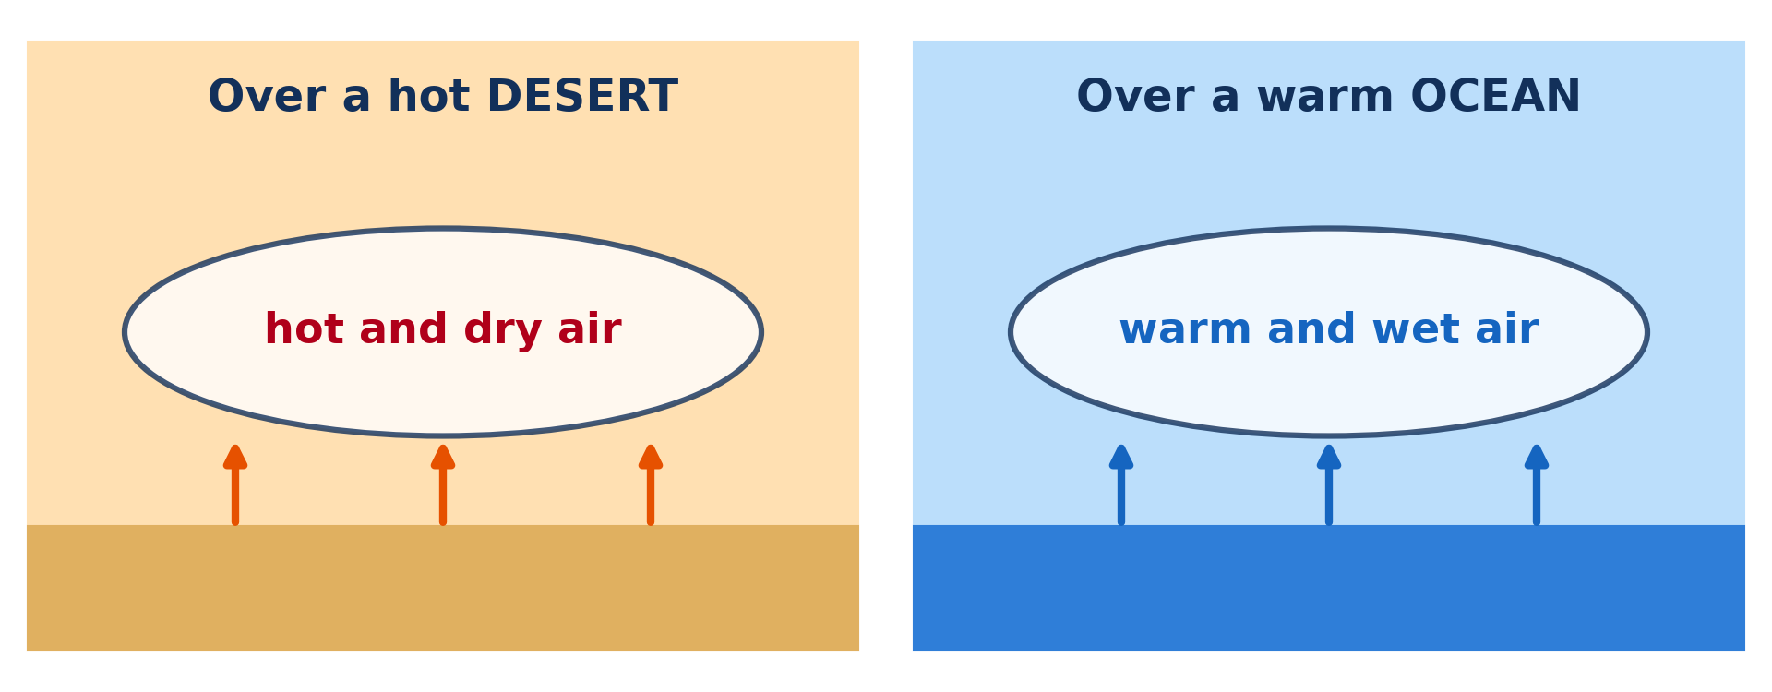
1. MEANING
Activity 1
Source regions of air masses.
Notes:
Activity 1. Look carefully at this diagram: source regions of air masses. Observe every detail before I ask the question.

Slide 21
1. MEANING
Activity 1: Question
What is a source region?
Notes:
Here is the question for Activity 1: What is a source region? Take one minute to think and write your answer in your rough notebook.

Slide 22
1. MEANING
Activity 1: Answer
The large, uniform area where an air mass forms and takes its characteristics.
Notes:
Let us check the answer together. The large, uniform area where an air mass forms and takes its characteristics.

Slide 23
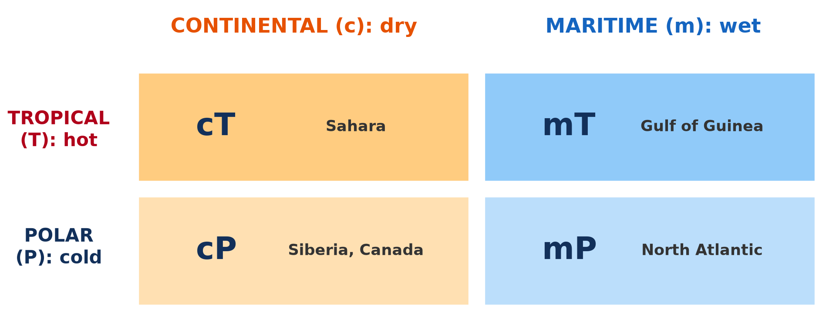
2. CLASSIFICATION
Activity 2
Classification of air masses.
Notes:
Activity 2. Look carefully at this diagram: classification of air masses. Observe every detail before I ask the question.

Slide 24
2. CLASSIFICATION
Activity 2: Question
What does the letter "m" mean in "mT"?
Notes:
Here is the question for Activity 2: What does the letter "m" mean in "mT"? Take one minute to think and write your answer in your rough notebook.

Slide 25
2. CLASSIFICATION
Activity 2: Answer
Maritime: formed over the sea, so moist.
Notes:
Let us check the answer together. Maritime: formed over the sea, so moist.

Slide 26
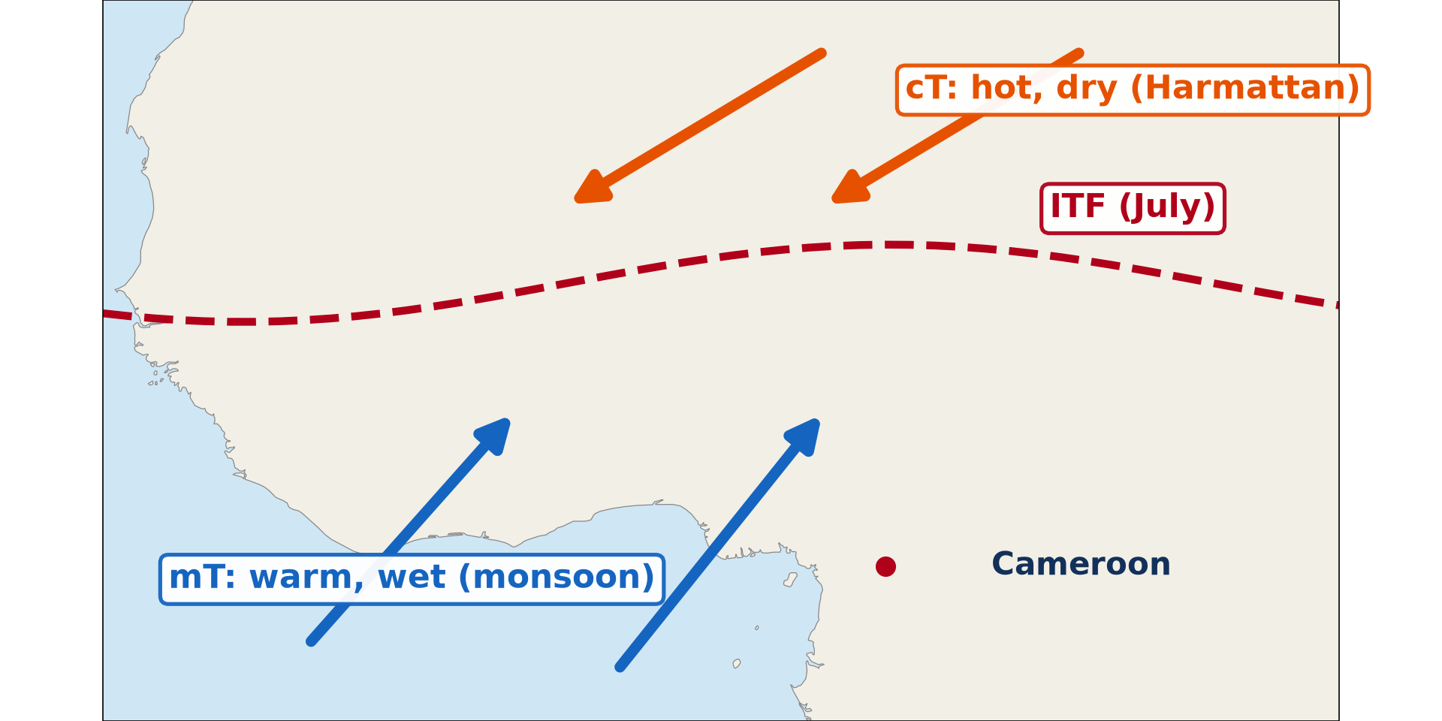
3. CAMEROON
Activity 3
Air masses over West Africa.
Notes:
Activity 3. Look carefully at this diagram: air masses over West Africa. Observe every detail before I ask the question.

Slide 27
3. CAMEROON
Activity 3: Question
Which air mass brings the rainy season to Garoua?
Notes:
Here is the question for Activity 3: Which air mass brings the rainy season to Garoua? Take one minute to think and write your answer in your rough notebook.

Slide 28
3. CAMEROON
Activity 3: Answer
The tropical maritime (mT) air mass.
Notes:
Let us check the answer together. The tropical maritime (mT) air mass.

Slide 29

3. CAMEROON
Activity 4
Harmattan haze.
Notes:
Activity 4. Look carefully at this picture: harmattan haze. Observe every detail before I ask the question.

Slide 30
3. CAMEROON
Activity 4: Question
Is the Harmattan air stable or unstable?
Notes:
Here is the question for Activity 4: Is the Harmattan air stable or unstable? Take one minute to think and write your answer in your rough notebook.

Slide 31
3. CAMEROON
Activity 4: Answer
Stable: it prevents clouds and rain.
Notes:
Let us check the answer together. Stable: it prevents clouds and rain.

Slide 32

3. CAMEROON
Activity 5
Heavy rain.
Notes:
Activity 5. Look carefully at this picture: heavy rain. Observe every detail before I ask the question.

Slide 33
3. CAMEROON
Activity 5: Question
Why does mT air give heavy rain?
Notes:
Here is the question for Activity 5: Why does mT air give heavy rain? Take one minute to think and write your answer in your rough notebook.

Slide 34
3. CAMEROON
Activity 5: Answer
It is moist and unstable, so it rises and forms cumulonimbus clouds.
Notes:
Let us check the answer together. It is moist and unstable, so it rises and forms cumulonimbus clouds.

Slide 35
BOARD SUMMARY
Board Summary
Topic: Climates
Sub-topic: Air Masses and Effects on Climate
Lesson 18: Air Masses
Notes:
Now we are going to copy the board summary. Write the title and the headings neatly in your notebooks. I will give you enough time for each slide, so do not rush.

Slide 36
BOARD SUMMARY
DEFINITIONS
The key terms of this lesson are defined as follows:
Air mass: It is a very large body of air with nearly the same temperature and humidity throughout at a given height.
Notes:
Let us copy the definitions. The key terms of this lesson are defined as follows. On this slide we have Air mass. Write each point on a new line, with the key term first, and explain it in your own words when we revise. When you finish, we go to the next slide.

Slide 37
BOARD SUMMARY
DEFINITIONS (continued)
Source region: It is the large, uniform area where an air mass forms and acquires its characteristics.
Notes:
We continue with the definitions. On this slide we have Source region. Write each point on a new line, with the key term first, and explain it in your own words when we revise.

Slide 38
BOARD SUMMARY
1. Meaning and Characteristics of Air Masses
Air masses are presented as follows:
Size: An air mass covers thousands of square kilometres.
Illustration: source regions
Notes:
Let us copy Meaning and Characteristics of Air Masses. Air masses are presented as follows. Copy the point on Size on the left, then draw the diagram on the right: source regions. Give it a title and label it clearly.

Slide 39
BOARD SUMMARY
1. Meaning and Characteristics of Air Masses
Acquired characteristics: Air staying long over a surface takes its temperature and moisture, like a sponge.
Good source regions: Large, flat and uniform areas such as deserts, oceans and ice-covered lands.
Notes:
We continue with Meaning and Characteristics of Air Masses. On this slide we have Acquired characteristics and Good source regions. Write each point on a new line, with the key term first, and explain it in your own words when we revise. When you finish, we go to the next slide.

Slide 40
BOARD SUMMARY
1. Meaning and Characteristics of Air Masses (continued)
Movement: When an air mass moves, it brings the weather of its source region.
Notes:
We continue with Meaning and Characteristics of Air Masses. On this slide we have Movement. Write each point on a new line, with the key term first, and explain it in your own words when we revise.

Slide 41
BOARD SUMMARY
2. Classification of Air Masses
Air masses are classified with two letters as follows:
First letter (moisture):
c = continental: formed over land, dry.
m = maritime: formed over the sea, moist.
Notes:
Let us copy Classification of Air Masses. Air masses are classified with two letters as follows. On this slide we have First letter (moisture). Write each point on a new line, with the key term first, and explain it in your own words when we revise. When you finish, we go to the next slide.

Slide 42
BOARD SUMMARY
2. Classification of Air Masses (continued)
Second letter (temperature):
E = equatorial: very warm.
T = tropical: warm.
P = polar: cold.
A = arctic or antarctic: very cold.
Notes:
We continue with Classification of Air Masses. On this slide we have Second letter (temperature). Write each point on a new line, with the key term first, and explain it in your own words when we revise.

Slide 43
BOARD SUMMARY
2. Classification of Air Masses
Examples: cT is hot and dry (Sahara), mT is warm and moist (tropical oceans), cP is cold and dry (Siberia).
Illustration: classification of air masses
Notes:
Copy the point on Examples on the left, then draw the diagram on the right: classification of air masses. Give it a title and label it clearly.

Slide 44
BOARD SUMMARY
3. Air Masses Affecting Cameroon and West Africa
Two air masses control the seasons of Cameroon as follows:
Tropical continental (cT): It comes from the Sahara; it is hot, very dry, dusty and stable, and blows as the Harmattan.
Illustration: Harmattan haze
Notes:
Let us copy Air Masses Affecting Cameroon and West Africa. Two air masses control the seasons of Cameroon as follows. Copy the point on Tropical continental (cT) on the left, then draw the diagram on the right: harmattan haze. Give it a title and label it clearly.

Slide 45
BOARD SUMMARY
3. Air Masses Affecting Cameroon and West Africa
Influence of cT: It dominates the dry season (about November to March in Garoua), with sunshine, haze, low humidity and a risk of fires.
Notes:
We continue with Air Masses Affecting Cameroon and West Africa. On this slide we have Influence of cT. Write each point on a new line, with the key term first, and explain it in your own words when we revise.

Slide 46
BOARD SUMMARY
3. Air Masses Affecting Cameroon and West Africa
Tropical maritime (mT): It comes from the South Atlantic; it is warm, very moist and unstable, and blows as the south-west monsoon.
Illustration: heavy rain
Notes:
Copy the point on Tropical maritime (mT) on the left, then draw the diagram on the right: heavy rain. Give it a title and label it clearly.

Slide 47
BOARD SUMMARY
3. Air Masses Affecting Cameroon and West Africa
Influence of mT: It brings the rainy season (about May to September–October in Garoua), with cumulonimbus clouds and storms; the coast of Cameroon receives the most rain.
Notes:
We continue with Air Masses Affecting Cameroon and West Africa. On this slide we have Influence of mT. Write each point on a new line, with the key term first, and explain it in your own words when we revise.

Slide 48
BOARD SUMMARY
3. Air Masses Affecting Cameroon and West Africa
The meeting zone: The two air masses meet at the Intertropical Front (ITF), which moves north and south with the seasons.
Illustration: air masses over West Africa
Notes:
Copy the point on The meeting zone on the left, then draw the diagram on the right: air masses over West Africa. Give it a title and label it clearly.

Slide 49
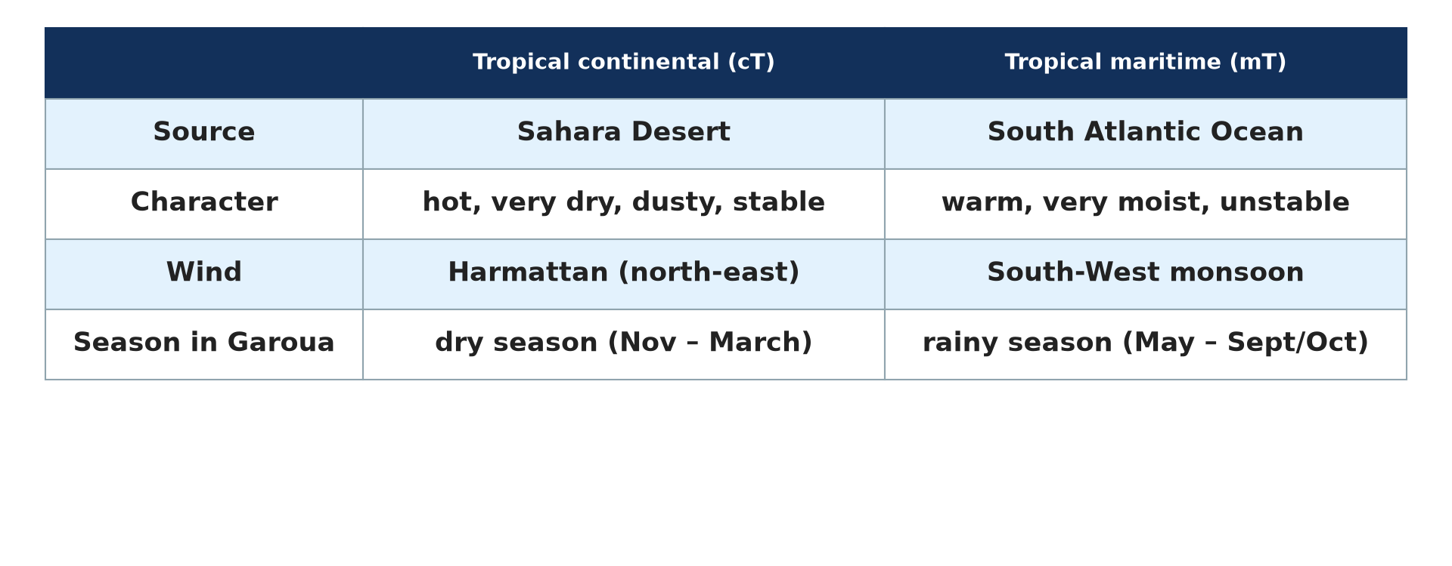
BOARD SUMMARY
3. Air Masses Affecting Cameroon and West Africa
Comparison: The two air masses are opposite in almost everything.
Illustration: cT and mT compared
Notes:
Copy the point on Comparison on the left, then draw the diagram on the right: cT and mT compared. Give it a title and label it clearly.

Slide 50
FORMATIVE EVALUATION
Evaluation 1
Distinguish a continental air mass from a maritime air mass.
Notes:
Now let us check what you have understood. Question 1: Distinguish a continental air mass from a maritime air mass. Answer in your exercise book.

Slide 51
FORMATIVE EVALUATION
Expected Answer
A continental air mass forms over land and is dry; a maritime air mass forms over the sea and is moist.
Notes:
The expected answer is: a continental air mass forms over land and is dry; a maritime air mass forms over the sea and is moist. If you got it right, well done.

Slide 52
FORMATIVE EVALUATION
Evaluation 2
Which air mass brings the rainy season to Garoua, and why?
Notes:
Now let us check what you have understood. Question 2: Which air mass brings the rainy season to Garoua, and why? Answer in your exercise book.

Slide 53
FORMATIVE EVALUATION
Expected Answer
The tropical maritime (mT) air mass, because it is moist and unstable.
Notes:
The expected answer is: the tropical maritime (mT) air mass, because it is moist and unstable. If you got it right, well done.

Slide 54
REMEDIATION
Remediation
Fill in the blanks:
An air mass takes its characteristics from its ______ region.
The Harmattan is a ______ air mass.
The two air masses meet at the ______.
Notes:
For those who need more practice, fill in the blanks in your exercise book. The answers are: number 1, source; number 2, tropical continental (cT); number 3, Intertropical Front (ITF).

Slide 55
HOMEWORK
Homework
Define climate.
Notes:
For your homework: Define climate. We shall correct it at the beginning of our next lesson.

Slide 56
NEXT LESSON
Next Lesson
Our next lesson will be on:
Lesson 19: Meaning of Climate and Köppen's Classification
Notes:
Our next lesson will be on Lesson 19: Meaning of Climate and Köppen's Classification. Thank you for your attention, and see you next time.

Slide 57
BILINGUAL GAME
Bilingual Game (Jeu Bilingue)
English | Français
Air mass | La masse d'air
Continental | Continental
Maritime | Maritime
Harmattan | L'harmattan
Monsoon | La mousson
Source region | La région source
Notes:
Let us play the bilingual game. I say a word in English, and you give me the French word. Then we do the reverse.

Slide 58
LOGBOOK
Official Logbook (1/2)
Module / Topic | Climates
Lesson Title | Lesson 18: Air Masses
Expected Learning Outcomes | Define an air mass and a source region. Explain how air masses acquire their characteristics. Classify air masses with the two-letter system. Describe the cT and mT air masses affecting Cameroon.
Competence | Learners are able to classify air masses and explain how the cT and mT air masses produce the seasons of Garoua.
Notes:
I record this information in the official logbook of the class after the lesson.

Slide 59
LOGBOOK
Official Logbook (2/2)
Matter Taught | DEFINITIONS; Meaning and Characteristics of Air Masses; Classification of Air Masses; Air Masses Affecting Cameroon and West Africa.
Evaluation | Formative evaluation and remediation exercise.
Homework | Define climate.
Enrolment / Present / Absent | ____ / ____ / ____
Achievement | To be completed after the lesson.
Notes:
I complete the second page of the logbook: the matter taught, the evaluation, the homework and the attendance.

Slide 60
TEACHER'S NOTE
Teacher's Note
Timing: Homework correction, plan, objectives 8 min | Recall, situation, action 10 min | 5 activities 30 min | Board summary (copying) 30 min | Evaluation, remediation 10 min | Homework, next lesson 5 min | Logbook 7 min
Without the projector (Activity 1): use the sponge example.
Without the projector (Activity 2): write the codes on the board.
Without the projector (Activity 3): draw the two air masses and the ITF.
Without the projector (Activity 4): describe a Harmattan day.
Without the projector (Activity 5): describe an August storm.
Notes:
This slide is for me, the teacher: it gives the timing of the lesson and what to do if the projector is not available.

Slide 61
REFERENCES
References
Geography Syllabus for Sixth Forms (Lower and Upper Sixth), MINESEC, 2019 — Module 1 (Meteorology, Climatology & Hydrology).
Teacher's course notes: Mr KAMDEM E., Meteorology (LSA), GBHS Garoua, 2026.
Photo, Activity 4: “Bamenda sob a poeira do Harmattan” by carlosoliveirareis, CC BY-NC-SA 2.0, via Flickr (https://www.flickr.com/photos/54218923@N00/387054136)
Photo, Activity 5: “Heavy rain. Johannesburg, South Africa” by varfolomeev, CC BY-NC 2.0, via Flickr (https://www.flickr.com/photos/45427632@N02/49745935146)
Diagrams and animations: drawn for this lesson (Geography Department).
Notes:
These are the references and picture credits used to prepare this lesson.

