Slide 1
LOWER SIXTH ARTS
GEOGRAPHY
Lesson 21
Mountain Climates
Notes:
Good morning, class, and welcome to our geography lesson. I am your geography teacher, Mr Kamdem. Today we are starting Lesson 21: Mountain Climates.

Slide 2
CLASS INFO
Class, Chapter and Duration
Class | Lower Sixth Arts
Chapter | Module 1: Understanding and managing atmospheric and hydrological phenomena and hazards across the world in general and Cameroon in particular
Duration | 2 periods (2 × 50 minutes)
Notes:
This lesson is for Lower Sixth Arts. It belongs to Module 1: Understanding and managing atmospheric and hydrological phenomena and hazards across the world in general and Cameroon in particular. We shall need 2 periods to cover it.

Slide 3
IDENTIFICATION
Lesson Identification
Topic | Climates
Sub-topic | Concept of Micro-climate
Lesson | Lesson 21: Mountain Climates
Notions / Concepts | Mountain (highland) climate, lapse rate, air pressure, orographic rain, rain shadow, ultraviolet radiation, daily range, vertical zonation, altitude, relief, aspect, latitude.
Syllabus focus | Characteristics of mountain climates; vertical zonation; factors of mountain climates (altitude, relief, aspect, latitude).
Competence | Learners are able to explain the climate of mountains such as the Mandara Mountains and Mount Cameroon and its effects on vegetation and people.
Notes:
Our topic is Climates, and the sub-topic is Concept of Micro-climate. The key notions we shall use today are: mountain (highland) climate, lapse rate, air pressure, orographic rain, rain shadow, ultraviolet radiation, daily range, vertical zonation, altitude, relief, aspect, latitude. At the end, you should be able to do this: learners are able to explain the climate of mountains such as the Mandara Mountains and Mount Cameroon and its effects on vegetation and people.

Slide 4

HOMEWORK CORRECTION
Correction of the Homework
Question (Lesson 20: Micro-climates):
State how temperature changes with altitude.
Notes:
Before we start the new lesson, let us correct the homework I gave you at the end of Lesson 20: Micro-climates. The question was: State how temperature changes with altitude. Take out your exercise books.

Slide 5
HOMEWORK CORRECTION
Correction: Possible Answer
Temperature decreases as altitude increases, by about 6.5 °C per 1,000 m.
Notes:
Here is a good answer. Temperature decreases as altitude increases, by about 6.5 °C per 1,000 m. Compare it with your own answer and correct your work in red.

Slide 6
LESSON PLAN
Lesson Plan
Correction of the homework
Objectives and recall
Real-life situation and action to take
Learning activities
Board summary
Evaluation, remediation and homework
Notes:
Here is the plan of our lesson today. First, we shall correct the homework. Then we shall look at the objectives and recall what you already know. After that, we shall study a situation from real life and the action to take, and do the learning activities. Finally, we shall copy the board summary, do the evaluation and the remediation, and I will give you the homework.

Slide 7
OBJECTIVES
Objectives
By the end of this lesson, you should be able to:
Define a mountain climate.
Describe its main characteristics.
Explain the vertical zonation of climate and vegetation.
Notes:
Take your time to copy this part; we will continue together.

Slide 8
OBJECTIVES
Objectives (continued)
Explain the factors of mountain climates.
Notes:
By the end of this lesson, you should be able to do four things. Number 1: define a mountain climate. Number 2: describe its main characteristics. Number 3: explain the vertical zonation of climate and vegetation. Number 4: explain the factors of mountain climates.

Slide 9
PREVIOUS KNOWLEDGE
Previous Knowledge
Temperature falls about 6.5 °C per 1,000 m.
Moist air rising over mountains gives relief rain.
Aspect is the direction a slope faces.
Notes:
Let us first remember what you already know. Temperature falls about 6.5 °C per 1,000 m. Moist air rising over mountains gives relief rain. Aspect is the direction a slope faces. Keep this in mind, because we shall build on it today.

Slide 10
REAL-LIFE SITUATION
Situation in Real Life
Your family travels from Garoua to Mokolo in the Mandara Mountains.
In Garoua the air is hot and dusty, but as the car climbs the winding road, the air through the window becomes cooler and fresher.
Notes:
Take your time to copy this part; we will continue together.

Slide 11
REAL-LIFE SITUATION
Situation in Real Life (continued)
Yet the sun on your arm feels sharper than in Garoua.
You ask: "Why is the air cooler in the mountains while the sun burns more, and how does the climate change so much over such a short distance?"
Notes:
Listen carefully to this situation from real life. Your family travels from Garoua to Mokolo in the Mandara Mountains. In Garoua the air is hot and dusty, but as the car climbs the winding road, the air through the window becomes cooler and fresher. Yet the sun on your arm feels sharper than in Garoua. You ask: "Why is the air cooler in the mountains while the sun burns more, and how does the climate change so much over such a short distance?" Think about it, because I am going to ask you some questions.

Slide 12
REAL-LIFE SITUATION
Situation: Question 1
What is the problem in the situation?
Notes:
Question 1: What is the problem in the situation? Think for a moment, then raise your hand to answer.

Slide 13
REAL-LIFE SITUATION
Answer
The learner does not know the characteristics and factors of mountain climates.
Notes:
Good. The learner does not know the characteristics and factors of mountain climates.

Slide 14
REAL-LIFE SITUATION
Situation: Question 2
Why is the air cooler in the mountains?
Notes:
Question 2: Why is the air cooler in the mountains? Think for a moment, then raise your hand to answer.

Slide 15
REAL-LIFE SITUATION
Answer
Because of altitude: temperature falls as height increases.
Notes:
Good. Because of altitude: temperature falls as height increases.

Slide 16
REAL-LIFE SITUATION
Situation: Question 3
Why does the sun burn more?
Notes:
Question 3: Why does the sun burn more? Think for a moment, then raise your hand to answer.

Slide 17
REAL-LIFE SITUATION
Possible Answer
The thin, clean air filters less of the Sun's ultraviolet rays.
Notes:
Good. The thin, clean air filters less of the Sun's ultraviolet rays.

Slide 18
ACTION TO TAKE
Action to Take
Protect your skin from strong sun in the mountains and carry warm clothes for cold nights.
Notes:
From this situation, the action we are working towards in this lesson is the following: protect your skin from strong sun in the mountains and carry warm clothes for cold nights.

Slide 19
JUSTIFICATION
Justification of the Lesson
This lesson explains the cool, wet highland climates of Cameroon that support dense populations, tea, coffee and tourism.
Notes:
Why is this lesson important for you? This lesson explains the cool, wet highland climates of Cameroon that support dense populations, tea, coffee and tourism.

Slide 20

1. CHARACTERISTICS
Activity 1
Temperature and height.
Notes:
Activity 1. Look carefully at this diagram: temperature and height. Observe every detail before I ask the question.

Slide 21
1. CHARACTERISTICS
Activity 1: Question
If Garoua (about 200 m) is at 34 °C, what is the temperature at Mokolo (about 800 m)?
Notes:
Here is the question for Activity 1: If Garoua (about 200 m) is at 34 °C, what is the temperature at Mokolo (about 800 m)? Take one minute to think and write your answer in your rough notebook.

Slide 22
1. CHARACTERISTICS
Activity 1: Answer
34 − (0.6 × 6.5) ≈ 30 °C.
Notes:
Let us check the answer together. 34 − (0.6 × 6.5) ≈ 30 °C.

Slide 23

1. CHARACTERISTICS
Activity 2
Relief rain and rain shadow.
Notes:
Activity 2. Look carefully at this diagram: relief rain and rain shadow. Observe every detail before I ask the question.

Slide 24
1. CHARACTERISTICS
Activity 2: Question
Which side of a mountain receives more rain?
Notes:
Here is the question for Activity 2: Which side of a mountain receives more rain? Take one minute to think and write your answer in your rough notebook.

Slide 25
1. CHARACTERISTICS
Activity 2: Answer
The windward side.
Notes:
Let us check the answer together. The windward side.

Slide 26
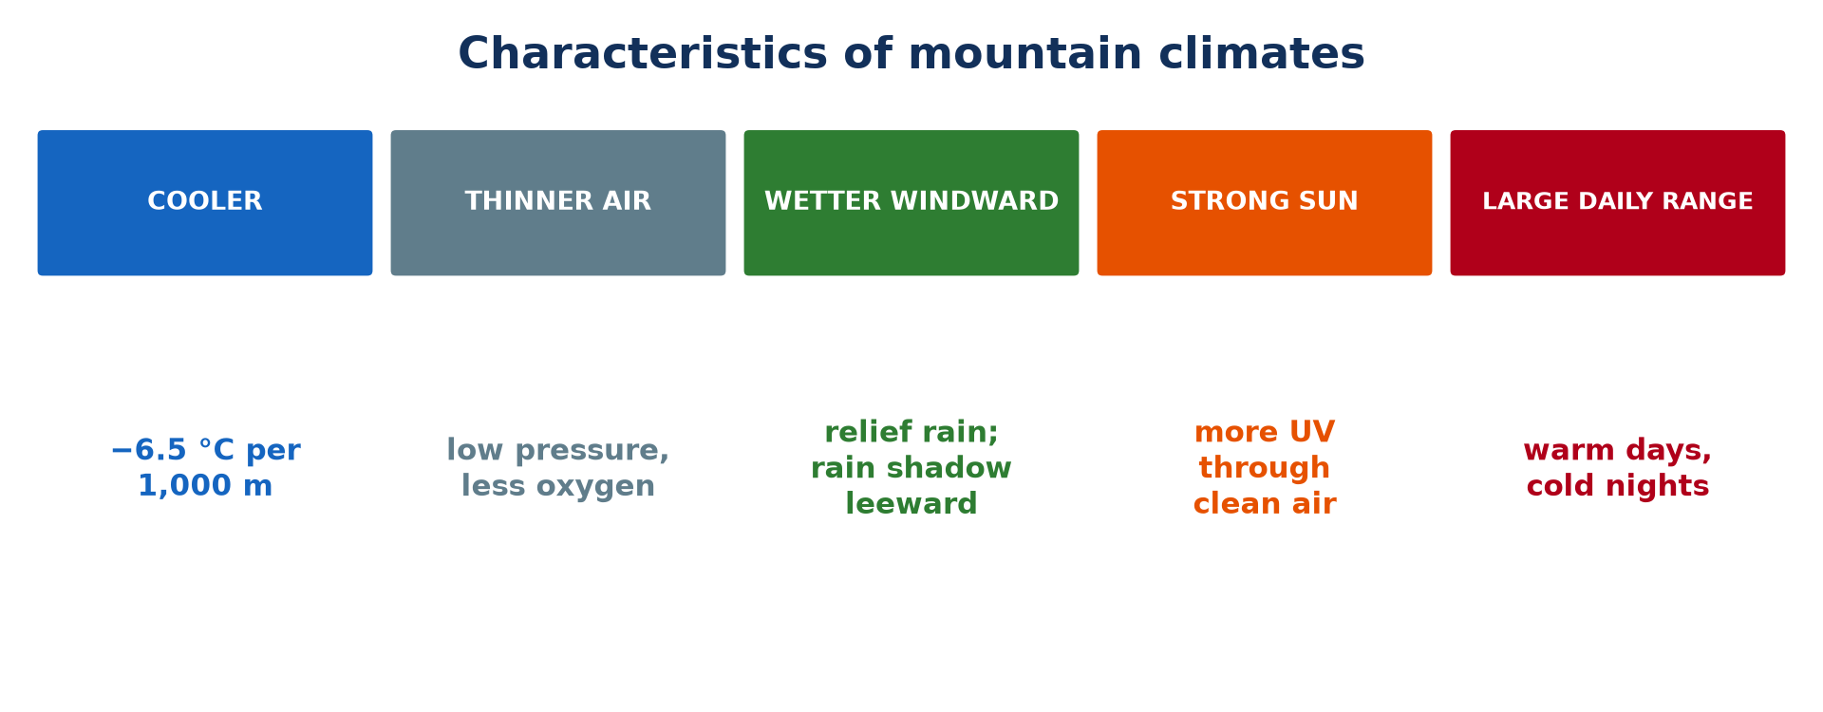
1. CHARACTERISTICS
Activity 3
Characteristics of mountain climates.
Notes:
Activity 3. Look carefully at this picture: characteristics of mountain climates. Observe every detail before I ask the question.

Slide 27
1. CHARACTERISTICS
Activity 3: Question
Why are mountain nights very cold?
Notes:
Here is the question for Activity 3: Why are mountain nights very cold? Take one minute to think and write your answer in your rough notebook.

Slide 28
1. CHARACTERISTICS
Activity 3: Answer
The thin air cannot keep the heat, which escapes quickly.
Notes:
Let us check the answer together. The thin air cannot keep the heat, which escapes quickly.

Slide 29
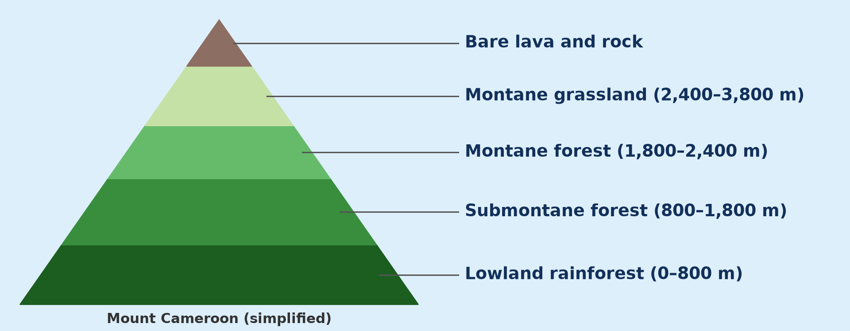
2. VERTICAL ZONATION
Activity 4
Vegetation zones on Mount Cameroon.
Notes:
Activity 4. Look carefully at this diagram: vegetation zones on Mount Cameroon. Observe every detail before I ask the question.

Slide 30
2. VERTICAL ZONATION
Activity 4: Question
What is found near the summit of Mount Cameroon?
Notes:
Here is the question for Activity 4: What is found near the summit of Mount Cameroon? Take one minute to think and write your answer in your rough notebook.

Slide 31
2. VERTICAL ZONATION
Activity 4: Answer
Bare lava and rock (with montane grassland below).
Notes:
Let us check the answer together. Bare lava and rock (with montane grassland below).

Slide 32
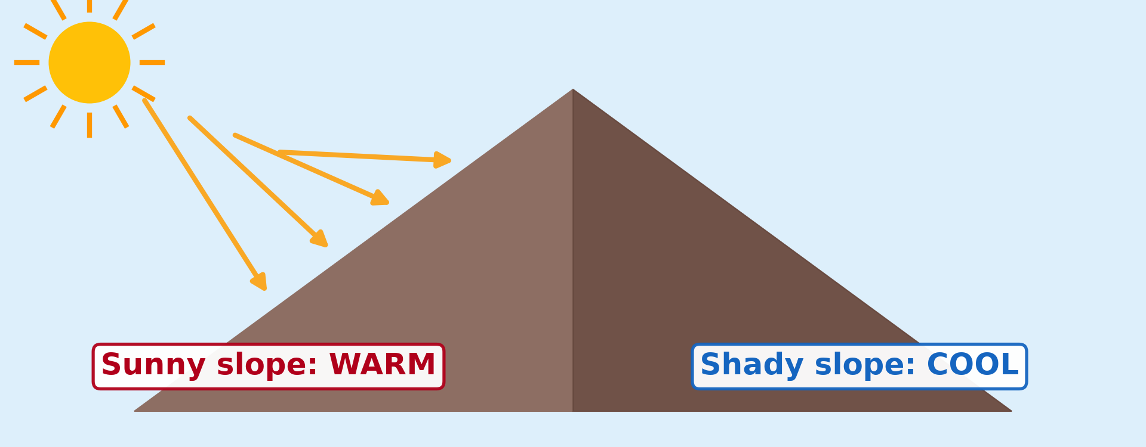
3. FACTORS
Activity 5
The aspect of slopes.
Notes:
Activity 5. Look carefully at this diagram: the aspect of slopes. Observe every detail before I ask the question.

Slide 33
3. FACTORS
Activity 5: Question
Which slope is warmer and drier: the one facing the sun or the one facing away?
Notes:
Here is the question for Activity 5: Which slope is warmer and drier: the one facing the sun or the one facing away? Take one minute to think and write your answer in your rough notebook.

Slide 34
3. FACTORS
Activity 5: Answer
The one facing the sun.
Notes:
Let us check the answer together. The one facing the sun.

Slide 35
BOARD SUMMARY
Board Summary
Topic: Climates
Sub-topic: Concept of Micro-climate
Lesson 21: Mountain Climates
Notes:
Now we are going to copy the board summary. Write the title and the headings neatly in your notebooks. I will give you enough time for each slide, so do not rush.

Slide 36
BOARD SUMMARY
DEFINITIONS
The key terms of this lesson are defined as follows:
Mountain climate: It is the climate of high-altitude areas, cooler and wetter than the surrounding lowlands.
Notes:
Let us copy the definitions. The key terms of this lesson are defined as follows. On this slide we have Mountain climate. Write each point on a new line, with the key term first, and explain it in your own words when we revise. When you finish, we go to the next slide.

Slide 37
BOARD SUMMARY
DEFINITIONS (continued)
Vertical zonation: It is the succession of climate and vegetation zones from the foot to the top of a mountain.
Mountain barrier: It is a mountain range that blocks moving air, forcing it to rise on one side and descend on the other.
Notes:
We continue with the definitions. On this slide we have Vertical zonation and Mountain barrier. Write each point on a new line, with the key term first, and explain it in your own words when we revise.

Slide 38
BOARD SUMMARY
1. Characteristics of Mountain Climates
A) Temperature and Pressure
Mountain climates have the following characteristics of temperature and pressure:
Lower temperatures: Temperature falls by about 6.5 °C for every 1,000 m of altitude. This is why Bamenda (about 1,200 m) and the Mandara Mountains are cooler than the plains around them.
Illustration: the fall of temperature with height
Notes:
Let us copy Temperature and Pressure. Mountain climates have the following characteristics of temperature and pressure. Copy the point on Lower temperatures on the left, then draw the diagram on the right: the fall of temperature with height. Give it a title and label it clearly.

Slide 39
BOARD SUMMARY
1. Characteristics of Mountain Climates
A) Temperature and Pressure
Lower air pressure: The higher we climb, the less air there is above us, so the pressure and the amount of oxygen fall. At high altitude, people breathe with difficulty and water boils below 100 °C.
Notes:
We continue with Temperature and Pressure. Copy the point on Lower air pressure: write the key term first, then its explanation.

Slide 40
BOARD SUMMARY
1. Characteristics of Mountain Climates
A) Temperature and Pressure
Large daily range of temperature: The thin air lets the sun heat the ground strongly by day but lets heat escape quickly at night. Days are therefore warm in the sun, while nights are very cold, with frost on high summits.
Illustration: the mountain climate
Notes:
Copy the point on Large daily range of temperature on the left, then draw the diagram on the right: the mountain climate. Give it a title and label it clearly.

Slide 41
BOARD SUMMARY
1. Characteristics of Mountain Climates
B) Rainfall and Radiation
Mountain climates have the following characteristics of rainfall and radiation:
Heavy rain on windward slopes: Moist air forced to rise over mountains cools and gives orographic rain, as on the seaward side of Mount Cameroon. The leeward side receives much less rain and forms a rain shadow.
Illustration: relief rainfall
Notes:
Let us copy Rainfall and Radiation. Mountain climates have the following characteristics of rainfall and radiation. Copy the point on Heavy rain on windward slopes on the left, then draw the diagram on the right: relief rainfall. Give it a title and label it clearly.

Slide 42
BOARD SUMMARY
1. Characteristics of Mountain Climates
B) Rainfall and Radiation
Mist and cloud: The slopes are often in the clouds, especially in the rainy season. Mist and drizzle keep the air humid on the middle slopes.
Notes:
We continue with Rainfall and Radiation. Copy the point on Mist and cloud: write the key term first, then its explanation.

Slide 43
BOARD SUMMARY
1. Characteristics of Mountain Climates
B) Rainfall and Radiation
Strong solar radiation: The thin, clean air lets more sunshine and ultraviolet rays through than in the lowlands. People can therefore get sunburnt quickly even when the air is cool.
Notes:
We continue with Rainfall and Radiation. Copy the point on Strong solar radiation: write the key term first, then its explanation.

Slide 44
BOARD SUMMARY
2. Vertical Zonation: Mount Cameroon
On Mount Cameroon, climate and vegetation change with height as follows:
Lower slopes (0 to 800 m): The climate is hot and very wet, with more than 3,000 mm of rain on the seaward side. The natural vegetation is lowland rainforest, largely replaced by plantations of the CDC.
Illustration: vertical zonation
Notes:
Let us copy Vertical Zonation: Mount Cameroon. On Mount Cameroon, climate and vegetation change with height as follows. Copy the point on Lower slopes (0 to 800 m) on the left, then draw the diagram on the right: vertical zonation. Give it a title and label it clearly.

Slide 45
BOARD SUMMARY
2. Vertical Zonation: Mount Cameroon
Middle slopes (800 to 2,400 m): The climate is cooler and often misty. It supports submontane and montane forest with tree ferns, mosses and epiphytes.
Notes:
We continue with Vertical Zonation: Mount Cameroon. Copy the point on Middle slopes (800 to 2,400 m): write the key term first, then its explanation.

Slide 46
BOARD SUMMARY
2. Vertical Zonation: Mount Cameroon
Upper slopes (2,400 to 3,800 m): The climate is cool to cold, with less rain above the cloud layer. Montane grassland replaces the forest.
Notes:
We continue with Vertical Zonation: Mount Cameroon. Copy the point on Upper slopes (2,400 to 3,800 m): write the key term first, then its explanation.

Slide 47
BOARD SUMMARY
2. Vertical Zonation: Mount Cameroon
Summit (above 3,800 m): The climate is cold, windy and dry, with frost at night. The ground is mostly bare lava and rock with few plants.
Notes:
We continue with Vertical Zonation: Mount Cameroon. Copy the point on Summit (above 3,800 m): write the key term first, then its explanation.

Slide 48
BOARD SUMMARY
3. Factors of Mountain Climates
Mountain climates are controlled by the following factors:
Altitude: Altitude is the most important factor, because height lowers both temperature and pressure. Each rise of 1,000 m cools the air by about 6.5 °C.
Notes:
Let us copy Factors of Mountain Climates. Mountain climates are controlled by the following factors. Copy the point on Altitude: write the key term first, then its explanation.

Slide 49
BOARD SUMMARY
3. Factors of Mountain Climates
Relief (mountain barrier): The shape and direction of a mountain range force moving air to rise on one side and descend on the other. This gives rain on the windward side and a dry, warm rain shadow on the leeward side.
Notes:
We continue with Factors of Mountain Climates. Copy the point on Relief (mountain barrier): write the key term first, then its explanation.

Slide 50
BOARD SUMMARY
3. Factors of Mountain Climates
Aspect: Slopes facing the sun (adret) receive more heat and are warmer and drier. Slopes facing away from it (ubac) are cooler, shadier and moister.
Illustration: adret and ubac
Notes:
Copy the point on Aspect on the left, then draw the diagram on the right: adret and ubac. Give it a title and label it clearly.

Slide 51
BOARD SUMMARY
3. Factors of Mountain Climates
Latitude: Latitude sets the base temperature of the mountain. A mountain near Garoua has a much warmer foot, and a higher snow line, than a mountain of the same height in Europe.
Notes:
We continue with Factors of Mountain Climates. Copy the point on Latitude: write the key term first, then its explanation.

Slide 52
FORMATIVE EVALUATION
Evaluation 1
Give three characteristics of mountain climates.
Notes:
Now let us check what you have understood. Question 1: Give three characteristics of mountain climates. Answer in your exercise book.

Slide 53
FORMATIVE EVALUATION
Expected Answer
Lower temperatures, lower pressure, heavy windward rain, strong sunshine, large daily range (any three).
Notes:
The expected answer is: lower temperatures, lower pressure, heavy windward rain, strong sunshine, large daily range (any three). If you got it right, well done.

Slide 54
FORMATIVE EVALUATION
Evaluation 2
Explain why the sun feels stronger in the mountains although the air is cooler.
Notes:
Now let us check what you have understood. Question 2: Explain why the sun feels stronger in the mountains although the air is cooler. Answer in your exercise book.

Slide 55
FORMATIVE EVALUATION
Expected Answer
The thin, clean air filters less solar and ultraviolet radiation.
Notes:
The expected answer is: the thin, clean air filters less solar and ultraviolet radiation. If you got it right, well done.

Slide 56
REMEDIATION
Remediation
Fill in the blanks:
The most important factor of mountain climates is ______.
The sheltered side of a mountain is the ______ side.
Notes:
Take your time to copy this part; we will continue together.

Slide 57
REMEDIATION
Remediation (continued)
The change of vegetation with height is vertical ______.
Notes:
For those who need more practice, fill in the blanks in your exercise book. The answers are: number 1, altitude; number 2, leeward; number 3, zonation.

Slide 58
HOMEWORK
Homework
Name one instrument of a weather station.
Notes:
For your homework: Name one instrument of a weather station. We shall correct it at the beginning of our next lesson.

Slide 59
NEXT LESSON
Next Lesson
Our next lesson will be on:
Further Study 2: Weather Observation, Prediction, Modification and Mapping
Notes:
Our next lesson will be on Further Study 2: Weather Observation, Prediction, Modification and Mapping. Thank you for your attention, and see you next time.

Slide 60
BILINGUAL GAME
Bilingual Game (Jeu Bilingue)
English | Français
Mountain | La montagne
Altitude | L'altitude
Aspect | L'exposition
Relief | Le relief
Precipitation | Les précipitations
Rain shadow | L'ombre pluviométrique
Notes:
Let us play the bilingual game. I say a word in English, and you give me the French word. Then we do the reverse.

Slide 61
LOGBOOK
Official Logbook (1/2)
Module / Topic | Climates
Lesson Title | Lesson 21: Mountain Climates
Expected Learning Outcomes | Define a mountain climate. Describe its main characteristics. Explain the vertical zonation of climate and vegetation. Explain the factors of mountain climates.
Competence | Learners are able to explain the climate of mountains such as the Mandara Mountains and Mount Cameroon and its effects on vegetation and people.
Notes:
I record this information in the official logbook of the class after the lesson.

Slide 62
LOGBOOK
Official Logbook (2/2)
Matter Taught | DEFINITIONS; Temperature and Pressure; Rainfall and Radiation; Vertical Zonation: Mount Cameroon; Factors of Mountain Climates.
Evaluation | Formative evaluation and remediation exercise.
Homework | Name one instrument of a weather station.
Enrolment / Present / Absent | ____ / ____ / ____
Achievement | To be completed after the lesson.
Notes:
I complete the second page of the logbook: the matter taught, the evaluation, the homework and the attendance.

Slide 63
TEACHER'S NOTE
Teacher's Note
Timing: Homework correction, plan, objectives 8 min | Recall, situation, action 10 min | 5 activities 30 min | Board summary (copying) 30 min | Evaluation, remediation 10 min | Homework, next lesson 5 min | Logbook 7 min
Without the projector (Activity 1): calculate on the board.
Without the projector (Activity 2): draw a mountain with wind and rain.
Without the projector (Activity 3): list the five characteristics.
Without the projector (Activity 4): draw the zones on a mountain.
Without the projector (Activity 5): compare two sides of a hill.
Notes:
This slide is for me, the teacher: it gives the timing of the lesson and what to do if the projector is not available.

Slide 64
REFERENCES
References
Geography Syllabus for Sixth Forms (Lower and Upper Sixth), MINESEC, 2019 — Module 1 (Meteorology, Climatology & Hydrology).
Teacher's course notes: Mr KAMDEM E., Meteorology and Climatology (LSA), GBHS Garoua, 2026.
Diagrams and animations: drawn for this lesson (Geography Department).
Notes:
These are the references and picture credits used to prepare this lesson.

