Slide 1
LOWER SIXTH ARTS
GEOGRAPHY
Lesson 7
Volcanoes and Man
Notes:
Good morning, class, and welcome to our geography lesson. I am your geography teacher, Mr Kamdem. Today we are starting Lesson 7: Volcanoes and Man.

Slide 2
CLASS INFO
Class, Chapter and Duration
Class | Lower Sixth Arts
Chapter | Module 2: Understanding and managing physical landscapes, geomorphological processes and hazards across the world in general and Cameroon in particular
Duration | 2 periods (2 × 50 minutes)
Notes:
This lesson is for Lower Sixth Arts. It belongs to Module 2: Understanding and managing physical landscapes, geomorphological processes and hazards across the world in general and Cameroon in particular. We shall need 2 periods to cover it.

Slide 3
IDENTIFICATION
Lesson Identification
Topic | Crustal Processes and their Effect on the Land Surface and Man
Sub-topic | Volcanicity
Lesson | Lesson 7: Volcanoes and Man
Notions / Concepts | Volcanic resource, volcanic hazard, andosol, geothermal energy, pyroclastic flow, lahar, limnic eruption, monitoring, mitigation, adaptation.
Syllabus focus | Volcanoes as resources (soils, tourism, energy, materials, minerals); volcanoes as hazards (lava, ash, pyroclastic flows, lahars, gases, Lake Nyos); adaptation and mitigation.
Competence | Learners are able to explain why people live near volcanoes and propose measures to reduce volcanic risks in Cameroon.
Notes:
Our topic is Crustal Processes and their Effect on the Land Surface and Man, and the sub-topic is Volcanicity. The key notions we shall use today are: volcanic resource, volcanic hazard, andosol, geothermal energy, pyroclastic flow, lahar, limnic eruption, monitoring, mitigation, adaptation. At the end, you should be able to do this: learners are able to explain why people live near volcanoes and propose measures to reduce volcanic risks in Cameroon.

Slide 4

HOMEWORK CORRECTION
Correction of the Homework
Question (Lesson 6: Volcanism):
Give one benefit of volcanoes to man.
Notes:
Before we start the new lesson, let us correct the homework I gave you at the end of Lesson 6: Volcanism. The question was: Give one benefit of volcanoes to man. Take out your exercise books.

Slide 5
HOMEWORK CORRECTION
Correction: Possible Answer
Fertile soils, tourism, geothermal energy, building stone or minerals (any one).
Notes:
Here is a good answer. Fertile soils, tourism, geothermal energy, building stone or minerals (any one). Compare it with your own answer and correct your work in red.

Slide 6
LESSON PLAN
Lesson Plan
Correction of the homework
Objectives and recall
Real-life situation and action to take
Learning activities
Board summary
Evaluation, remediation and homework
Notes:
Here is the plan of our lesson today. First, we shall correct the homework. Then we shall look at the objectives and recall what you already know. After that, we shall study a situation from real life and the action to take, and do the learning activities. Finally, we shall copy the board summary, do the evaluation and the remediation, and I will give you the homework.

Slide 7
OBJECTIVES
Objectives
By the end of this lesson, you should be able to:
Explain the resources provided by volcanoes.
Explain the hazards of volcanoes.
Describe the Lake Nyos disaster.
Notes:
Take your time to copy this part; we will continue together.

Slide 8
OBJECTIVES
Objectives (continued)
Describe adaptation and mitigation strategies.
Notes:
By the end of this lesson, you should be able to do four things. Number 1: explain the resources provided by volcanoes. Number 2: explain the hazards of volcanoes. Number 3: describe the Lake Nyos disaster. Number 4: describe adaptation and mitigation strategies.

Slide 9
PREVIOUS KNOWLEDGE
Previous Knowledge
Mount Cameroon is an active composite cone.
Lake Nyos is a crater lake.
Eruptions release lava, pyroclasts and gases.
Notes:
Let us first remember what you already know. Mount Cameroon is an active composite cone. Lake Nyos is a crater lake. Eruptions release lava, pyroclasts and gases. Keep this in mind, because we shall build on it today.

Slide 10
REAL-LIFE SITUATION
Situation in Real Life
Your friend's elder sister works for the Cameroon Development Corporation (CDC) on a banana plantation near Tiko, on the slopes of Mount Cameroon.
In her photos the soil is very dark and the plants grow extremely well.
Notes:
Take your time to copy this part; we will continue together.

Slide 11
REAL-LIFE SITUATION
Situation in Real Life (continued)
Yet you know that Mount Cameroon is an active volcano.
You ask: "Why do people choose to farm and live so close to a mountain that can erupt, and how can they protect themselves?"
Notes:
Listen carefully to this situation from real life. Your friend's elder sister works for the Cameroon Development Corporation (CDC) on a banana plantation near Tiko, on the slopes of Mount Cameroon. In her photos the soil is very dark and the plants grow extremely well. Yet you know that Mount Cameroon is an active volcano. You ask: "Why do people choose to farm and live so close to a mountain that can erupt, and how can they protect themselves?" Think about it, because I am going to ask you some questions.

Slide 12
REAL-LIFE SITUATION
Situation: Question 1
What is the problem in the situation?
Notes:
Question 1: What is the problem in the situation? Think for a moment, then raise your hand to answer.

Slide 13
REAL-LIFE SITUATION
Answer
The learner does not understand why volcanoes are both a resource and a hazard.
Notes:
Good. The learner does not understand why volcanoes are both a resource and a hazard.

Slide 14
REAL-LIFE SITUATION
Situation: Question 2
Why are CDC plantations on Mount Cameroon?
Notes:
Question 2: Why are CDC plantations on Mount Cameroon? Think for a moment, then raise your hand to answer.

Slide 15
REAL-LIFE SITUATION
Answer
Volcanic ash weathers into very fertile soils.
Notes:
Good. Volcanic ash weathers into very fertile soils.

Slide 16
REAL-LIFE SITUATION
Situation: Question 3
What must people living there do?
Notes:
Question 3: What must people living there do? Think for a moment, then raise your hand to answer.

Slide 17
REAL-LIFE SITUATION
Possible Answer
Use monitoring, hazard maps, education and evacuation plans.
Notes:
Good. Use monitoring, hazard maps, education and evacuation plans.

Slide 18
ACTION TO TAKE
Action to Take
Follow the advice of the authorities in volcanic areas and support monitoring and evacuation plans.
Notes:
From this situation, the action we are working towards in this lesson is the following: follow the advice of the authorities in volcanic areas and support monitoring and evacuation plans.

Slide 19
JUSTIFICATION
Justification of the Lesson
This lesson helps us to weigh the advantages and dangers of volcanoes and to reduce disasters such as Lake Nyos.
Notes:
Why is this lesson important for you? This lesson helps us to weigh the advantages and dangers of volcanoes and to reduce disasters such as Lake Nyos.

Slide 20
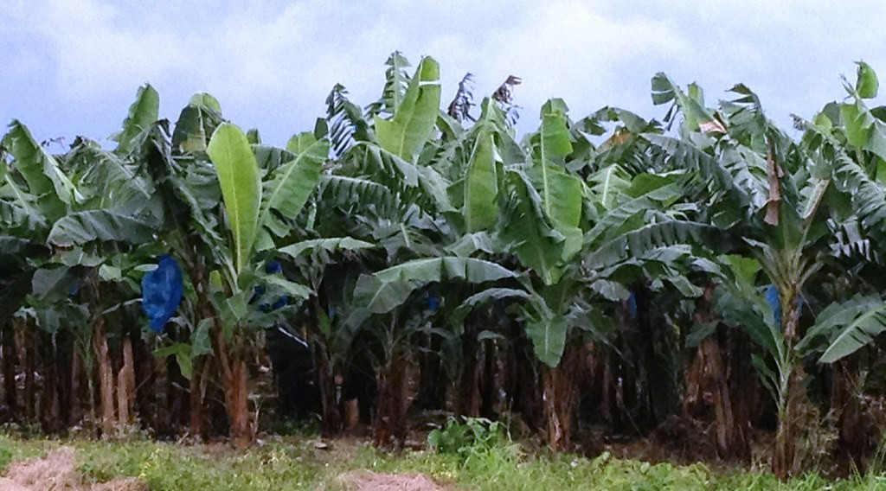
1. RESOURCES
Activity 1
A banana plantation.
Notes:
Activity 1. Look carefully at this picture: a banana plantation. Observe every detail before I ask the question.

Slide 21
1. RESOURCES
Activity 1: Question
Why are volcanic soils so fertile?
Notes:
Here is the question for Activity 1: Why are volcanic soils so fertile? Take one minute to think and write your answer in your rough notebook.

Slide 22
1. RESOURCES
Activity 1: Answer
Ash and lava weather into soils rich in minerals (andosols).
Notes:
Let us check the answer together. Ash and lava weather into soils rich in minerals (andosols).

Slide 23

1. RESOURCES
Activity 2
A geothermal power station.
Notes:
Activity 2. Look carefully at this picture: a geothermal power station. Observe every detail before I ask the question.

Slide 24
1. RESOURCES
Activity 2: Question
How can the heat of magma produce electricity?
Notes:
Here is the question for Activity 2: How can the heat of magma produce electricity? Take one minute to think and write your answer in your rough notebook.

Slide 25
1. RESOURCES
Activity 2: Answer
It heats underground water into steam that turns turbines.
Notes:
Let us check the answer together. It heats underground water into steam that turns turbines.

Slide 26

2. HAZARDS
Activity 3
A house destroyed by lava.
Notes:
Activity 3. Look carefully at this picture: a house destroyed by lava. Observe every detail before I ask the question.

Slide 27
2. HAZARDS
Activity 3: Question
Which volcanic hazard is the most deadly?
Notes:
Here is the question for Activity 3: Which volcanic hazard is the most deadly? Take one minute to think and write your answer in your rough notebook.

Slide 28
2. HAZARDS
Activity 3: Answer
The pyroclastic flow.
Notes:
Let us check the answer together. The pyroclastic flow.

Slide 29

2. HAZARDS
Activity 4
Lake Nyos.
Notes:
Activity 4. Look carefully at this picture: lake Nyos. Observe every detail before I ask the question.

Slide 30
2. HAZARDS
Activity 4: Question
What killed about 1,700 people at Lake Nyos in 1986?
Notes:
Here is the question for Activity 4: What killed about 1,700 people at Lake Nyos in 1986? Take one minute to think and write your answer in your rough notebook.

Slide 31
2. HAZARDS
Activity 4: Answer
A sudden release of carbon dioxide gas from the lake.
Notes:
Let us check the answer together. A sudden release of carbon dioxide gas from the lake.

Slide 32
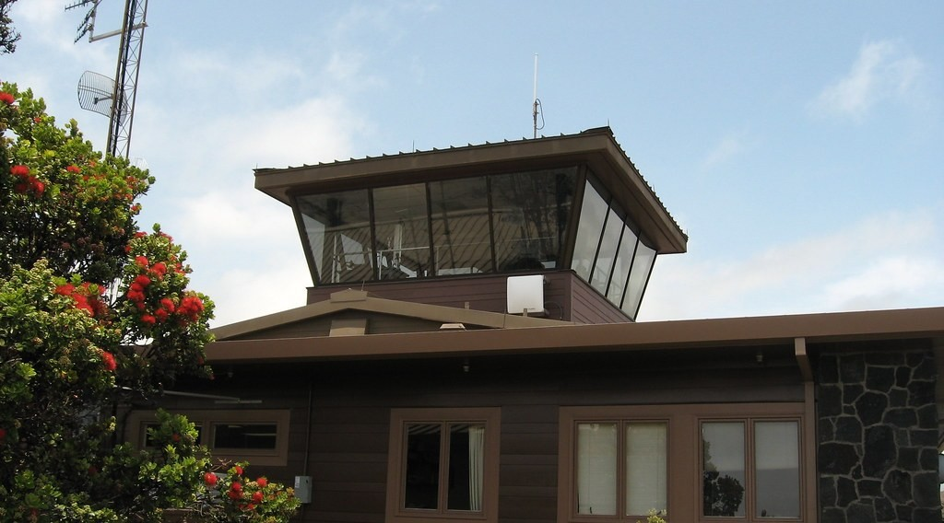
3. MITIGATION
Activity 5
Monitoring a volcano.
Notes:
Activity 5. Look carefully at this picture: monitoring a volcano. Observe every detail before I ask the question.

Slide 33
3. MITIGATION
Activity 5: Question
Name one instrument used to monitor a volcano.
Notes:
Here is the question for Activity 5: Name one instrument used to monitor a volcano. Take one minute to think and write your answer in your rough notebook.

Slide 34
3. MITIGATION
Activity 5: Answer
A seismometer, a gas sensor or GPS.
Notes:
Let us check the answer together. A seismometer, a gas sensor or GPS.

Slide 35
BOARD SUMMARY
Board Summary
Topic: Crustal Processes and their Effect on the Land Surface and Man
Sub-topic: Volcanicity
Lesson 7: Volcanoes and Man
Notes:
Now we are going to copy the board summary. Write the title and the headings neatly in your notebooks. I will give you enough time for each slide, so do not rush.

Slide 36
BOARD SUMMARY
DEFINITIONS
The key terms of this lesson are defined as follows:
Volcanic resource: It is a benefit that people obtain from volcanoes, such as fertile soils or energy.
Volcanic hazard: It is a volcanic event that can harm people and property.
Notes:
Let us copy the definitions. The key terms of this lesson are defined as follows. On this slide we have Volcanic resource and Volcanic hazard. Write each point on a new line, with the key term first, and explain it in your own words when we revise. When you finish, we go to the next slide.

Slide 37
BOARD SUMMARY
DEFINITIONS (continued)
Adaptation: It is the adjustment of people's way of life to live with a hazard.
Mitigation: It is the set of actions that reduce the damage of a hazard.
Notes:
We continue with the definitions. On this slide we have Adaptation and Mitigation. Write each point on a new line, with the key term first, and explain it in your own words when we revise.

Slide 38
BOARD SUMMARY
1. Volcanoes as a Resource
Volcanoes are important to man in the following ways:
Fertile soils: Volcanic ash and lava weather into deep, rich soils called andosols. On the slopes of Mount Cameroon, they support the CDC plantations of bananas, rubber, tea and oil palm, and in the Western Highlands dense farming of coffee and food crops.
Illustration: a banana plantation
Notes:
Let us copy Volcanoes as a Resource. Volcanoes are important to man in the following ways. Copy the point on Fertile soils on the left, then draw the diagram on the right: a banana plantation. Give it a title and label it clearly.

Slide 39
BOARD SUMMARY
1. Volcanoes as a Resource
Tourism: Volcanoes and crater lakes attract visitors, which creates jobs and income. The Mount Cameroon Race of Hope and the crater lakes of the Western Highlands are examples.
Notes:
We continue with Volcanoes as a Resource. Copy the point on Tourism: write the key term first, then its explanation.

Slide 40
BOARD SUMMARY
1. Volcanoes as a Resource
Geothermal energy: Underground heat turns water into steam, which drives turbines to produce electricity and heats houses. Iceland and Kenya produce a large part of their electricity in this way.
Illustration: a geothermal power station
Notes:
Copy the point on Geothermal energy on the left, then draw the diagram on the right: a geothermal power station. Give it a title and label it clearly.

Slide 41
BOARD SUMMARY
1. Volcanoes as a Resource
Building materials and minerals: Basalt and pozzolana are quarried for roads, houses and cement. Volcanic areas also contain valuable minerals such as sulphur, copper and diamonds.
Notes:
We continue with Volcanoes as a Resource. Copy the point on Building materials and minerals: write the key term first, then its explanation.

Slide 42
BOARD SUMMARY
2. Volcanoes as a Hazard
Volcanoes cause the following hazards:
Lava flows: Rivers of molten rock destroy houses, roads and farms in their path, as during the 1999 eruption of Mount Cameroon, which cut the road near Bakingili. They usually move slowly, so people can escape.
Illustration: a house destroyed by lava
Notes:
Let us copy Volcanoes as a Hazard. Volcanoes cause the following hazards. Copy the point on Lava flows on the left, then draw the diagram on the right: a house destroyed by lava. Give it a title and label it clearly.

Slide 43
BOARD SUMMARY
2. Volcanoes as a Hazard
Ash falls and pyroclastic flows: Heavy ash collapses roofs, ruins crops and damages engines and aircraft. Pyroclastic flows, clouds of hot ash, rock and gas moving at over 100 km/h, destroy everything and are the deadliest hazard.
Notes:
We continue with Volcanoes as a Hazard. Copy the point on Ash falls and pyroclastic flows: write the key term first, then its explanation.

Slide 44
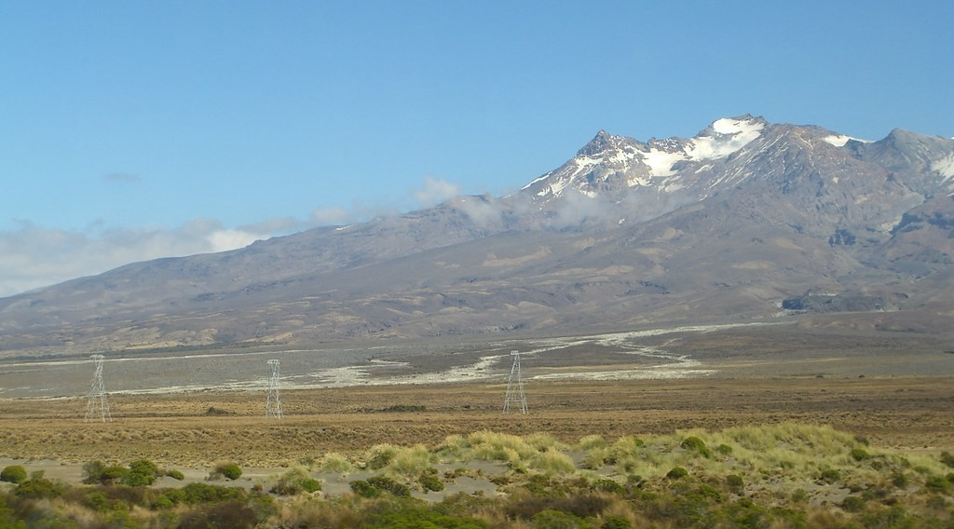
BOARD SUMMARY
2. Volcanoes as a Hazard
Lahars: Ash mixed with heavy rain or melted snow forms fast mudflows that rush down valleys. In 1985, a lahar from Nevado del Ruiz in Colombia buried the town of Armero and killed about 23,000 people.
Illustration: a lahar
Notes:
Copy the point on Lahars on the left, then draw the diagram on the right: a lahar. Give it a title and label it clearly.

Slide 45
BOARD SUMMARY
2. Volcanoes as a Hazard
Poisonous gases: Volcanic gases can suffocate people and animals. In 1986, Lake Nyos suddenly released a cloud of carbon dioxide that killed about 1,700 people and thousands of cattle.
Illustration: Lake Nyos
Notes:
Copy the point on Poisonous gases on the left, then draw the diagram on the right: lake Nyos. Give it a title and label it clearly.

Slide 46
BOARD SUMMARY
3. Adaptation and Mitigation Strategies
People reduce volcanic risks with the following strategies:
Monitoring and warning: Seismometers detect the small earthquakes caused by rising magma, sensors measure gases and satellites detect the swelling of the volcano. When an eruption is likely, warnings allow people to leave in time.
Illustration: monitoring a volcano
Notes:
Let us copy Adaptation and Mitigation Strategies. People reduce volcanic risks with the following strategies. Copy the point on Monitoring and warning on the left, then draw the diagram on the right: monitoring a volcano. Give it a title and label it clearly.

Slide 47
BOARD SUMMARY
3. Adaptation and Mitigation Strategies
Hazard mapping and land-use planning: Maps show the zones threatened by lava, ash, lahars and gases. Houses, schools and hospitals are then built outside the most dangerous zones.
Notes:
We continue with Adaptation and Mitigation Strategies. Copy the point on Hazard mapping and land-use planning: write the key term first, then its explanation.

Slide 48
BOARD SUMMARY
3. Adaptation and Mitigation Strategies
Education and evacuation plans: People learn the warning signs and what to do during an eruption. Evacuation routes and shelters are prepared in advance.
Notes:
We continue with Adaptation and Mitigation Strategies. Copy the point on Education and evacuation plans: write the key term first, then its explanation.

Slide 49
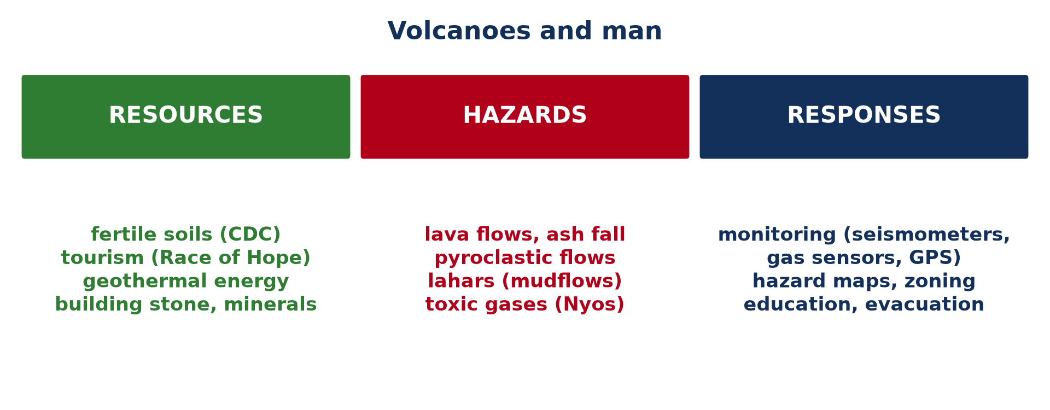
BOARD SUMMARY
3. Adaptation and Mitigation Strategies
Engineering measures: Strong, steep roofs resist the weight of ash, and barriers or channels divert lava and lahars. At Lake Nyos, pipes have been installed since 2001 to release the gas slowly and prevent another disaster.
Illustration: volcanoes and man
Notes:
Copy the point on Engineering measures on the left, then draw the diagram on the right: volcanoes and man. Give it a title and label it clearly.

Slide 50
FORMATIVE EVALUATION
Evaluation 1
Explain why a volcano is both a resource and a hazard.
Notes:
Now let us check what you have understood. Question 1: Explain why a volcano is both a resource and a hazard. Answer in your exercise book.

Slide 51
FORMATIVE EVALUATION
Expected Answer
It gives fertile soils, energy and tourism, but its eruptions and gases destroy property and kill people.
Notes:
The expected answer is: it gives fertile soils, energy and tourism, but its eruptions and gases destroy property and kill people. If you got it right, well done.

Slide 52
FORMATIVE EVALUATION
Evaluation 2
Give two measures to reduce volcanic risks.
Notes:
Now let us check what you have understood. Question 2: Give two measures to reduce volcanic risks. Answer in your exercise book.

Slide 53
FORMATIVE EVALUATION
Expected Answer
Monitoring, hazard maps and zoning, education and evacuation plans, engineering works (any two).
Notes:
The expected answer is: monitoring, hazard maps and zoning, education and evacuation plans, engineering works (any two). If you got it right, well done.

Slide 54
REMEDIATION
Remediation
Fill in the blanks:
Volcanic soils are called ______.
The deadliest volcanic hazard is the ______ flow.
Lake Nyos released ______ in 1986.
Notes:
For those who need more practice, fill in the blanks in your exercise book. The answers are: number 1, andosols; number 2, pyroclastic; number 3, carbon dioxide.

Slide 55
HOMEWORK
Homework
Define the epicentre of an earthquake.
Notes:
For your homework: Define the epicentre of an earthquake. We shall correct it at the beginning of our next lesson.

Slide 56
NEXT LESSON
Next Lesson
Our next lesson will be on:
Lesson 8: Earthquakes and Man
Notes:
Our next lesson will be on Lesson 8: Earthquakes and Man. Thank you for your attention, and see you next time.

Slide 57
BILINGUAL GAME
Bilingual Game (Jeu Bilingue)
English | Français
Hazard | Le risque / l'aléa
Resource | La ressource
Fertile soil | Le sol fertile
Mitigation | L'atténuation
Evacuation | L'évacuation
Geothermal energy | L'énergie géothermique
Notes:
Let us play the bilingual game. I say a word in English, and you give me the French word. Then we do the reverse.

Slide 58
LOGBOOK
Official Logbook (1/2)
Module / Topic | Crustal Processes and their Effect on the Land Surface and Man
Lesson Title | Lesson 7: Volcanoes and Man
Expected Learning Outcomes | Explain the resources provided by volcanoes. Explain the hazards of volcanoes. Describe the Lake Nyos disaster. Describe adaptation and mitigation strategies.
Competence | Learners are able to explain why people live near volcanoes and propose measures to reduce volcanic risks in Cameroon.
Notes:
I record this information in the official logbook of the class after the lesson.

Slide 59
LOGBOOK
Official Logbook (2/2)
Matter Taught | DEFINITIONS; Volcanoes as a Resource; Volcanoes as a Hazard; Adaptation and Mitigation Strategies.
Evaluation | Formative evaluation and remediation exercise.
Homework | Define the epicentre of an earthquake.
Enrolment / Present / Absent | ____ / ____ / ____
Achievement | To be completed after the lesson.
Notes:
I complete the second page of the logbook: the matter taught, the evaluation, the homework and the attendance.

Slide 60
TEACHER'S NOTE
Teacher's Note
Timing: Homework correction, plan, objectives 8 min | Recall, situation, action 10 min | 5 activities 30 min | Board summary (copying) 30 min | Evaluation, remediation 10 min | Homework, next lesson 5 min | Logbook 7 min
Without the projector (Activity 1): name crops of the South-West.
Without the projector (Activity 2): describe a kettle producing steam.
Without the projector (Activity 3): list volcanic hazards.
Without the projector (Activity 4): locate Nyos in the North-West.
Without the projector (Activity 5): describe an evacuation plan.
Notes:
This slide is for me, the teacher: it gives the timing of the lesson and what to do if the projector is not available.

Slide 61
REFERENCES
References
Geography Syllabus for Sixth Forms (Lower and Upper Sixth), MINESEC, 2019 — Module 2 (Geomorphology).
Teacher's course notes: Mr KAMDEM E., Geomorphology (LSA), GBHS Garoua, 2026.
Photo, Activity 1: “Banana Plantation” by AfricaTravelAssociation, CC BY 2.0, via Flickr (https://www.flickr.com/photos/65134942@N06/8164706151)
Photo, Activity 2: “Global Geothermal Alliance Stakeholder Meeting and Site Tour, 15-16 Ju” by International Renewable Energy Agency (IRENA), CC BY-NC-SA 2.0, via Flickr (https://www.flickr.com/photos/127932406@N06/18856399410)
Photo, Activity 3: “Lava flow over road” by J. N. Stuart, CC BY-NC-ND 2.0, via Flickr (https://www.flickr.com/photos/21786539@N03/3387263273)
Photo, Activity 4: “Lake Nyos, Cameroon” by jbdodane, CC BY-NC 2.0, via Flickr (https://www.flickr.com/photos/27998473@N02/11584073056)
Photo, Activity 5: “Hawaiian Volcano Observatory, Hawaiʻi Volcanoes National Park, Hawaii” by Ken Lund, CC BY-SA 2.0, via Flickr (https://www.flickr.com/photos/75683070@N00/4528702285)
Notes:
Take your time to copy this part; we will continue together.

Slide 62
REFERENCES
References (continued)
Photo, board summary (Lahars): “Lahar (mudflow) remnants from Mount Ruapehu” by Wade Tregaskis, CC BY-NC 2.0, via Flickr (https://www.flickr.com/photos/7725552@N06/502073245)
Diagrams and animations: drawn for this lesson (Geography Department).
Notes:
These are the references and picture credits used to prepare this lesson.

