Slide 1
LOWER SIXTH ARTS
GEOGRAPHY
Lesson 9
Denudation and Weathering
Notes:
Good morning, class, and welcome to our geography lesson. I am your geography teacher, Mr Kamdem. Today we are starting Lesson 9: Denudation and Weathering.

Slide 2
CLASS INFO
Class, Chapter and Duration
Class | Lower Sixth Arts
Chapter | Module 2: Understanding and managing physical landscapes, geomorphological processes and hazards across the world in general and Cameroon in particular
Duration | 2 periods (2 × 50 minutes)
Notes:
This lesson is for Lower Sixth Arts. It belongs to Module 2: Understanding and managing physical landscapes, geomorphological processes and hazards across the world in general and Cameroon in particular. We shall need 2 periods to cover it.

Slide 3
IDENTIFICATION
Lesson Identification
Topic | Denudational Processes on Slopes
Sub-topic | Weathering
Lesson | Lesson 9: Denudation and Weathering
Notions / Concepts | Denudation, weathering, erosion, mass movement, slope, convex, concave, rectilinear, slope system, mechanical, chemical and biological weathering.
Syllabus focus | Meaning of denudation; slopes (types and the slope system); weathering and its types (mechanical, chemical, biological).
Competence | Learners are able to explain how rocks are broken down and how slopes work as systems, using examples from Garoua.
Notes:
Our topic is Denudational Processes on Slopes, and the sub-topic is Weathering. The key notions we shall use today are: denudation, weathering, erosion, mass movement, slope, convex, concave, rectilinear, slope system, mechanical, chemical and biological weathering. At the end, you should be able to do this: learners are able to explain how rocks are broken down and how slopes work as systems, using examples from Garoua.

Slide 4

HOMEWORK CORRECTION
Correction of the Homework
Question (Lesson 8: Earthquakes and Man):
Define weathering.
Notes:
Before we start the new lesson, let us correct the homework I gave you at the end of Lesson 8: Earthquakes and Man. The question was: Define weathering. Take out your exercise books.

Slide 5
HOMEWORK CORRECTION
Correction: Possible Answer
Weathering is the breakdown of rocks in place, at or near the surface of the Earth.
Notes:
Here is a good answer. Weathering is the breakdown of rocks in place, at or near the surface of the Earth. Compare it with your own answer and correct your work in red.

Slide 6
LESSON PLAN
Lesson Plan
Correction of the homework
Objectives and recall
Real-life situation and action to take
Learning activities
Board summary
Evaluation, remediation and homework
Notes:
Here is the plan of our lesson today. First, we shall correct the homework. Then we shall look at the objectives and recall what you already know. After that, we shall study a situation from real life and the action to take, and do the learning activities. Finally, we shall copy the board summary, do the evaluation and the remediation, and I will give you the homework.

Slide 7
OBJECTIVES
Objectives
By the end of this lesson, you should be able to:
Define denudation, weathering and slope.
Describe the types of slopes.
Explain the slope as an open system.
Notes:
Take your time to copy this part; we will continue together.

Slide 8
OBJECTIVES
Objectives (continued)
Explain mechanical, chemical and biological weathering.
Notes:
By the end of this lesson, you should be able to do four things. Number 1: define denudation, weathering and slope. Number 2: describe the types of slopes. Number 3: explain the slope as an open system. Number 4: explain mechanical, chemical and biological weathering.

Slide 9
PREVIOUS KNOWLEDGE
Previous Knowledge
External forces wear down the land.
Igneous rocks form from cooled magma.
Garoua is very hot in the dry season.
Notes:
Let us first remember what you already know. External forces wear down the land. Igneous rocks form from cooled magma. Garoua is very hot in the dry season. Keep this in mind, because we shall build on it today.

Slide 10
REAL-LIFE SITUATION
Situation in Real Life
In the dry season, you notice that the surface of a large rock in your quarter of Garoua is peeling off in thin layers, like an onion.
After the first heavy rains, you see small gullies cut into the slopes of nearby hills, with piles of sand at the bottom.
Notes:
Take your time to copy this part; we will continue together.

Slide 11
REAL-LIFE SITUATION
Situation in Real Life (continued)
You ask: "What makes hard rock crumble, and where does all the soil that moves down the hills come from?"
Notes:
Listen carefully to this situation from real life. In the dry season, you notice that the surface of a large rock in your quarter of Garoua is peeling off in thin layers, like an onion. After the first heavy rains, you see small gullies cut into the slopes of nearby hills, with piles of sand at the bottom. You ask: "What makes hard rock crumble, and where does all the soil that moves down the hills come from?" Think about it, because I am going to ask you some questions.

Slide 12
REAL-LIFE SITUATION
Situation: Question 1
What is the problem in the situation?
Notes:
Question 1: What is the problem in the situation? Think for a moment, then raise your hand to answer.

Slide 13
REAL-LIFE SITUATION
Answer
The learner does not know how rocks break down and how material moves down slopes.
Notes:
Good. The learner does not know how rocks break down and how material moves down slopes.

Slide 14
REAL-LIFE SITUATION
Situation: Question 2
What is the general name for the wearing down of the land?
Notes:
Question 2: What is the general name for the wearing down of the land? Think for a moment, then raise your hand to answer.

Slide 15
REAL-LIFE SITUATION
Answer
Denudation.
Notes:
Good. Denudation.

Slide 16
REAL-LIFE SITUATION
Situation: Question 3
What breaks the rock before it is moved?
Notes:
Question 3: What breaks the rock before it is moved? Think for a moment, then raise your hand to answer.

Slide 17
REAL-LIFE SITUATION
Possible Answer
Weathering.
Notes:
Good. Weathering.

Slide 18
ACTION TO TAKE
Action to Take
Protect slopes with vegetation to limit the removal of weathered material.
Notes:
From this situation, the action we are working towards in this lesson is the following: protect slopes with vegetation to limit the removal of weathered material.

Slide 19
JUSTIFICATION
Justification of the Lesson
This lesson explains how landscapes are worn down and how soils form, which matters for farming and building.
Notes:
Why is this lesson important for you? This lesson explains how landscapes are worn down and how soils form, which matters for farming and building.

Slide 20
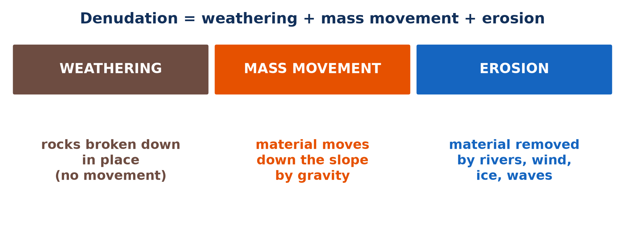
1. DENUDATION
Activity 1
The three parts of denudation.
Notes:
Activity 1. Look carefully at this picture: the three parts of denudation. Observe every detail before I ask the question.

Slide 21
1. DENUDATION
Activity 1: Question
Which part of denudation happens without any movement?
Notes:
Here is the question for Activity 1: Which part of denudation happens without any movement? Take one minute to think and write your answer in your rough notebook.

Slide 22
1. DENUDATION
Activity 1: Answer
Weathering.
Notes:
Let us check the answer together. Weathering.

Slide 23
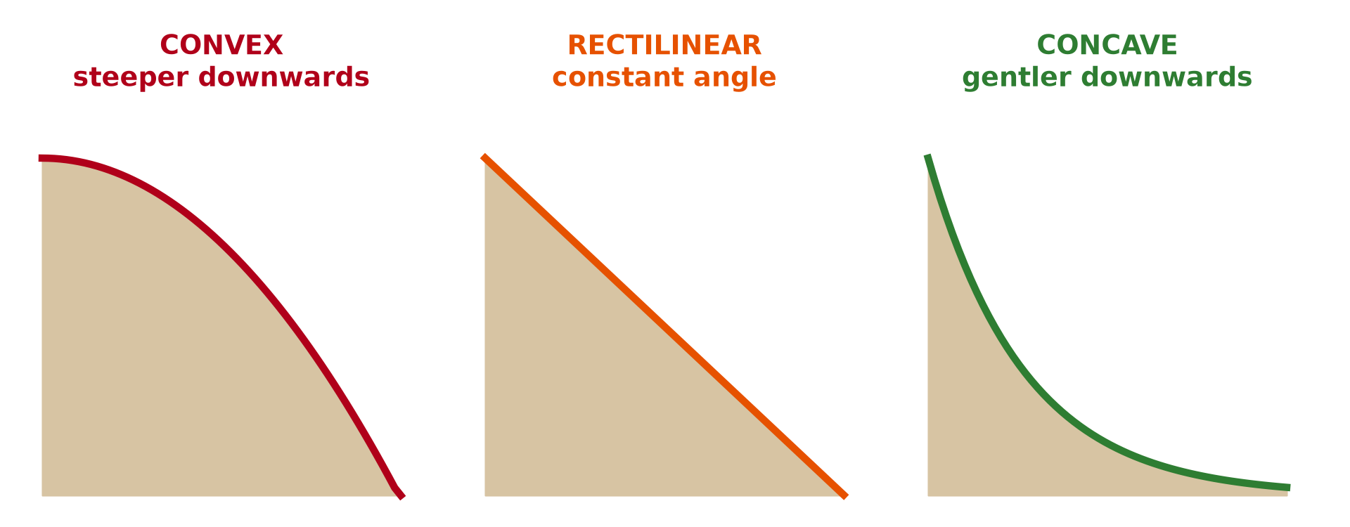
2. SLOPES
Activity 2
Three types of slopes.
Notes:
Activity 2. Look carefully at this picture: three types of slopes. Observe every detail before I ask the question.

Slide 24
2. SLOPES
Activity 2: Question
Which slope becomes steeper as you go down?
Notes:
Here is the question for Activity 2: Which slope becomes steeper as you go down? Take one minute to think and write your answer in your rough notebook.

Slide 25
2. SLOPES
Activity 2: Answer
The convex slope.
Notes:
Let us check the answer together. The convex slope.

Slide 26
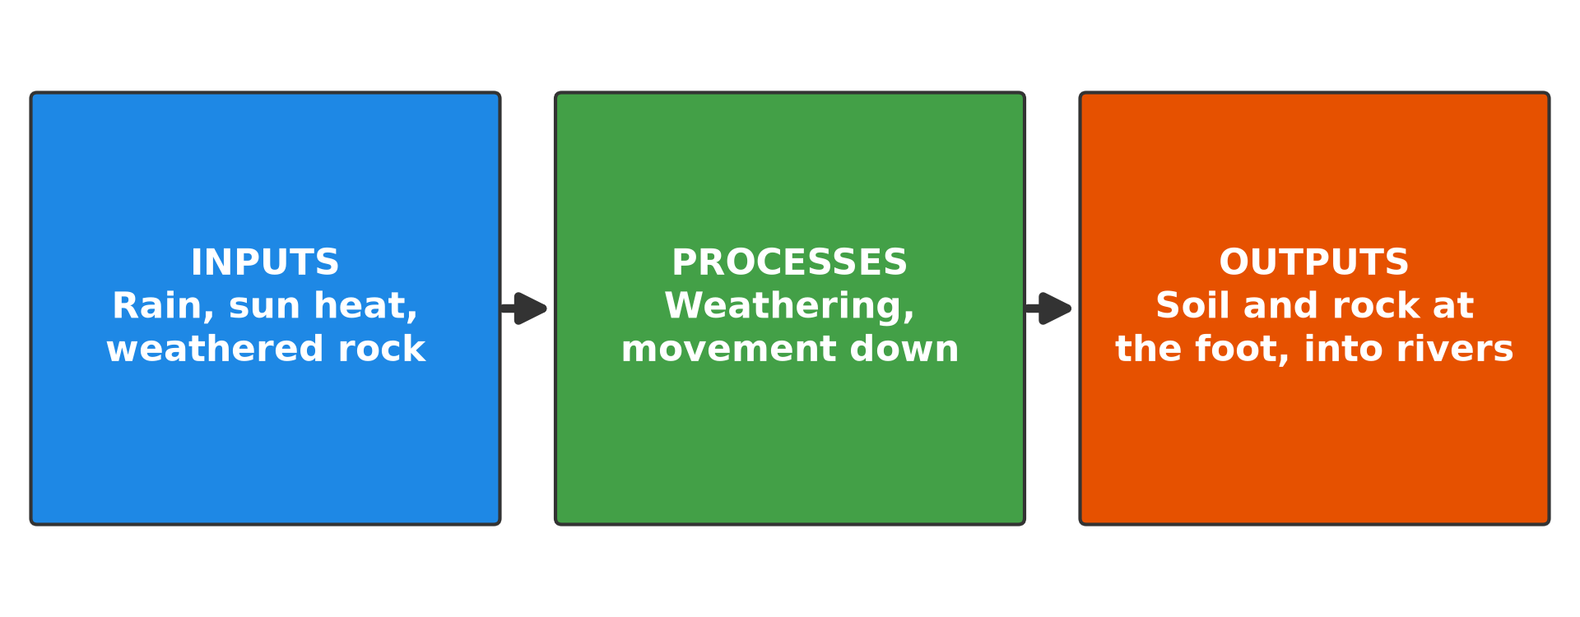
2. SLOPES
Activity 3
The slope system.
Notes:
Activity 3. Look carefully at this diagram: the slope system. Observe every detail before I ask the question.

Slide 27
2. SLOPES
Activity 3: Question
Give one input of the slope system.
Notes:
Here is the question for Activity 3: Give one input of the slope system. Take one minute to think and write your answer in your rough notebook.

Slide 28
2. SLOPES
Activity 3: Answer
Rainwater or heat from the Sun.
Notes:
Let us check the answer together. Rainwater or heat from the Sun.

Slide 29
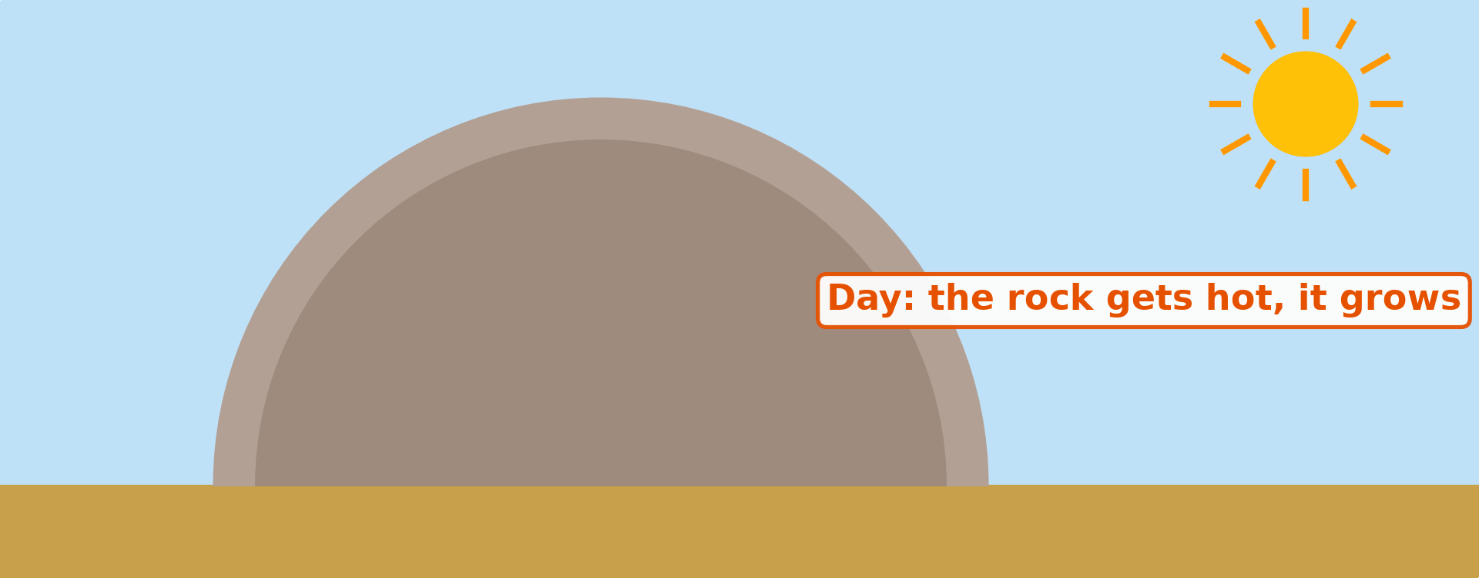
3. WEATHERING
Activity 4
Animation: exfoliation.
Notes:
Activity 4. Look carefully at this animation: animation: exfoliation. Watch the animation to the end; it will play again.

Slide 30
3. WEATHERING
Activity 4: Question
Why does a rock peel like an onion in Garoua?
Notes:
Here is the question for Activity 4: Why does a rock peel like an onion in Garoua? Take one minute to think and write your answer in your rough notebook.

Slide 31
3. WEATHERING
Activity 4: Answer
It expands in the heat of the day and contracts at night, so the outer layers crack.
Notes:
Let us check the answer together. It expands in the heat of the day and contracts at night, so the outer layers crack.

Slide 32

3. WEATHERING
Activity 5
Roots in a rock.
Notes:
Activity 5. Look carefully at this picture: roots in a rock. Observe every detail before I ask the question.

Slide 33
3. WEATHERING
Activity 5: Question
What type of weathering do these roots cause?
Notes:
Here is the question for Activity 5: What type of weathering do these roots cause? Take one minute to think and write your answer in your rough notebook.

Slide 34
3. WEATHERING
Activity 5: Answer
Biological weathering.
Notes:
Let us check the answer together. Biological weathering.

Slide 35
BOARD SUMMARY
Board Summary
Topic: Denudational Processes on Slopes
Sub-topic: Weathering
Lesson 9: Denudation and Weathering
Notes:
Now we are going to copy the board summary. Write the title and the headings neatly in your notebooks. I will give you enough time for each slide, so do not rush.

Slide 36
BOARD SUMMARY
DEFINITIONS
The key terms of this lesson are defined as follows:
Denudation: It is the general wearing down and lowering of the land surface by weathering, mass movement and erosion.
Degradation: It is the lowering of the land surface by the removal of material.
Notes:
Let us copy the definitions. The key terms of this lesson are defined as follows. On this slide we have Denudation and Degradation. Write each point on a new line, with the key term first, and explain it in your own words when we revise. When you finish, we go to the next slide.

Slide 37
BOARD SUMMARY
DEFINITIONS (continued)
Aggradation: It is the building up of the land surface by the deposition of material.
Weathering: It is the breakdown of rocks in place, at or near the surface, without movement.
Slope: It is any inclined surface of the land.
Notes:
We continue with the definitions. On this slide we have Aggradation, Weathering and Slope. Write each point on a new line, with the key term first, and explain it in your own words when we revise.

Slide 38
BOARD SUMMARY
1. Denudation
Denudation is explained and classified as follows:
Meaning: Denudation is the sum of all the processes that wear down the relief, lowering high land (degradation) and filling low land with deposits (aggradation). It is driven by the energy of the Sun and by gravity.
Illustration: the processes of denudation
Notes:
Let us copy Denudation. Denudation is explained and classified as follows. Copy the point on Meaning on the left, then draw the diagram on the right: the processes of denudation. Give it a title and label it clearly.

Slide 39
BOARD SUMMARY
1. Denudation
Weathering: Weathering is the first stage of denudation: rocks are broken down in place by heat, water, chemicals and living things. It prepares loose material that can be moved.
Notes:
We continue with Denudation. Copy the point on Weathering: write the key term first, then its explanation.

Slide 40
BOARD SUMMARY
1. Denudation
Mass movement: Mass movement is the second stage: the weathered material moves down the slopes under the pull of gravity. It feeds material to the valleys.
Notes:
We continue with Denudation. Copy the point on Mass movement: write the key term first, then its explanation.

Slide 41

BOARD SUMMARY
1. Denudation
Erosion, transport and deposition: Rivers, wind, ice and waves then remove the material, carry it away and deposit it in lowlands, lakes and seas. For example, the Benue carries the sand of the North towards the Niger.
Illustration: gully erosion
Notes:
Copy the point on Erosion, transport and deposition on the left, then draw the diagram on the right: gully erosion. Give it a title and label it clearly.

Slide 42
BOARD SUMMARY
2. Slopes
Slopes are explained as follows:
Meaning: A slope is any inclined surface of the land, from a gentle river bank to a steep mountain side. Slopes cover most of the land surface and are the place where weathering and mass movement act.
Notes:
Let us copy Slopes. Slopes are explained as follows. Copy the point on Meaning: write the key term first, then its explanation.

Slide 43
BOARD SUMMARY
2. Slopes
Convex and concave slopes: A convex slope becomes steeper downwards, while a concave slope becomes gentler downwards. Most hills have a convex top and a concave foot.
Illustration: types of slopes
Notes:
Copy the point on Convex and concave slopes on the left, then draw the diagram on the right: types of slopes. Give it a title and label it clearly.

Slide 44
BOARD SUMMARY
2. Slopes
Rectilinear slopes and free faces: A rectilinear slope keeps the same angle from top to bottom. A free face is a vertical rock wall, often found in the middle of a hillside.
Notes:
We continue with Slopes. Copy the point on Rectilinear slopes and free faces: write the key term first, then its explanation.

Slide 45
BOARD SUMMARY
2. Slopes
The slope system: Inputs such as solar energy, rainwater and weathered rock enter the slope, and processes such as weathering, soil creep and runoff act on it. Outputs of soil, rock fragments and water leave it at the foot, usually into a river.
Illustration: the slope system
Notes:
Copy the point on The slope system on the left, then draw the diagram on the right: the slope system. Give it a title and label it clearly.

Slide 46
BOARD SUMMARY
3. Weathering and its Products
A) Mechanical (Physical) Weathering
Mechanical weathering breaks rocks without changing their minerals, by the following processes:
Exfoliation (thermal expansion): The sun heats the outer layer of the rock by day, and it cools quickly at night, so it expands and contracts more than the inside. The outer layers crack and peel off like an onion skin, as is common around Garoua.
Notes:
Let us copy Mechanical (Physical) Weathering. Mechanical weathering breaks rocks without changing their minerals, by the following processes. Copy the point on Exfoliation (thermal expansion): write the key term first, then its explanation.

Slide 47
BOARD SUMMARY
3. Weathering and its Products
A) Mechanical (Physical) Weathering
Frost action: Water in cracks freezes at night, expands by about 9 % and forces the cracks open. When repeated, it splits the rock into sharp fragments that form scree on cold mountains.
Notes:
We continue with Mechanical (Physical) Weathering. Copy the point on Frost action: write the key term first, then its explanation.

Slide 48
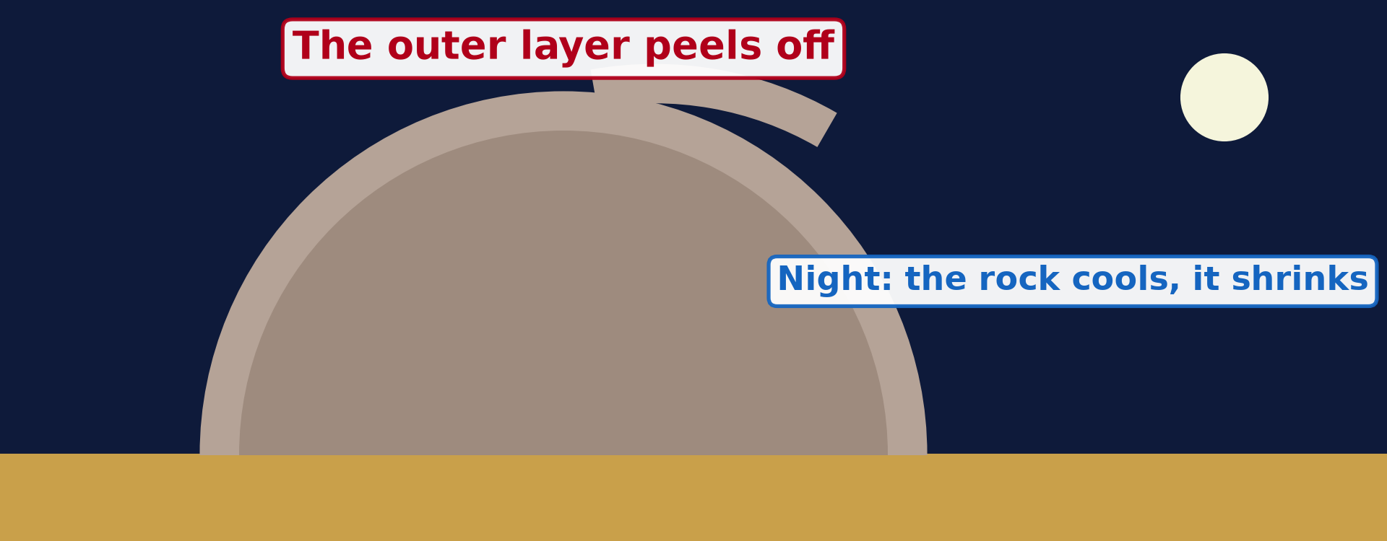
BOARD SUMMARY
3. Weathering and its Products
A) Mechanical (Physical) Weathering
Pressure release: When the rocks above a buried granite are removed by erosion, the pressure on it is reduced and it expands. Cracks parallel to the surface form, and sheets of rock break off, giving rounded domes.
Illustration: exfoliation and sheeting
Notes:
Copy the point on Pressure release on the left, then draw the diagram on the right: exfoliation and sheeting. Give it a title and label it clearly.

Slide 49
BOARD SUMMARY
3. Weathering and its Products
B) Chemical Weathering
Chemical weathering changes the minerals of rocks by the following processes:
Oxidation: Oxygen dissolved in water reacts with iron minerals in the rock and turns them into rust. This weakens the rock and gives the red colour of soils and laterite in the tropics.
Notes:
Let us copy Chemical Weathering. Chemical weathering changes the minerals of rocks by the following processes. Copy the point on Oxidation: write the key term first, then its explanation.

Slide 50
BOARD SUMMARY
3. Weathering and its Products
B) Chemical Weathering
Solution and carbonation: Some minerals, such as rock salt, dissolve directly in water. Rainwater that contains carbon dioxide forms a weak acid, which slowly dissolves limestone and forms caves and karst.
Notes:
We continue with Chemical Weathering. Copy the point on Solution and carbonation: write the key term first, then its explanation.

Slide 51
BOARD SUMMARY
3. Weathering and its Products
B) Chemical Weathering
Hydrolysis and hydration: In hydrolysis, water reacts with minerals such as feldspar in granite and turns them into clay. In hydration, minerals absorb water, swell and crumble; both are fastest in hot, wet climates.
Notes:
We continue with Chemical Weathering. Copy the point on Hydrolysis and hydration: write the key term first, then its explanation.

Slide 52
BOARD SUMMARY
3. Weathering and its Products
C) Biological Weathering
Biological weathering is caused by the following agents:
Plants: Roots grow into cracks and force them apart as they thicken, and decaying plants release acids that attack the rock. Lichens and mosses also slowly eat into bare rock surfaces.
Illustration: roots splitting a rock
Notes:
Let us copy Biological Weathering. Biological weathering is caused by the following agents. Copy the point on Plants on the left, then draw the diagram on the right: roots splitting a rock. Give it a title and label it clearly.

Slide 53
BOARD SUMMARY
3. Weathering and its Products
C) Biological Weathering
Animals: Termites, rodents and earthworms dig in the soil and bring rock fragments to the surface, where they are exposed to weathering. Their burrows also let water and air enter deeper.
Notes:
We continue with Biological Weathering. Copy the point on Animals: write the key term first, then its explanation.

Slide 54
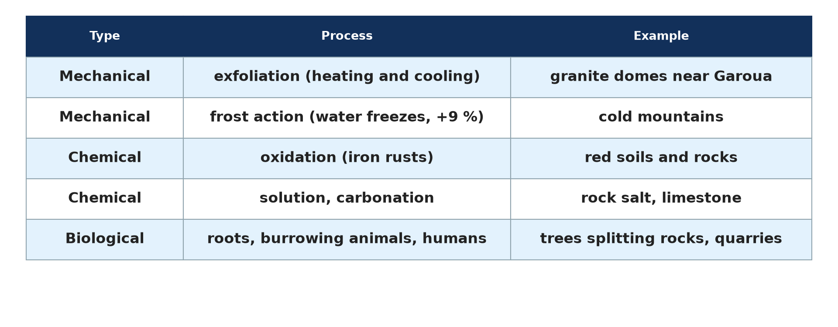
BOARD SUMMARY
3. Weathering and its Products
C) Biological Weathering
Man: Quarrying, building, mining and ploughing break up rocks and expose fresh surfaces. Pollution also produces acid rain, which speeds up chemical weathering.
Illustration: the types of weathering
Notes:
Copy the point on Man on the left, then draw the diagram on the right: the types of weathering. Give it a title and label it clearly.

Slide 55
FORMATIVE EVALUATION
Evaluation 1
Distinguish weathering from erosion.
Notes:
Now let us check what you have understood. Question 1: Distinguish weathering from erosion. Answer in your exercise book.

Slide 56
FORMATIVE EVALUATION
Expected Answer
Weathering breaks rocks in place; erosion removes and carries the material away.
Notes:
The expected answer is: weathering breaks rocks in place; erosion removes and carries the material away. If you got it right, well done.

Slide 57
FORMATIVE EVALUATION
Evaluation 2
Explain exfoliation in Garoua.
Notes:
Now let us check what you have understood. Question 2: Explain exfoliation in Garoua. Answer in your exercise book.

Slide 58
FORMATIVE EVALUATION
Expected Answer
Strong heating by day and cooling at night make the outer layers of rocks expand and contract until they crack and peel off.
Notes:
The expected answer is: strong heating by day and cooling at night make the outer layers of rocks expand and contract until they crack and peel off. If you got it right, well done.

Slide 59
REMEDIATION
Remediation
Fill in the blanks:
Denudation means "to make ______".
A slope that becomes gentler downwards is ______.
Rusting of iron in rocks is ______.
Notes:
For those who need more practice, fill in the blanks in your exercise book. The answers are: number 1, bare; number 2, concave; number 3, oxidation.

Slide 60
HOMEWORK
Homework
Name the most important factor of weathering.
Notes:
For your homework: Name the most important factor of weathering. We shall correct it at the beginning of our next lesson.

Slide 61
NEXT LESSON
Next Lesson
Our next lesson will be on:
Lesson 10: Intensity and Factors of Weathering
Notes:
Our next lesson will be on Lesson 10: Intensity and Factors of Weathering. Thank you for your attention, and see you next time.

Slide 62
BILINGUAL GAME
Bilingual Game (Jeu Bilingue)
English | Français
Denudation | La dénudation
Weathering | L'altération
Slope | La pente
Erosion | L'érosion
Rock | La roche
Exfoliation | La desquamation
Notes:
Let us play the bilingual game. I say a word in English, and you give me the French word. Then we do the reverse.

Slide 63
LOGBOOK
Official Logbook (1/2)
Module / Topic | Denudational Processes on Slopes
Lesson Title | Lesson 9: Denudation and Weathering
Expected Learning Outcomes | Define denudation, weathering and slope. Describe the types of slopes. Explain the slope as an open system. Explain mechanical, chemical and biological weathering.
Competence | Learners are able to explain how rocks are broken down and how slopes work as systems, using examples from Garoua.
Notes:
I record this information in the official logbook of the class after the lesson.

Slide 64
LOGBOOK
Official Logbook (2/2)
Matter Taught | DEFINITIONS; Denudation; Slopes; Mechanical (Physical) Weathering; Chemical Weathering; Biological Weathering.
Evaluation | Formative evaluation and remediation exercise.
Homework | Name the most important factor of weathering.
Enrolment / Present / Absent | ____ / ____ / ____
Achievement | To be completed after the lesson.
Notes:
I complete the second page of the logbook: the matter taught, the evaluation, the homework and the attendance.

Slide 65
TEACHER'S NOTE
Teacher's Note
Timing: Homework correction, plan, objectives 8 min | Recall, situation, action 10 min | 5 activities 30 min | Board summary (copying) 30 min | Evaluation, remediation 10 min | Homework, next lesson 5 min | Logbook 7 min
Activity 4 is an animation (GIF): it plays automatically in slide-show mode.
Without the projector (Activity 1): write the three processes on the board.
Without the projector (Activity 2): draw the three slopes.
Without the projector (Activity 3): draw inputs, processes and outputs.
Without the projector (Activity 4): describe a peeling rock.
Without the projector (Activity 5): find a tree growing in a crack.
Notes:
This slide is for me, the teacher: it gives the timing of the lesson and what to do if the projector is not available.

Slide 66
REFERENCES
References
Geography Syllabus for Sixth Forms (Lower and Upper Sixth), MINESEC, 2019 — Module 2 (Geomorphology).
Teacher's course notes: Mr KAMDEM E., Geomorphology (LSA), GBHS Garoua, 2026.
Photo, Activity 5: “Stones 'n' Roots” by erix!, CC BY 2.0, via Flickr (https://www.flickr.com/photos/68387408@N00/55692423)
Photo, board summary (Erosion, transport and deposition): “Soil erosion in the central Mexican Highlands” by CIMMYT, CC BY-NC-SA 2.0, via Flickr (https://www.flickr.com/photos/44760652@N05/6244930288)
Diagrams and animations: drawn for this lesson (Geography Department).
Notes:
These are the references and picture credits used to prepare this lesson.

