Slide 1
LOWER SIXTH ARTS
GEOGRAPHY
Lesson 7
Geographical Factors Affecting Temperature
Notes:
Good morning, class, and welcome to our geography lesson. I am your geography teacher, Mr Kamdem. Today we are starting Lesson 7: Geographical Factors Affecting Temperature.

Slide 2
CLASS INFO
Class, Chapter and Duration
Class | Lower Sixth Arts
Chapter | Module 1: Understanding and managing atmospheric and hydrological phenomena and hazards across the world in general and Cameroon in particular
Duration | 2 periods (2 × 50 minutes)
Notes:
This lesson is for Lower Sixth Arts. It belongs to Module 1: Understanding and managing atmospheric and hydrological phenomena and hazards across the world in general and Cameroon in particular. We shall need 2 periods to cover it.

Slide 3
IDENTIFICATION
Lesson Identification
Topic | Energy in the Atmosphere
Sub-topic | Global Distribution of Heat (Temperature)
Lesson | Lesson 7: Geographical Factors Affecting Temperature
Notions / Concepts | Continentality, maritime influence, specific heat, relief, altitude, aspect, ocean currents, prevailing winds, cloud cover, urban heat island.
Syllabus focus | Geographical factors that modify temperatures at the same latitude: land and sea, relief (altitude, aspect), ocean currents, winds, cloud cover, urbanisation.
Competence | Learners are able to explain why places at the same latitude have different temperatures, with examples around Garoua.
Notes:
Our topic is Energy in the Atmosphere, and the sub-topic is Global Distribution of Heat (Temperature). The key notions we shall use today are: continentality, maritime influence, specific heat, relief, altitude, aspect, ocean currents, prevailing winds, cloud cover, urban heat island. At the end, you should be able to do this: learners are able to explain why places at the same latitude have different temperatures, with examples around Garoua.

Slide 4

HOMEWORK CORRECTION
Correction of the Homework
Question (Lesson 6: Latitudinal Distribution of Temperature):
Define continentality.
Notes:
Before we start the new lesson, let us correct the homework I gave you at the end of Lesson 6: Latitudinal Distribution of Temperature. The question was: Define continentality. Take out your exercise books.

Slide 5
HOMEWORK CORRECTION
Correction: Possible Answer
Continentality is the effect of distance from the sea: inland areas have hotter summers, cooler winters and less rain.
Notes:
Here is a good answer. Continentality is the effect of distance from the sea: inland areas have hotter summers, cooler winters and less rain. Compare it with your own answer and correct your work in red.

Slide 6
LESSON PLAN
Lesson Plan
Correction of the homework
Objectives and recall
Real-life situation and action to take
Learning activities
Board summary
Evaluation, remediation and homework
Notes:
Here is the plan of our lesson today. First, we shall correct the homework. Then we shall look at the objectives and recall what you already know. After that, we shall study a situation from real life and the action to take, and do the learning activities. Finally, we shall copy the board summary, do the evaluation and the remediation, and I will give you the homework.

Slide 7
OBJECTIVES
Objectives
By the end of this lesson, you should be able to:
Explain the different heating of land and water (continentality).
Explain the effects of altitude and aspect.
Notes:
Take your time to copy this part; we will continue together.

Slide 8
OBJECTIVES
Objectives (continued)
Explain the effects of ocean currents and winds.
Explain the double role of clouds.
Explain the urban heat island.
Notes:
By the end of this lesson, you should be able to do five things. Number 1: explain the different heating of land and water (continentality). Number 2: explain the effects of altitude and aspect. Number 3: explain the effects of ocean currents and winds. Number 4: explain the double role of clouds. Number 5: explain the urban heat island.

Slide 9
PREVIOUS KNOWLEDGE
Previous Knowledge
Temperature decreases with latitude.
The Harmattan brings hot, dry air.
Clouds reflect sunlight.
Notes:
Let us first remember what you already know. Temperature decreases with latitude. The Harmattan brings hot, dry air. Clouds reflect sunlight. Keep this in mind, because we shall build on it today.

Slide 10
REAL-LIFE SITUATION
Situation in Real Life
You spend Saturday afternoon in your grandmother's village, 30 km from Garoua.
Coming back in the evening, as your bus enters the city around the Central Market, the air suddenly feels much hotter and stuffier than in the village.
Notes:
Take your time to copy this part; we will continue together.

Slide 11
REAL-LIFE SITUATION
Situation in Real Life (continued)
You ask: "We are at the same latitude, so why does the town feel like an oven compared to the village?"
Notes:
Listen carefully to this situation from real life. You spend Saturday afternoon in your grandmother's village, 30 km from Garoua. Coming back in the evening, as your bus enters the city around the Central Market, the air suddenly feels much hotter and stuffier than in the village. You ask: "We are at the same latitude, so why does the town feel like an oven compared to the village?" Think about it, because I am going to ask you some questions.

Slide 12
REAL-LIFE SITUATION
Situation: Question 1
What is the problem in the situation?
Notes:
Question 1: What is the problem in the situation? Think for a moment, then raise your hand to answer.

Slide 13
REAL-LIFE SITUATION
Answer
The learner does not know the geographical factors that change temperature at the same latitude.
Notes:
Good. The learner does not know the geographical factors that change temperature at the same latitude.

Slide 14
REAL-LIFE SITUATION
Situation: Question 2
Why is the town hotter than the village?
Notes:
Question 2: Why is the town hotter than the village? Think for a moment, then raise your hand to answer.

Slide 15
REAL-LIFE SITUATION
Answer
Tar and concrete store heat, and there are fewer trees: an urban heat island.
Notes:
Good. Tar and concrete store heat, and there are fewer trees: an urban heat island.

Slide 16
REAL-LIFE SITUATION
Situation: Question 3
Name another factor that changes temperature locally.
Notes:
Question 3: Name another factor that changes temperature locally. Think for a moment, then raise your hand to answer.

Slide 17
REAL-LIFE SITUATION
Possible Answer
Altitude, nearness to water (Lagdo), winds or cloud cover.
Notes:
Good. Altitude, nearness to water (Lagdo), winds or cloud cover.

Slide 18
ACTION TO TAKE
Action to Take
Plant and protect trees in town to reduce the urban heat island.
Notes:
From this situation, the action we are working towards in this lesson is the following: plant and protect trees in town to reduce the urban heat island.

Slide 19
JUSTIFICATION
Justification of the Lesson
This lesson explains local differences of temperature and the importance of green spaces in towns.
Notes:
Why is this lesson important for you? This lesson explains local differences of temperature and the importance of green spaces in towns.

Slide 20
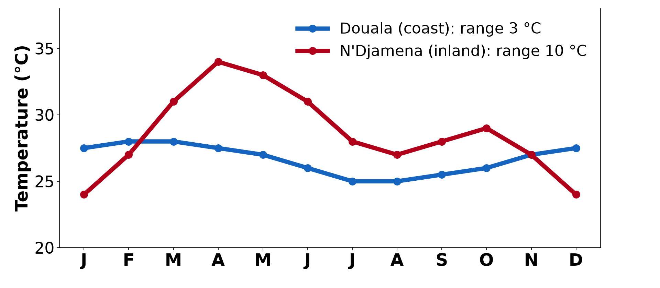
1. LAND AND SEA
Activity 1
Coastal and inland temperatures.
Notes:
Activity 1. Look carefully at this diagram: coastal and inland temperatures. Observe every detail before I ask the question.

Slide 21
1. LAND AND SEA
Activity 1: Question
Why do places far inland have more extreme temperatures?
Notes:
Here is the question for Activity 1: Why do places far inland have more extreme temperatures? Take one minute to think and write your answer in your rough notebook.

Slide 22
1. LAND AND SEA
Activity 1: Answer
Land heats and cools quickly, while the sea moderates coastal temperatures.
Notes:
Let us check the answer together. Land heats and cools quickly, while the sea moderates coastal temperatures.

Slide 23

2. RELIEF
Activity 2
Snow on Kilimanjaro near the Equator.
Notes:
Activity 2. Look carefully at this picture: snow on Kilimanjaro near the Equator. Observe every detail before I ask the question.

Slide 24
2. RELIEF
Activity 2: Question
Why is there snow on Kilimanjaro near the Equator?
Notes:
Here is the question for Activity 2: Why is there snow on Kilimanjaro near the Equator? Take one minute to think and write your answer in your rough notebook.

Slide 25
2. RELIEF
Activity 2: Answer
Temperature falls with altitude (about 6.5 °C per 1,000 m).
Notes:
Let us check the answer together. Temperature falls with altitude (about 6.5 °C per 1,000 m).

Slide 26
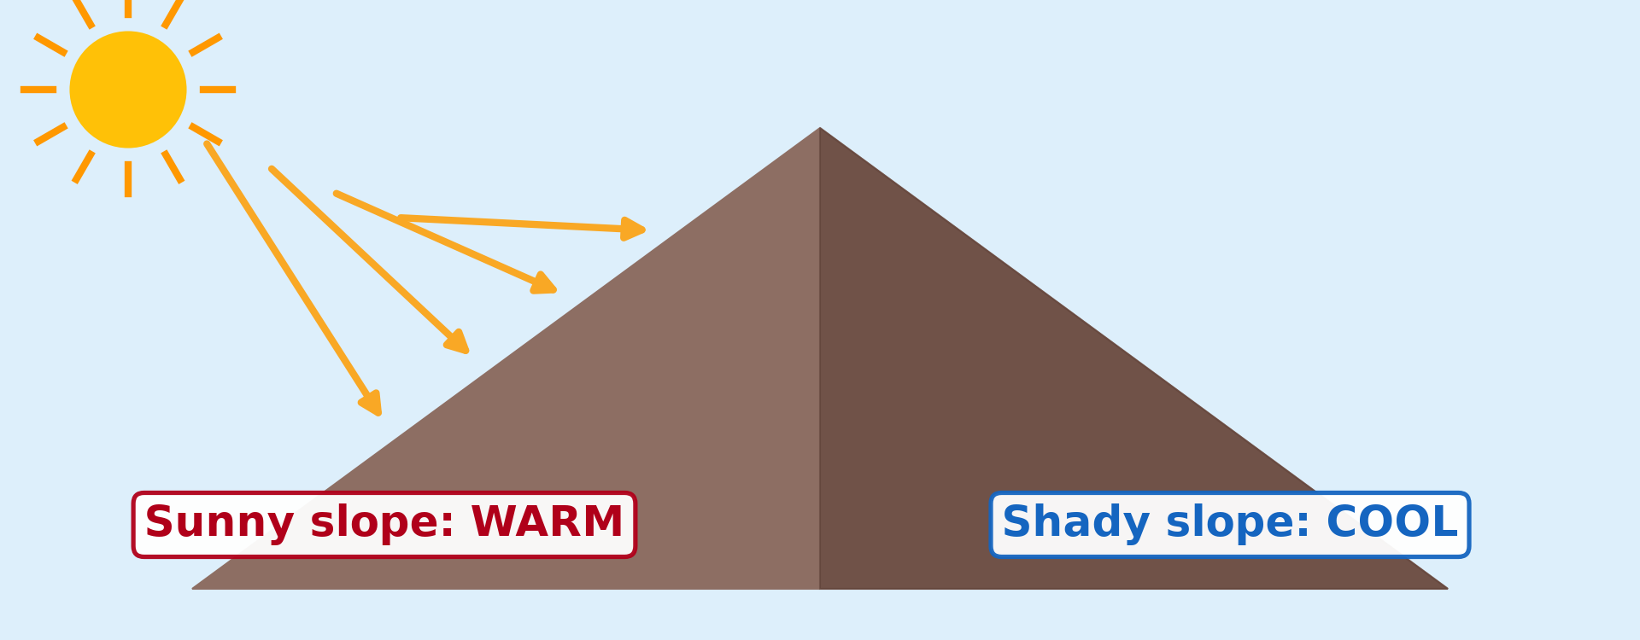
2. RELIEF
Activity 3
The aspect of slopes.
Notes:
Activity 3. Look carefully at this diagram: the aspect of slopes. Observe every detail before I ask the question.

Slide 27
2. RELIEF
Activity 3: Question
What is aspect?
Notes:
Here is the question for Activity 3: What is aspect? Take one minute to think and write your answer in your rough notebook.

Slide 28
2. RELIEF
Activity 3: Answer
The direction a slope faces.
Notes:
Let us check the answer together. The direction a slope faces.

Slide 29

3. CURRENTS AND WINDS
Activity 4
Warm and cold currents.
Notes:
Activity 4. Look carefully at this diagram: warm and cold currents. Observe every detail before I ask the question.

Slide 30
3. CURRENTS AND WINDS
Activity 4: Question
How does the cold Benguela Current affect Namibia?
Notes:
Here is the question for Activity 4: How does the cold Benguela Current affect Namibia? Take one minute to think and write your answer in your rough notebook.

Slide 31
3. CURRENTS AND WINDS
Activity 4: Answer
It cools the coast and makes it dry.
Notes:
Let us check the answer together. It cools the coast and makes it dry.

Slide 32
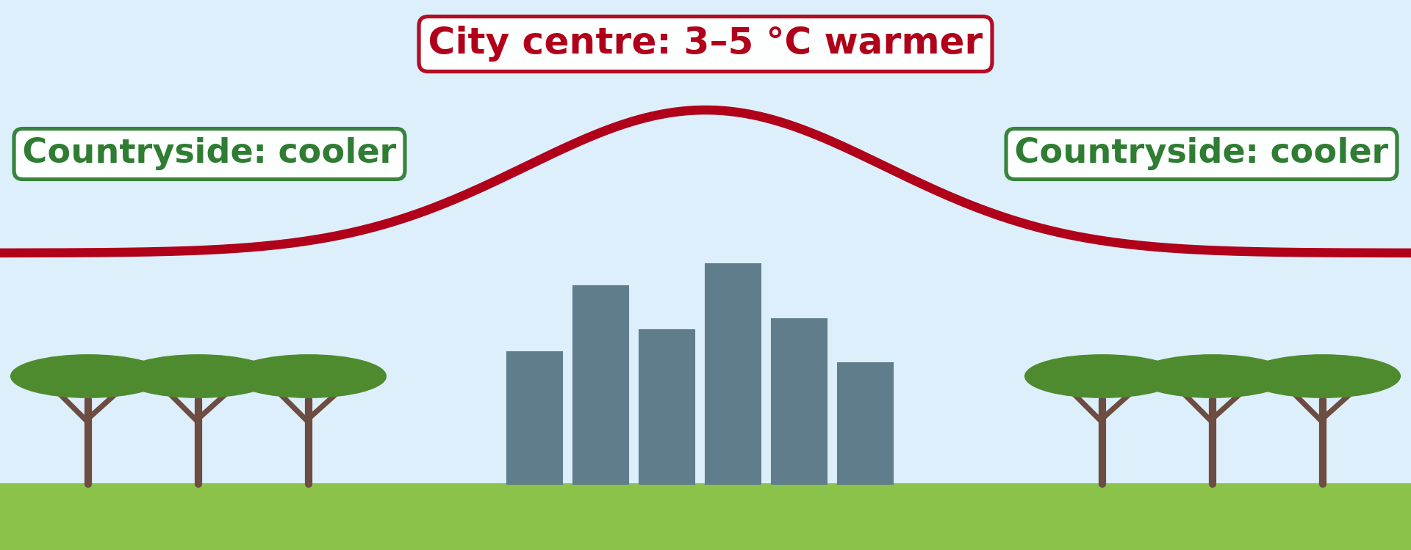
4. TOWNS
Activity 5
The urban heat island.
Notes:
Activity 5. Look carefully at this diagram: the urban heat island. Observe every detail before I ask the question.

Slide 33
4. TOWNS
Activity 5: Question
Give two causes of the urban heat island.
Notes:
Here is the question for Activity 5: Give two causes of the urban heat island. Take one minute to think and write your answer in your rough notebook.

Slide 34
4. TOWNS
Activity 5: Answer
Tar and concrete, heat from vehicles and machines, few trees, tall buildings (any two).
Notes:
Let us check the answer together. Tar and concrete, heat from vehicles and machines, few trees, tall buildings (any two).

Slide 35
BOARD SUMMARY
Board Summary
Topic: Energy in the Atmosphere
Sub-topic: Global Distribution of Heat (Temperature)
Lesson 7: Geographical Factors Affecting Temperature
Notes:
Now we are going to copy the board summary. Write the title and the headings neatly in your notebooks. I will give you enough time for each slide, so do not rush.

Slide 36
BOARD SUMMARY
DEFINITIONS
The key terms of this lesson are defined as follows:
Continentality: It is the effect of distance from the sea, which makes inland temperatures more extreme.
Notes:
Let us copy the definitions. The key terms of this lesson are defined as follows. On this slide we have Continentality. Write each point on a new line, with the key term first, and explain it in your own words when we revise. When you finish, we go to the next slide.

Slide 37
BOARD SUMMARY
DEFINITIONS (continued)
Adret: It is the slope that faces the sun (south-facing in the northern hemisphere), which is warmer and drier.
Ubac: It is the slope that faces away from the sun, which is cooler and more humid.
Notes:
We continue with the definitions. On this slide we have Adret and Ubac. Write each point on a new line, with the key term first, and explain it in your own words when we revise. When you finish, we go to the next slide.

Slide 38
BOARD SUMMARY
DEFINITIONS (continued)
Temperature lapsing: It is the fall of temperature with height, on average 6.5 °C per 1,000 m.
Heat island: It is a town that is warmer than the surrounding countryside.
Notes:
We continue with the definitions. On this slide we have Temperature lapsing and Heat island. Write each point on a new line, with the key term first, and explain it in your own words when we revise.

Slide 39
BOARD SUMMARY
1. Nature of the Surface
The nature of the surface influences temperature in the following ways:
Land surfaces: Land has a low specific heat, so it heats up quickly by day and in summer and cools quickly at night and in winter. Heat also stays in the top few centimetres of rock and soil, which makes land temperatures extreme.
Illustration: land and sea
Notes:
Let us copy Nature of the Surface. The nature of the surface influences temperature in the following ways. Copy the point on Land surfaces on the left, then draw the diagram on the right: land and sea. Give it a title and label it clearly.

Slide 40
BOARD SUMMARY
1. Nature of the Surface
Water surfaces: Water heats and cools slowly because it has a high specific heat, it is transparent and it is mixed by waves and currents. It therefore stores heat and moderates the temperature of the air above it.
Notes:
We continue with Nature of the Surface. Copy the point on Water surfaces: write the key term first, then its explanation.

Slide 41
BOARD SUMMARY
1. Nature of the Surface
Distance from the sea: Coastal places such as Douala and Kribi have a small range of temperature because the sea keeps them mild. Inland places such as Garoua and Maroua have a large range, with very hot days in March and April and cool nights in December and January.
Notes:
We continue with Nature of the Surface. Copy the point on Distance from the sea: write the key term first, then its explanation.

Slide 42
BOARD SUMMARY
2. Relief
Relief influences temperature in the following ways:
Altitude above sea level: Temperature falls by about 6.5 °C for every 1,000 m of height, because the air is thinner and further from the heated ground. This is why Ngaoundéré (about 1,100 m) and the Mandara Mountains are cooler than Garoua.
Illustration: a snow-capped mountain in the tropics
Notes:
Let us copy Relief. Relief influences temperature in the following ways. Copy the point on Altitude above sea level on the left, then draw the diagram on the right: a snow-capped mountain in the tropics. Give it a title and label it clearly.

Slide 43
BOARD SUMMARY
2. Relief
Aspect of slope: In the northern hemisphere, the adret (south-facing slope) receives the rays of the sun more directly and is warmer and drier. The ubac (north-facing slope) is shaded, so it is cooler, and in the Alps villages and farms are built on the adret.
Illustration: adret and ubac
Notes:
Copy the point on Aspect of slope on the left, then draw the diagram on the right: adret and ubac. Give it a title and label it clearly.

Slide 44
BOARD SUMMARY
3. Ocean Currents
Ocean currents influence temperature in the following ways:
Warm currents: Warm currents flow from the tropics towards the poles and warm the air of the coasts they touch. For example, the North Atlantic Drift keeps the ports of Norway free of ice in winter, and the Guinea Current keeps the coast of Cameroon warm.
Illustration: ocean currents
Notes:
Let us copy Ocean Currents. Ocean currents influence temperature in the following ways. Copy the point on Warm currents on the left, then draw the diagram on the right: ocean currents. Give it a title and label it clearly.

Slide 45
BOARD SUMMARY
3. Ocean Currents
Cold currents: Cold currents flow from the poles towards the Equator and cool the air above them. For example, the Benguela Current cools the coast of Namibia and helps to form the Namib Desert.
Notes:
We continue with Ocean Currents. Copy the point on Cold currents: write the key term first, then its explanation.

Slide 46

BOARD SUMMARY
4. Prevailing Winds
Prevailing winds influence temperature in the following ways:
Winds from warm regions: Winds carry the temperature of the regions they come from. For example, the Harmattan brings hot, dry air from the Sahara, so it raises the day temperature of Garoua in February and March.
Illustration: the Harmattan
Notes:
Let us copy Prevailing Winds. Prevailing winds influence temperature in the following ways. Copy the point on Winds from warm regions on the left, then draw the diagram on the right: the Harmattan. Give it a title and label it clearly.

Slide 47
BOARD SUMMARY
4. Prevailing Winds
Winds from the sea or cold regions: Winds that blow from the sea keep coastal places mild, as the westerlies do in western Europe. Winds from cold regions lower temperatures, as polar winds do in North America in winter.
Notes:
We continue with Prevailing Winds. Copy the point on Winds from the sea or cold regions: write the key term first, then its explanation.

Slide 48
BOARD SUMMARY
5. Cloud Cover
Cloud cover influences temperature in the following ways:
By day: Clouds reflect a large part of the solar radiation back to space before it reaches the ground. Cloudy days, as in the rainy season, are therefore cooler than clear days.
Notes:
Let us copy Cloud Cover. Cloud cover influences temperature in the following ways. Copy the point on By day: write the key term first, then its explanation.

Slide 49
BOARD SUMMARY
5. Cloud Cover
By night: Clouds absorb the heat given off by the ground and send it back down, acting like a blanket. Cloudy nights are therefore warmer than clear nights, which explains the cold nights of the Harmattan season in the North.
Notes:
We continue with Cloud Cover. Copy the point on By night: write the key term first, then its explanation.

Slide 50
BOARD SUMMARY
6. Urbanisation: the Heat Island
Towns are warmer than the countryside for the following reasons:
Artificial surfaces: Concrete, tar and metal roofs absorb more solar energy than soil and plants and release it slowly at night. For this reason, a large town can be 2 to 5 °C warmer than the countryside after sunset.
Illustration: the urban heat island
Notes:
Let us copy Urbanisation: the Heat Island. Towns are warmer than the countryside for the following reasons. Copy the point on Artificial surfaces on the left, then draw the diagram on the right: the urban heat island. Give it a title and label it clearly.

Slide 51
BOARD SUMMARY
6. Urbanisation: the Heat Island
Heat from human activities: Vehicles, motorbikes, air conditioners, kitchens and factories all release heat into the air. The more people and activities a town has, the more heat it produces.
Notes:
We continue with Urbanisation: the Heat Island. Copy the point on Heat from human activities: write the key term first, then its explanation.

Slide 52
BOARD SUMMARY
6. Urbanisation: the Heat Island
Lack of vegetation: Towns have few trees and little open water, so there is less shade and less cooling by evaporation and transpiration. The heat is therefore used to warm the air instead.
Notes:
We continue with Urbanisation: the Heat Island. Copy the point on Lack of vegetation: write the key term first, then its explanation.

Slide 53
BOARD SUMMARY
6. Urbanisation: the Heat Island
Buildings and pollution: Tall buildings trap heat in narrow streets and slow down the wind that could carry it away. A layer of pollution over the town also absorbs heat and sends it back to the ground.
Notes:
We continue with Urbanisation: the Heat Island. Copy the point on Buildings and pollution: write the key term first, then its explanation.

Slide 54
FORMATIVE EVALUATION
Evaluation 1
Distinguish a maritime climate from a continental climate.
Notes:
Now let us check what you have understood. Question 1: Distinguish a maritime climate from a continental climate. Answer in your exercise book.

Slide 55
FORMATIVE EVALUATION
Expected Answer
A maritime climate near the sea has small temperature ranges; a continental climate far inland has large ranges.
Notes:
The expected answer is: a maritime climate near the sea has small temperature ranges; a continental climate far inland has large ranges. If you got it right, well done.

Slide 56
FORMATIVE EVALUATION
Evaluation 2
Explain the double role of clouds on temperature.
Notes:
Now let us check what you have understood. Question 2: Explain the double role of clouds on temperature. Answer in your exercise book.

Slide 57
FORMATIVE EVALUATION
Expected Answer
By day they reflect sunlight and cool the ground; at night they trap heat and keep it warm.
Notes:
The expected answer is: by day they reflect sunlight and cool the ground; at night they trap heat and keep it warm. If you got it right, well done.

Slide 58
REMEDIATION
Remediation
Fill in the blanks:
Temperature falls by about ______ °C per 1,000 m.
The direction a slope faces is its ______.
A town warmer than the countryside is an urban heat ______.
Notes:
For those who need more practice, fill in the blanks in your exercise book. The answers are: number 1, ; number 6, 5; number 2, aspect; number 3, island.

Slide 59
HOMEWORK
Homework
Define the environmental lapse rate.
Notes:
For your homework: Define the environmental lapse rate. We shall correct it at the beginning of our next lesson.

Slide 60
NEXT LESSON
Next Lesson
Our next lesson will be on:
Lesson 8: Vertical Distribution of Temperature
Notes:
Our next lesson will be on Lesson 8: Vertical Distribution of Temperature. Thank you for your attention, and see you next time.

Slide 61
BILINGUAL GAME
Bilingual Game (Jeu Bilingue)
English | Français
Relief | Le relief
Altitude | L'altitude
Wind | Le vent
Cloud | Le nuage
Urban heat island | L'îlot de chaleur urbain
Continentality | La continentalité
Notes:
Let us play the bilingual game. I say a word in English, and you give me the French word. Then we do the reverse.

Slide 62
LOGBOOK
Official Logbook (1/2)
Module / Topic | Energy in the Atmosphere
Lesson Title | Lesson 7: Geographical Factors Affecting Temperature
Expected Learning Outcomes | Explain the different heating of land and water (continentality). Explain the effects of altitude and aspect. Explain the effects of ocean currents and winds. Explain the double role of clouds. Explain the urban heat island.
Competence | Learners are able to explain why places at the same latitude have different temperatures, with examples around Garoua.
Notes:
I record this information in the official logbook of the class after the lesson.

Slide 63
LOGBOOK
Official Logbook (2/2)
Matter Taught | DEFINITIONS; Nature of the Surface; Relief; Ocean Currents; Prevailing Winds; Cloud Cover; Urbanisation: the Heat Island.
Evaluation | Formative evaluation and remediation exercise.
Homework | Define the environmental lapse rate.
Enrolment / Present / Absent | ____ / ____ / ____
Achievement | To be completed after the lesson.
Notes:
I complete the second page of the logbook: the matter taught, the evaluation, the homework and the attendance.

Slide 64
TEACHER'S NOTE
Teacher's Note
Timing: Homework correction, plan, objectives 8 min | Recall, situation, action 10 min | 5 activities 30 min | Board summary (copying) 30 min | Evaluation, remediation 10 min | Homework, next lesson 5 min | Logbook 7 min
Without the projector (Activity 1): compare Douala and Garoua.
Without the projector (Activity 2): calculate the fall of temperature for 2,000 m.
Without the projector (Activity 3): find a slope facing the sun.
Without the projector (Activity 4): locate Namibia.
Without the projector (Activity 5): feel a tar road and grass at noon.
Notes:
This slide is for me, the teacher: it gives the timing of the lesson and what to do if the projector is not available.

Slide 65
REFERENCES
References
Geography Syllabus for Sixth Forms (Lower and Upper Sixth), MINESEC, 2019 — Module 1 (Meteorology, Climatology & Hydrology).
Teacher's course notes: Mr KAMDEM E., Meteorology (LSA), GBHS Garoua, 2026.
Photo, Activity 2: “Kilimanjaro” by ian 1602, CC BY-NC 2.0, via Flickr (https://www.flickr.com/photos/98181641@N00/2179855841)
Photo, board summary (Winds from warm regions): “Bamenda sob a poeira do Harmattan” by carlosoliveirareis, CC BY-NC-SA 2.0, via Flickr (https://www.flickr.com/photos/54218923@N00/387054136)
Diagrams and animations: drawn for this lesson (Geography Department).
Notes:
These are the references and picture credits used to prepare this lesson.

