Slide 1
LOWER SIXTH ARTS
GEOGRAPHY
Lesson 17
Local Winds
Notes:
Good morning, class, and welcome to our geography lesson. I am your geography teacher, Mr Kamdem. Today we are starting Lesson 17: Local Winds.

Slide 2
CLASS INFO
Class, Chapter and Duration
Class | Lower Sixth Arts
Chapter | Module 1: Understanding and managing atmospheric and hydrological phenomena and hazards across the world in general and Cameroon in particular
Duration | 2 periods (2 × 50 minutes)
Notes:
This lesson is for Lower Sixth Arts. It belongs to Module 1: Understanding and managing atmospheric and hydrological phenomena and hazards across the world in general and Cameroon in particular. We shall need 2 periods to cover it.

Slide 3
IDENTIFICATION
Lesson Identification
Topic | Atmospheric Motions
Sub-topic | Microscale (Local) Winds
Lesson | Lesson 17: Local Winds
Notions / Concepts | Local wind, sea breeze, land breeze, anabatic (valley) wind, katabatic (mountain) wind, foehn, Chinook.
Syllabus focus | Meaning of local winds; land and sea breezes; valley and mountain winds; foehn winds; effects of local winds on weather and man.
Competence | Learners are able to explain the daily local winds of coasts and mountains and their effects.
Notes:
Our topic is Atmospheric Motions, and the sub-topic is Microscale (Local) Winds. The key notions we shall use today are: local wind, sea breeze, land breeze, anabatic (valley) wind, katabatic (mountain) wind, foehn, Chinook. At the end, you should be able to do this: learners are able to explain the daily local winds of coasts and mountains and their effects.

Slide 4

HOMEWORK CORRECTION
Correction of the Homework
Question (Lesson 16: Tropical Seasonal Winds: Monsoon and Harmattan):
Define a sea breeze.
Notes:
Before we start the new lesson, let us correct the homework I gave you at the end of Lesson 16: Tropical Seasonal Winds: Monsoon and Harmattan. The question was: Define a sea breeze. Take out your exercise books.

Slide 5
HOMEWORK CORRECTION
Correction: Possible Answer
A sea breeze is a cool wind that blows from the sea to the land during the day.
Notes:
Here is a good answer. A sea breeze is a cool wind that blows from the sea to the land during the day. Compare it with your own answer and correct your work in red.

Slide 6
LESSON PLAN
Lesson Plan
Correction of the homework
Objectives and recall
Real-life situation and action to take
Learning activities
Board summary
Evaluation, remediation and homework
Notes:
Here is the plan of our lesson today. First, we shall correct the homework. Then we shall look at the objectives and recall what you already know. After that, we shall study a situation from real life and the action to take, and do the learning activities. Finally, we shall copy the board summary, do the evaluation and the remediation, and I will give you the homework.

Slide 7
OBJECTIVES
Objectives
By the end of this lesson, you should be able to:
Define local winds.
Explain sea and land breezes.
Explain anabatic and katabatic winds.
Explain foehn winds.
Notes:
Take your time to copy this part; we will continue together.

Slide 8
OBJECTIVES
Objectives (continued)
Describe the effects of local winds.
Notes:
By the end of this lesson, you should be able to do five things. Number 1: define local winds. Number 2: explain sea and land breezes. Number 3: explain anabatic and katabatic winds. Number 4: explain foehn winds. Number 5: describe the effects of local winds.

Slide 9
PREVIOUS KNOWLEDGE
Previous Knowledge
Air moves from high to low pressure.
Land heats and cools faster than water.
Cold air is heavy and sinks.
Notes:
Let us first remember what you already know. Air moves from high to low pressure. Land heats and cools faster than water. Cold air is heavy and sinks. Keep this in mind, because we shall build on it today.

Slide 10
REAL-LIFE SITUATION
Situation in Real Life
Your friend lives in a village at the foot of the Mandara Mountains.
Notes:
Take your time to copy this part; we will continue together.

Slide 11
REAL-LIFE SITUATION
Situation in Real Life (continued)
He tells you that every evening after sunset, a cool breeze flows down from the slopes through the village and makes the nights pleasant, while during the day a gentle warm breeze blows up towards the mountains.
Notes:
Take your time to copy this part; we will continue together.

Slide 12
REAL-LIFE SITUATION
Situation in Real Life (continued)
Your cousin in Limbe says the same thing happens with the sea: a cool wind from the sea in the afternoon, and from the land at night.
You ask: "Why do these winds change direction every day?"
Notes:
Listen carefully to this situation from real life. Your friend lives in a village at the foot of the Mandara Mountains. He tells you that every evening after sunset, a cool breeze flows down from the slopes through the village and makes the nights pleasant, while during the day a gentle warm breeze blows up towards the mountains. Your cousin in Limbe says the same thing happens with the sea: a cool wind from the sea in the afternoon, and from the land at night. You ask: "Why do these winds change direction every day?" Think about it, because I am going to ask you some questions.

Slide 13
REAL-LIFE SITUATION
Situation: Question 1
What is the problem in the situation?
Notes:
Question 1: What is the problem in the situation? Think for a moment, then raise your hand to answer.

Slide 14
REAL-LIFE SITUATION
Answer
The learner does not understand local winds.
Notes:
Good. The learner does not understand local winds.

Slide 15
REAL-LIFE SITUATION
Situation: Question 2
What is the cool wind flowing down the slopes at night?
Notes:
Question 2: What is the cool wind flowing down the slopes at night? Think for a moment, then raise your hand to answer.

Slide 16
REAL-LIFE SITUATION
Answer
A mountain (katabatic) wind.
Notes:
Good. A mountain (katabatic) wind.

Slide 17
REAL-LIFE SITUATION
Situation: Question 3
Why does the wind in Limbe blow from the sea in the afternoon?
Notes:
Question 3: Why does the wind in Limbe blow from the sea in the afternoon? Think for a moment, then raise your hand to answer.

Slide 18
REAL-LIFE SITUATION
Possible Answer
The land is hotter than the sea, so low pressure forms over the land: it is a sea breeze.
Notes:
Good. The land is hotter than the sea, so low pressure forms over the land: it is a sea breeze.

Slide 19
ACTION TO TAKE
Action to Take
Use sea and land breezes for fishing and ventilation, and protect crops in valleys from cold night air.
Notes:
From this situation, the action we are working towards in this lesson is the following: use sea and land breezes for fishing and ventilation, and protect crops in valleys from cold night air.

Slide 20
JUSTIFICATION
Justification of the Lesson
This lesson explains daily winds that affect the comfort, farming and fishing of people near coasts and mountains.
Notes:
Why is this lesson important for you? This lesson explains daily winds that affect the comfort, farming and fishing of people near coasts and mountains.

Slide 21

1. LAND AND SEA BREEZES
Activity 1
Animation: the sea breeze.
Notes:
Activity 1. Look carefully at this animation: animation: the sea breeze. Watch the animation to the end; it will play again.

Slide 22
1. LAND AND SEA BREEZES
Activity 1: Question
In which direction does the sea breeze blow?
Notes:
Here is the question for Activity 1: In which direction does the sea breeze blow? Take one minute to think and write your answer in your rough notebook.

Slide 23
1. LAND AND SEA BREEZES
Activity 1: Answer
From the sea to the land, during the day.
Notes:
Let us check the answer together. From the sea to the land, during the day.

Slide 24

1. LAND AND SEA BREEZES
Activity 2
Fishermen at sea.
Notes:
Activity 2. Look carefully at this picture: fishermen at sea. Observe every detail before I ask the question.

Slide 25
1. LAND AND SEA BREEZES
Activity 2: Question
How can fishermen use the land breeze?
Notes:
Here is the question for Activity 2: How can fishermen use the land breeze? Take one minute to think and write your answer in your rough notebook.

Slide 26
1. LAND AND SEA BREEZES
Activity 2: Answer
It helps to push their boats out to sea at night or dawn.
Notes:
Let us check the answer together. It helps to push their boats out to sea at night or dawn.

Slide 27
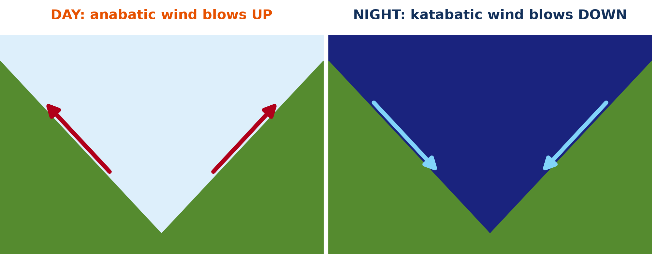
2. VALLEY AND MOUNTAIN WINDS
Activity 3
Anabatic and katabatic winds.
Notes:
Activity 3. Look carefully at this diagram: anabatic and katabatic winds. Observe every detail before I ask the question.

Slide 28
2. VALLEY AND MOUNTAIN WINDS
Activity 3: Question
Why does air flow down the slopes at night?
Notes:
Here is the question for Activity 3: Why does air flow down the slopes at night? Take one minute to think and write your answer in your rough notebook.

Slide 29
2. VALLEY AND MOUNTAIN WINDS
Activity 3: Answer
The slopes cool quickly, the air becomes cold and heavy, and gravity pulls it down.
Notes:
Let us check the answer together. The slopes cool quickly, the air becomes cold and heavy, and gravity pulls it down.

Slide 30
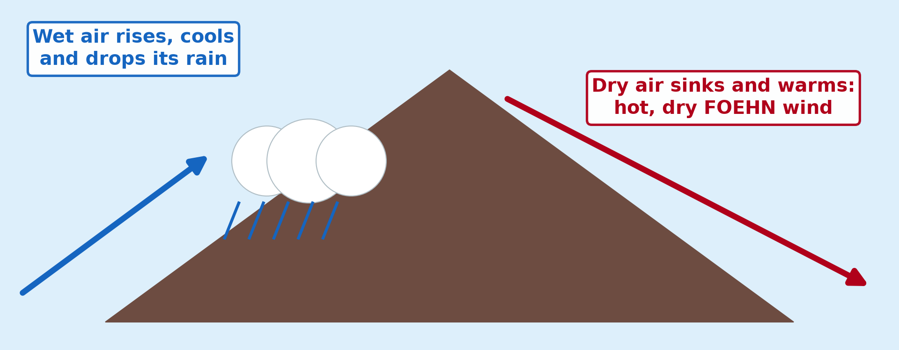
3. FOEHN
Activity 4
The foehn effect.
Notes:
Activity 4. Look carefully at this diagram: the foehn effect. Observe every detail before I ask the question.

Slide 31
3. FOEHN
Activity 4: Question
Why is the foehn warm and dry?
Notes:
Here is the question for Activity 4: Why is the foehn warm and dry? Take one minute to think and write your answer in your rough notebook.

Slide 32
3. FOEHN
Activity 4: Answer
It lost its moisture on the windward side and warms as it descends.
Notes:
Let us check the answer together. It lost its moisture on the windward side and warms as it descends.

Slide 33
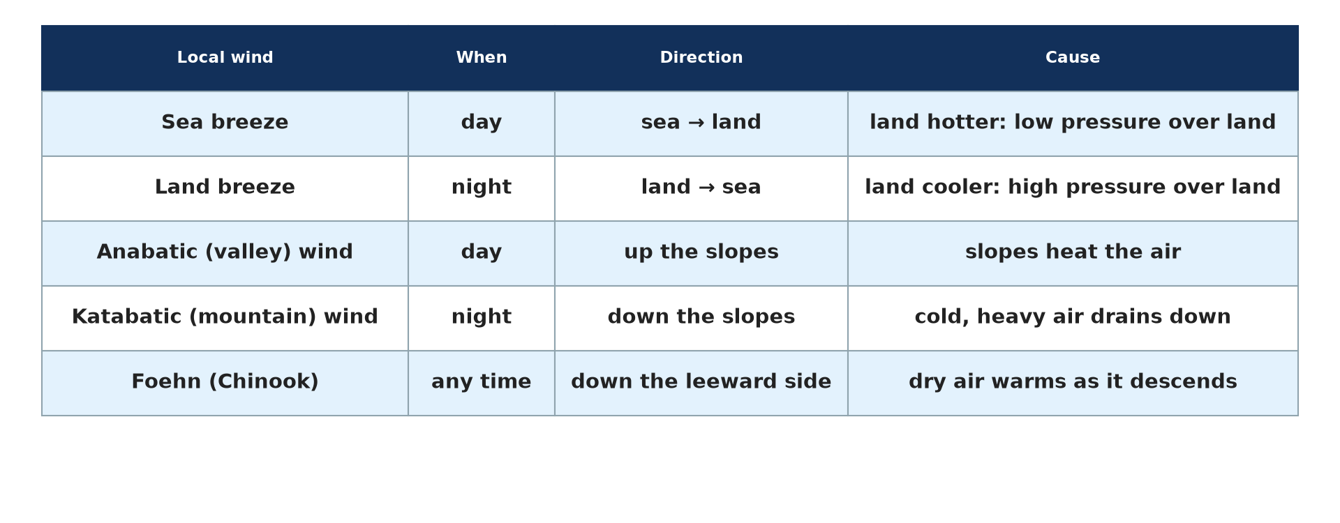
4. EFFECTS
Activity 5
The local winds.
Notes:
Activity 5. Look carefully at this picture: the local winds. Observe every detail before I ask the question.

Slide 34
4. EFFECTS
Activity 5: Question
Give one danger of warm, dry foehn winds.
Notes:
Here is the question for Activity 5: Give one danger of warm, dry foehn winds. Take one minute to think and write your answer in your rough notebook.

Slide 35
4. EFFECTS
Activity 5: Answer
Forest fires (and rapid snowmelt).
Notes:
Let us check the answer together. Forest fires (and rapid snowmelt).

Slide 36
BOARD SUMMARY
Board Summary
Topic: Atmospheric Motions
Sub-topic: Microscale (Local) Winds
Lesson 17: Local Winds
Notes:
Now we are going to copy the board summary. Write the title and the headings neatly in your notebooks. I will give you enough time for each slide, so do not rush.

Slide 37
BOARD SUMMARY
DEFINITIONS
The key terms of this lesson are defined as follows:
Local winds: They are winds produced over a small area by local differences of temperature and pressure.
Sea breeze: It is a cool wind blowing from the sea to the land during the day.
Notes:
Let us copy the definitions. The key terms of this lesson are defined as follows. On this slide we have Local winds and Sea breeze. Write each point on a new line, with the key term first, and explain it in your own words when we revise. When you finish, we go to the next slide.

Slide 38
BOARD SUMMARY
DEFINITIONS (continued)
Land breeze: It is a wind blowing from the land to the sea at night.
Anabatic wind: It is a warm wind blowing up the slopes during the day.
Katabatic wind: It is a cold wind blowing down the slopes at night.
Notes:
We continue with the definitions. On this slide we have Land breeze, Anabatic wind and Katabatic wind. Write each point on a new line, with the key term first, and explain it in your own words when we revise.

Slide 39
BOARD SUMMARY
1. Meaning and Categories of Local Winds
Local winds are explained as follows:
Meaning: Local winds blow over a small area, such as a coast or a valley, and usually last only a few hours. They are caused by local differences of heating between land and sea or between slopes and valleys, or by relief.
Notes:
Let us copy Meaning and Categories of Local Winds. Local winds are explained as follows. Copy the point on Meaning: write the key term first, then its explanation.

Slide 40
BOARD SUMMARY
1. Meaning and Categories of Local Winds
Thermal local winds: Thermal local winds are caused by the unequal heating of neighbouring surfaces. Land and sea breezes and anabatic and katabatic winds belong to this category.
Illustration: local winds
Notes:
Copy the point on Thermal local winds on the left, then draw the diagram on the right: local winds. Give it a title and label it clearly.

Slide 41
BOARD SUMMARY
1. Meaning and Categories of Local Winds
Relief (dynamic) local winds: Relief local winds are caused by air that is forced to cross mountains. The Foehn and the Chinook belong to this category.
Notes:
We continue with Meaning and Categories of Local Winds. Copy the point on Relief (dynamic) local winds: write the key term first, then its explanation.

Slide 42
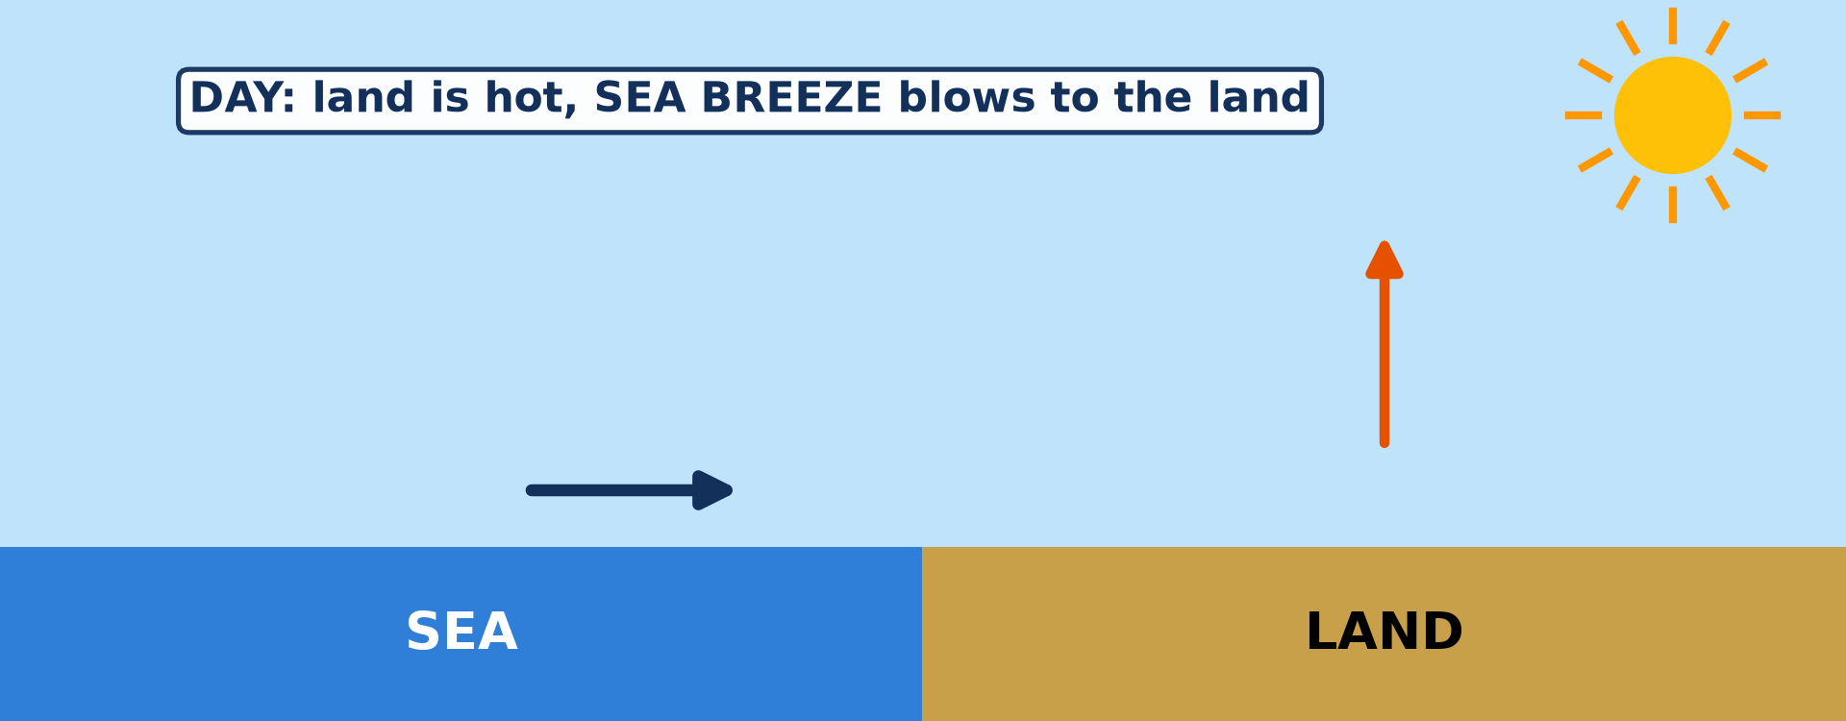
BOARD SUMMARY
2. Land and Sea Breezes
Land and sea breezes form and act as follows:
Sea breeze (by day): By day, the land heats faster than the sea, so the air above it rises and a low pressure forms. Cool, moist air then blows from the sea towards the land, usually from late morning to evening.
Illustration: the sea breeze
Notes:
Let us copy Land and Sea Breezes. Land and sea breezes form and act as follows. Copy the point on Sea breeze (by day) on the left, then draw the diagram on the right: the sea breeze. Give it a title and label it clearly.

Slide 43
BOARD SUMMARY
2. Land and Sea Breezes
Land breeze (at night): At night, the land cools faster than the sea, so a high pressure forms over it. Air then blows gently from the land towards the sea, which is warmer.
Notes:
We continue with Land and Sea Breezes. Copy the point on Land breeze (at night): write the key term first, then its explanation.

Slide 44
BOARD SUMMARY
2. Land and Sea Breezes
Comfort in coastal towns: Coastal towns such as Limbe, Kribi and Douala feel the sea breeze on hot afternoons. The cool air makes them more comfortable.
Notes:
We continue with Land and Sea Breezes. Copy the point on Comfort in coastal towns: write the key term first, then its explanation.

Slide 45
BOARD SUMMARY
2. Land and Sea Breezes
Use by fishermen: Fishermen use the land breeze to sail out to sea at dawn. They use the sea breeze to return in the afternoon.
Illustration: fishing canoes
Notes:
Copy the point on Use by fishermen on the left, then draw the diagram on the right: fishing canoes. Give it a title and label it clearly.

Slide 46
BOARD SUMMARY
3. Anabatic and Katabatic Winds
Winds on mountain slopes form and act as follows:
Anabatic (valley) wind: By day, the sun heats the slopes more than the air at the same height over the valley. The warm, light air rises up the slopes, often forming clouds on the summits in the afternoon.
Illustration: anabatic and katabatic winds
Notes:
Let us copy Anabatic and Katabatic Winds. Winds on mountain slopes form and act as follows. Copy the point on Anabatic (valley) wind on the left, then draw the diagram on the right: anabatic and katabatic winds. Give it a title and label it clearly.

Slide 47
BOARD SUMMARY
3. Anabatic and Katabatic Winds
Katabatic (mountain) wind: At night, the slopes lose heat quickly and cool the air in contact with them. This cold, heavy air flows down into the valley, where it collects.
Notes:
We continue with Anabatic and Katabatic Winds. Copy the point on Katabatic (mountain) wind: write the key term first, then its explanation.

Slide 48
BOARD SUMMARY
3. Anabatic and Katabatic Winds
Cool evenings at the foot of mountains: Villages at the foot of the Mandara Mountains and the Adamawa Plateau receive cool katabatic breezes after sunset. These breezes make the evenings pleasant.
Notes:
We continue with Anabatic and Katabatic Winds. Copy the point on Cool evenings at the foot of mountains: write the key term first, then its explanation.

Slide 49
BOARD SUMMARY
3. Anabatic and Katabatic Winds
Frost and fog in cold regions: In cold regions, katabatic winds bring frost and fog to valley floors. On the ice caps of Greenland and Antarctica, they can be very strong.
Notes:
We continue with Anabatic and Katabatic Winds. Copy the point on Frost and fog in cold regions: write the key term first, then its explanation.

Slide 50
BOARD SUMMARY
4. Foehn Winds
Foehn winds form and act as follows:
On the windward side: Moist air is forced to rise over a mountain range, cools and forms clouds. It loses most of its moisture as rain or snow on the windward slope.
Illustration: the Foehn wind
Notes:
Let us copy Foehn Winds. Foehn winds form and act as follows. Copy the point on On the windward side on the left, then draw the diagram on the right: the Foehn wind. Give it a title and label it clearly.

Slide 51
BOARD SUMMARY
4. Foehn Winds
On the leeward side: The dry air then descends the other side and is compressed, so it warms quickly at the dry adiabatic rate. It reaches the foot of the mountain much warmer and drier than it was at the start.
Notes:
We continue with Foehn Winds. Copy the point on On the leeward side: write the key term first, then its explanation.

Slide 52
BOARD SUMMARY
4. Foehn Winds
Examples: The Foehn blows in the valleys of the Alps, and the Chinook on the eastern side of the Rocky Mountains. They can raise the temperature by 20 °C in a few hours.
Notes:
We continue with Foehn Winds. Copy the point on Examples: write the key term first, then its explanation.

Slide 53
BOARD SUMMARY
4. Foehn Winds
Effects on snow and vegetation: Foehn winds melt snow quickly, which is good for early grazing but can cause floods. They also dry the vegetation and increase the risk of forest fires.
Notes:
We continue with Foehn Winds. Copy the point on Effects on snow and vegetation: write the key term first, then its explanation.

Slide 54
BOARD SUMMARY
5. Effects of Winds on Weather and Man
Local winds have the following effects on weather and man:
On temperature and comfort: Sea breezes cool coastal towns on hot afternoons, and katabatic winds bring cool nights to valleys. These winds make life more pleasant in hot regions.
Notes:
Let us copy Effects of Winds on Weather and Man. Local winds have the following effects on weather and man. Copy the point on On temperature and comfort: write the key term first, then its explanation.

Slide 55
BOARD SUMMARY
5. Effects of Winds on Weather and Man
On clouds and rain: Sea breezes and anabatic winds make moist air rise, which forms clouds and afternoon showers on coasts and mountains. Foehn winds, on the other hand, bring dry, clear weather to the leeward side.
Notes:
We continue with Effects of Winds on Weather and Man. Copy the point on On clouds and rain: write the key term first, then its explanation.

Slide 56
BOARD SUMMARY
5. Effects of Winds on Weather and Man
On agriculture: Foehn winds melt snow early and help grapes and fruit to ripen. Katabatic winds can bring frost to valleys, so farmers plant sensitive crops on the slopes.
Notes:
We continue with Effects of Winds on Weather and Man. Copy the point on On agriculture: write the key term first, then its explanation.

Slide 57
BOARD SUMMARY
5. Effects of Winds on Weather and Man
On fishing and energy: Fishermen use land and sea breezes to sail out and return. Steady local winds can also drive wind turbines to produce electricity.
Notes:
We continue with Effects of Winds on Weather and Man. Copy the point on On fishing and energy: write the key term first, then its explanation.

Slide 58
FORMATIVE EVALUATION
Evaluation 1
Explain why a sea breeze differs from a land breeze.
Notes:
Now let us check what you have understood. Question 1: Explain why a sea breeze differs from a land breeze. Answer in your exercise book.

Slide 59
FORMATIVE EVALUATION
Expected Answer
By day the land is hotter than the sea and wind blows from the sea; at night the land is cooler and wind blows from the land.
Notes:
The expected answer is: by day the land is hotter than the sea and wind blows from the sea; at night the land is cooler and wind blows from the land. If you got it right, well done.

Slide 60
FORMATIVE EVALUATION
Evaluation 2
Why is a katabatic wind cold?
Notes:
Now let us check what you have understood. Question 2: Why is a katabatic wind cold? Answer in your exercise book.

Slide 61
FORMATIVE EVALUATION
Expected Answer
It is air cooled on the slopes at night, which becomes heavy and flows down.
Notes:
The expected answer is: it is air cooled on the slopes at night, which becomes heavy and flows down. If you got it right, well done.

Slide 62
REMEDIATION
Remediation
Fill in the blanks:
A wind from the sea by day is a sea ______.
A wind blowing down slopes at night is ______.
The Chinook is a ______ wind.
Notes:
For those who need more practice, fill in the blanks in your exercise book. The answers are: number 1, breeze; number 2, katabatic; number 3, foehn.

Slide 63
HOMEWORK
Homework
Define an air mass.
Notes:
For your homework: Define an air mass. We shall correct it at the beginning of our next lesson.

Slide 64
NEXT LESSON
Next Lesson
Our next lesson will be on:
Lesson 18: Air Masses
Notes:
Our next lesson will be on Lesson 18: Air Masses. Thank you for your attention, and see you next time.

Slide 65
BILINGUAL GAME
Bilingual Game (Jeu Bilingue)
English | Français
Local wind | Le vent local
Sea breeze | La brise de mer
Land breeze | La brise de terre
Katabatic wind | Le vent catabatique
Anabatic wind | Le vent anabatique
Leeward | Sous le vent
Notes:
Let us play the bilingual game. I say a word in English, and you give me the French word. Then we do the reverse.

Slide 66
LOGBOOK
Official Logbook (1/2)
Module / Topic | Atmospheric Motions
Lesson Title | Lesson 17: Local Winds
Expected Learning Outcomes | Define local winds. Explain sea and land breezes. Explain anabatic and katabatic winds. Explain foehn winds. Describe the effects of local winds.
Competence | Learners are able to explain the daily local winds of coasts and mountains and their effects.
Notes:
I record this information in the official logbook of the class after the lesson.

Slide 67
LOGBOOK
Official Logbook (2/2)
Matter Taught | DEFINITIONS; Meaning and Categories of Local Winds; Land and Sea Breezes; Anabatic and Katabatic Winds; Foehn Winds; Effects of Winds on Weather and Man.
Evaluation | Formative evaluation and remediation exercise.
Homework | Define an air mass.
Enrolment / Present / Absent | ____ / ____ / ____
Achievement | To be completed after the lesson.
Notes:
I complete the second page of the logbook: the matter taught, the evaluation, the homework and the attendance.

Slide 68
TEACHER'S NOTE
Teacher's Note
Timing: Homework correction, plan, objectives 8 min | Recall, situation, action 10 min | 5 activities 30 min | Board summary (copying) 30 min | Evaluation, remediation 10 min | Homework, next lesson 5 min | Logbook 7 min
Activity 1 is an animation (GIF): it plays automatically in slide-show mode.
Without the projector (Activity 1): draw the coastline, LAND and SEA.
Without the projector (Activity 2): describe fishing at Limbe.
Without the projector (Activity 3): draw day and night arrows.
Without the projector (Activity 4): draw the mountain and the two sides.
Without the projector (Activity 5): list effects on the board.
Notes:
This slide is for me, the teacher: it gives the timing of the lesson and what to do if the projector is not available.

Slide 69
REFERENCES
References
Geography Syllabus for Sixth Forms (Lower and Upper Sixth), MINESEC, 2019 — Module 1 (Meteorology, Climatology & Hydrology).
Teacher's course notes: Mr KAMDEM E., Meteorology (LSA), GBHS Garoua, 2026.
Photo, Activity 2: “Fishermen, Lake Tana” by A.Davey, CC BY 2.0, via Flickr (https://www.flickr.com/photos/40595948@N00/2260748777)
Diagrams and animations: drawn for this lesson (Geography Department).
Notes:
These are the references and picture credits used to prepare this lesson.

