Slide 1
FORM 3
GEOGRAPHY
Lesson 11
Volcanoes
Notes:
Good morning, class, and welcome to our geography lesson. I am your geography teacher, Madam Che. Today we are starting Lesson 11: Volcanoes.

Slide 2
CLASS INFO
Class, Chapter and Duration
Class | Form 3
Chapter | The Structure of the Earth: Building Processes and Impacts on Man — Volcanoes
Duration | 2 periods (2 × 50 minutes)
Notes:
This lesson is for Form 3. It belongs to The Structure of the Earth: Building Processes and Impacts on Man — Volcanoes. We shall need 2 periods to cover it.

Slide 3
IDENTIFICATION
Lesson Identification
Topic | The Structure of the Earth: Building Processes and Impacts on Man
Sub-topic | Volcanoes
Lesson | Lesson 11: Volcanoes
Notions / Concepts | Volcanicity, magma, lava, vent, crater, caldera, intrusive and extrusive features.
Syllabus focus | Definition and origin of volcanoes; types of volcanoes; processes and general structure of a volcano; features of volcanicity (intrusive and extrusive features).
Competence | Learners are able to draw and label a volcano, to name the intrusive and extrusive volcanic features, and to recognise volcanic landforms in Cameroon.
Notes:
Our topic is The Structure of the Earth: Building Processes and Impacts on Man, and the sub-topic is Volcanoes. The key notions we shall use today are: volcanicity, magma, lava, vent, crater, caldera, intrusive and extrusive features. At the end, you should be able to do this: learners are able to draw and label a volcano, to name the intrusive and extrusive volcanic features, and to recognise volcanic landforms in Cameroon.

Slide 4

HOMEWORK CORRECTION
Correction of the Homework
Question (Lesson 10: Plate Tectonics):
Name one active volcano of Cameroon.
Notes:
Before we start the new lesson, let us correct the homework I gave you at the end of Lesson 10: Plate Tectonics. The question was: Name one active volcano of Cameroon. Take out your exercise books.

Slide 5
HOMEWORK CORRECTION
Correction: Possible Answer
Mount Cameroon.
Notes:
Here is a good answer. Mount Cameroon. Compare it with your own answer and correct your work in red.

Slide 6
LESSON PLAN
Lesson Plan
Correction of the homework
Objectives and recall
Real-life situation and action to take
Learning activities
Board summary
Evaluation, remediation and homework
Notes:
Here is the plan of our lesson today. First, we shall correct the homework. Then we shall look at the objectives and recall what you already know. After that, we shall study a situation from real life and the action to take, and do the learning activities. Finally, we shall copy the board summary, do the evaluation and the remediation, and I will give you the homework.

Slide 7
OBJECTIVES
Objectives
By the end of this lesson, you should be able to:
Define a volcano and explain its origin.
Classify the types of volcanoes.
Describe the processes and the general structure of a volcano.
Notes:
Take your time to copy this part; we will continue together.

Slide 8
OBJECTIVES
Objectives (continued)
Name and illustrate the intrusive features.
Describe the extrusive features.
Notes:
By the end of this lesson, you should be able to do five things. Number 1: define a volcano and explain its origin. Number 2: classify the types of volcanoes. Number 3: describe the processes and the general structure of a volcano. Number 4: name and illustrate the intrusive features. Number 5: describe the extrusive features.

Slide 9
PREVIOUS KNOWLEDGE
Previous Knowledge
The plates move at their margins.
Magma rises at constructive margins and at subduction zones.
Mount Cameroon is an active volcano.
Notes:
Let us first remember what you already know. The plates move at their margins. Magma rises at constructive margins and at subduction zones. Mount Cameroon is an active volcano. Keep this in mind, because we shall build on it today.

Slide 10
REAL-LIFE SITUATION
Situation in Real Life
Mount Cameroon, near Buea, is a high mountain and an active volcano: in 1999 and 2000, lava flowed down its sides. Yet the dark soils around it are very fertile, and many people live there. Pupils from Buea ask: "What exactly is a volcano, and how is it built?"
Notes:
Listen carefully to this situation from real life. Mount Cameroon, near Buea, is a high mountain and an active volcano: in 1999 and 2000, lava flowed down its sides. Yet the dark soils around it are very fertile, and many people live there. Pupils from Buea ask: "What exactly is a volcano, and how is it built?" Think about it, because I am going to ask you some questions.

Slide 11
REAL-LIFE SITUATION
Situation: Question 1
What is the problem in the situation?
Notes:
Question 1: What is the problem in the situation? Think for a moment, then raise your hand to answer.

Slide 12
REAL-LIFE SITUATION
Answer
The pupils do not know what a volcano is or how it is built.
Notes:
Good. The pupils do not know what a volcano is or how it is built.

Slide 13
REAL-LIFE SITUATION
Situation: Question 2
What came out of Mount Cameroon in 2000?
Notes:
Question 2: What came out of Mount Cameroon in 2000? Think for a moment, then raise your hand to answer.

Slide 14
REAL-LIFE SITUATION
Answer
Lava.
Notes:
Good. Lava.

Slide 15
REAL-LIFE SITUATION
Situation: Question 3
Is Mount Cameroon active, dormant or extinct?
Notes:
Question 3: Is Mount Cameroon active, dormant or extinct? Think for a moment, then raise your hand to answer.

Slide 16
REAL-LIFE SITUATION
Possible Answer
Active: it has erupted recently.
Notes:
Good. Active: it has erupted recently.

Slide 17
ACTION TO TAKE
Action to Take
Know the volcanoes of Cameroon and respect safety rules near them.
Notes:
From this situation, the action we are working towards in this lesson is the following: know the volcanoes of Cameroon and respect safety rules near them.

Slide 18
JUSTIFICATION
Justification of the Lesson
This lesson helps us to know volcanoes, their parts and the landforms they build.
Notes:
Why is this lesson important for you? This lesson helps us to know volcanoes, their parts and the landforms they build.

Slide 19
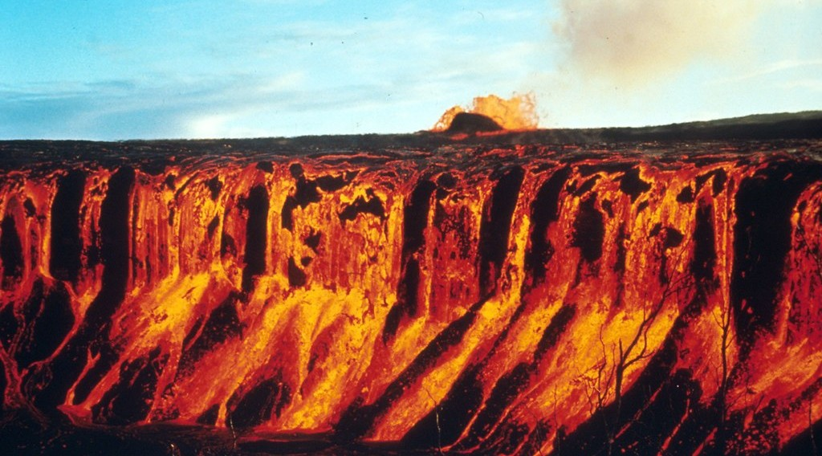
1. DEFINITION AND ORIGIN
Activity 1
A volcano erupts.
Notes:
Activity 1. Look carefully at this picture: a volcano erupts. Observe every detail before I ask the question.

Slide 20
1. DEFINITION AND ORIGIN
Activity 1: Question
What comes out of a volcano during an eruption?
Notes:
Here is the question for Activity 1: What comes out of a volcano during an eruption? Take one minute to think and write your answer in your rough notebook.

Slide 21
1. DEFINITION AND ORIGIN
Activity 1: Answer
Lava, gases and ash.
Notes:
Let us check the answer together. Lava, gases and ash.

Slide 22
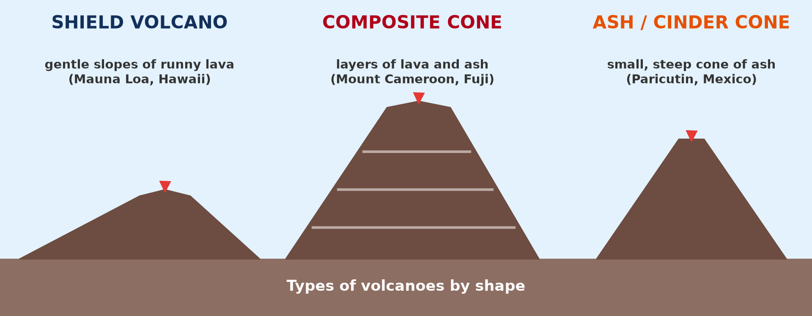
2. TYPES OF VOLCANOES
Activity 2
Types of volcanoes by shape.
Notes:
Activity 2. Look carefully at this diagram: types of volcanoes by shape. Observe every detail before I ask the question.

Slide 23
2. TYPES OF VOLCANOES
Activity 2: Question
Which type of volcano has gentle slopes made of runny lava?
Notes:
Here is the question for Activity 2: Which type of volcano has gentle slopes made of runny lava? Take one minute to think and write your answer in your rough notebook.

Slide 24
2. TYPES OF VOLCANOES
Activity 2: Answer
The shield volcano.
Notes:
Let us check the answer together. The shield volcano.

Slide 25
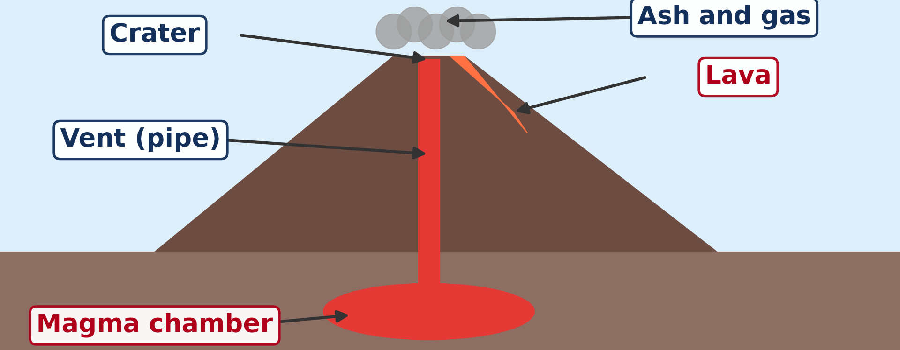
3. PROCESSES AND GENERAL STRUCTURE
Activity 3
The parts of a volcano.
Notes:
Activity 3. Look carefully at this diagram: the parts of a volcano. Observe every detail before I ask the question.

Slide 26
3. PROCESSES AND GENERAL STRUCTURE
Activity 3: Question 1
Where is magma stored under a volcano?
Notes:
Here is the question for Activity 3: Where is magma stored under a volcano? Take one minute to think and write your answer in your rough notebook.

Slide 27
3. PROCESSES AND GENERAL STRUCTURE
Activity 3: Answer 1
In the magma chamber.
Notes:
Let us check the answer together. In the magma chamber.

Slide 28
3. PROCESSES AND GENERAL STRUCTURE
Activity 3: Question 2
Through which part does it rise?
Notes:
Here is the next question: Through which part does it rise? Take one minute to think and write your answer in your rough notebook.

Slide 29
3. PROCESSES AND GENERAL STRUCTURE
Activity 3: Answer 2
Through the vent (pipe).
Notes:
Let us check the answer together. Through the vent (pipe).

Slide 30
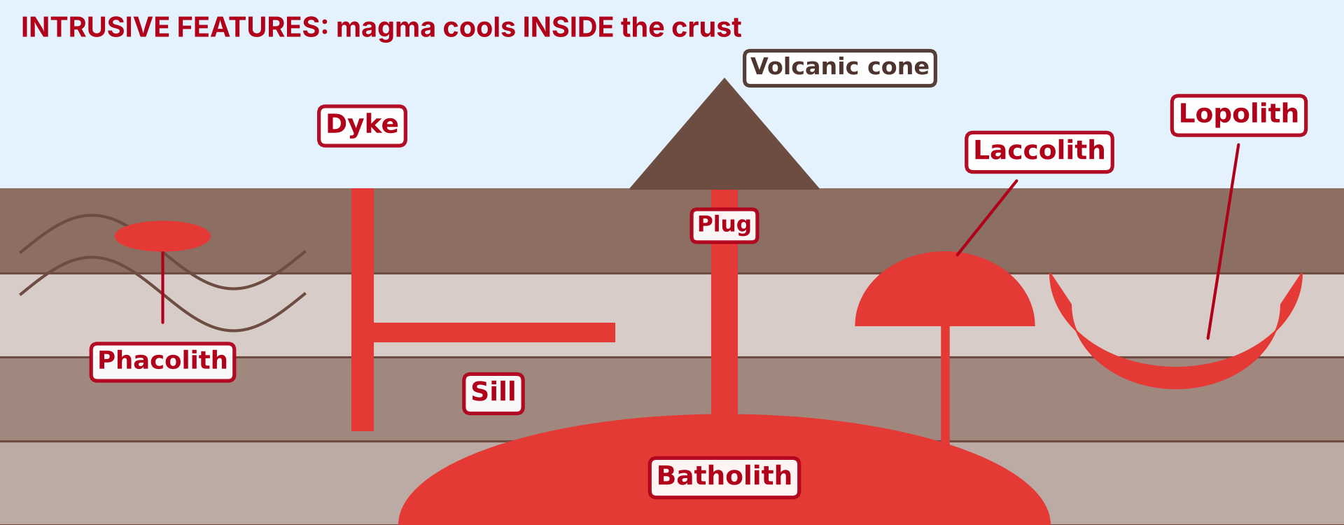
4. FEATURES OF VOLCANICITY
Activity 4
Intrusive features: magma cools inside the crust.
Notes:
Activity 4. Look carefully at this diagram: intrusive features: magma cools inside the crust. Observe every detail before I ask the question.

Slide 31
4. FEATURES OF VOLCANICITY
Activity 4: Question
Which intrusive feature is a vertical sheet of rock that cuts across the layers?
Notes:
Here is the question for Activity 4: Which intrusive feature is a vertical sheet of rock that cuts across the layers? Take one minute to think and write your answer in your rough notebook.

Slide 32
4. FEATURES OF VOLCANICITY
Activity 4: Answer
A dyke.
Notes:
Let us check the answer together. A dyke.

Slide 33
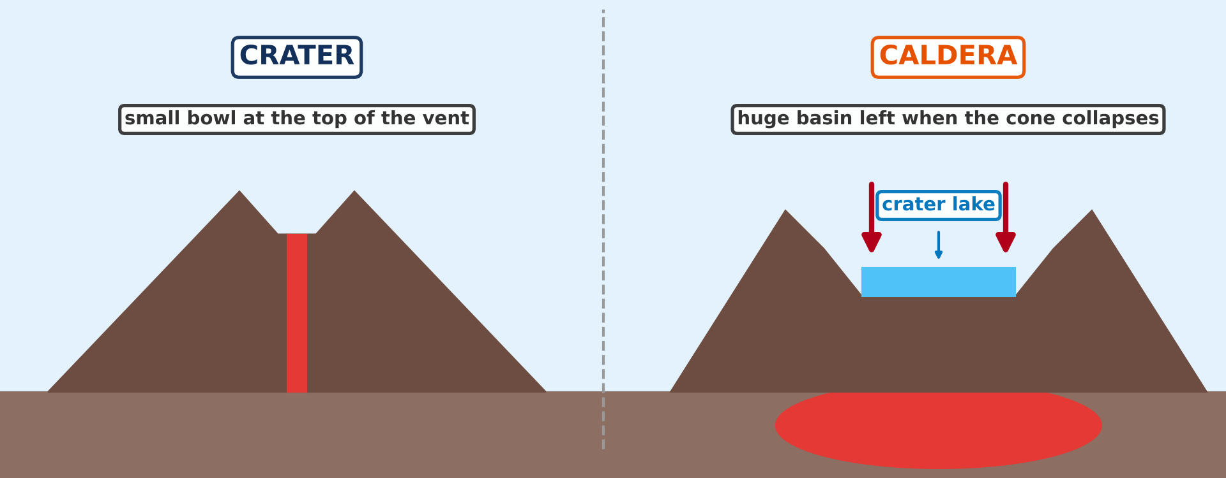
4. FEATURES OF VOLCANICITY
Activity 5
A crater and a caldera.
Notes:
Activity 5. Look carefully at this diagram: a crater and a caldera. Observe every detail before I ask the question.

Slide 34
4. FEATURES OF VOLCANICITY
Activity 5: Question
Which extrusive feature is a huge basin left when a volcano collapses?
Notes:
Here is the question for Activity 5: Which extrusive feature is a huge basin left when a volcano collapses? Take one minute to think and write your answer in your rough notebook.

Slide 35
4. FEATURES OF VOLCANICITY
Activity 5: Answer
A caldera.
Notes:
Let us check the answer together. A caldera.

Slide 36
BOARD SUMMARY
Board Summary
Topic: The Structure of the Earth: Building Processes and Impacts on Man
Sub-topic: Volcanoes
Lesson 11: Volcanoes
Notes:
Now we are going to copy the board summary. Write the title and the headings neatly in your notebooks. I will give you enough time for each slide, so do not rush.

Slide 37
BOARD SUMMARY
DEFINITIONS
The key terms of this lesson are defined as follows:
Volcano: It is an opening in the crust through which magma, gases and ash come out onto the surface.
Notes:
Let us copy the definitions. The key terms of this lesson are defined as follows. On this slide we have Volcano. Write each point on a new line, with the key term first, and explain it in your own words when we revise. When you finish, we go to the next slide.

Slide 38
BOARD SUMMARY
DEFINITIONS (continued)
Volcanicity: It is all the processes by which magma rises into the crust or onto the surface.
Magma: It is molten rock under the ground.
Lava: It is magma that comes out onto the surface.
Notes:
We continue with the definitions. On this slide we have Volcanicity, Magma and Lava. Write each point on a new line, with the key term first, and explain it in your own words when we revise. When you finish, we go to the next slide.

Slide 39
BOARD SUMMARY
DEFINITIONS (continued)
Crater: It is the round hollow at the top of the vent of a volcano.
Caldera: It is a very large basin left when the top of a volcano collapses or explodes.
Intrusive features: They are landforms made by magma that cools inside the crust.
Notes:
We continue with the definitions. On this slide we have Crater, Caldera and Intrusive features. Write each point on a new line, with the key term first, and explain it in your own words when we revise. When you finish, we go to the next slide.

Slide 40
BOARD SUMMARY
DEFINITIONS (continued)
Extrusive features: They are landforms made by lava, ash and gases that come out onto the surface.
Notes:
We continue with the definitions. On this slide we have Extrusive features. Write each point on a new line, with the key term first, and explain it in your own words when we revise.

Slide 41
BOARD SUMMARY
1. Definition and Origin of Volcanoes
Volcanoes have the following origin:
Source of magma: Magma forms deep in the Earth, in the mantle and the lower crust, where the rocks are very hot and partly melt.
Notes:
Let us copy Definition and Origin of Volcanoes. Volcanoes have the following origin. On this slide we have Source of magma. Write each point on a new line, with the key term first, and explain it in your own words when we revise. When you finish, we go to the next slide.

Slide 42
BOARD SUMMARY
1. Definition and Origin of Volcanoes (continued)
Constructive plate margins: Where plates move apart, magma rises through the gap, as in Iceland and the East African Rift.
Destructive plate margins: Where one plate sinks and melts, magma rises to the surface, as around the Pacific Ocean.
Notes:
We continue with Definition and Origin of Volcanoes. On this slide we have Constructive plate margins and Destructive plate margins. Write each point on a new line, with the key term first, and explain it in your own words when we revise. When you finish, we go to the next slide.

Slide 43
BOARD SUMMARY
1. Definition and Origin of Volcanoes (continued)
Hot spots: In some places, hot magma rises from deep in the mantle in the middle of a plate, as in Hawaii.
Notes:
We continue with Definition and Origin of Volcanoes. On this slide we have Hot spots. Write each point on a new line, with the key term first, and explain it in your own words when we revise.

Slide 44
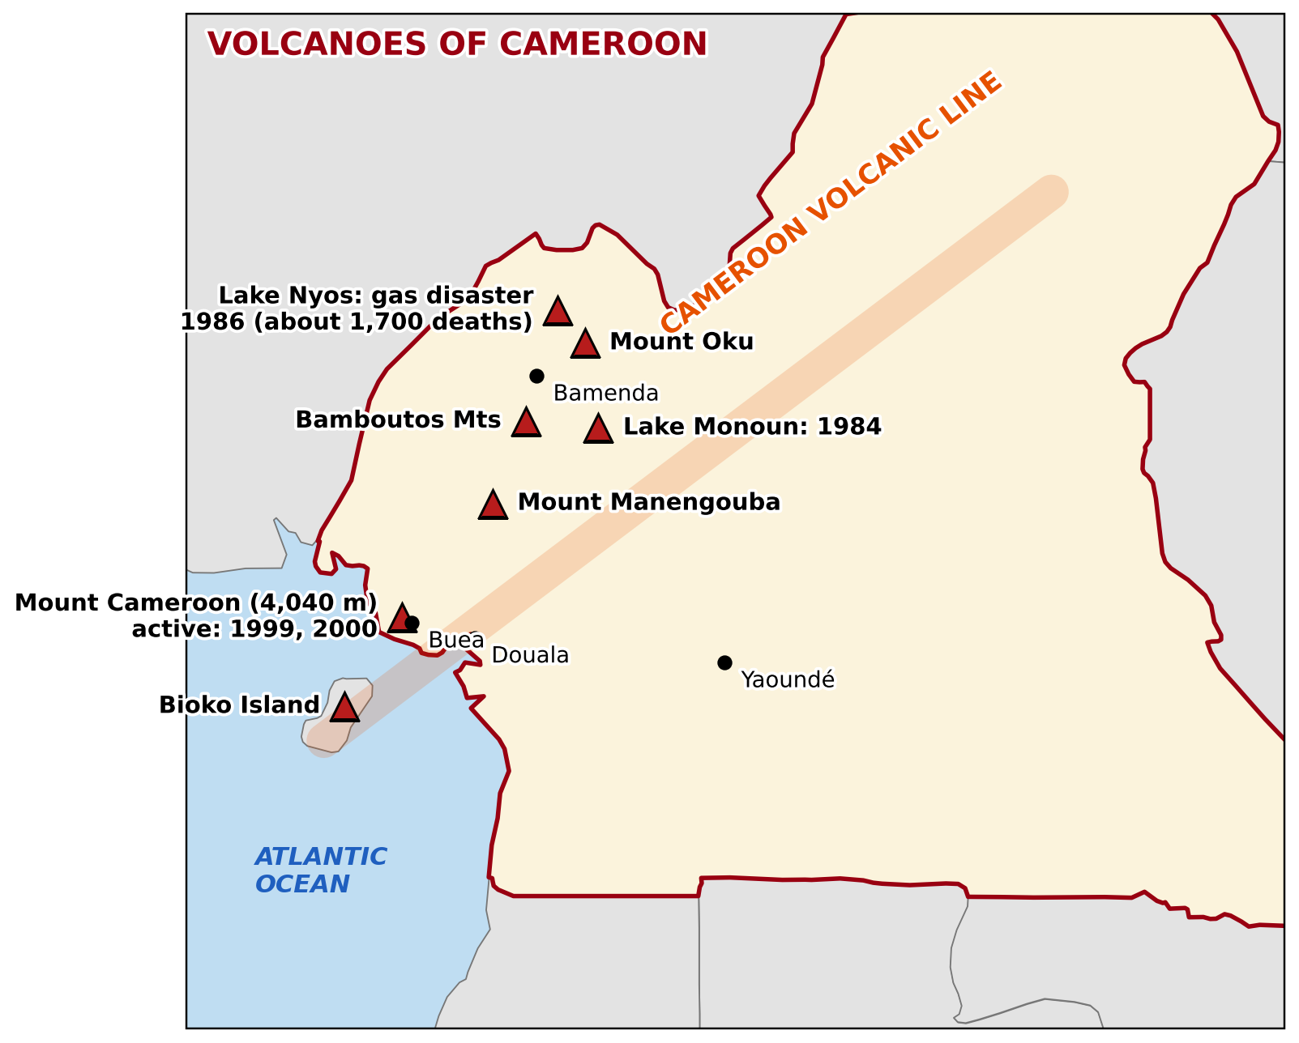
BOARD SUMMARY
1. Definition and Origin of Volcanoes
Lines of weakness: Magma rises along cracks in the crust, as on the Cameroon Volcanic Line.
Illustration: volcanoes of Cameroon
Notes:
Copy the point on Lines of weakness on the left, then draw the diagram on the right: volcanoes of Cameroon. Give it a title and label it clearly.

Slide 45
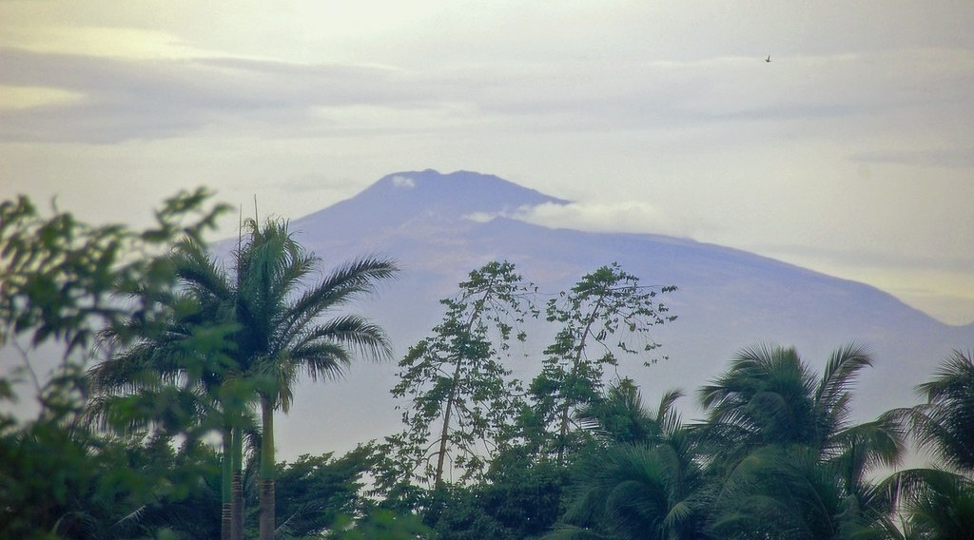
BOARD SUMMARY
2. Types of Volcanoes
A) According to Activity
Volcanoes are classified according to their activity as follows:
Active volcano: It erupts now or has erupted recently, like Mount Cameroon.
Illustration: Mount Cameroon
Notes:
Let us copy According to Activity. Volcanoes are classified according to their activity as follows. Copy the point on Active volcano on the left, then draw the diagram on the right: mount Cameroon. Give it a title and label it clearly.

Slide 46
BOARD SUMMARY
2. Types of Volcanoes
A) According to Activity
Dormant volcano: It has not erupted for a long time but can erupt again.
Extinct volcano: It will never erupt again, like Mount Manengouba.
Notes:
We continue with According to Activity. On this slide we have Dormant volcano and Extinct volcano. Write each point on a new line, with the key term first, and explain it in your own words when we revise.

Slide 47
BOARD SUMMARY
2. Types of Volcanoes
B) According to Shape
Volcanoes are classified according to their shape as follows:
Shield volcano: It has gentle slopes built by runny lava, like Mauna Loa in Hawaii.
Illustration: types of volcanoes by shape
Notes:
Let us copy According to Shape. Volcanoes are classified according to their shape as follows. Copy the point on Shield volcano on the left, then draw the diagram on the right: types of volcanoes by shape. Give it a title and label it clearly.

Slide 48
BOARD SUMMARY
2. Types of Volcanoes
B) According to Shape
Composite cone: It is a high, steep cone built of layers of lava and ash, like Mount Cameroon.
Ash and cinder cone: It is a small, steep cone built of ash and cinders.
Notes:
We continue with According to Shape. On this slide we have Composite cone and Ash and cinder cone. Write each point on a new line, with the key term first, and explain it in your own words when we revise.

Slide 49
BOARD SUMMARY
3. Processes and General Structure of a Volcano
A) Processes
Magma moves by the following processes:
Intrusion: Magma cools inside the crust and forms intrusive features.
Extrusion: Magma comes out as lava, ash and gases and forms extrusive features.
Notes:
Let us copy Processes. Magma moves by the following processes. On this slide we have Intrusion and Extrusion. Write each point on a new line, with the key term first, and explain it in your own words when we revise. When you finish, we go to the next slide.

Slide 50
BOARD SUMMARY
3. Processes and General Structure of a Volcano
A) Processes (continued)
Eruption: It is the sudden release of lava, ash and gases through the vent. It is quiet when the lava is runny and explosive when the lava is thick and full of gas.
Notes:
We continue with Processes. On this slide we have Eruption. Write each point on a new line, with the key term first, and explain it in your own words when we revise.

Slide 51
BOARD SUMMARY
3. Processes and General Structure of a Volcano
B) General Structure
A volcano has the following parts:
Magma chamber: It is the store of molten rock under the volcano.
Illustration: the structure of a volcano
Notes:
Let us copy General Structure. A volcano has the following parts. Copy the point on Magma chamber on the left, then draw the diagram on the right: the structure of a volcano. Give it a title and label it clearly.

Slide 52
BOARD SUMMARY
3. Processes and General Structure of a Volcano
B) General Structure
Vent (pipe): It is the channel through which magma rises.
Cone: It is the mountain built by layers of lava and ash.
Notes:
We continue with General Structure. On this slide we have Vent (pipe) and Cone. Write each point on a new line, with the key term first, and explain it in your own words when we revise.

Slide 53
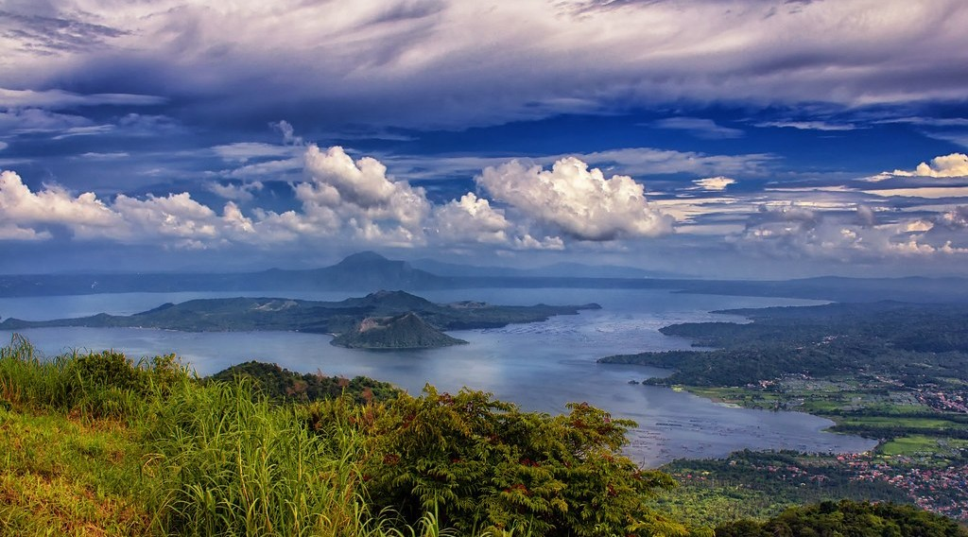
BOARD SUMMARY
3. Processes and General Structure of a Volcano
B) General Structure
Crater: It is the round hollow at the top of the vent.
Illustration: a crater
Notes:
Copy the point on Crater on the left, then draw the diagram on the right: a crater. Give it a title and label it clearly.

Slide 54
BOARD SUMMARY
3. Processes and General Structure of a Volcano
B) General Structure
Secondary cone: It is a small cone on the side of the volcano, fed by a side vent.
Lava flow: It is the stream of lava running down the slopes of the volcano.
Notes:
We continue with General Structure. On this slide we have Secondary cone and Lava flow. Write each point on a new line, with the key term first, and explain it in your own words when we revise.

Slide 55
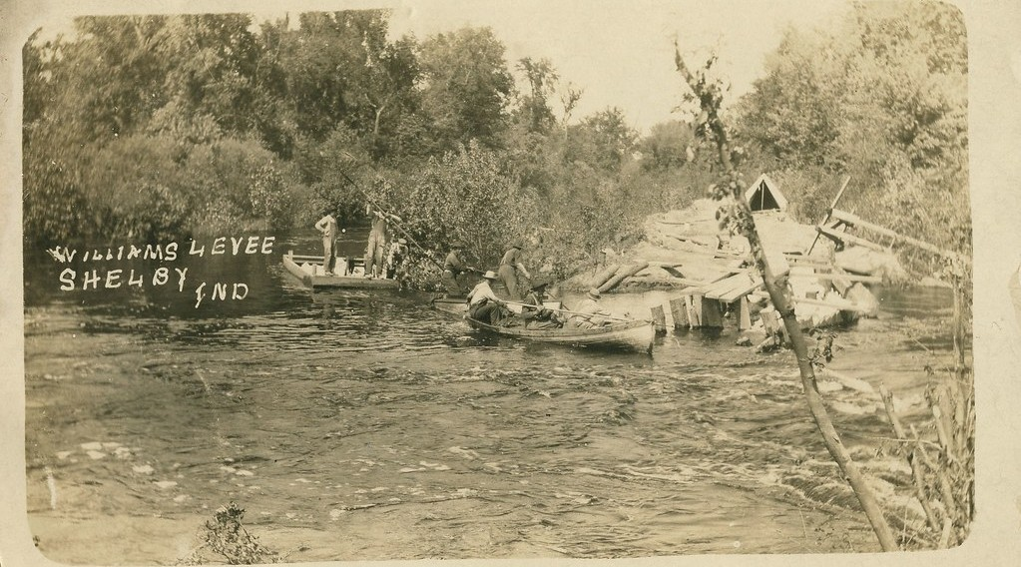
BOARD SUMMARY
4. Features of Volcanicity
A) Intrusive Features
Intrusive features are made by magma that cools inside the crust:
Dyke: It is a vertical sheet of igneous rock that cuts across the layers of rock.
Illustration: a dyke
Notes:
Let us copy Intrusive Features. Intrusive features are made by magma that cools inside the crust. Copy the point on Dyke on the left, then draw the diagram on the right: a dyke. Give it a title and label it clearly.

Slide 56
BOARD SUMMARY
4. Features of Volcanicity
A) Intrusive Features
Sill: It is a horizontal sheet of igneous rock between two layers of rock.
Laccolith: It is a dome-shaped mass of igneous rock with a flat base that pushes up the layers above it.
Notes:
We continue with Intrusive Features. On this slide we have Sill and Laccolith. Write each point on a new line, with the key term first, and explain it in your own words when we revise. When you finish, we go to the next slide.

Slide 57
BOARD SUMMARY
4. Features of Volcanicity
A) Intrusive Features (continued)
Lopolith: It is a saucer-shaped mass of igneous rock that sinks into the layers below it.
Phacolith: It is a lens-shaped mass of igneous rock found in the crest or the trough of a fold.
Notes:
We continue with Intrusive Features. On this slide we have Lopolith and Phacolith. Write each point on a new line, with the key term first, and explain it in your own words when we revise. When you finish, we go to the next slide.

Slide 58
BOARD SUMMARY
4. Features of Volcanicity
A) Intrusive Features (continued)
Batholith: It is a huge mass of igneous rock, often granite, deep in the crust. It is the largest intrusive feature.
Notes:
We continue with Intrusive Features. On this slide we have Batholith. Write each point on a new line, with the key term first, and explain it in your own words when we revise.

Slide 59
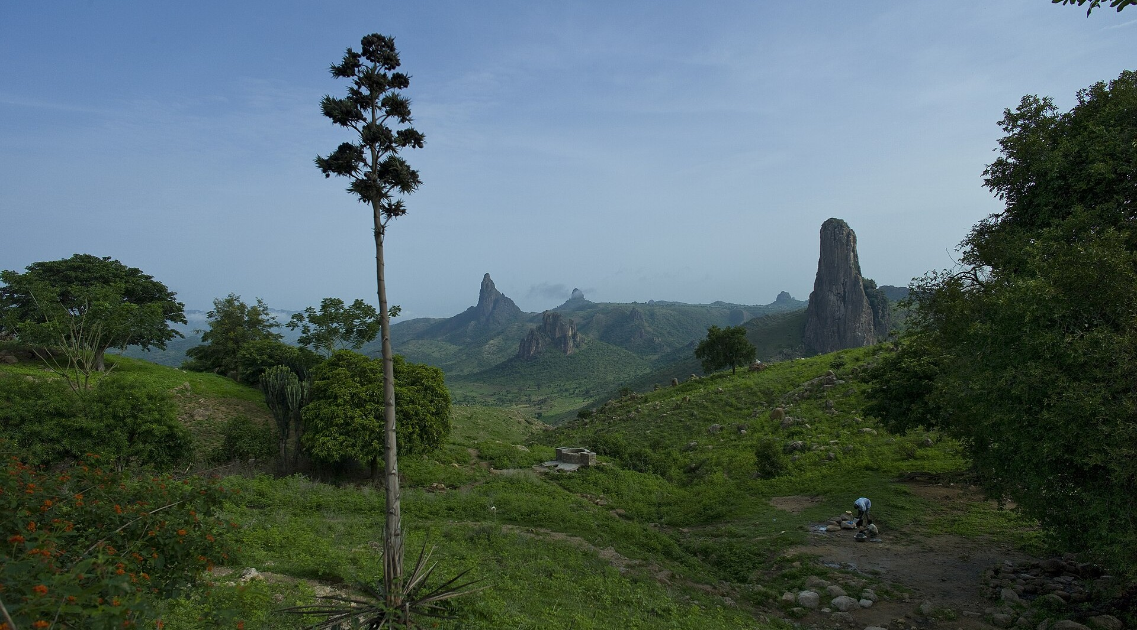
BOARD SUMMARY
4. Features of Volcanicity
A) Intrusive Features
Volcanic plug (spine): It is the hard magma that fills the vent of an old volcano, and stays as a rocky hill when erosion removes the cone, like Rhumsiki in northern Cameroon.
Illustration: a volcanic plug
Notes:
Copy the point on Volcanic plug (spine) on the left, then draw the diagram on the right: a volcanic plug. Give it a title and label it clearly.

Slide 60
BOARD SUMMARY
4. Features of Volcanicity
Illustration: Copy the intrusive features on a generalised diagram
Notes:
Now draw this illustration in your notebook: copy the intrusive features on a generalised diagram. Give it a title and label it clearly.

Slide 61
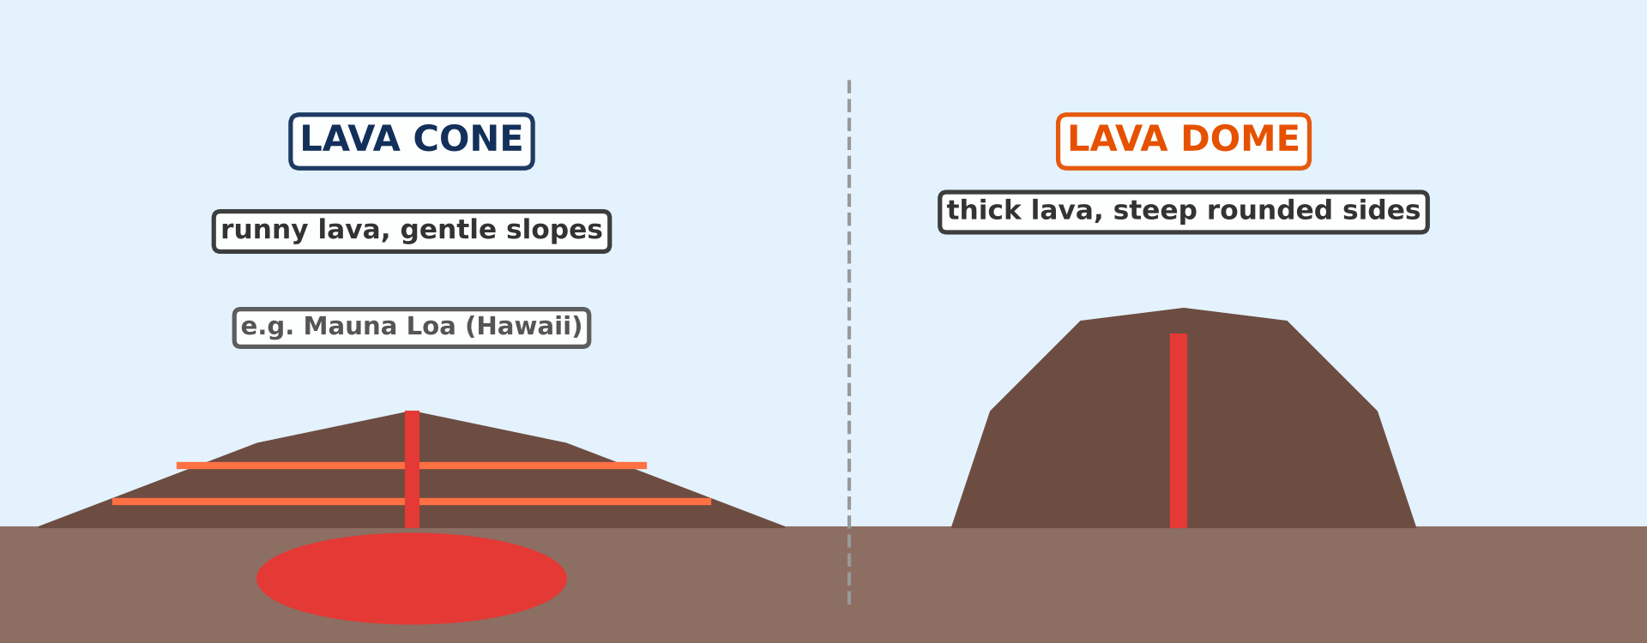
BOARD SUMMARY
4. Features of Volcanicity
B) Extrusive Features
Extrusive features are made on the surface by lava, ash and gases:
Lava cones: They are broad cones with gentle slopes built by runny lava, like Mauna Loa in Hawaii. Thick lava builds steep lava domes.
Illustration: a lava cone and a lava dome
Notes:
Let us copy Extrusive Features. Extrusive features are made on the surface by lava, ash and gases. Copy the point on Lava cones on the left, then draw the diagram on the right: a lava cone and a lava dome. Give it a title and label it clearly.

Slide 62
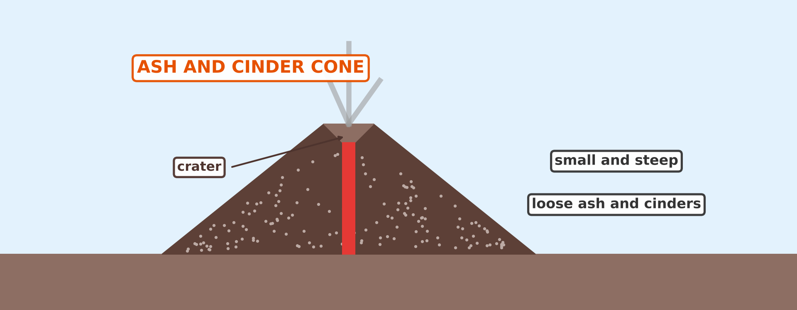
BOARD SUMMARY
4. Features of Volcanicity
B) Extrusive Features
Ash and cinder cones: They are small, steep cones built of loose ash and cinders, usually less than 300 metres high. Many are found on the slopes of Mount Cameroon.
Illustration: an ash and cinder cone
Notes:
Copy the point on Ash and cinder cones on the left, then draw the diagram on the right: an ash and cinder cone. Give it a title and label it clearly.

Slide 63
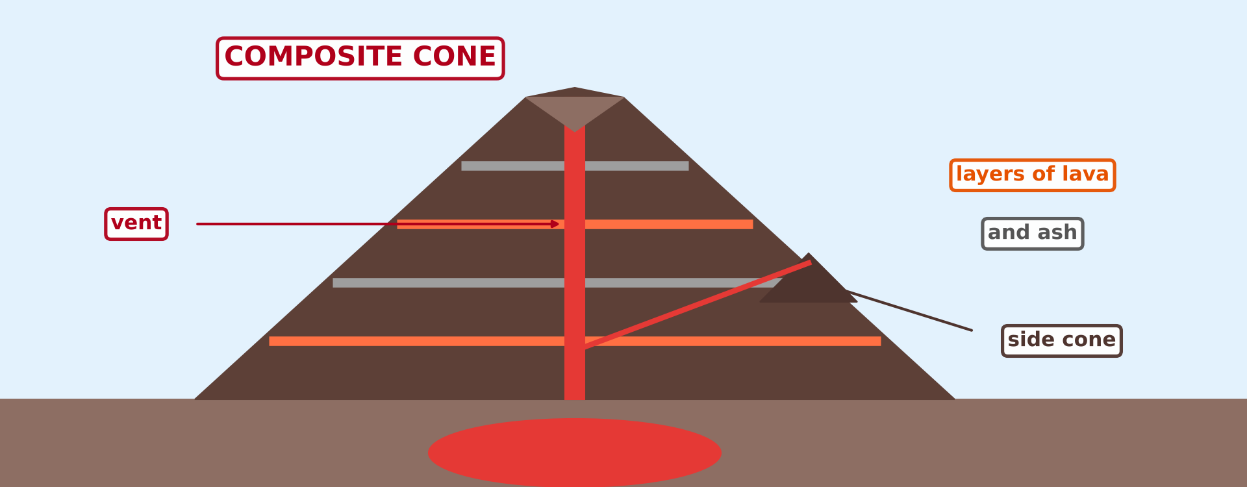
BOARD SUMMARY
4. Features of Volcanicity
B) Extrusive Features
Composite cones: They are high cones built of alternate layers of lava and ash, like Mount Cameroon and Mount Fuji.
Illustration: a composite cone
Notes:
Copy the point on Composite cones on the left, then draw the diagram on the right: a composite cone. Give it a title and label it clearly.

Slide 64
BOARD SUMMARY
4. Features of Volcanicity
B) Extrusive Features
Craters and calderas: A crater is a small hollow at the top of the vent. A caldera is a huge basin left when the volcano collapses, like those of Mount Manengouba and the Bambouto Mountains.
Illustration: a crater and a caldera
Notes:
Copy the point on Craters and calderas on the left, then draw the diagram on the right: a crater and a caldera. Give it a title and label it clearly.

Slide 65
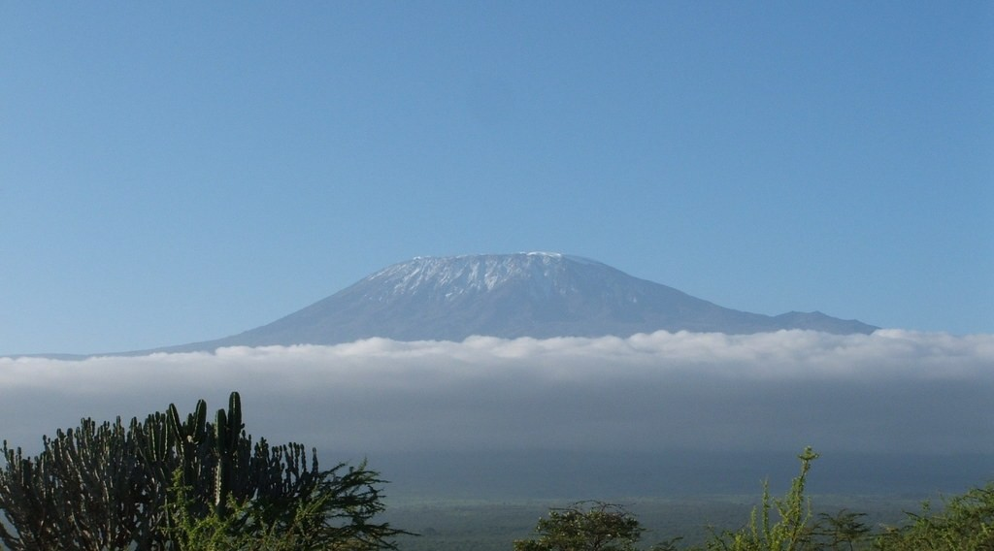
BOARD SUMMARY
4. Features of Volcanicity
B) Extrusive Features
Volcanic mountains: They are large mountains built by many eruptions over a long time, like Mount Cameroon, Mount Kilimanjaro and Mount Fuji.
Illustration: Mount Kilimanjaro
Notes:
Copy the point on Volcanic mountains on the left, then draw the diagram on the right: mount Kilimanjaro. Give it a title and label it clearly.

Slide 66
BOARD SUMMARY
4. Features of Volcanicity
B) Extrusive Features
Lava plateaux: They are wide, flat highlands built by thick layers of runny lava from long cracks, like the Deccan Plateau in India.
Notes:
We continue with Extrusive Features. On this slide we have Lava plateaux. Write each point on a new line, with the key term first, and explain it in your own words when we revise.

Slide 67
FORMATIVE EVALUATION
Evaluation 1
What is a volcano?
Notes:
Now let us check what you have understood. Question 1: What is a volcano? Answer in your exercise book.

Slide 68
FORMATIVE EVALUATION
Expected Answer
It is an opening in the crust through which magma, gases and ash come out.
Notes:
The expected answer is: it is an opening in the crust through which magma, gases and ash come out. If you got it right, well done.

Slide 69
FORMATIVE EVALUATION
Evaluation 2
Name two intrusive features and two extrusive features.
Notes:
Now let us check what you have understood. Question 2: Name two intrusive features and two extrusive features. Answer in your exercise book.

Slide 70
FORMATIVE EVALUATION
Expected Answer
Intrusive: a dyke and a sill (or a laccolith, a batholith). Extrusive: a lava cone and a composite cone (or an ash and cinder cone, a caldera).
Notes:
The expected answer is: intrusive: a dyke and a sill (or a laccolith, a batholith). Extrusive: a lava cone and a composite cone (or an ash and cinder cone, a caldera). If you got it right, well done.

Slide 71
FORMATIVE EVALUATION
Evaluation 3
Distinguish a crater from a caldera.
Notes:
Now let us check what you have understood. Question 3: Distinguish a crater from a caldera. Answer in your exercise book.

Slide 72
FORMATIVE EVALUATION
Expected Answer
A crater is a small hollow at the top of the vent; a caldera is a huge basin left when the volcano collapses.
Notes:
The expected answer is: a crater is a small hollow at the top of the vent; a caldera is a huge basin left when the volcano collapses. If you got it right, well done.

Slide 73
REMEDIATION
Remediation
Fill in the blanks:
Magma that reaches the surface is called ______.
A vertical sheet of igneous rock that cuts across the layers is a ______.
Notes:
Take your time to copy this part; we will continue together.

Slide 74
REMEDIATION
Remediation (continued)
A horizontal sheet of igneous rock between two layers is a ______.
A huge basin left when a volcano collapses is a ______.
A cone built of layers of lava and ash is a ______ cone.
Notes:
For those who need more practice, fill in the blanks in your exercise book. The answers are: number 1, lava; number 2, dyke; number 3, sill; number 4, caldera; number 5, composite.

Slide 75
HOMEWORK
Homework
Give one danger and one advantage of volcanoes.
Notes:
For your homework: Give one danger and one advantage of volcanoes. We shall correct it at the beginning of our next lesson.

Slide 76
NEXT LESSON
Next Lesson
Our next lesson will be on:
Lesson 12: The Impact of Volcanicity on Man
Notes:
Our next lesson will be on Lesson 12: The Impact of Volcanicity on Man. Thank you for your attention, and see you next time.

Slide 77
BILINGUAL GAME
Bilingual Game (Jeu Bilingue)
English | Français
Volcano | Le volcan
Lava | La lave
Crater | Le cratère
Caldera | La caldeira
Dyke | Le dyke
Sill | Le sill
Batholith | Le batholite
Volcanic plug | Le culot volcanique
Notes:
Let us play the bilingual game. I say a word in English, and you give me the French word. Then we do the reverse.

Slide 78
LOGBOOK
Official Logbook (1/2)
Module / Topic | The Structure of the Earth: Building Processes and Impacts on Man
Lesson Title | Lesson 11: Volcanoes
Expected Learning Outcomes | Define a volcano and explain its origin. Classify the types of volcanoes. Describe the processes and the general structure of a volcano. Name and illustrate the intrusive features. Describe the extrusive features.
Competence | Learners are able to draw and label a volcano, to name the intrusive and extrusive volcanic features, and to recognise volcanic landforms in Cameroon.
Notes:
I record this information in the official logbook of the class after the lesson.

Slide 79
LOGBOOK
Official Logbook (2/2)
Matter Taught | DEFINITIONS; Definition and Origin of Volcanoes; According to Activity; According to Shape; Processes; General Structure; Intrusive Features; Extrusive Features.
Evaluation | Formative evaluation and remediation exercise.
Homework | Give one danger and one advantage of volcanoes.
Enrolment / Present / Absent | ____ / ____ / ____
Achievement | To be completed after the lesson.
Notes:
I complete the second page of the logbook: the matter taught, the evaluation, the homework and the attendance.

Slide 80
TEACHER'S NOTE
Teacher's Note
Timing: Homework correction, plan, objectives 8 min | Recall, situation, action 10 min | 5 activities 30 min | Board summary (copying) 30 min | Evaluation, remediation 10 min | Homework, next lesson 5 min | Logbook 7 min
Without the projector (Activity 1): describe the 2000 eruption of Mount Cameroon.
Without the projector (Activity 2): draw the three shapes on the board.
Without the projector (Activity 3): draw a simple volcano on the board.
Without the projector (Activity 4): draw a dyke and a sill on the board.
Without the projector (Activity 5): draw a small crater and a big caldera on the board.
Notes:
This slide is for me, the teacher: it gives the timing of the lesson and what to do if the projector is not available.

Slide 81
REFERENCES
References
National Geography Syllabus (MINESEC), Form 3 — The Structure of the Earth: Building Processes and Impacts on Man.
Teacher's lesson notes (Form 3), checked and corrected where necessary.
Global Volcanism Program (Smithsonian): Mount Cameroon.
Photo, Activity 1: “Happy Anniversary Hawaii” by U.S. Geological Survey, CC0 1.0, via Flickr (https://www.flickr.com/photos/27784370@N05/14802198589)
Photo, board summary (Active volcano): “Mount Cameroon” by John & Mel Kots, CC BY-NC-ND 2.0, via Flickr (https://www.flickr.com/photos/26745817@N00/2347261849)
Photo, board summary (Crater): “Taal Lake and Volcano, Tagaytay, Philippines” by Ray in Manila, CC BY 2.0, via Flickr (https://www.flickr.com/photos/21186555@N07/28260012661)
Photo, board summary (Dyke): “Williams Levee on Kankakee River near Shelby, Indiana, May 1912” by Shook Photos, CC BY 2.0, via Flickr (https://www.flickr.com/photos/24724221@N07/18458778016)
Notes:
Take your time to copy this part; we will continue together.

Slide 82
REFERENCES
References (continued)
Photo, board summary (Volcanic plug (spine)): Rhumsiki with Kapsiki Peak (after sunrise), Far North Province of Cameroon.jpg — Alfred Weidinger, CC BY 2.0, via Wikimedia Commons (https://commons.wikimedia.org/wiki/File:Rhumsiki_with_Kapsiki_Peak_(after_sunrise),_Far_North_Province_of_Cameroon.jpg)
Photo, board summary (Volcanic mountains): “Kilimanjaro” by ian 1602, CC BY-NC 2.0, via Flickr (https://www.flickr.com/photos/98181641@N00/2179855841)
Diagrams and animations: drawn for this lesson (Geography Department).
Notes:
These are the references and picture credits used to prepare this lesson.

