Slide 1
Developing Custom Visuals for Power BI by Ted Pattison of Critical Path Training

Slide 2
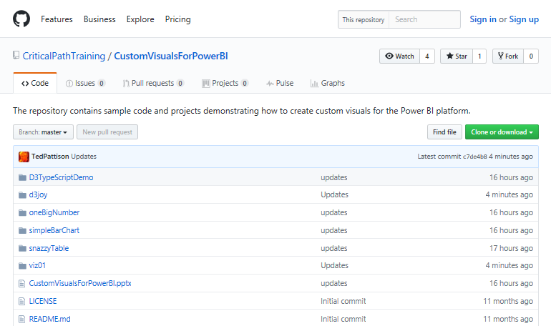
GitHub Repository for This Webinar
https://github.com/CriticalPathTraining/CustomVisualsForPowerBI

Slide 3
Agenda
Introduction to Custom Visuals in Power BI
Programming in TypeScript
Programming with the D3 Library
Getting Started with the PBIVIZ Utility
Designing and Implementing Custom Visuals
Packaging and Distribution Custom Visuals

Slide 4
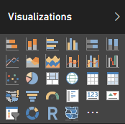
Built-in Visualization Types
Table and Matrix
Bar charts and Column charts
Pie charts and Doughnut chart
Line chart and Area chart
Scatter chart and Combo charts
Card and Multi-row Card
Treemap
Waterfall charts
Funnel charts
Gauge charts
Map and Filled Map
Slicer
R script visual
Shape map (in preview)

Slide 5
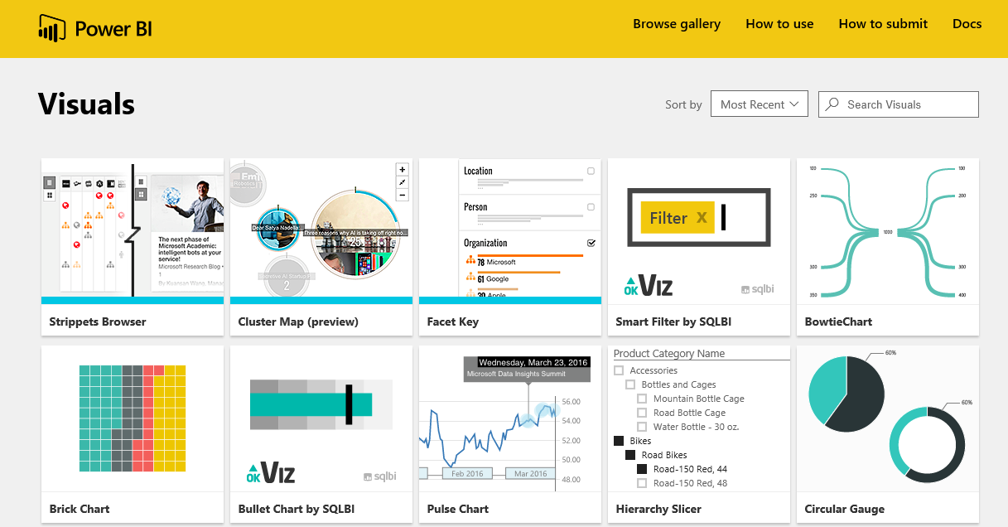
Custom Visual Gallery
Power BI Framework for Visuals is Extensible
Developers can extend Power BI with Custom Visuals
Microsoft Hosts gallery of custom visuals
Gallery located at https://app.powerbi.com/visuals/

Slide 6
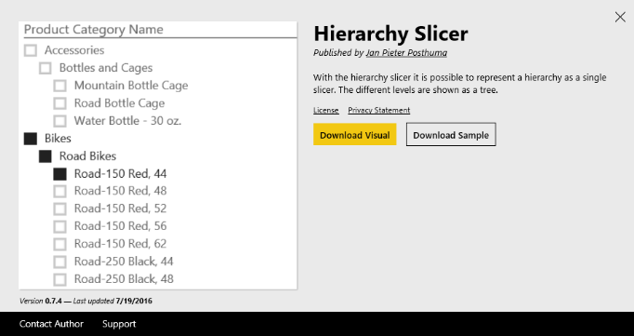
Downloading & Importing a Custom Visual
Visual must be downloaded from Visuals Gallery
Custom Visual files packaged in PBIVIZ File
Custom Visual can be imported into Power BI Desktop project
Custom Visual can be imported into workspace in Power BI service
Power BI Desktop Project
PBIVIZ
Power BI Workspace

Slide 7
Importing the Hierarchy Slicer Custom Visual
Visually Gratuitous Demo #1

Slide 8
Developing Your Own Custom Visuals
What are the learning curves?
Programming in TypeScript
Learning JavaScript libraries (e.g. D3.js)
Getting up to speed with the PBIVIZ utility
Learning to design and implement custom visuals
Learning to package and distribute custom visuals

Slide 9
Agenda
Introduction to Custom Visuals in Power BI
Programming in TypeScript
Programming with the D3 Library
Getting Started with the PBIVIZ Utility
Designing and Implementing Custom Visuals
Packaging and Distribution Custom Visuals

Slide 10
What is TypeScript?
A programming language which compiles into plain JavaScript
A superset of JavaScript that adds a strongly-typed dimension
It can be compiled into ECMAScript3, ECMAScript3 or ECMAScript 6
It runs in any browser, in any host and on any OS
product.ts
product.js
TypeScript
Compiler
Notes:
There is a getting started tutorial at https://www.typescriptlang.org/docs/tutorial.html .

Slide 11
Type Annotation
TypeScript allows you to annotate types
Provides basis for strongly-typed programming
Type annotations used by compiler for type checking
Type annotations are erased at the end of compile time

Slide 12
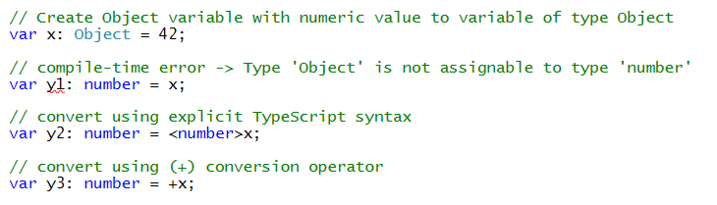
Casting Between Types

Slide 13
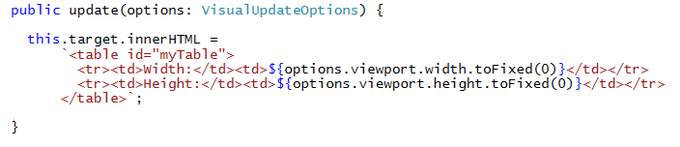
Template Strings

Slide 14
Arrow Function Syntax
TypeScript supports arrow function syntax
Special ()=>{} syntax to define anonymous functions
Arrow function syntax can be used to retain this pointer in classes

Slide 15
Classes
TypeScript supports defining classes
Class defines type for object
Export keyword makes class created across files
Class can be passed as factory function
Default accessibility is public

Slide 16
Class Constructors
Constructor parameters can be marked as public or private
Parameters marked as public or private become fields in class
Client-side code calls constructor using new operator

Slide 17
Interfaces
Interface defines a programming contract
Classes can implement interfaces
Client code can be decoupled from concrete classes

Slide 18
TypeScript Definition Files (d.ts)
What are TypeScript definition files
Typed definitions for 3rd party JavaScript libraries
DefinitelyTyped provides great community resource
Typed definition files have a d.ts extension

Slide 19
The D3TypeScriptDemo Project – Part 1
Visually Gratuitous Demo #2

Slide 20
Agenda
Introduction to Custom Visuals in Power BI
Programming in TypeScript
Programming with the D3 Library
Getting Started with the PBIVIZ Utility
Designing and Implementing Custom Visuals
Packaging and Distribution Custom Visuals

Slide 21
The D3 Library
What does the D3 library do?
Loading data into the browser’s memory
Binding data to create new set of SVG elements
Adding and removing SVG elements as needed
Transforming SVG elements by setting properties
Transitioning SVG elements in response to user actions

Slide 22
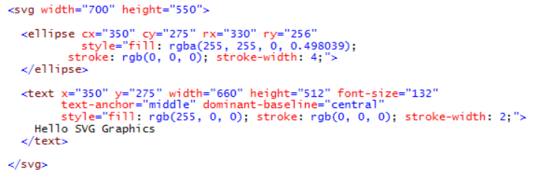
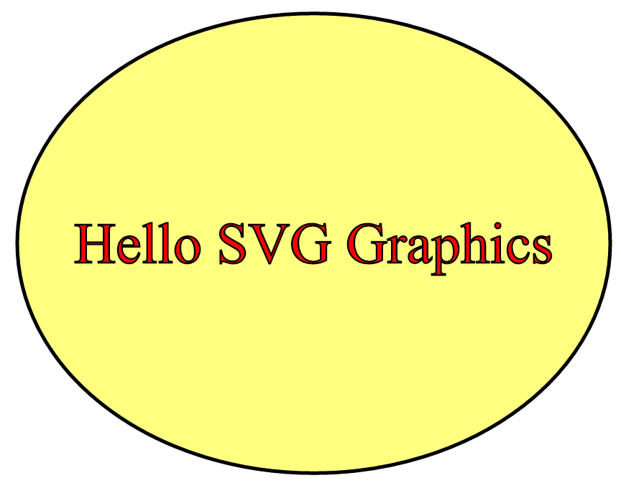
SVG Graphics
SVG = Scalable Vector Graphics
Specialized type of HTML element
More reliable and consistent than other HTML elements

Slide 23
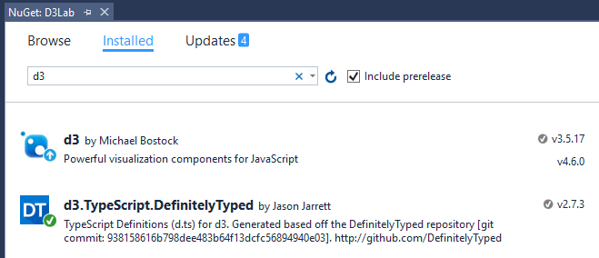
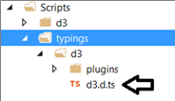
Adding D3 and D3 type definition files

Slide 24
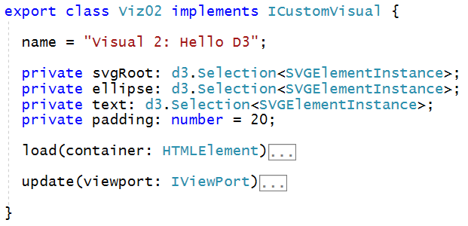
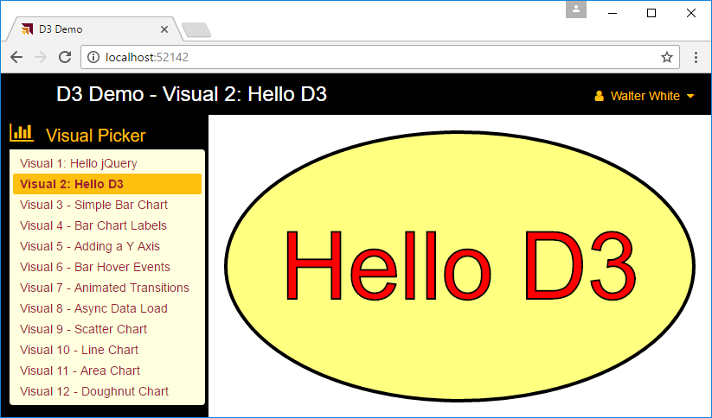
Designing a D3 Custom Visual

Slide 25
The D3TypeScriptDemo Project – Part 2
Visually Gratuitous Demo #3

Slide 26
Agenda
Introduction to Custom Visuals in Power BI
Programming in TypeScript
Programming with the D3 Library
Getting Started with the PBIVIZ Utility
Designing and Implementing Custom Visuals
Packaging and Distribution Custom Visuals

Slide 27
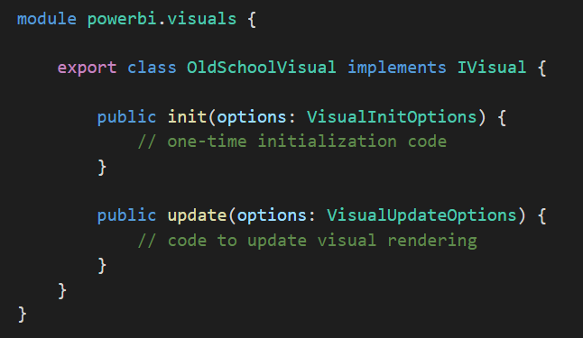
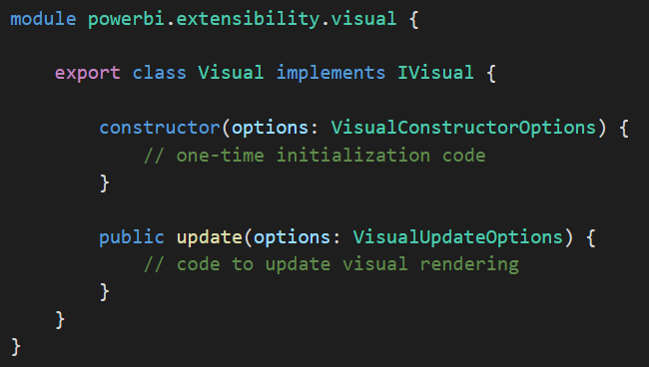
Developing Custom Visuals
There are two ways to develop a custom visual
The original way which is now deprecated
Still supported for backwards compatibility with older visuals
The new and better way introduced in July of 2016
Provides richer and significantly faster developer experience
Tools and documentation maintained in a GITHUB repository
Visual created using older style
Visual created using newer style

Slide 28
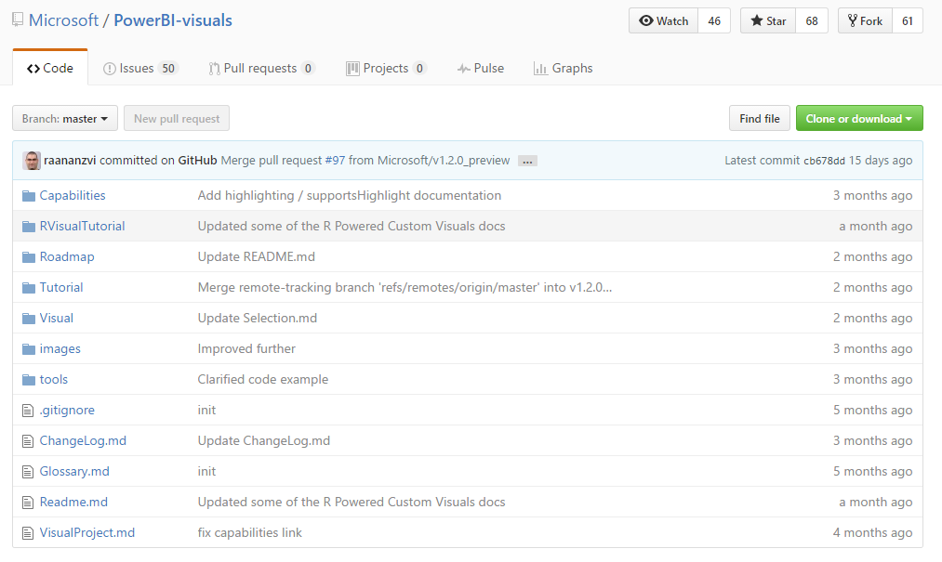
GitHub Repo for Custom Visuals
https://github.com/Microsoft/PowerBI-visuals

Slide 29
Install the Power BI Developer Toolchain
Install Node.JS
Installs Node Package Manage (npm)
Install Power BI visuals CLI tool (pbiviz)
Install using Node Package Manager (npm)
Install Local self-signed certificate
Install using Power BI visuals CLI tool (pbiviz)
Install Visual Studio Code
Lightweight alternative to Visual Studio for Node.js Development
Install Visual Studio 2017
Significant improvements for the Node.js development style

Slide 30
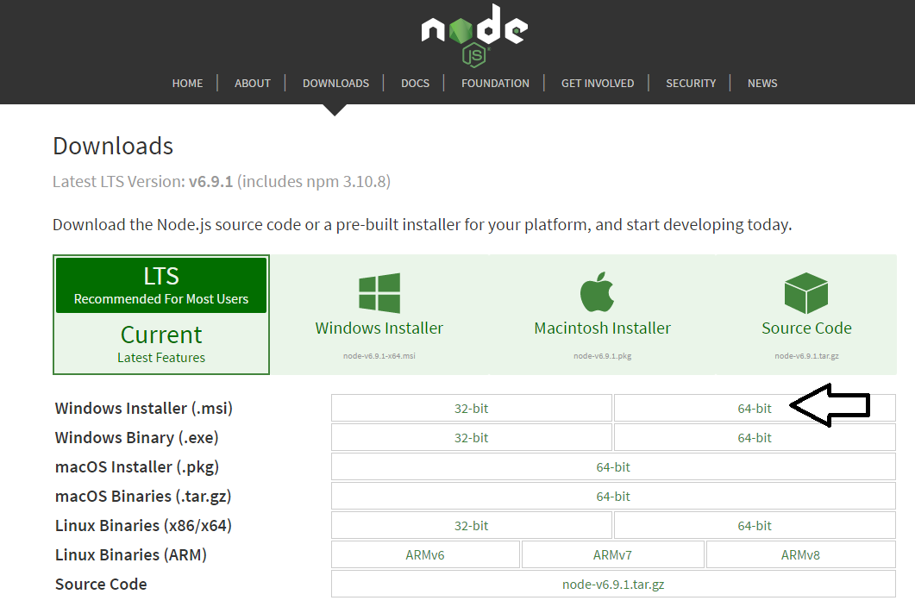
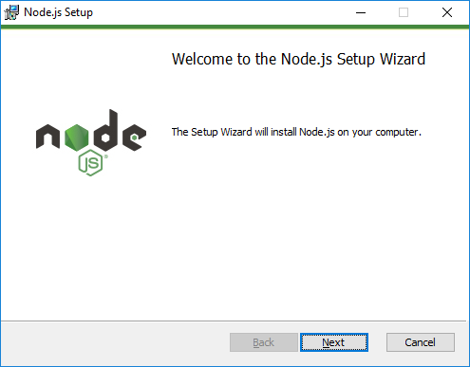
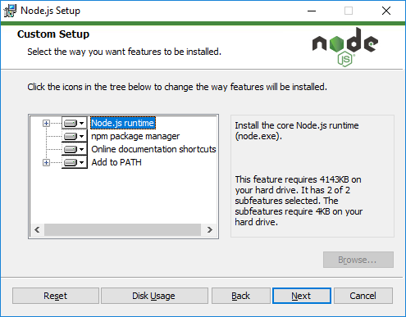
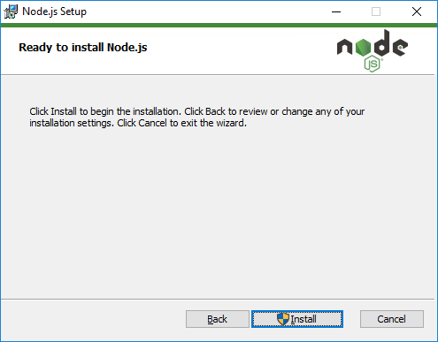
Installing node.js
https://nodejs.org/en/download/

Slide 31
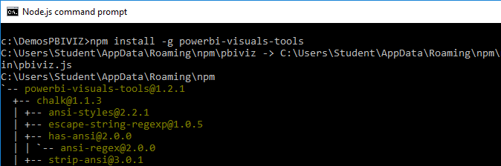
Power BI Visual CLI Tool (PBIVIZ)
What is the Power BI Custom Visual Tool?
Command-line utility for cross-platform dev
Use it with Visual Studio or Visual Studio Code
Requires that you first install node.js
Install by running command from node.js command prompt
npm install -g powerbi-visuals-tools

Slide 32
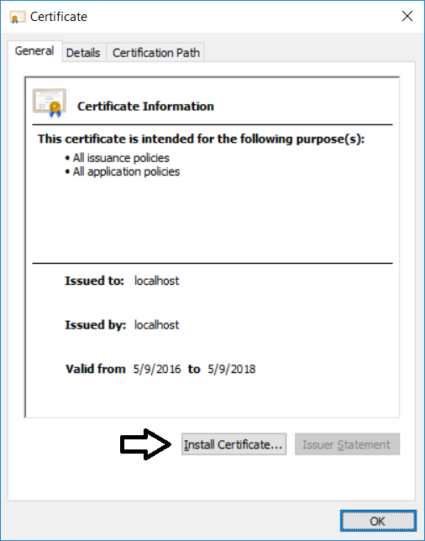
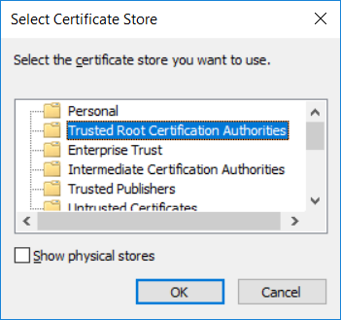

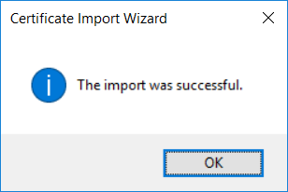
Installing the Developer Certificate
Debugging visuals inside PowerBI.com requires SSL
PBIVIZ leverages Node.js to provide debugging experience
Node.js acts as web service to serve project files through HTTP
Node.js debugging session uses http://localhost address
Installing certificate enables SSL through https://localhost
Installing certificate is a one time operation – not once per project

Slide 33
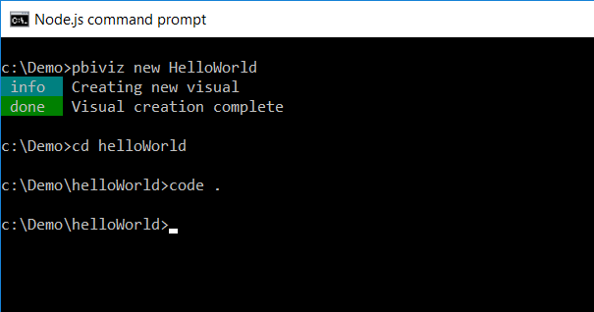
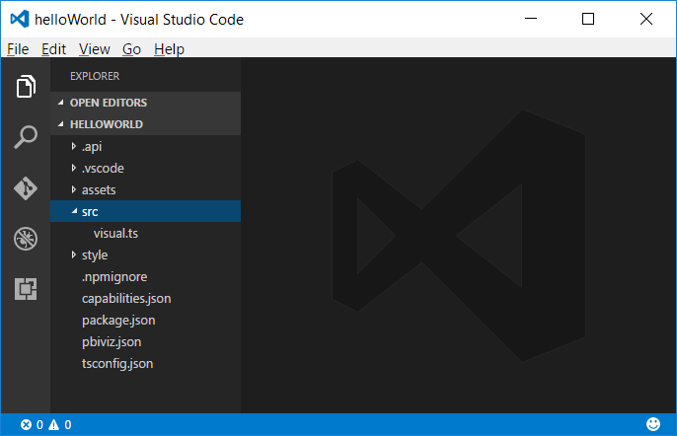
Creating a New Custom Visual Project
Creating a new project
pbiviz new <ProjectName>
Open the Project with Visual Studio Code
code .

Slide 34
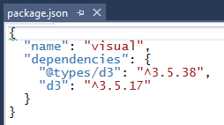
The package.json file
package.json used in Node.JS development
serves as project manifest
Includes references to 3rd party libraries
Modified using Node Package Manager (NPM) utility

Slide 35
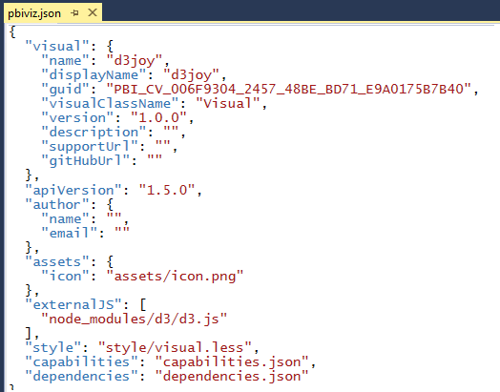
The pbiviz.json File
PBIVIZ.JSON serves a manifest for custom visual
This is where you add references to JavaScript libraries

Slide 36
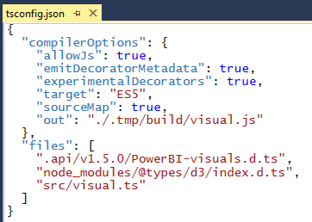
The tsconfig.json File
Used to add references to Typed Definition files (d.ts)
This is what enables compile-time type checking and IntelliSense
DO NOT add JavaScript files to files list

Slide 37
Getting Up and Running with the PBIVIZ Utility
Visually Gratuitous Demo #4

Slide 38
Recap of Basic Development Steps
Create a new project using PBIVIZ
There will be one custom visual per project
Modify files within the project
Use the editor of your choice
Extend the class that implements IVisual
The update method is where rendering takes place
Start a debugging session to test the visual out
Done using pbiviz start

Slide 39
Adding in Support for the D3.js Library
Visually Gratuitous Demo #5

Slide 40
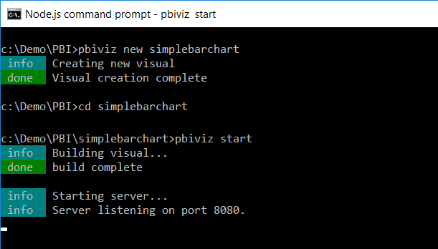
Running a Custom Visual Project

Slide 41
Agenda
Introduction to Custom Visuals in Power BI
Programming in TypeScript
Programming with the D3 Library
Getting Started with the PBIVIZ Utility
Designing and Implementing Custom Visuals
Packaging and Distribution Custom Visuals

Slide 42
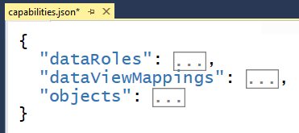
Visual Capabilities
Visual capabilities define in capabilities.json
Used to provide information to host
All capabilities are optional

Slide 43
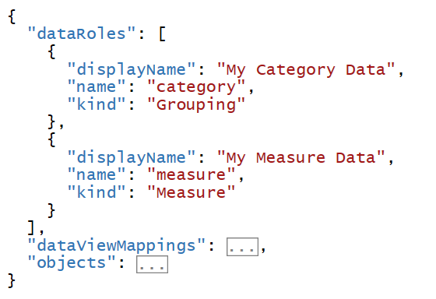
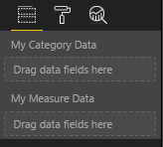
Data Roles
Defines the fields that can be added to your visual
Data roles can be defined as Grouping, Measure or both

Slide 44
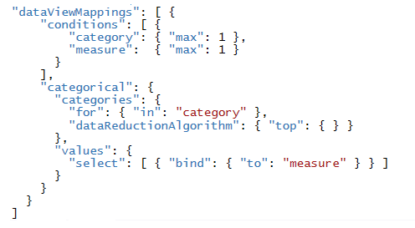
Data View Mappings
Data View mappings define requirements for data roles
Conditions which determine when set of data fields is valid
You can define mappings for several different forms
single
table
matrix
category
tree

Slide 45
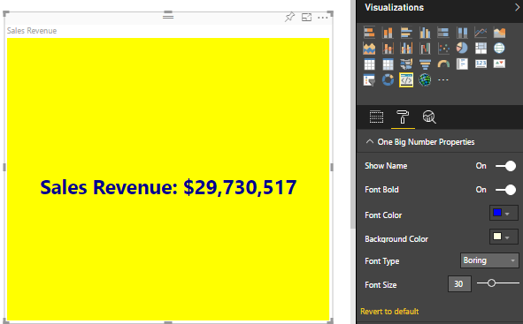
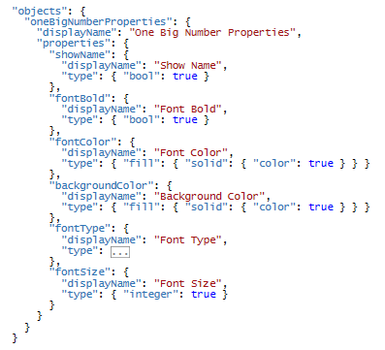
Objects
Objects are used to create custom properties
Requires TypeScript code in addition to this JSON

Slide 46
Demoing the OneBigNumber Custom Visual
Visually Gratuitous Demo #6

Slide 47
Demoing the SnazzyTable Custom Visual
Visually Gratuitous Demo #7

Slide 48
Agenda
Introduction to Custom Visuals in Power BI
Programming in TypeScript
Programming with the D3 Library
Getting Started with the PBIVIZ Utility
Designing and Implementing Custom Visuals
Packaging and Distribution Custom Visuals

Slide 49
Packaging a Custom Visual for Distribution
Visually Gratuitous Demo #8

Slide 50
Summary
Introduction to Custom Visuals in Power BI
Programming in TypeScript
Programming with the D3 Library
Getting Started with the PBIVIZ Utility
Designing and Implementing Custom Visuals
Packaging and Distribution Custom Visuals

