Slide 1
Developing Custom Visuals for Power BI

Slide 2
Abstract
This live interactive session will give you a jumpstart into the development of custom visuals for Power BI using TypeScript, the D3 library and Visual Studio Code. You will learn how to use the Power BI visual tool (PBIVIZ) to create and debug a custom visual project as well as how to package up a custom visual for distribution. Along the way, you will learn about visual capabilities, data mappings, D3 data binding, custom properties and programming with the Power BI visual API to leverage built-in services such as TooltipServiceWrapper and SelectionManager.

Slide 3
Agenda
Introduction to Custom Visuals in Power BI
Programming in Typescript
Programming with the D3 Library
Getting Started with the PBIVIZ Utility
Designing and Implementing Custom Visuals
Packaging and Distribution Custom Visuals

Slide 4
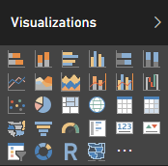
Built-in Visualization Types
Table and Matrix
Bar charts and Column charts
Pie charts and Doughnut chart
Line chart and Area chart
Scatter chart and Combo charts
Card and Multi-row Card
Treemap
Waterfall charts
Funnel charts
Gauge charts
Map and Filled Map
Slicer
R script visual
Shape map (in preview)

Slide 5
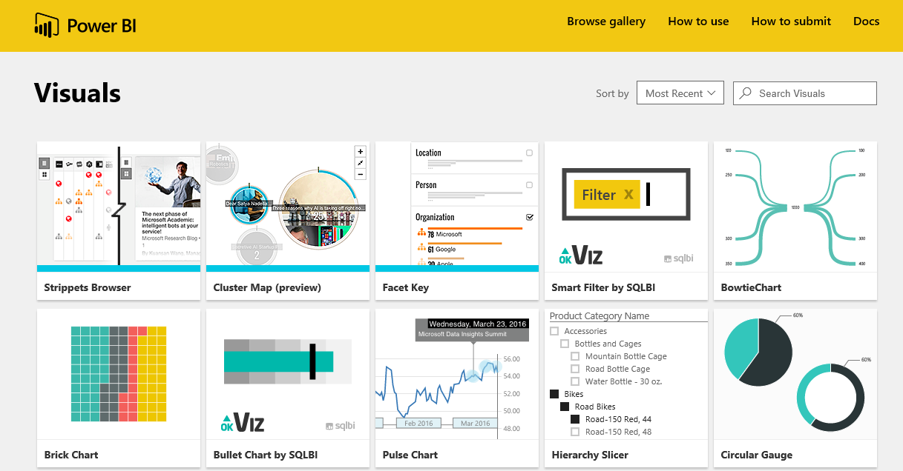
Custom Visual Gallery
Power BI Framework for Visuals is Extensible
Developers can extend Power BI with Custom Visuals
Microsoft Hosts gallery of custom visuals
Gallery located at https://app.powerbi.com/visuals/

Slide 6
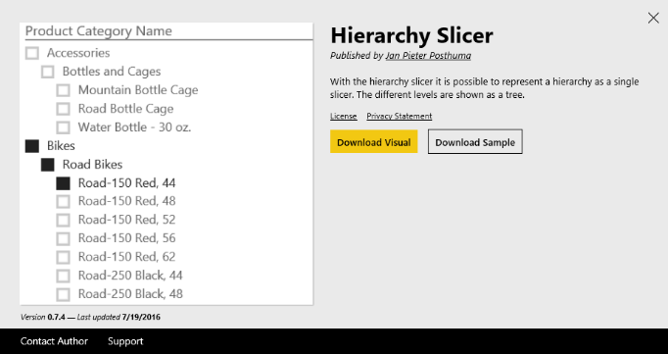
Downloading & Importing a Custom Visual
Visual must be downloaded from Visuals Gallery
Custom Visual files packaged in PBIVIZ File
Custom Visual can be imported into Power BI Desktop project
Custom Visual can be imported into workspace in Power BI service
Power BI Desktop Project
PBIVIZ
Power BI Workspace

Slide 7
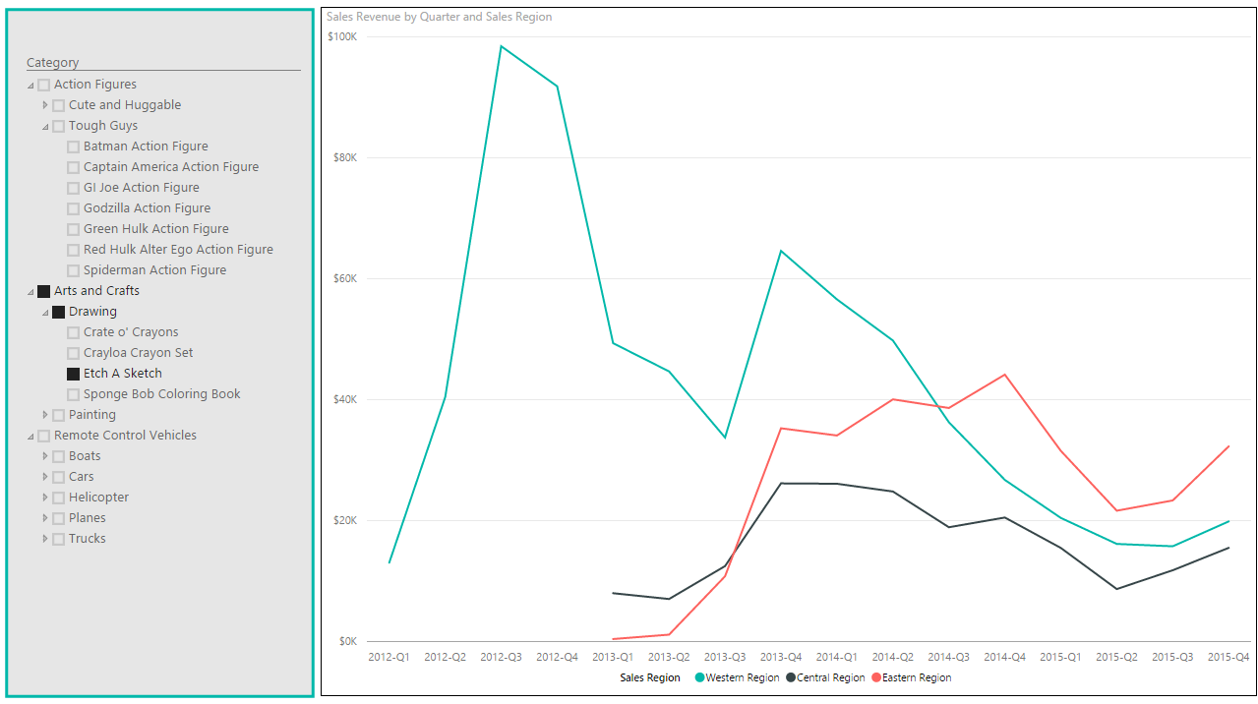
Hierarchy Slicer Visually Gratuitous Demo 1

Slide 8
Developing Your Own Custom Visuals
What are the learning curves?
Programming in TypeScript
Learning JavaScript libraries (e.g. D3.js)
Getting up to speed with the PBIVIZ utility
Learning to design and implement custom visuals
Learning to package and distribute custom visuals

Slide 9
Agenda
Introduction to Custom Visuals in Power BI
Programming in Typescript
Programming with the D3 Library
Getting Started with the PBIVIZ Utility
Designing and Implementing Custom Visuals
Packaging and Distribution Custom Visuals

Slide 10
What is TypeScript?
A programming language which compiles into plain JavaScript
A superset of JavaScript that adds a strongly-typed dimension
It can be compiled into ECMAScript3, ECMAScript3 or ECMAScript 6
It runs in any browser, in any host and on any OS
product.ts
product.js
TypeScript
Compiler
Notes:
There is a getting started tutorial at https://www.typescriptlang.org/docs/tutorial.html .

Slide 11
Type Annotation
TypeScript allows you to annotate types
Provides basis for strongly-typed programming
Type annotations used by compiler for type checking
Type annotations are erased at the end of compile time

Slide 12
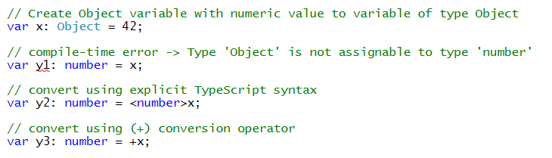
Casting Between Types in TypeScript
xxx

Slide 13
Arrow Function Syntax
TypeScript supports arrow function syntax
Concise syntax to define anonymous functions
Can be used to retain this pointer in classes

Slide 14
Classes
TypeScript supports defining classes
Class defines type for object
Export keyword makes class created across files
Class can be passed as factory function
Default accessibility is public

Slide 15
Class Constructors
Constructor parameters become fields in class
Client-side code calls constructor using new operator

Slide 16
Interfaces
Interface defines a programming contract
Classes can implement interfaces
Client code can be decoupled from concrete classes

Slide 17
TypeScript Definition Files (d.ts)
What are TypeScript definition files
Typed definitions for 3rd party JavaScript libraries
DefinitelyTyped provides great community resource
Typed definition files have a d.ts extension

Slide 18
Agenda
Introduction to Custom Visuals in Power BI
Programming in Typescript
Programming with the D3 Library
Getting Started with the PBIVIZ Utility
Designing and Implementing Custom Visuals
Packaging and Distribution Custom Visuals

Slide 19
The D3 Library
What does the D3 library do?
Loading data into the browser’s memory
Binding data to create new set of SVG elements
Adding and removing SVG elements as needed
Transforming SVG elements by setting properties
Transitioning SVG elements in response to user actions

Slide 20
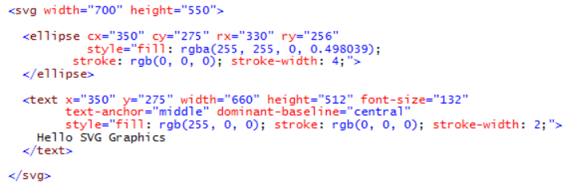
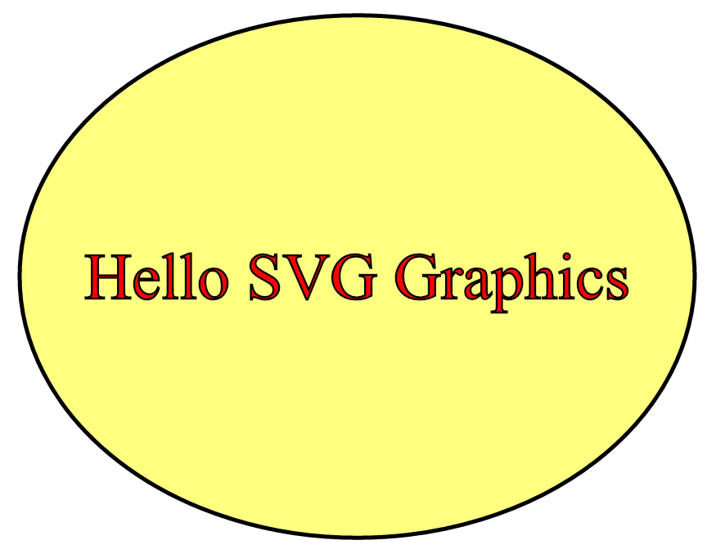
SVG Graphics
SVG = Scalable Vector Graphics
Specialized type of HTML element
More reliable and consistent than other HTML elements

Slide 21
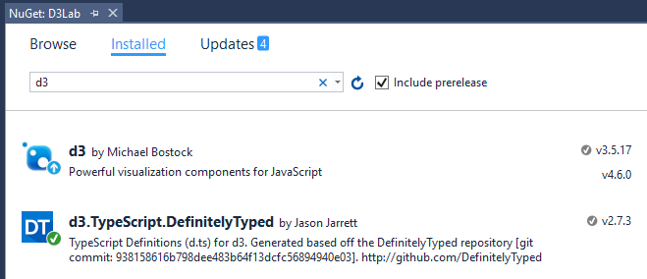
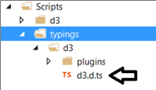
Adding d3 and d3 typings files

Slide 22
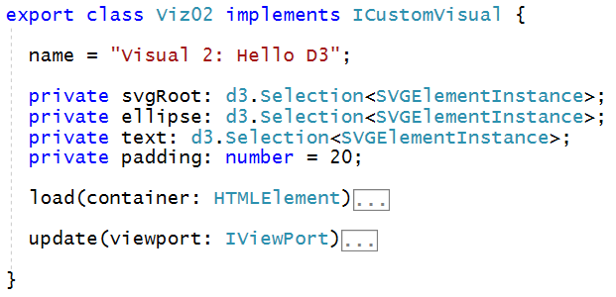
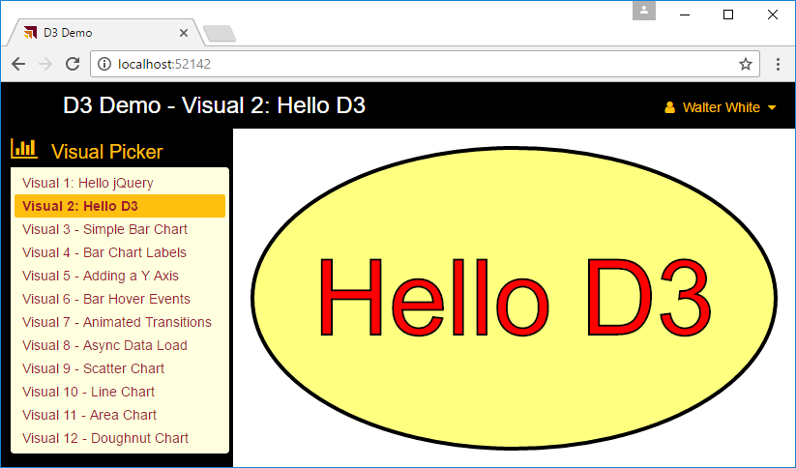
Designing a D3 Custom Visual

Slide 23
Agenda
Introduction to Custom Visuals in Power BI
Programming in Typescript
Programming with the D3 Library
Getting Started with the PBIVIZ Utility
Designing and Implementing Custom Visuals
Packaging and Distribution Custom Visuals

Slide 24
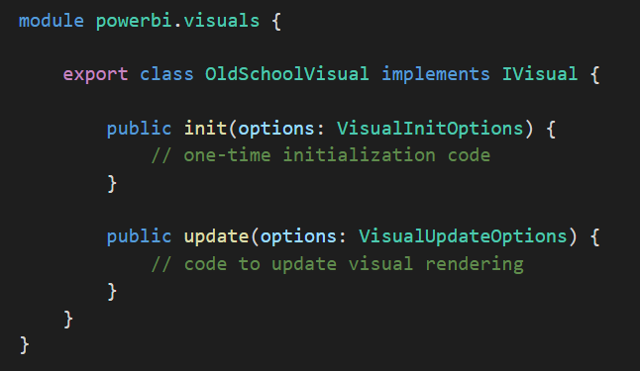
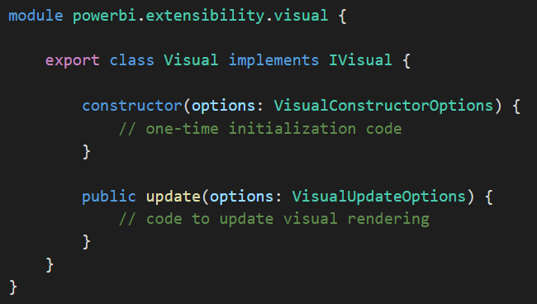
Developing Custom Visuals
There are two ways to develop a custom visual
The original way which is now deprecated
Still supported for backwards compatibility with older visuals
The new and better way introduced in July of 2016
Provides richer and significantly faster developer experience
Tools and documentation maintained in a GITHUB repository
Visual created using older style
Visual created using newer style

Slide 25
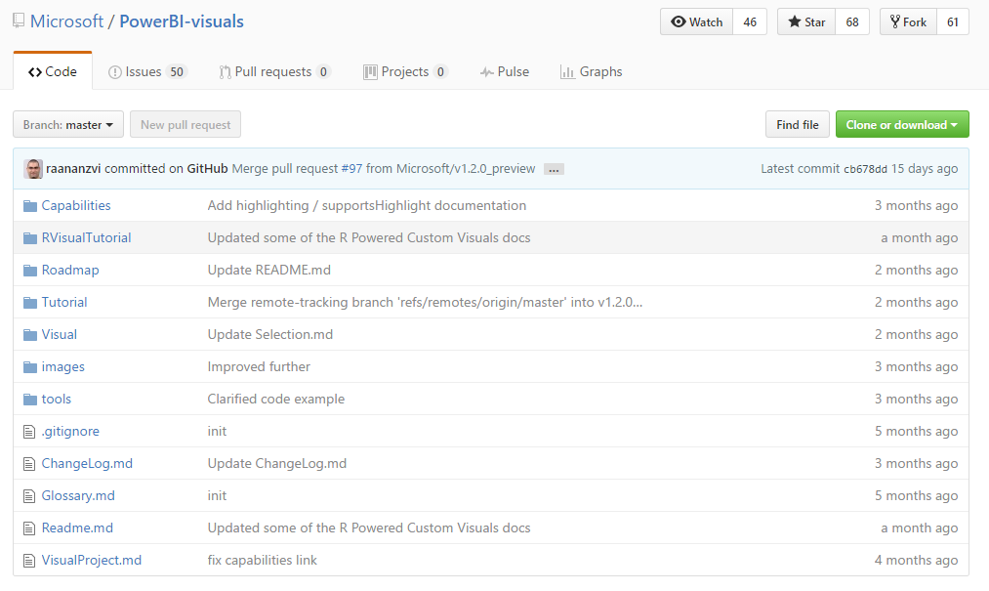
GitHub Repo for Custom Visuals
https://github.com/Microsoft/PowerBI-visuals

Slide 26
Install the Power BI Developer Toolchain
Install Node.JS
Installs Node Package Manage (npm)
Install Power BI visuals CLI tool (pbiviz)
Install using Node Package Manager (npm)
Install Local self-signed certificate
Install using Power BI visuals CLI tool (pbiviz)
Install Visual Studio Code
Lightweight Alternative to Visual Studio for Node.js Development

Slide 27
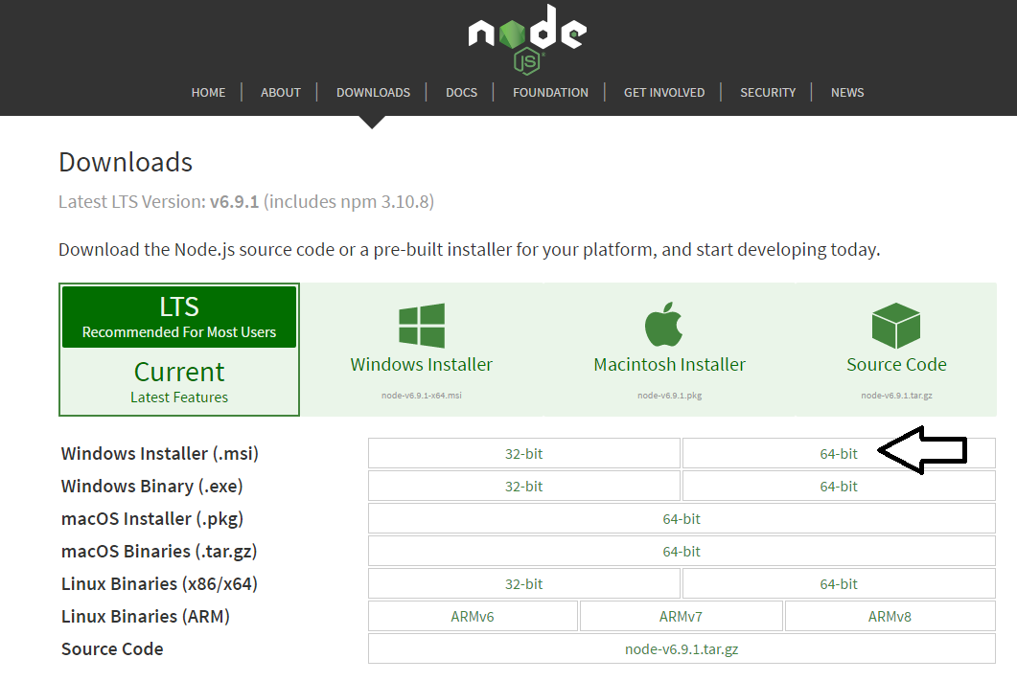
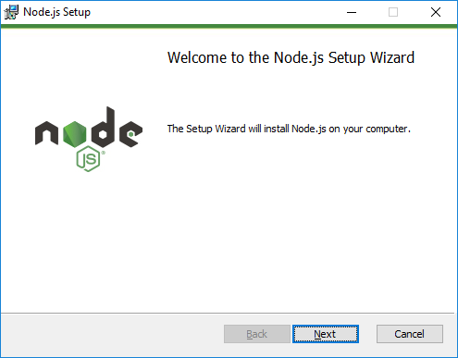
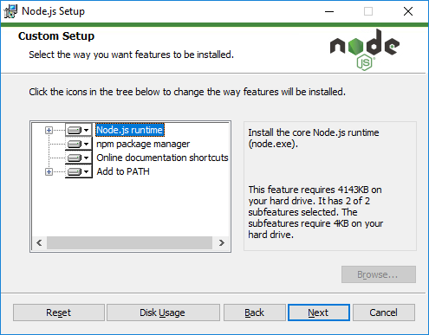
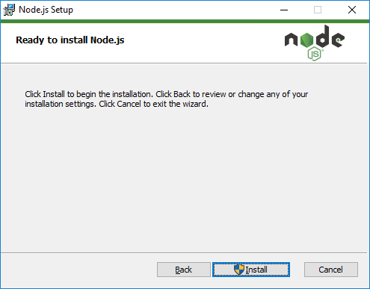
Installing node.js
https://nodejs.org/en/download/

Slide 28
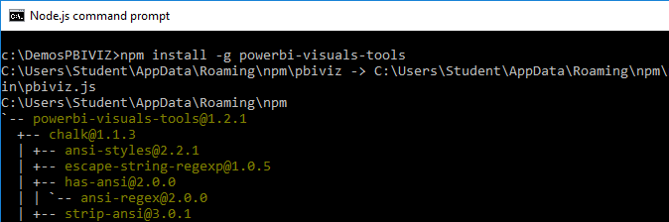
Power BI Visual CLI Tool (PBIVIZ)
What is the Power BI Custom Visual Tool?
Command-line utility for cross-platform dev
Use it with Visual Studio or Visual Studio Code
Requires that you first install node.js
Install by running command from node.js command prompt
npm install -g powerbi-visuals-tools

Slide 29
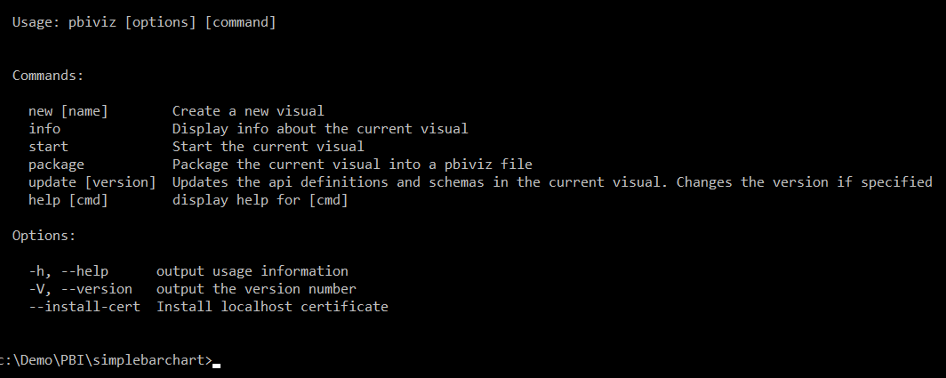
Getting Started with PBIVIZ

Slide 30
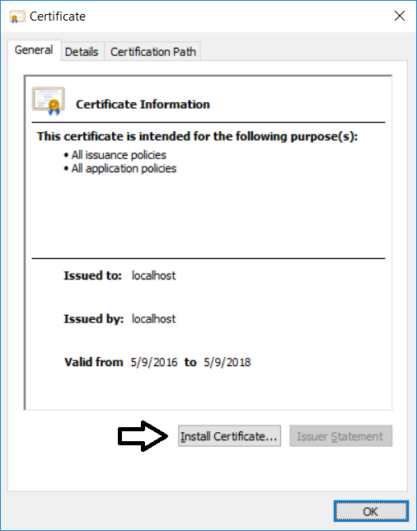
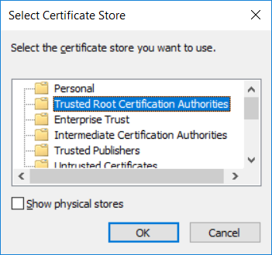

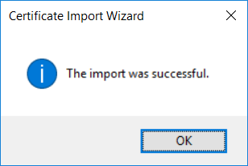
Installing the Developer Certificate
Debugging visuals inside PowerBI.com requires SSL
PBIVIZ leverages Node.js to provide debugging experience
Node.js acts as web service to serve project files through HTTP
Node.js debugging session uses http://localhost address
Installing certificate enables SSL through https://localhost
Installing certificate is a one time operation – not once per project

Slide 31
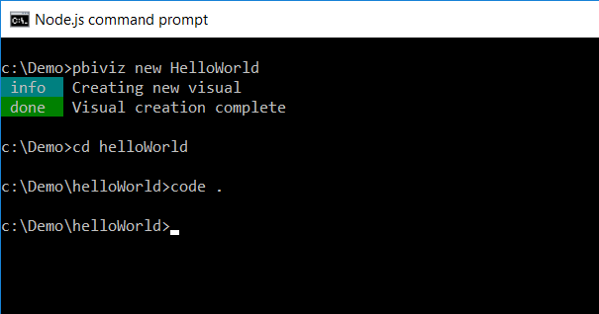
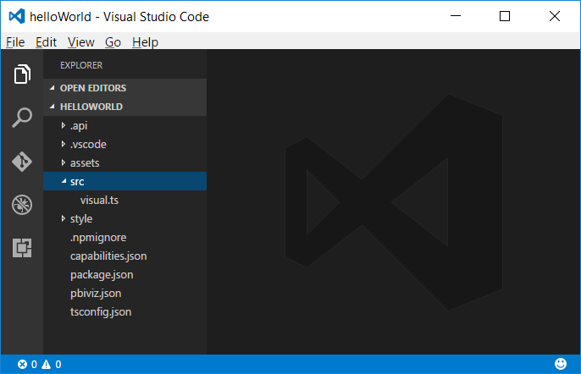
Creating a New Custom Visual Project
Creating a new project
pbiviz new <ProjectName>
Open the Project with Visual Studio Code
code .

Slide 32
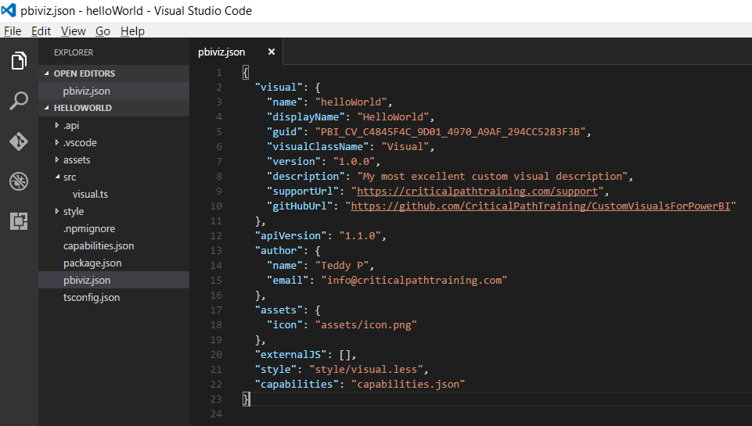
The pbiviz.json File
PBIVIZ.JSON serves a manifest for custom visual

Slide 33
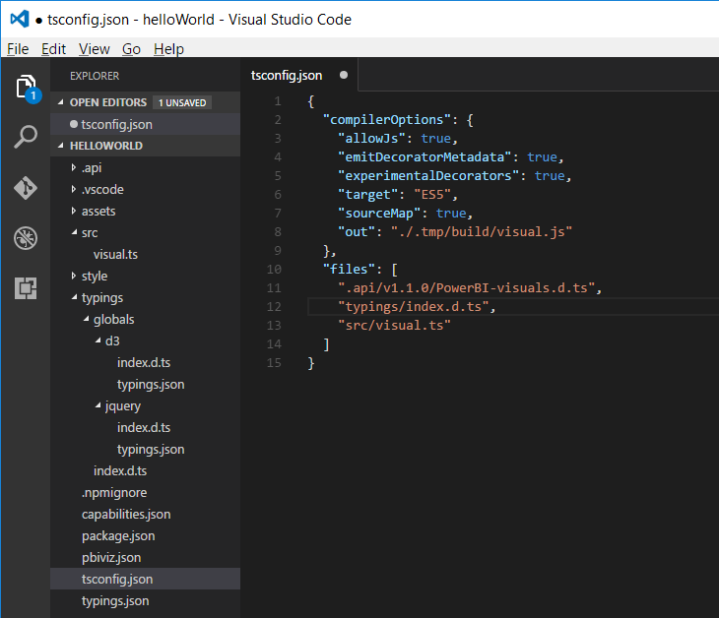
The tsconfig.json File
Used to add references to typings files
This is what enables Intellisense
Typings file reference

Slide 34
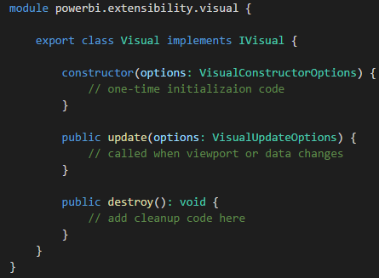
Developing a Custom Visual?
Create a class that implements IVisual
Class wrapped in module with namespace to APIs
You code can program again PBI APIs types

Slide 35
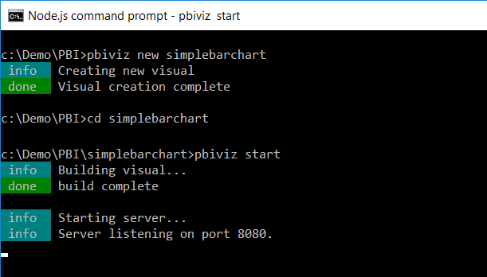
Running a Custom Visual Project

Slide 36
Agenda
Introduction to Custom Visuals in Power BI
Programming in Typescript
Programming with the D3 Library
Getting Started with the PBIVIZ Utility
Designing and Implementing Custom Visuals
Packaging and Distribution Custom Visuals

Slide 37
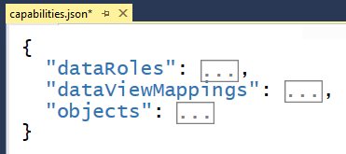
Visual Capabilities
Visual capabilities define in capabilities.json
Used to provide information to host
All capabilities are optional

Slide 38
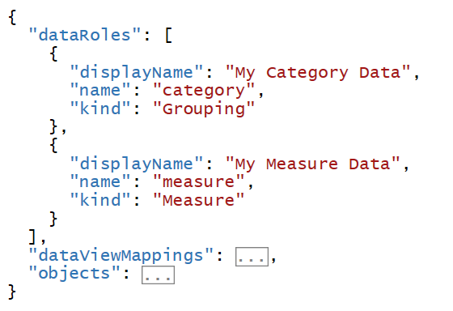
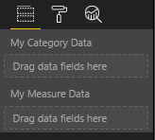
Data Roles
ssss

Slide 39
Data View Mappings
Data View mappings define requirements for data roles
Conditions which determine when set of data fields is valid

Slide 40
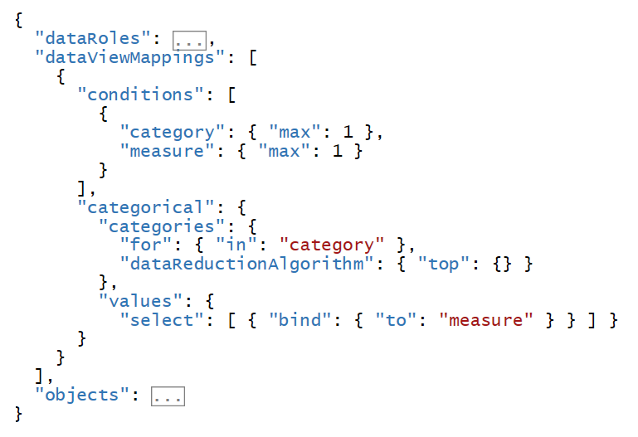
Data Mappings

Slide 41
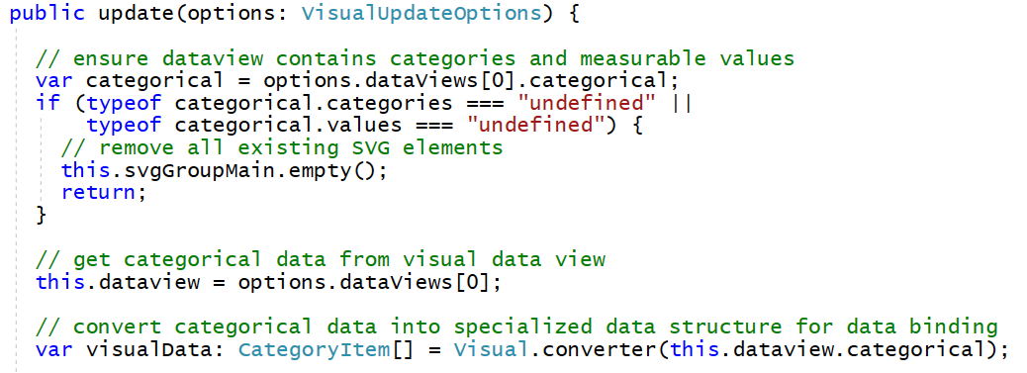
Binding Visuals to Categorical Data

Slide 42
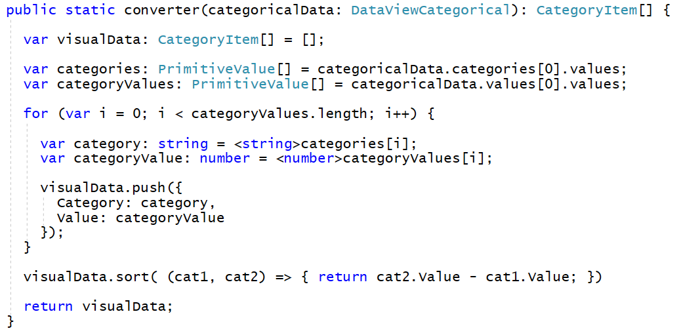
Creating a Converter Function

Slide 43
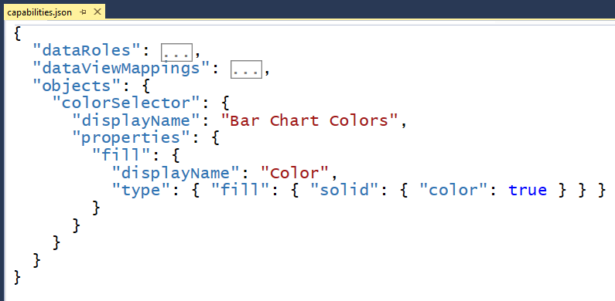
Extending Visuals with Custom Properties

Slide 44
Agenda
Introduction to Custom Visuals in Power BI
Programming in Typescript
Programming with the D3 Library
Getting Started with the PBIVIZ Utility
Designing and Implementing Custom Visuals
Packaging and Distribution Custom Visuals

Slide 45
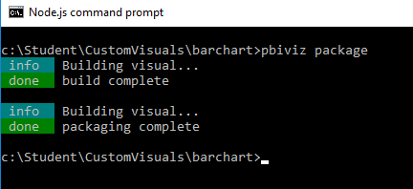
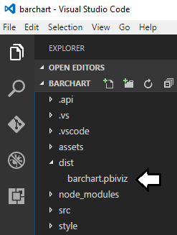
Packaging and Deploying Custom Visuals

Slide 46
Agenda
Introduction to Custom Visuals in Power BI
Programming with Typescript and the D3 Library
Getting Started with the PBIVIZ Utility
Developing Custom Visuals for Power BI
Packaging and Distribution Custom Visuals

Slide 47
Summary
Introduction to Custom Visuals in Power BI
Programming in Typescript
Programming with the D3 Library
Getting Started with the PBIVIZ Utility
Designing and Implementing Custom Visuals
Packaging and Distribution Custom Visuals

Slide 48
Summary
Introduction to Custom Visuals in Power BI
Programming with Typescript and the D3 Library
Getting Started with the PBIVIZ Utility
Developing Custom Visuals for Power BI
Packaging and Distribution Custom Visuals

Slide 49
Install the Power BI Developer Toolchain
Install Node.JS
Version 5.0 recommended - 4.0+ minimum
Installs Node Package Manage (npm)
Install Visual Studio Code
Better environment for Development with Node.js
Install Power BI visuals CLI tool (pbiviz)
Install using Node Package Manager (npm)
Install Local self-signed certificate
pbiviz --install-cert

Slide 50
Installing node.js
https://nodejs.org/en/download/

Slide 51
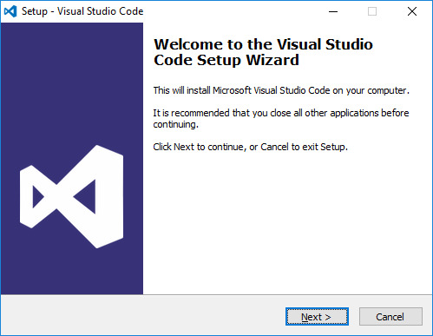
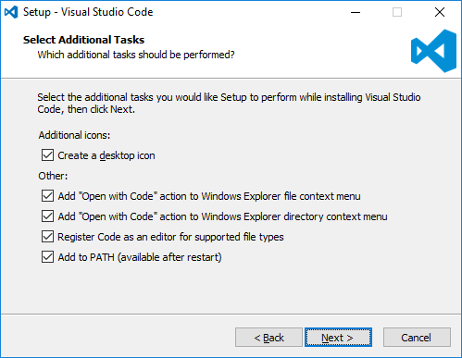
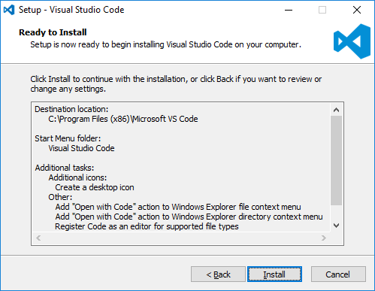
Install Visual Studio Code
http://code.visualstudio.com/

Slide 52
Power BI Visual CLI Tool (PBIVIZ)
What is the Power BI Custom Visual Tool?
Command-line utility for cross-platform dev
Use it with Visual Studio or Visual Studio Code
Requires that you first install node.js
Install by running command from node.js command prompt
npm install -g powerbi-visuals-tools

Slide 53
Getting Started with PBIVIZ

Slide 54
Creating a New Custom Visual Project
Creating a new project
pbiviz new <ProjectName>
Open the Project with Visual Studio Code
code .

Slide 55
Files in the new project
gitignore
tells git to ignore files that shouldn't be tracked in the repository
capabilities.json
used to define the capabilities of your visual learn more about visual capabilities
package.json
Used by npm to manage modules learn more about npm
pbiviz.json
Main configuration file for your visual
tsconfig.json
Typescript compiler settings learn more about tsconfig

Slide 56
The pbiviz.json File

Slide 57
Folders in the new project
assets/
Used to store visual assets (icon, screenshots, etc)
dist/
when you run pbiviz package the pbiviz file will be generated here
src/
Typescript code for your visual goes here
style/
Less styles for your visual go here

Slide 58
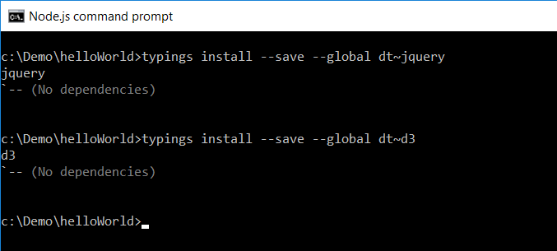
Installing Typings for D3 using npm
Installing typings support using Node Package Manage
Start by installing global support for typings
npm install typings –g
Install typings for specific JavaScript libraries
typings install --save --global dt~d3

Slide 59
The tsconfig.json File
Used to add references to typings files
This is what enables Intellisense
Typings file reference

Slide 60
Developing a Custom Visual?
Create a class that implements IVisual
Class wrapped in module with namespace to APIs
You code can program again PBI APIs types

Slide 61
Running a Custom Visual Project

Slide 62
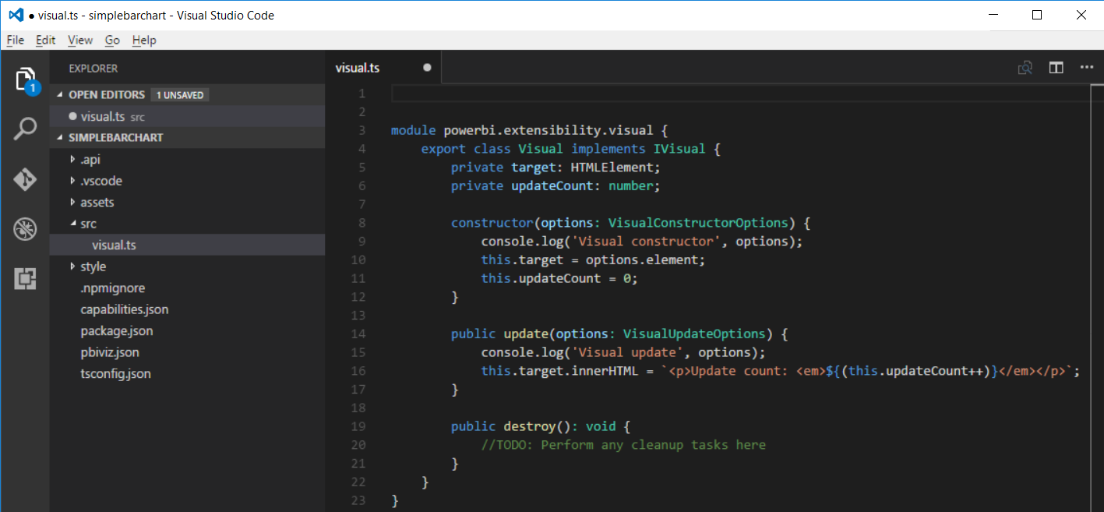
Developing with Visual Studio Code

Slide 63
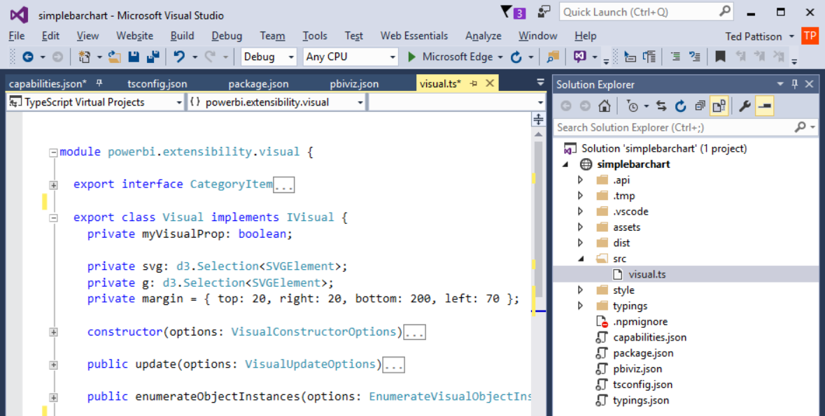
Developing with Visual Studio 2015

Slide 64
Agenda
Power BI Visuals Overview
Importing Custom Visuals
Programming with D3 in Typescript
Developing Custom Visuals for Power BI

