Slide 1
Custom Visuals for Power BI

Slide 2
Agenda
Power BI Visuals Overview
Importing Custom Visuals
Programming with D3 in Typescript
Developing Custom Visuals for Power BI

Slide 3
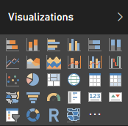
Built-in Visualization Types
Table and Matrix
Bar charts and Column charts
Pie charts and Doughnut chart
Line chart and Area chart
Scatter chart and Combo charts
Card and Multi-row Card
Treemap
Waterfall charts
Funnel charts
Gauge charts
Map and Filled Map
Slicer
R script visual
Shape map (in preview)

Slide 4
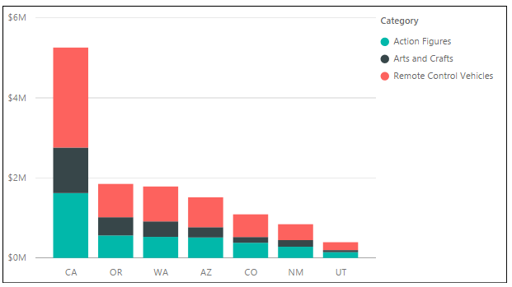
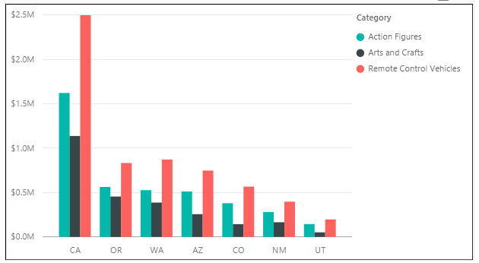
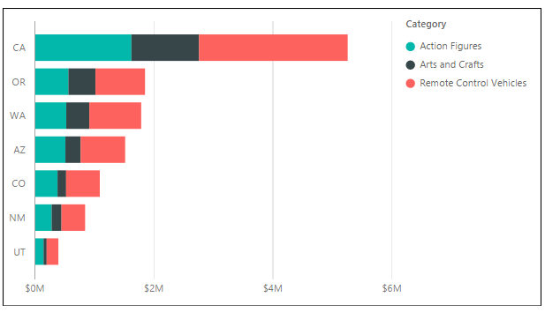
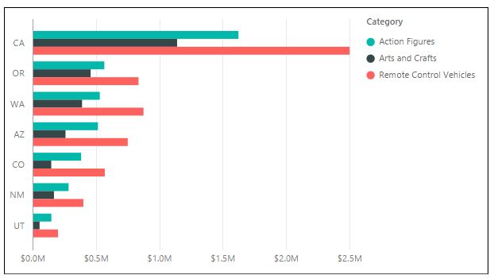
Column Chart and Bar Chart Variations
Stacked Column Chart and Clustered Column Charted
Stacked Bar Chart and Clustered Bar Chart

Slide 5
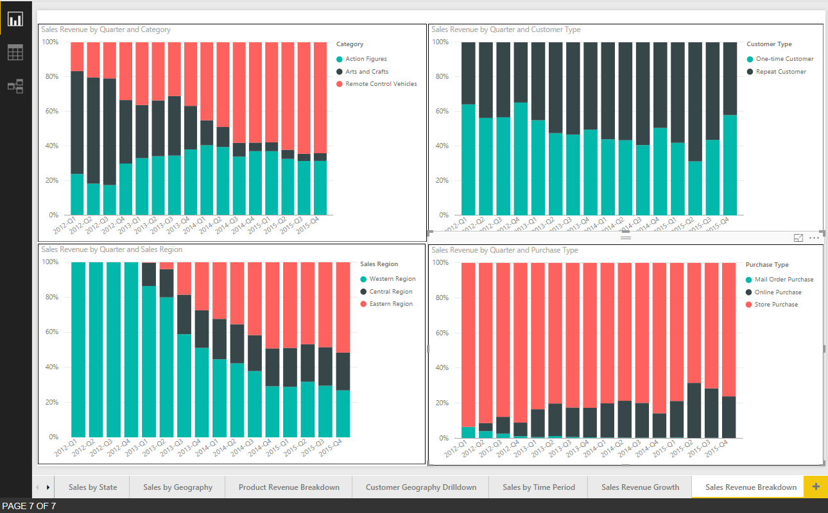
100% Stacked Column Chart
Used to visual distribution over time across categories

Slide 6
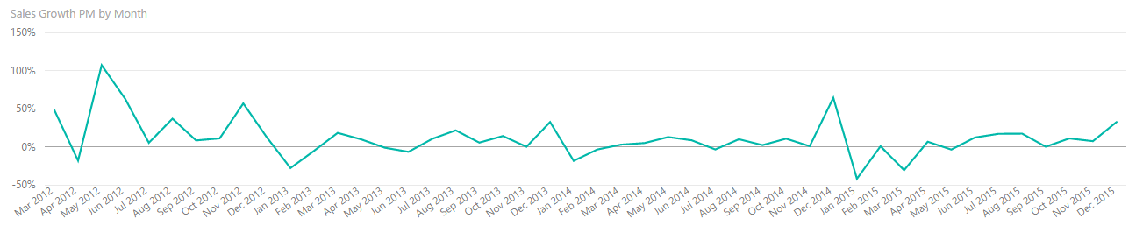
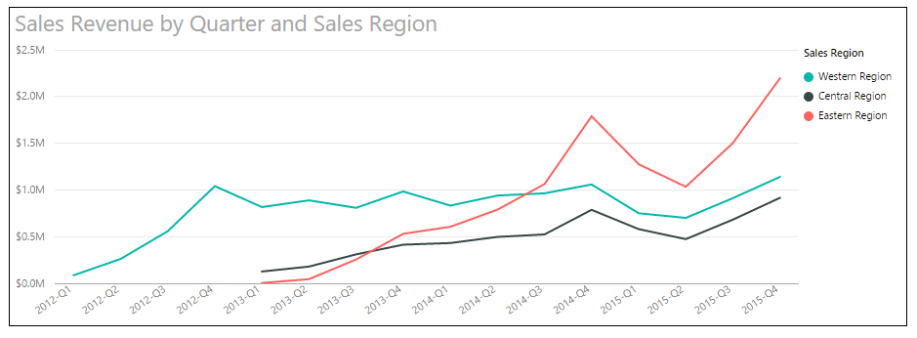
Line Charts
Visualizes a series of data points across X and Y axis
Commonly used for time-based analysis
Add field to Legend to create multiple lines for comparative analysis

Slide 7
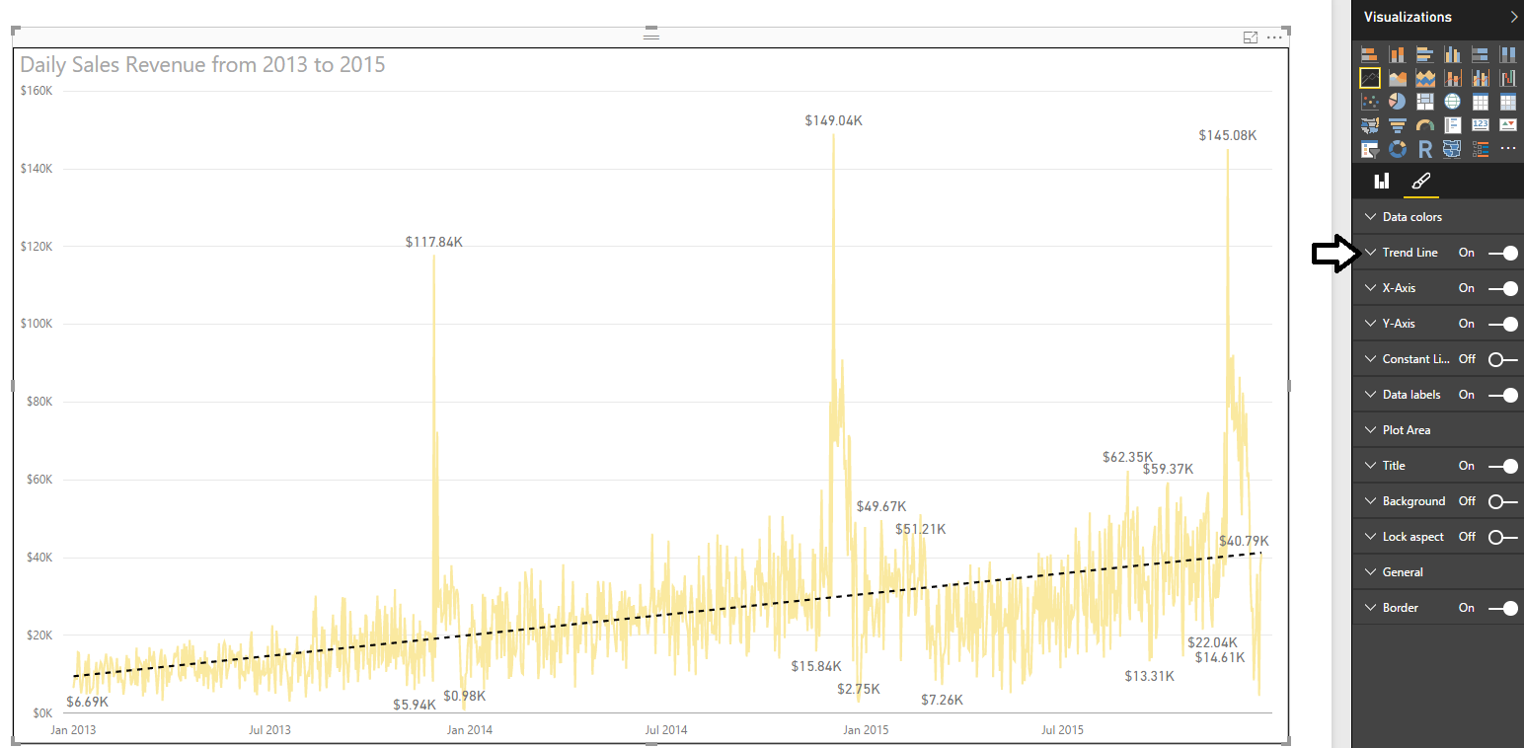
Trend Lines
Used to visualize trends in series-based data
Flattens out the ups and downs
Used to determine if values are trending up or down

Slide 8
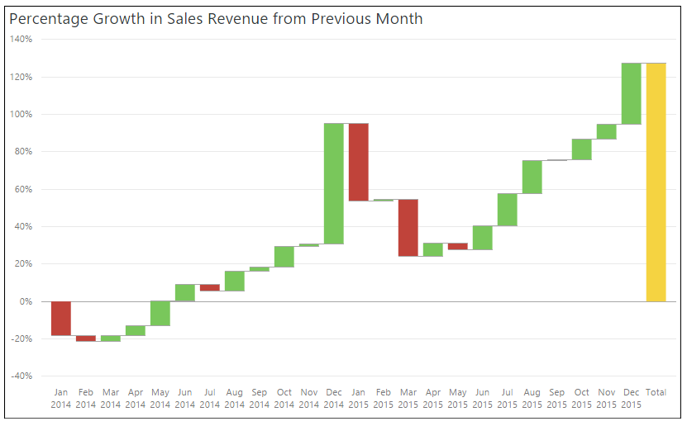
Waterfall
Visualizes series-based data with positive and negative values

Slide 9
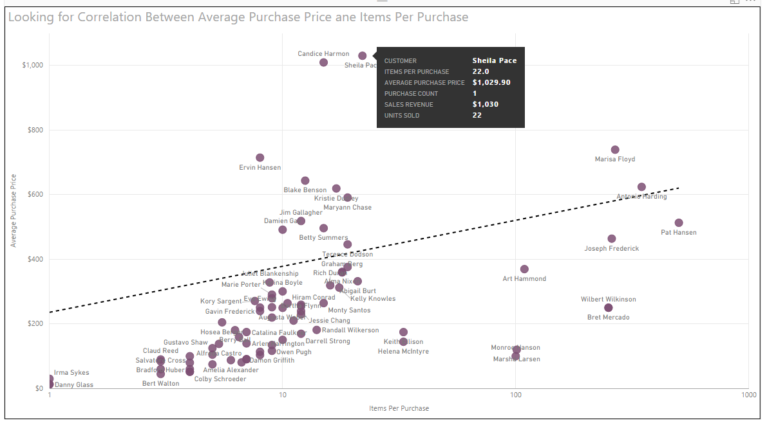
Scatter Chart
Visualizes set of data points when looking for correlation
Scatter chart used to discover correlation between two variables
Each data point has two values which are mapped to X and Y axis
How does number of items purchase per customer affect average purchase price?

Slide 10
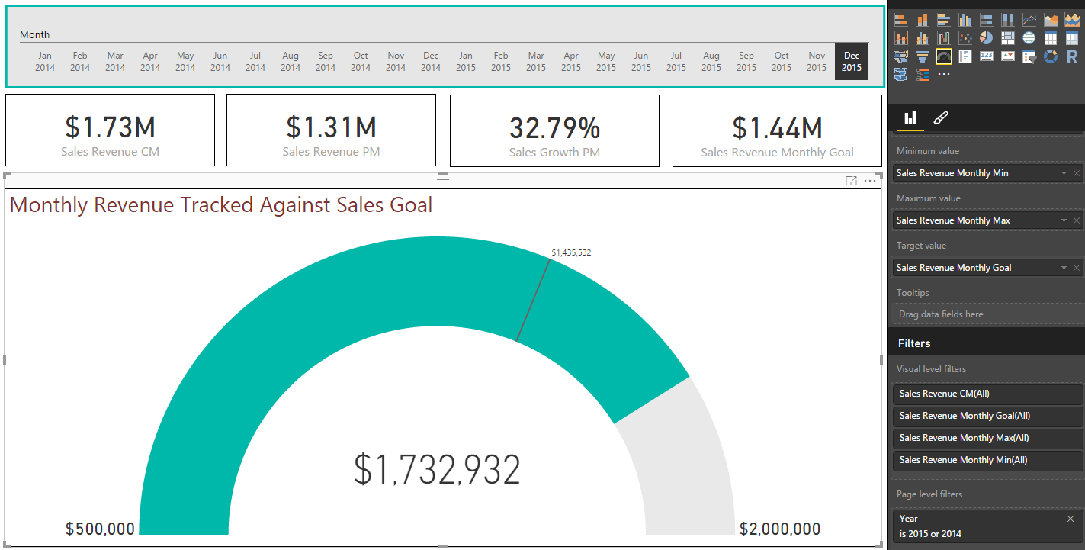
Gauge Visual
Visualizes how measured value is tracking against goal or budget

Slide 11
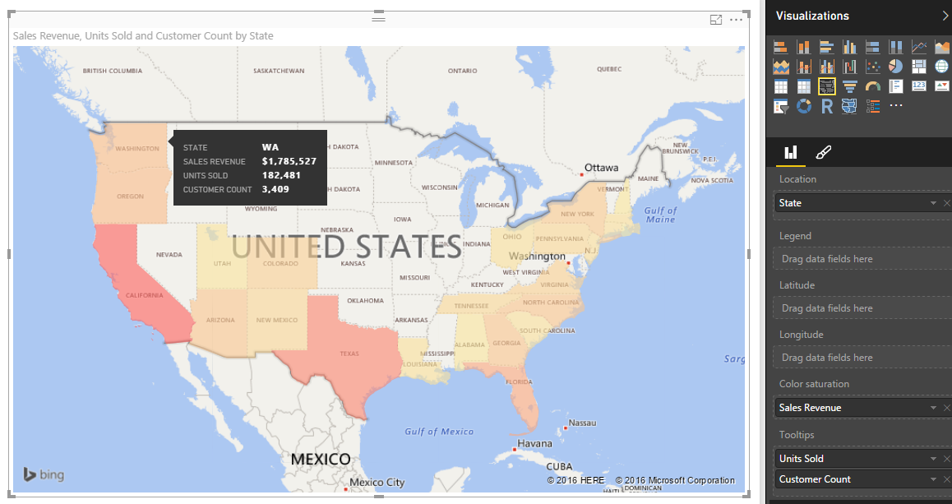
Filled Map
Visualizes distribution across states and countries

Slide 12
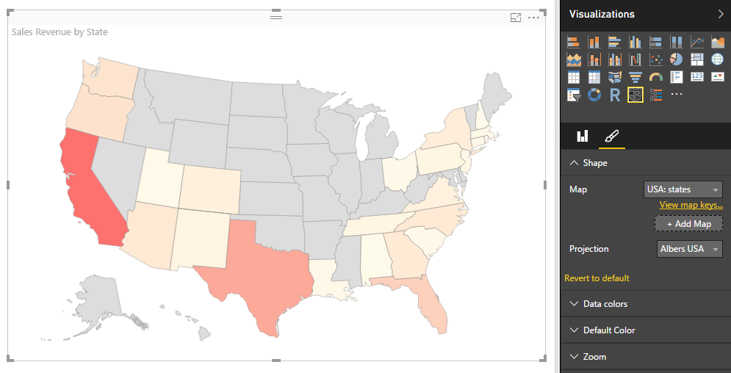
Inline Shape Map
Similar to filled map with a few important exceptions
Based on TopoJSON map format created by ESRI
Allows for creation of custom maps using JSON
Create maps for geography, seating arrangements, floor plans, etc.
In Preview as of August 2016

Slide 13
Agenda
Power BI Visuals Overview
Importing Custom Visuals
Programming with D3 in Typescript
Developing Custom Visuals for Power BI

Slide 14
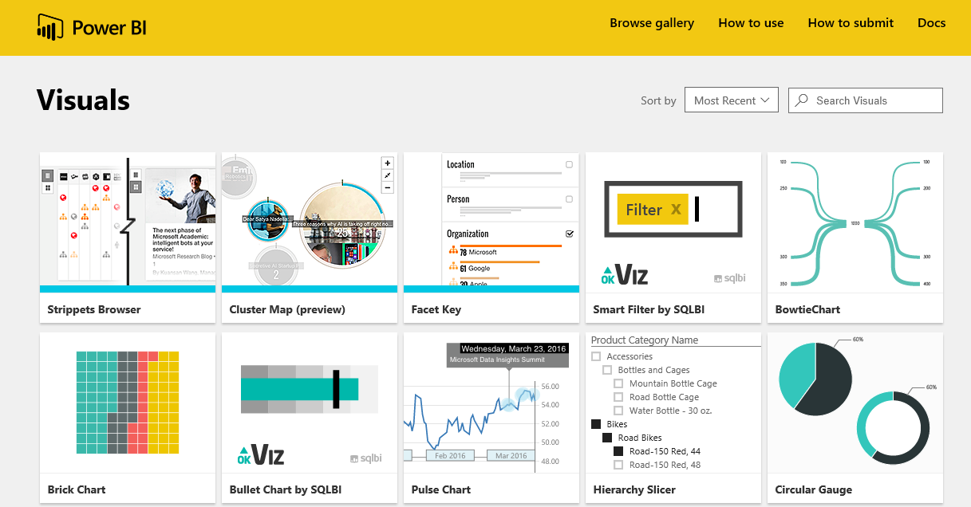
Custom Visual Gallery
Power BI Framework for Visuals is Extensible
Developers can extend Power BI with Custom Visuals
Microsoft Hosts gallery of custom visuals
Gallery located at https://app.powerbi.com/visuals/

Slide 15
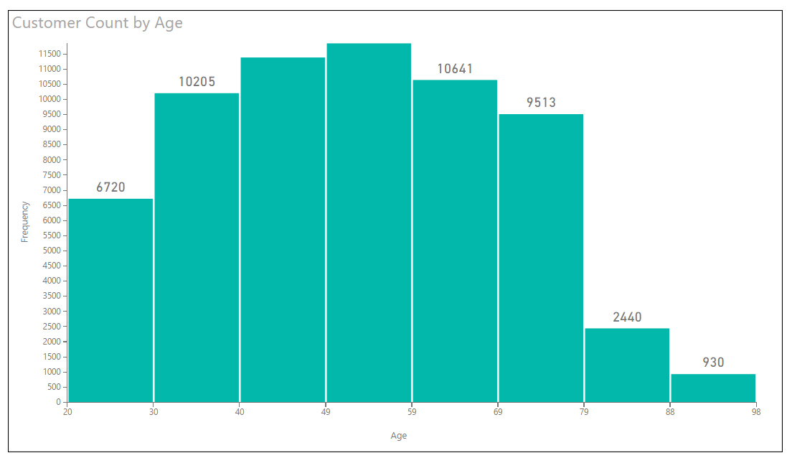
Histogram Custom Visual Example 1

Slide 16
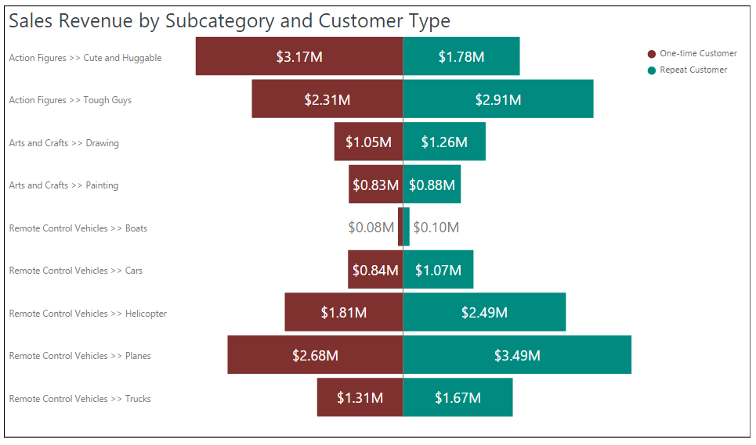
Tornado Chart Custom Visual Example 2

Slide 17
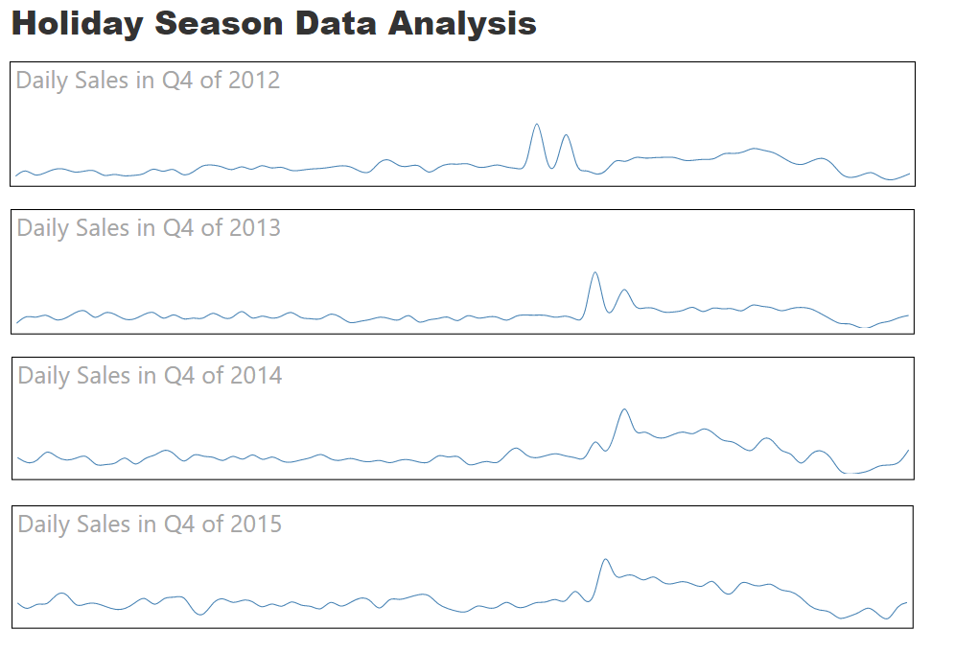
Spark Lines Custom Visual Example 3

Slide 18
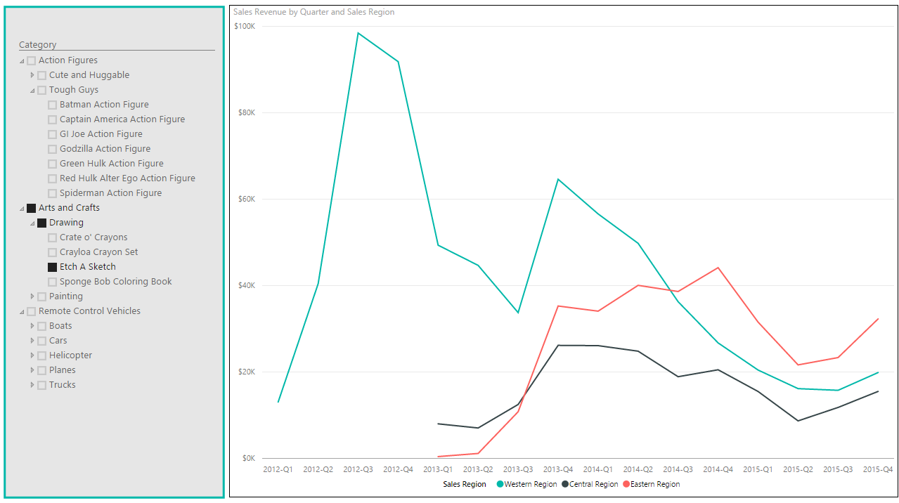
Hierarchy Slicer Custom Visual Example 4

Slide 19
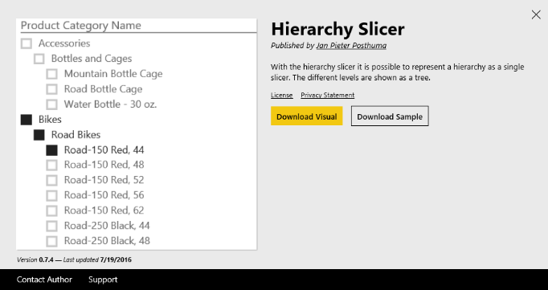
Downloading & Importing a Custom Visual
Visual must be downloaded from Visuals Gallery
Custom Visual files packaged in PBIVIZ File
Custom Visual can be imported into Power BI Desktop project
Custom Visual can be imported into workspace in Power BI service

Slide 20
Agenda
Power BI Visuals Overview
Importing Custom Visuals
Programming with D3 in Typescript
Developing Custom Visuals for Power BI

Slide 21
Agenda
Power BI Visuals Overview
Importing Custom Visuals
Programming with D3 in Typescript
Developing Custom Visuals for Power BI

Slide 22
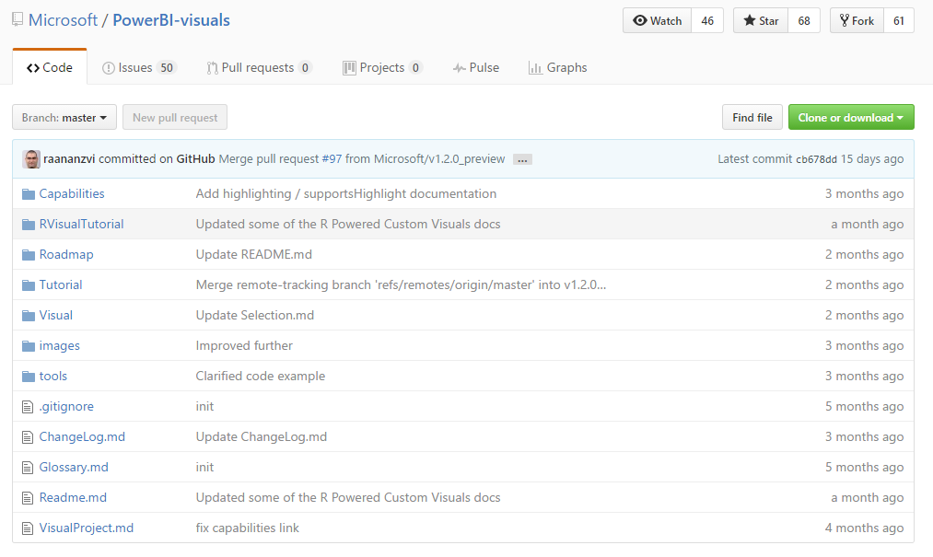
GitHub Repo for Custom Visuals
https://github.com/Microsoft/PowerBI-visuals

Slide 23
Install the Power BI Developer Toolchain
Install Node.JS
Version 5.0 recommended - 4.0+ minimum
Installs Node Package Manage (npm)
Install Visual Studio Code
Better environment for Development with Node.js
Install Power BI visuals CLI tool (pbiviz)
Install using Node Package Manager (npm)
Install Local self-signed certificate
pbiviz --install-cert

Slide 24
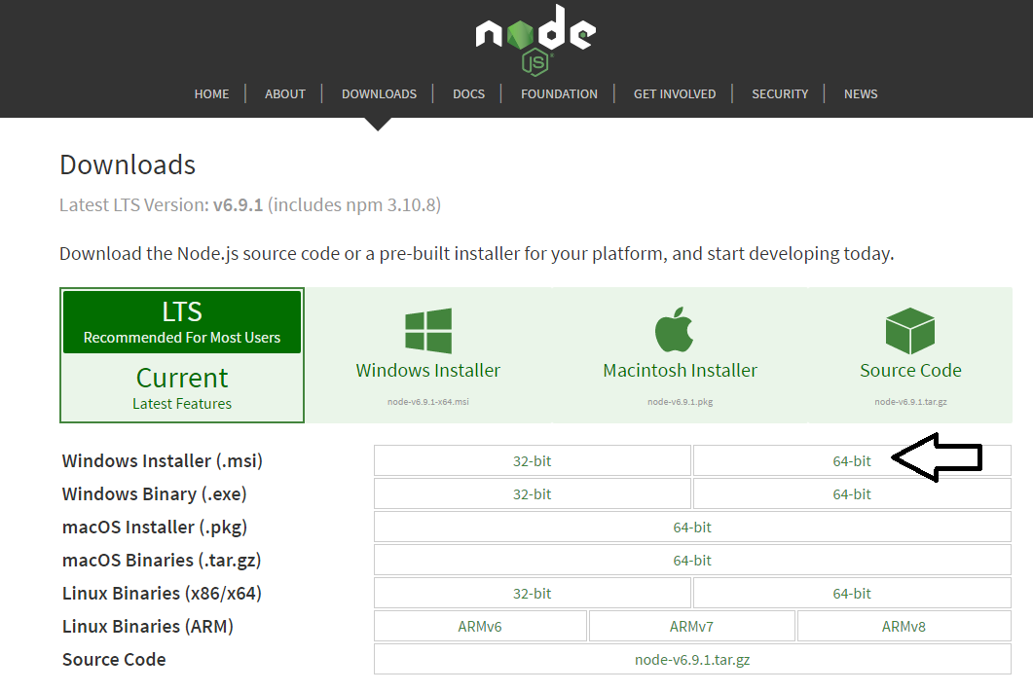
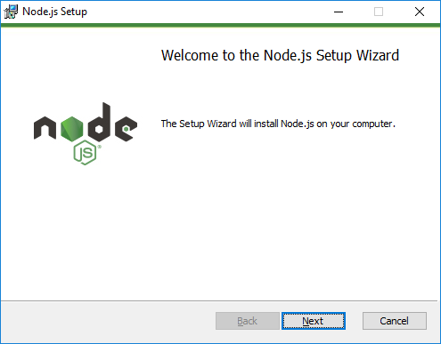
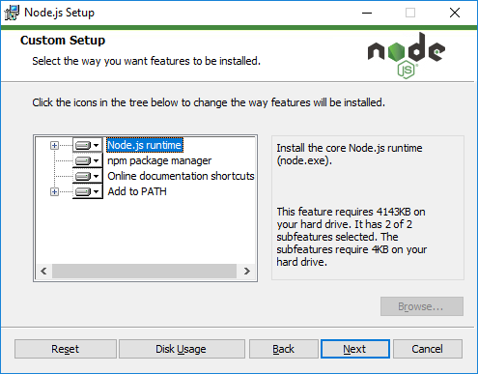
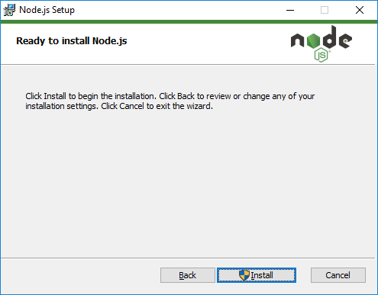
Installing node.js
https://nodejs.org/en/download/

Slide 25
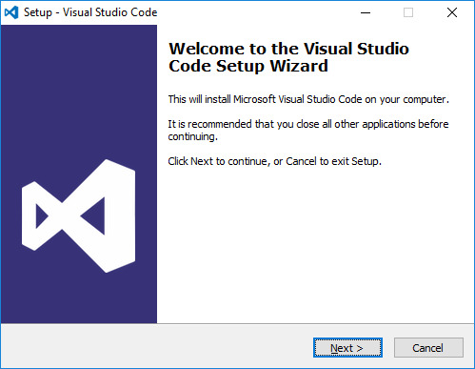
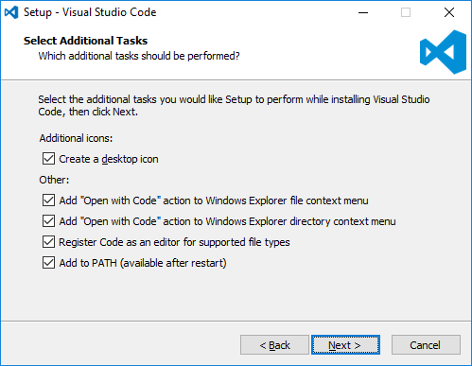
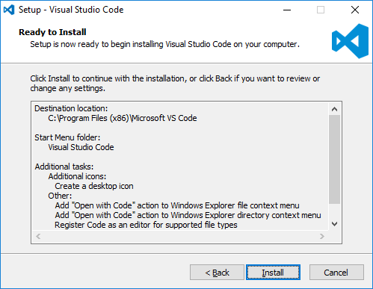
Install Visual Studio Code
http://code.visualstudio.com/

Slide 26
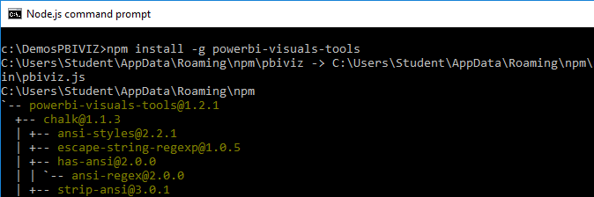
Power BI Visual CLI Tool (PBIVIZ)
What is the Power BI Custom Visual Tool?
Command-line utility for cross-platform dev
Use it with Visual Studio or Visual Studio Code
Requires that you first install node.js
Install by running command from node.js command prompt
npm install -g powerbi-visuals-tools

Slide 27
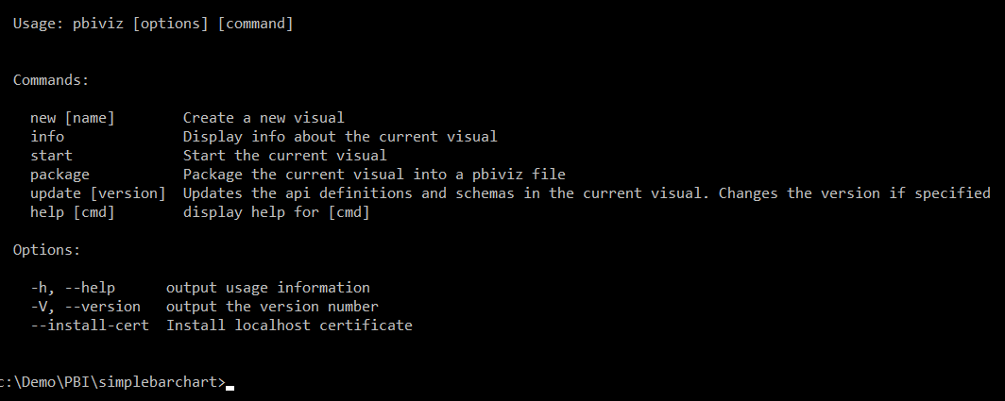
Getting Started with PBIVIZ

Slide 28
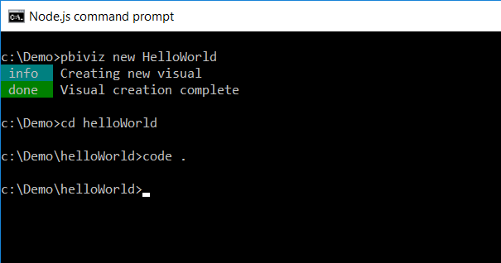
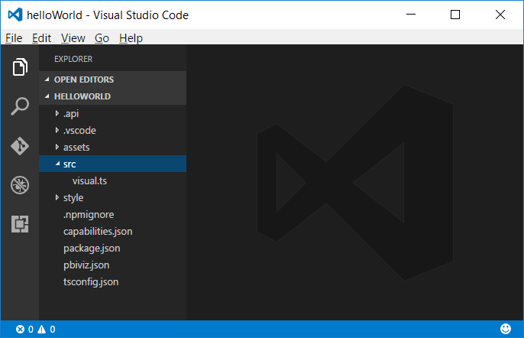
Creating a New Custom Visual Project
Creating a new project
pbiviz new <ProjectName>
Open the Project with Visual Studio Code
code .

Slide 29
Files in the new project
gitignore
tells git to ignore files that shouldn't be tracked in the repository
capabilities.json
used to define the capabilities of your visual learn more about visual capabilities
package.json
Used by npm to manage modules learn more about npm
pbiviz.json
Main configuration file for your visual
tsconfig.json
Typescript compiler settings learn more about tsconfig

Slide 30
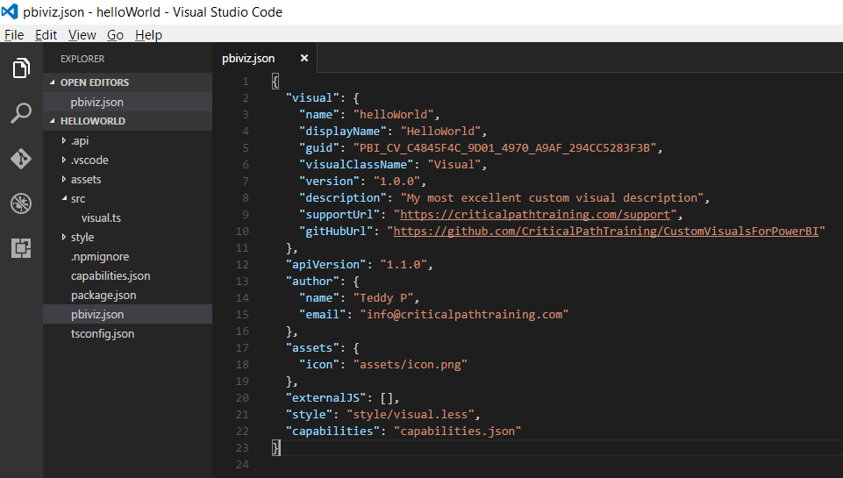
The pbiviz.json File

Slide 31
Folders in the new project
assets/
Used to store visual assets (icon, screenshots, etc)
dist/
when you run pbiviz package the pbiviz file will be generated here
src/
Typescript code for your visual goes here
style/
Less styles for your visual go here

Slide 32
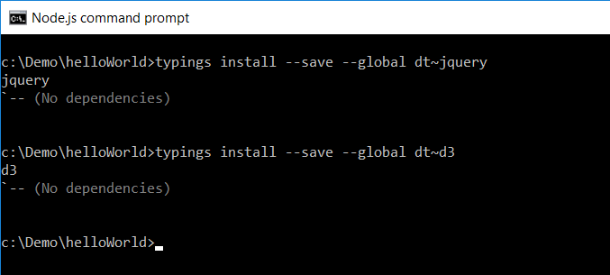
Installing Typings for D3 using npm
Installing typings support using Node Package Manage
Start by installing global support for typings
npm install typings –g
Install typings for specific JavaScript libraries
typings install --save --global dt~d3

Slide 33
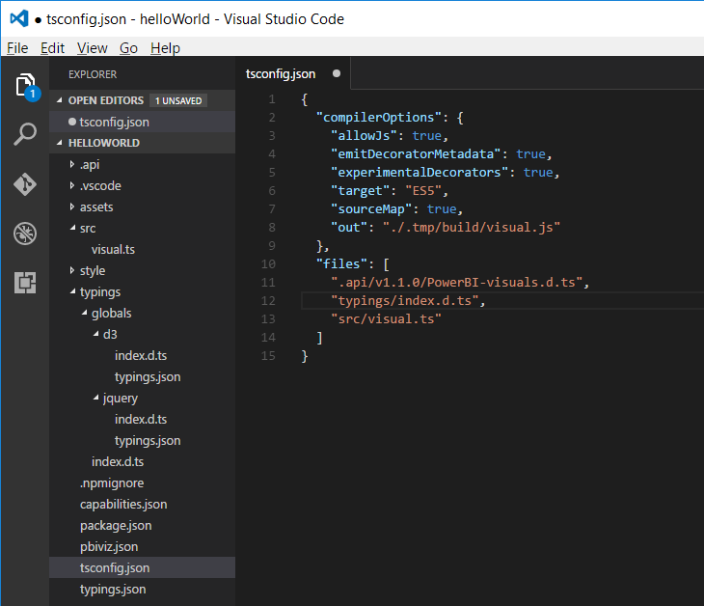
The tsconfig.json File
Used to add references to typings files
This is what enables Intellisense
Typings file reference

Slide 34
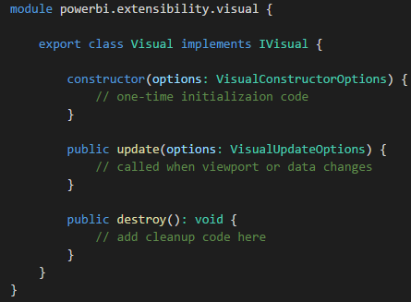
Developing a Custom Visual?
Create a class that implements IVisual
Class wrapped in module with namespace to APIs
You code can program again PBI APIs types

Slide 35
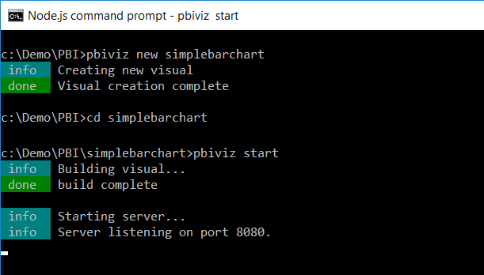
Running a Custom Visual Project

Slide 36
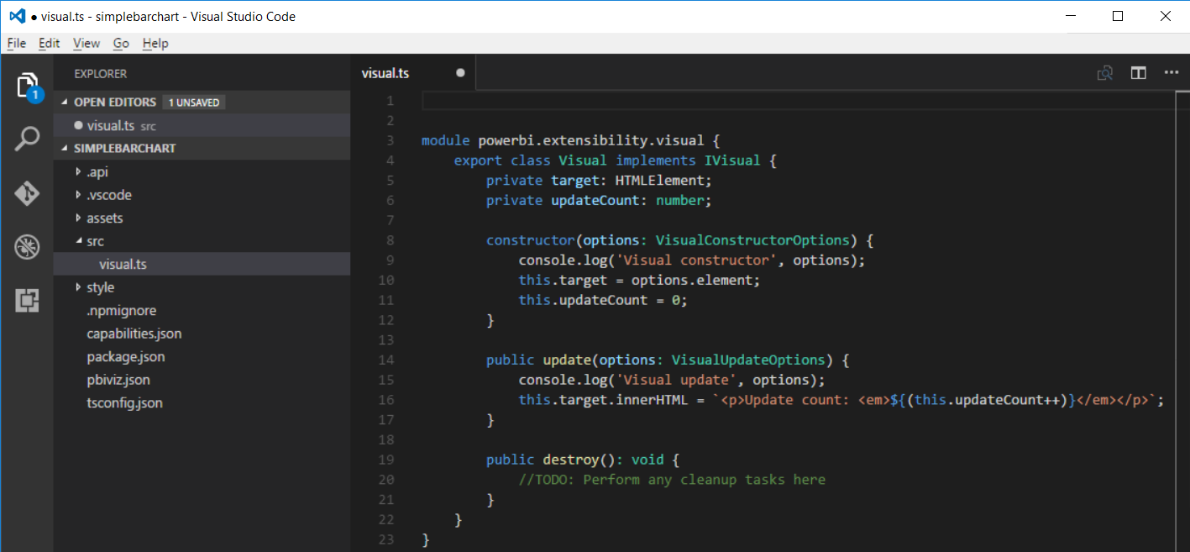
Developing with Visual Studio Code

Slide 37
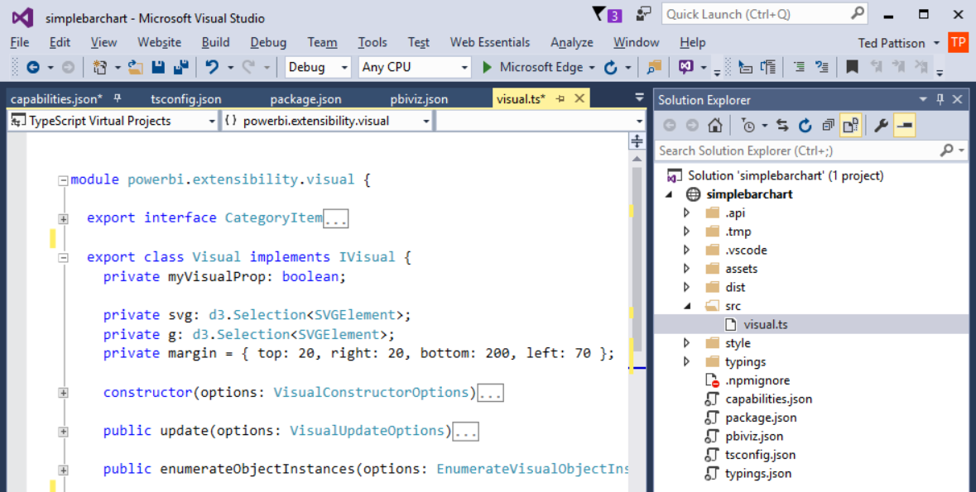
Developing with Visual Studio 2015

Slide 38
Agenda
Power BI Visuals Overview
Importing Custom Visuals
Programming with D3 in Typescript
Developing Custom Visuals for Power BI

