Slide 1
AMMM Project
Bertille Temple David Masek

Slide 2
Formalisation: optimisation problem with integers
For a given number n we want to find a set of different natural numbers such that no two different pairs of numbers in the set are the same distance apart and the difference between the maximum and minimum numbers in the set is minimized.
VARIABLES:
x[i],
d[i,j],
OBJECTIVE FUNCTION: min z
CONSTRAINTS: z is the maximum of the set, the set of x is ordered without repetitions, and the variables have the intending meaning
… how to implement the constraint “no two different pairs of numbers in the set are the same distance apart” in a linear way ?

Slide 3
Contents
OPL
Linear model
Not linear implementation
Meta-Heuristics
Greedy+Local Search
GRASP
Comparison

Slide 4
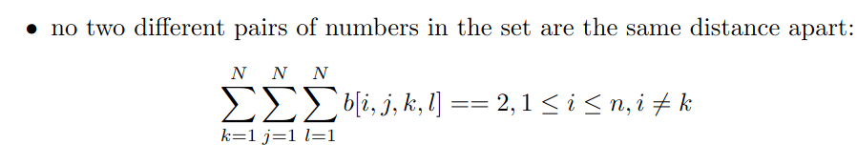
Linear model
VARIABLES: x[i], d[i,j]
av[i,j], and binary variable e[i,j]. e[i,j] = 1 if d[i,j]-av[i,j] ⩾ 0; e[i,j] = 0 if d[i,j]+av[i,j] ⩽ 0
b[i,j,k,l] is 1 when the distance between x[i] and x[j] is the same as the distance between x[k] and x[l], else 0
OBJECTIVE FUNCTION: min z
CONSTRAINTS: z is the maximum of the set, the set of x is ordered without repetitions, av[i,j] has the intended meaning:
-av[i,j] ⩽ d[i,j] ⩽ av[i,j]
d[i,j] - av[i,j] ⩾ -2*11 * (1-e[i,j]); -2*11 is a lower bound of d[i,j] - av[i,j]
d[i,j] + av[i,j] ⩽ 2*11 * e[i,j]; 2*11 is an upper bound of d[i,j] - av[i,j]

Slide 5
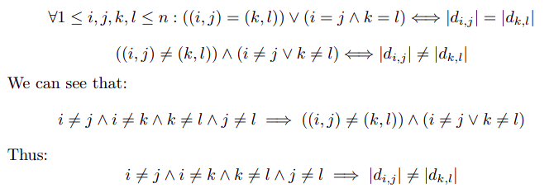
Not linear implementation
translated into
forall (i,j in N: i < j)
forall (k,l in N: k < l)
(i != k && j != l) => d[i,j] != d[k,l];
opl constraint

Slide 6
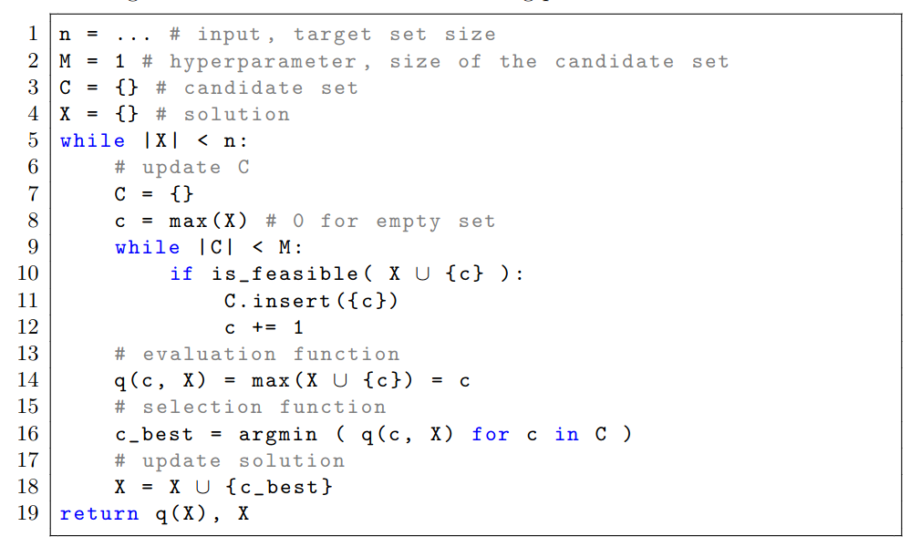
Greedy algorithm

Slide 7
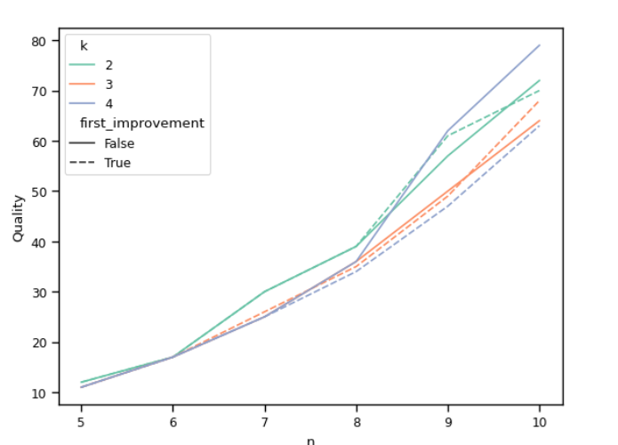
Local search
exchange K numbers
first improving strategy

Slide 8
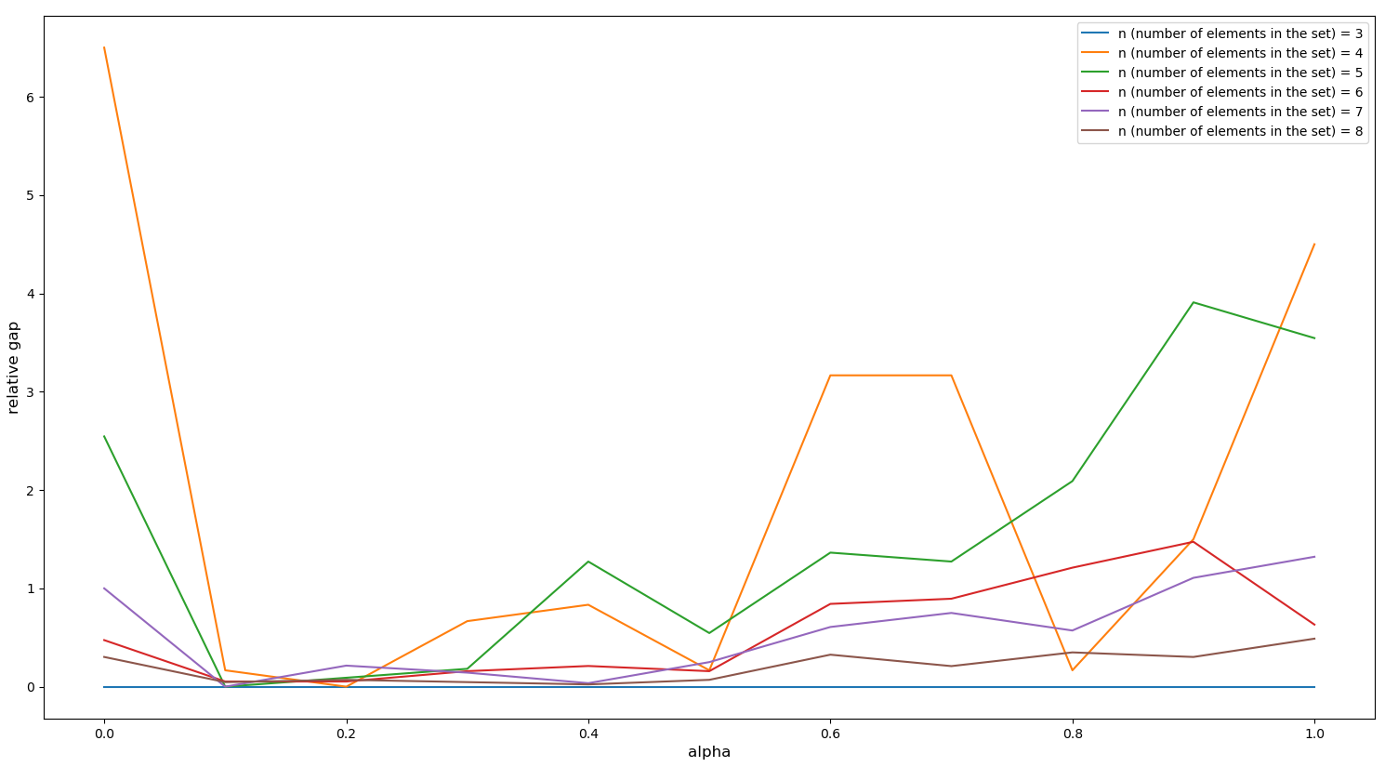
GRASP
Alpha tuning

Slide 9
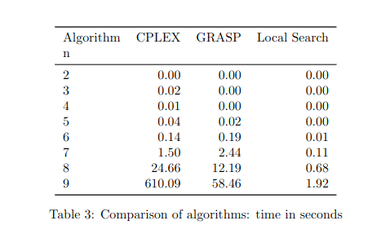
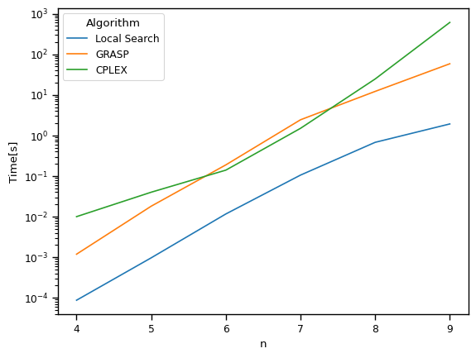
Comparison of algorithms performance, computing time

Slide 10
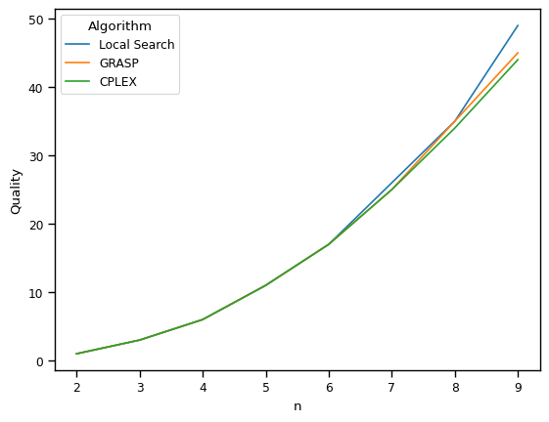
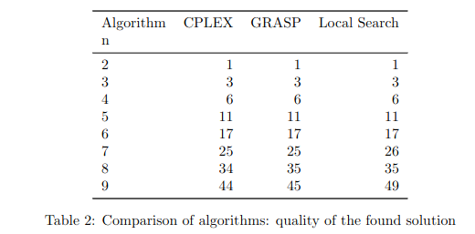
Comparison of algorithms performance, solution quality

Slide 11
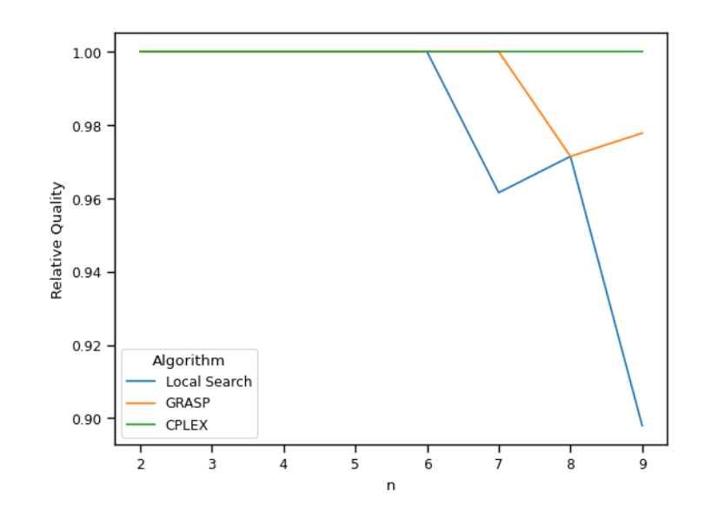
Recap/conlusion

