Slide 1
AUTOMATED MEDICAL IMAGE SEGMENTATION
Skin Lesion Segmentation with U-Net Variants
U-Net • Attention U-Net • U-Net++ — ISIC-2018 Dataset
Best model: U-Net++ / U-Net Test Dice 0.906 • IoU 0.829
Live demo: huggingface.co/spaces/unixio/skin-lesion-segmentation

Slide 2
MOTIVATION
The Problem & Our Objectives
Why it matters Skin cancer survival depends on early detection. Outlining a lesion's exact boundary is needed to measure size, track growth, and plan treatment — but manual delineation is slow and subjective.
1
Implement U-Net for lesion segmentation
2
Compare with Attention U-Net & U-Net++
3
Evaluate with Dice, IoU & Hausdorff
4
Build an upload-image prototype
5
Explain predictions with Grad-CAM

Slide 3
CONCEPT
What Is Semantic Segmentation?
← OUR TASK
Classification
Detection
Segmentation
One label for the whole image
A box around the object
A label for EVERY pixel
“Is there a lesion?”
“Roughly where?”
“Exactly which pixels?”
A supervised, pixel-wise binary classification: each pixel → lesion (1) or background (0).

Slide 4
DATA
Dataset: ISIC-2018 Skin Lesions
2,594
1,815
389
390
image / mask pairs
training (70%)
validation (15%)
test (15%)
Expert-annotated dermoscopy images, each with a ground-truth binary mask. Resized to 256×256. The lesion is the minority class (class imbalance) — which shapes our loss choice. Augmentation (flips, rotation, elastic deformation, CLAHE) improves generalisation on this small medical set.

Slide 5
MODELS
Encoder–Decoder Architectures
Encoder shrinks the image to learn “what”; decoder upsamples to draw “where”; skip connections restore fine detail.
U-Net
Attention U-Net
U-Net++
ResNet-34 encoder, pretrained on ImageNet. Classic symmetric skip connections.
Adds attention gates on skips to suppress background. Trained from scratch.
Dense nested skip pathways. Pretrained ResNet-34 encoder.
~24.4M params
~31.4M params
~26.1M params

Slide 6
TRAINING
Loss Functions
Lesions are a minority of pixels — so we combine two losses to beat class imbalance.
Binary Cross-Entropy
Penalises each pixel independently
BCE = -(1/N) Σ [ y·log ŷ + (1-y)·log(1-ŷ) ]
Dice Loss
Measures shape overlap — robust to imbalance
Dice = 1 - (2 Σ ŷy + ε)/(Σŷ + Σy + ε)
Combined (used)
Pixel accuracy + shape accuracy
L = 0.5·BCE + 0.5·Dice

Slide 7
EVALUATION
Metrics — How We Judge Quality
Dice (DSC)
IoU / Jaccard
2·TP / (2·TP + FP + FN)
TP / (TP + FP + FN)
Primary overlap score (0–1)
Standard overlap metric
Precision / Recall
Hausdorff (HD95)
TP/(TP+FP) • TP/(TP+FN)
max boundary distance (95%)
Recall = safety (no missed lesion)
Boundary accuracy for surgery

Slide 8
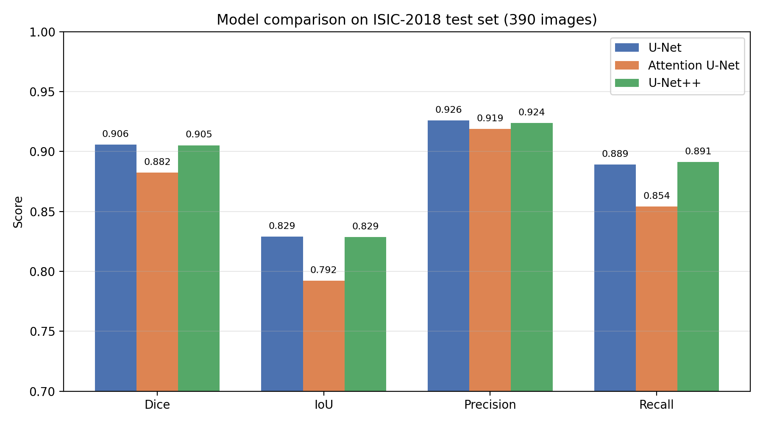
RESULTS
Test-Set Performance (390 images)
Model | Dice | IoU | Recall | HD95
U-Net | 0.906 | 0.829 | 0.889 | 12.46
Attention U-Net | 0.882 | 0.792 | 0.854 | 16.71
U-Net++ | 0.905 | 0.829 | 0.891 | 12.80
U-Net & U-Net++ are statistically tied; both use pretrained encoders.

Slide 9
KEY FINDING
Transfer learning beat architectural complexity.
The pretrained U-Net (0.906) matched the more complex U-Net++ (0.905) and clearly beat the scratch-trained Attention U-Net (0.882) — despite Attention U-Net having the most parameters.
0.906
0.905
0.882
U-Net (pretrained)
U-Net++ (pretrained)
Attention (scratch)
On small medical datasets, a pretrained encoder is the dominant lever for performance.

Slide 10
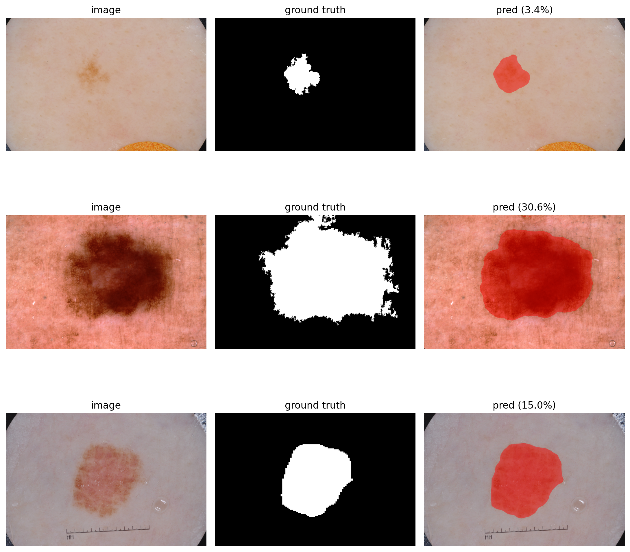
RESULTS
Qualitative Predictions (U-Net++)
Input → Expert ground truth → Predicted overlay

Slide 11
EXTENSION
Explainability with Grad-CAM
Why this region? Grad-CAM produces a heatmap of the pixels that most pushed the model toward “lesion”. 🔴 Warm = high influence 🔵 Cool = little influence It lets a clinician verify the model focused on the lesion — not on hair, shadows, or the image border. Essential for trustworthy clinical AI.
From black box → inspectable tool
The model turns a probability map into an explanation a human can audit, increasing trust and supporting safe clinical adoption.

Slide 12
PROTOTYPE
Live Web Application
Upload
Drag in any skin / dermoscopy photo
Deployed & always-on
Segment
Mask + colour overlay in seconds
Hugging Face Spaces (free CPU) Models pulled from the HF Hub at runtime — no local install, accessible any time. huggingface.co/spaces/
unixio/skin-lesion-segmentation
Explain
Grad-CAM heatmap on demand
Summarise
Area, confidence, border, disclaimer

Slide 13
IMPACT
Clinical Relevance
Early screening
Size tracking
Surgical planning
Flag suspicious lesions for review, cutting diagnostic delay
Objective mask area to monitor lesion growth over time
Pixel-precise boundaries (HD95) inform excision margins
Melanoma 5-year survival: ~98% at Stage I vs ~23% at Stage IV — early, accurate detection saves lives.

Slide 14
CONCLUSION
A complete, deployed segmentation system.
3 encoder–decoder models trained & compared on ISIC-2018
Best test Dice 0.906 — on par with published benchmarks
Full metrics: Dice, IoU, Precision, Recall, Hausdorff
Live web prototype with Grad-CAM explainability
Key insight: transfer learning > architectural complexity
Code: github.com/BertinAm/unet-skin-lesion-segmentation • Demo: huggingface.co/spaces/unixio/skin-lesion-segmentation

