Slide 1




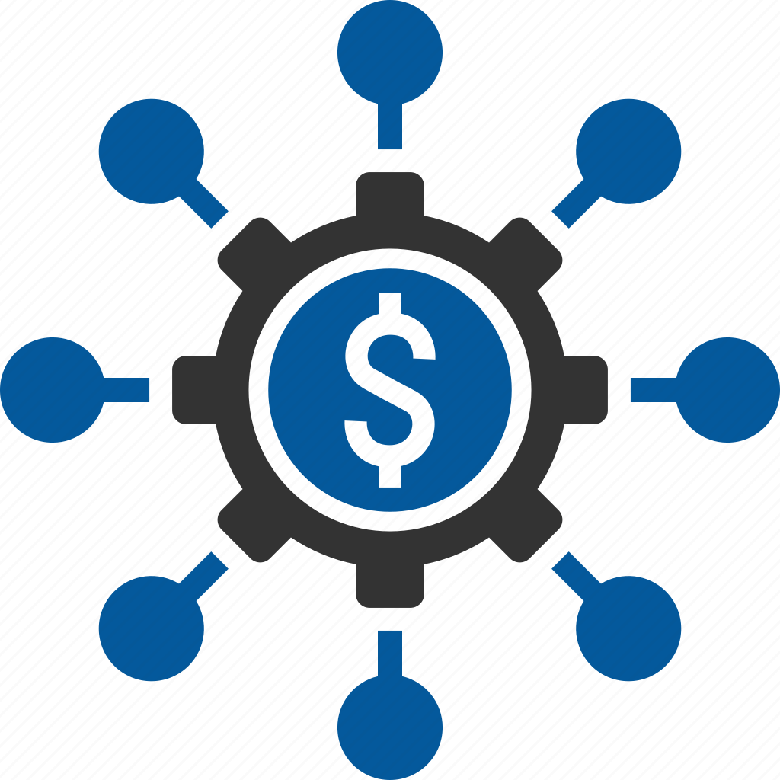
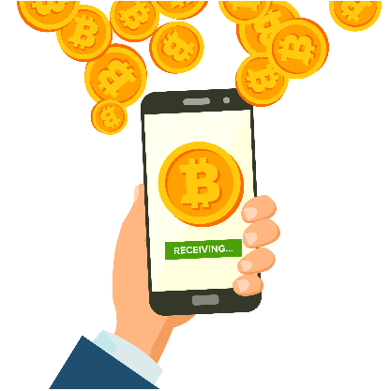
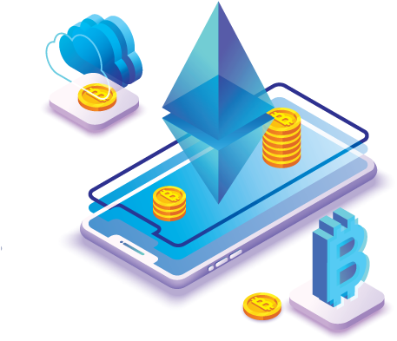



Toward Decentralization, Equity and Balance
Bertinity Coin (Token):
With our coins, people pay less for financial transactions in Bertinity eco system
Decentralized Worldwide Security Token Stock Market ( Security Token Marketplace ):
Global security token offering and trade platform which makes fundraising and investment process inclusive and accessible based on decentralized listing & delisting By blockchain consensus.
ICO Launchpad:
A blockchain crowdfunding platform on which users can buy ICO tokens and coins with fiat or other cryptocurrencies. This platform supports automatic distribution mechanisms and crypto payment gateways.
Crypto Payment Gateway (Anonymous CPG):
Our crypto payment gateway will remove cross-border restrictions
Crypto Exchange (No KYC CX):
Cryptocurrency and security token exchanges help better trading experience
Roadmap:
Other Products:
Crypto Wallet, Decentralized Crypto Exchange (DEX), DeFi Lending (No KYC Lending), Crypto Forex Broker, Public Blockchain Network (MainNet), Escrow service for P2P trades, Tokenizing assets, NFTs, Smart Contracts
01
02
Ideation:
The formation of idea
Concepting:
Mission, vision, initial strategy, website, key milestone
Token Distribution:
03
Total of : 29,000,000,000
Fundraising: Private placement and ICO
04
MVP: Minimum viable product
MLP: Minimum lovable product
05
06
Scaling: Focus on KPI based measurable growth
07
Stablishing:
Achieving great growth that will be expected to continue
@bertinity
@bertinity
bertinity.io
www.bertinity.com

