Slide 1
Chess AI
What did you expect?

Slide 2
TABLE OF CONTENTS
01
02
03
04
The Project
NLP Move Prediction
What Now?
Q&A

Slide 3
01
The Project

Slide 4

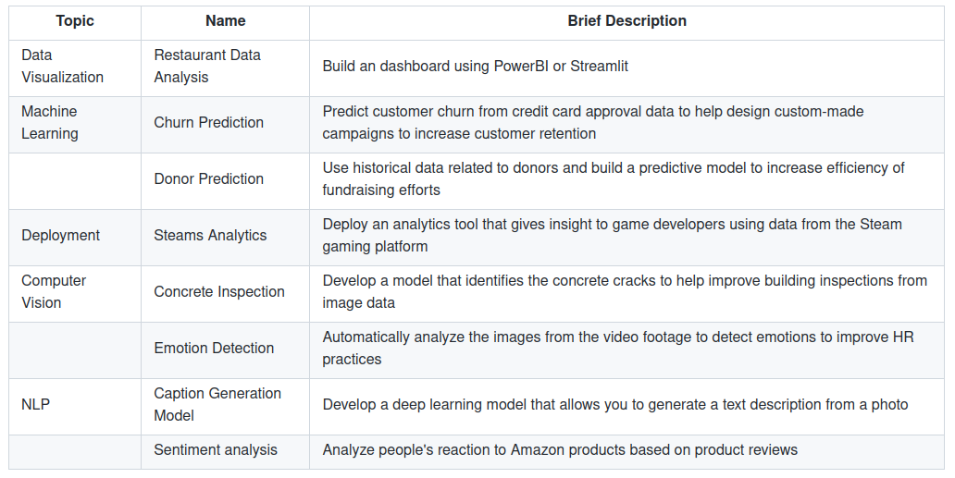
Final Project

Slide 5
Chess
Let’s build a chess AI!
How hard can it be?
Pretty hard…

Slide 6
Two Main Data Forms
Board
Moves
8x8x14 matrix
6 pieces per side
En Passant + Castling
+- 40 moves/game
20 per side
Tokenize/one-hot encode every move

Slide 7
2 Possible Approaches
Predicting the human move using previous moves
Predicting engine evaluation using boardstate

Slide 8
Possible Games
400
72 084
9
million
1 move each
2 moves each
3 moves each
16 pawn moves + 4 knight moves

Slide 9
69 352 859 712 417
Possible games after 5 moves each
Average +- 20 moves each per game

Slide 10
2 Possible Approaches
Predicting the human move using previous moves
Predicting engine evaluation using boardstate
Slow to train and predict
Large amounts of preprocessing required
⇒ Very interesting, but not
for now

Slide 11
02
NLP Move Prediction

Slide 12
e4 e5 Bc4 nc6 Qh5 nf6 Qxf7#
e4
e4 e5
e4 e5 Bc4
e4 e5 Bc4 nc6
e4 e5 Bc4 nc6 Qh5
e4 e5 Bc4 nc6 Qh5 nf6
e4 e5 Bc4 nc6 Qh5 nf6 Qxf7#
3
3 6
3 6 18
3 6 18 7
3 6 18 7 111
3 6 18 7 111 4
3 6 18 7 111 4 348
0 0 0 0 0 0 0 0 0
0 0 0 0 0 0 0 0
0 0 0 0 0 0 0
0 0 0 0 0 0
0 0 0 0 0
0 0 0 0
0 0 0

Slide 13
The Model
Model: "sequential"
_________________________________________________________________
Layer (type) Output Shape Param #
=================================================================
Embedding (Embedding) (None, 9, 100) 269400
Bidirectional (Bidirectio (None, 300) 301200
nal)
Dense (Dense) (None, 2694) 810894
=================================================================
Total params: 1,381,494
Trainable params: 1,381,494
Non-trainable params: 0

Slide 14
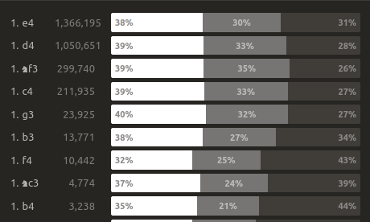
Result
Model Accuracy
Early
Late
43%
19%
Predicting only the first 10 moves
5 per side
Predicting ĺater moves

Slide 15
03
What now?

Slide 16
Main Goals
Application/Front End to play against
Further Splitting the data
Reinforcement Learning
Expand early game
Split games by rating
Board Evaluation

Slide 17

THANKS
ANY QUESTIONS?
bertramdhooge@gmail.com
https://ratings.fide.com/profile/246735
Please keep this slide for attribution

