Slide 1

An Introduction to Azure Kubernetes Services
Blaize Stewart – Architect
MS Azure MVP and Container Lover
bstewart@wintellect.com | @theonemule

Slide 2




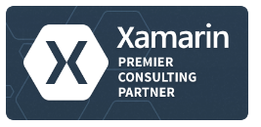
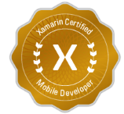

Wintellect Core Services
Consulting
Custom software application development and architecture
Instructor Led Training
Microsoft’s #1 training vendor for over 14 years having trained more than 50,000 Microsoft developers
On-Demand Training
World class, subscription based training

Slide 3
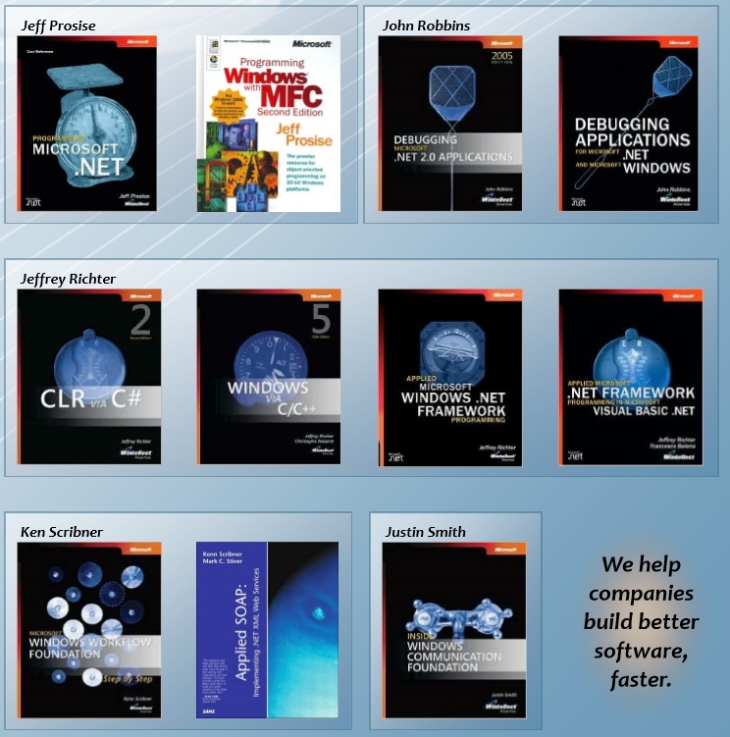
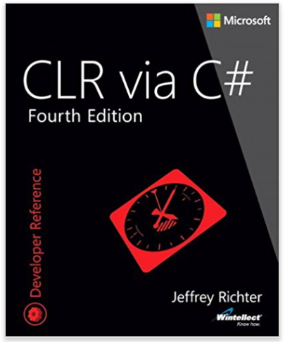
Industry Influencers We wrote the book (over 30 of them)

Slide 4
Some Highlights
Gold Cloud Platform Partner
Gold DevOps Partner
Multiple MVPs, ALM | DevOps Rangers, and Azure Advisors
2016 IAMCP Gold Partner of the Year for the U.S. announced at WPC
CEO is Microsoft Regional Director (RD) for Atlanta
Software Development competency partner
Xamarin Premier Consulting Partner
Multiple Xamarin Certified Engineers
Chosen to teach the 2-day Xamarin University pre-con at Evolve 2016
Other: Visual Studio Integration Partner, Azure Circle Partner, ALM Inner Circle Partner, MVP of the Year, and more…

Slide 5
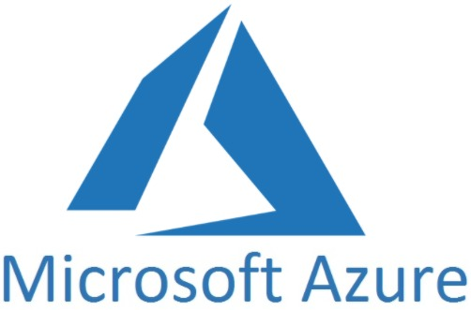
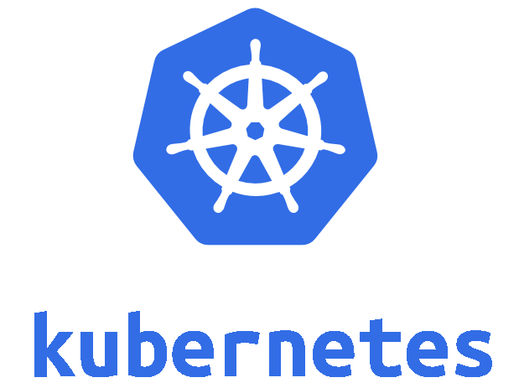
Azure Kubernetes Service (AKS)
+

Slide 6
Azure Kubernetes Services
Only pay for nodes and other Azure resources, not masters or orchestration nodes.
Fully managed – You don’t have to manage the cluster.
Easily scalable.
Fully integrates with other Azure services like Application Gateway and Load Balancers.
Fully supports most all native Kubernetes features.

Slide 7
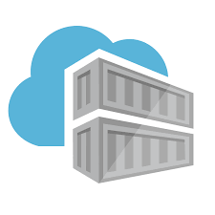
Azure Container Registry (ACR)
Azure Container Registry is a full featured Docker container registry.
Supports Geo-replication for high availability
Image can be built in the cloud with ACR Tasks
Webhooks can be triggered by way of a container image push

Slide 8
What is Kubernetes?
An orchestration engine for container
Automates deployments
Scales workloads
Manages workloads
Provides infrastructure for hosting workloads
Open Source
Is owned of the Cloud Native Foundation

Slide 9
Container vs. VM’s
Apps/Bins
Apps/Bins
Apps/Bins
Guest OS
Guest OS
Guest OS
VM Hardware
VM Hardware
VM Hardware
Apps/Bins
Apps/Bins
Apps/Bins
Hypervisor
Container Runtime
Host OS
Host OS
Hardware
Hardware

Slide 10
Dockerfiles
FROM alpine
RUN apk update && apk add bash wget
COPY no-ip.sh /no-ip.sh
CMD /bin/bash /no-ip.sh

Slide 11
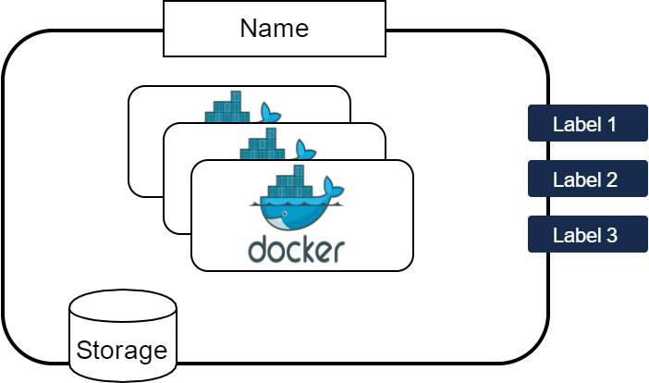
What is a Pod?
Labels are used to attach properties to pods (or any resource on a cluster) to help find and identify them.
The Name of Pod identifies it on the node and network
A Pod is the most basic unit on Kubernetes. Typically, they will contain 1 container, but can have more than. The containers in the pod share resources such as storage, CPU, and RAM. Network resources are connected to the pod
Kubernetes uses containers for deploying apps. In most cases, it uses Docker containers
Storage on a pod is shared with all of the containers in the pod.

Slide 12
Controllers
Pods are used in different ways on a Kubernetes cluster. The use cases are managed by controllers.
Controllers manage application scaling through replica sets, replication controllers, or deployments, which contain 1 or more copies of a pod for purposes of scaling.
Another common use case for running pods is jobs, which start, run, then terminate. These can be invoked on triggers (such as a cron job) or manually invoked.

Slide 13
Common Types of Controllers
Replica Sets – the original controller used for creating scaled applications.
Replication Controller – intended to replace replica sets
Deployments – creates a replica set with rollback options
Stateful Sets – manages ordering and uniqueness of deployed pods
Daemon Set – insure that every node has a copy of a pod
Jobs – Will run and look for termination statuses of the jobs
Chron Jobs – Jobs that run on a schedule

Slide 14
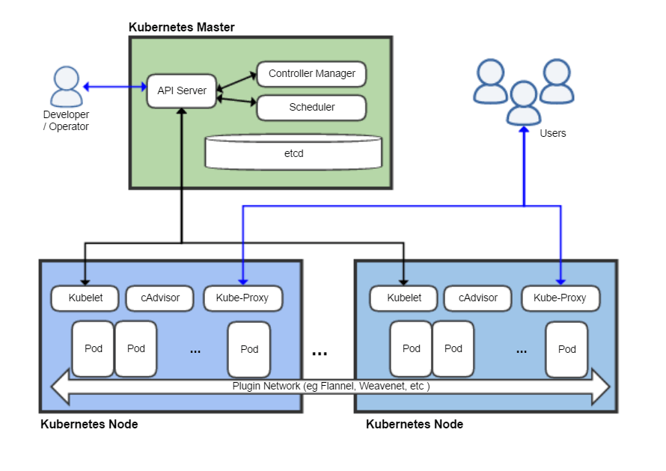
Kubernetes Architecture
Control Manager manages controllers that work to bring Kubernetes to the desired state. This includes scheduling controllers and replication controllers.
The API Server provides endpoints for developers and operators to interact with the cluster.
The Scheduler is responsible for actually doing the resource management of pods based
Cadvisor collects telemetry about the pods running on the nodes such as network, CPU, and RAM usage.
Kube-Proxy is a network proxy and load balancer for pods running on the node.
Kubelet is an agent that runs on each node that receives instructions from the Master about what to do on the node
etcd is a key-value store for storing configuration data in the Kubernetes cluster.
Kubernetes Masters act as the control unit for a cluster. A cluster needs 1 or more Masters to run.
Pods are the basic unit for building services. A Pod contains 1 or more containers that share resources like volumes, RAM, CPU, and Networking. A pod ensure that the containers are on the same host
Kubernetes Nodes actually run the workloads. Kubernetes needs at least 1 node to run. In small setups, the node and the master can be the same
Plugin Network uses a driver to create an overlay network between Kubernetes Nodes. This allows pods to communicate seamlessly between nodes on a Kubernetes Cluster

Slide 15
Setting up AKS

Slide 16

Container Workflow
Container Registry
Container Image
FROM alpine
RUN apk update && apk add bash wget
COPY no-ip.sh /no-ip.sh
CMD /bin/bash /no-ip.sh
Container Image
Container Image
Dockerfile
docker build
Container
docker push
kubectl create
Local (Dev)
Kubernetes

Slide 17
Docker Images
Layer 3
Layer 3
Layer 3
Layer 2
Layer 2
Layer 1

Slide 18
Common Types of Controllers
Replica Sets – the original controller used for creating scaled applications.
Replication Controller – intended to replace replica sets
Deployments – creates a replica set with rollback options
Stateful Sets – manages ordering and uniqueness of deployed pods
Daemon Set – insure that every node has a copy of a pod
Jobs – Will run and look for termination statuses of the jobs
Chron Jobs – Jobs that run on a schedule

Slide 19
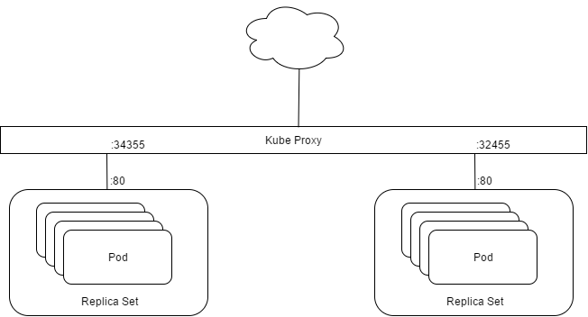
Services
A service is an exposure of pods, replica set, controllers, etc. on a port through the Kube Proxy
The Proxy determines which pod (and thus, which container) will receive the incoming request

Slide 20
Common Service Types
Load Balancers – a load balancer provides a Layer 4 TCP load balancer for a controller to expose the service to the cluster’s external network.
Cluster IP – This service will attach a deployment through a load balanced configuration to the clusters internal network.
Node Port – exposes a port on the nodes’ IP address.

Slide 21
Dockerfile to Running App Using Services
An end –to-end demo starting with a Dockerfile going all the way to an application running on AKS.

Slide 22
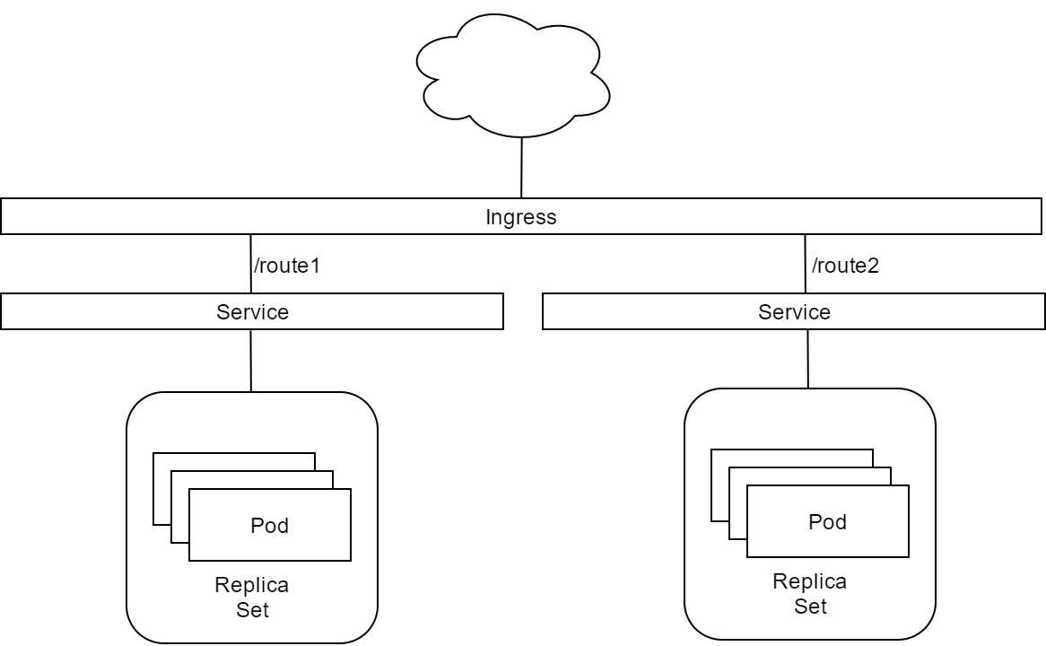
Ingress
Ingress allows HTTP and HTTPS traffic to be routed internally to services.

Slide 23
Ingress

Slide 24
Kubernetes in Production
Azure Kubernetes Services (AKS) is managed Kubernetes platform.
You can also build out Kubernetes clusters on PaaS with kubeadm

Slide 25
Wrap Up
Questions???
Check us out online at www.Wintellect.com.
Follow us on Twitter @Wintellect and @theonemule
Checkout our YouTube channel https://www.youtube.com/wintellectnow

