Slide 1
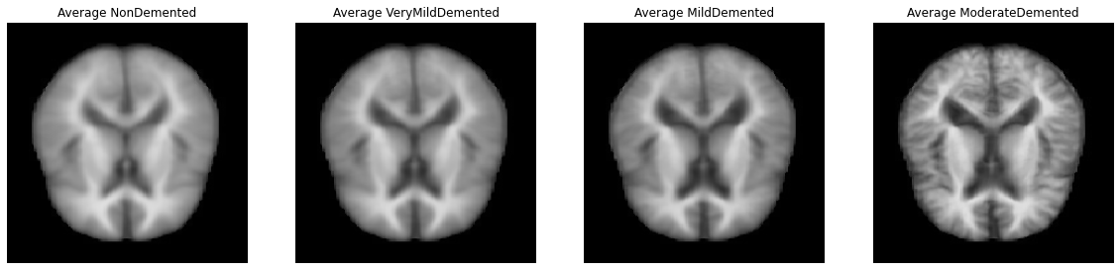
Deep Learning Methods for Alzheimer’s Disease Prediction
Longling Tian, Fang Shu, 12/09/2022

Slide 2
Background
Task: MRI Image Stage of Alzheimer Disease
Related Work:
Raees et.al.: AlexNet, VGG16&19: ~80% Accuracy
Islam et.al.: InceptionV4 and ResNet: ~92% Accuracy
ADNI Dataset

Slide 3
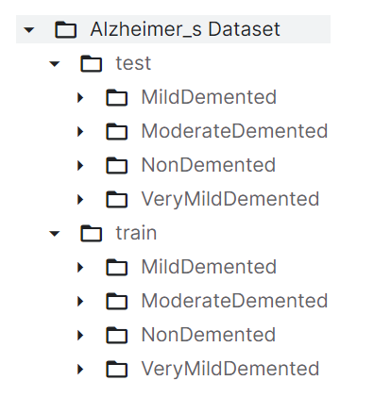
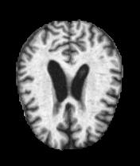
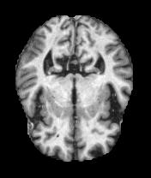
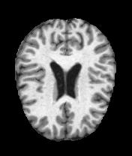
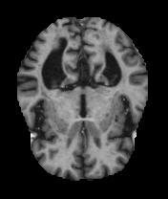
Dataset

Slide 4
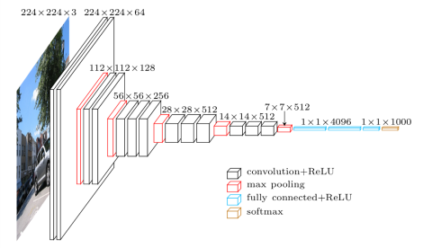
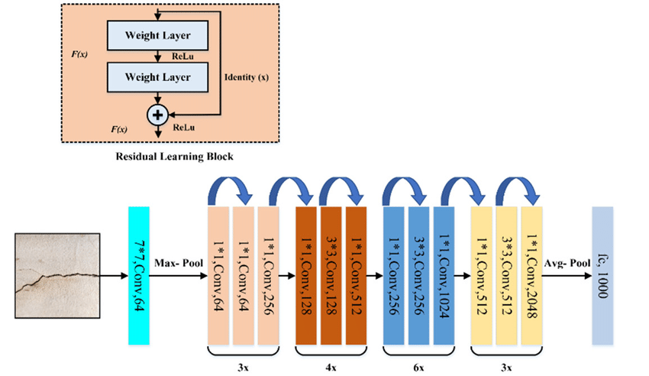
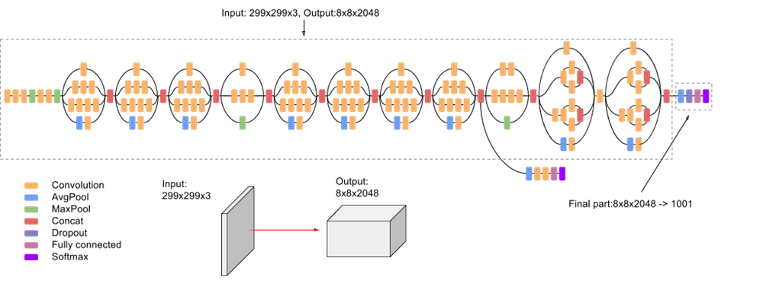
Methods
Baseline: VGG16, ResNet50, InceptionV3

Slide 5
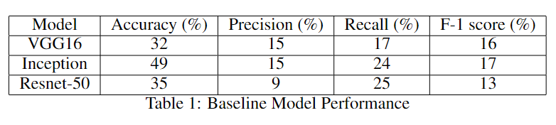
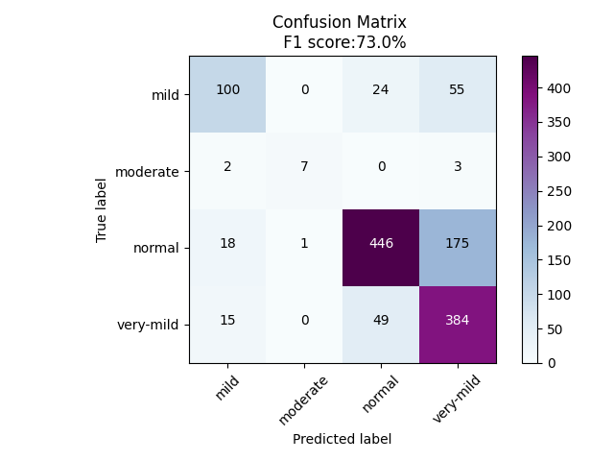
Results – Baseline and Final ResNet-50
> 60% Recall on every class

Slide 6
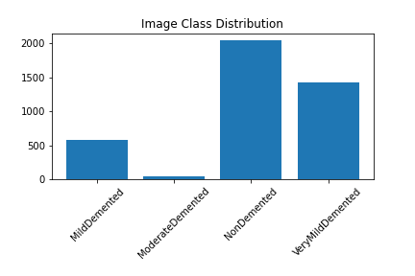
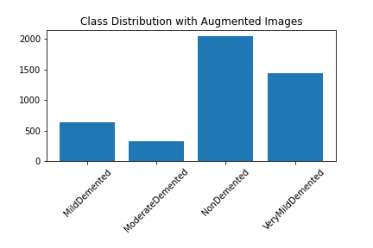
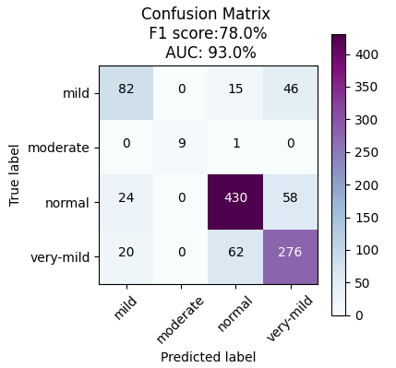
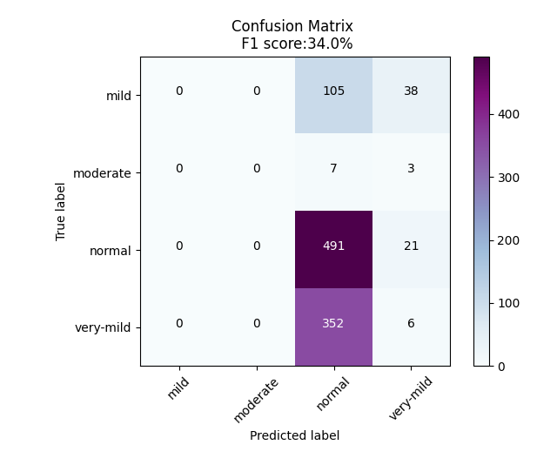
Results – Data Augmentation

Slide 7
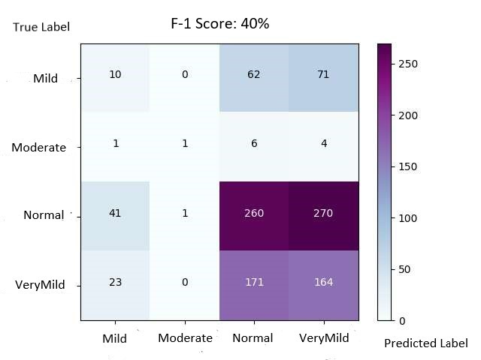
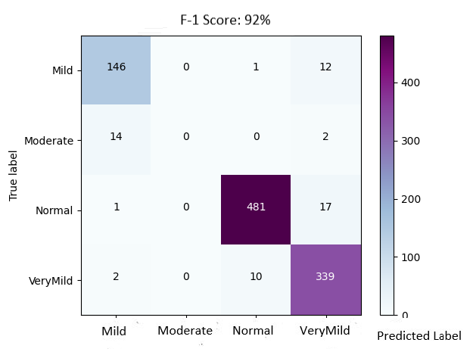
Novelty – Contrastive Learning
Semi-supervised
Supervised

