Slide 1
Collection

Slide 2
ArrayList
Java ArrayList class uses a dynamic array for storing the elements.
It is like an array, but no size limit.
can add or remove i.e manipulate elements anytime.
More flexible than the traditional array
ArrayList in Java can have the duplicate elements
ArrayList maintains the insertion order internally
Java ArrayList class is non synchronized
In ArrayList, manipulation is a little bit slower because a lot of shifting needs to occur if any element is removed from the array list.
Can not create an array list of the primitive types, such as int, float, char, etc. It is required to use the required wrapper class
{1,2,3,3,4,5,6,7,8,,56,455}

Slide 3
LinkedList
LinkedList class uses a doubly linked list to store the elements. It provides a linked-list data structure
Java LinkedList class can contain duplicate elements
Maintains insertion order
class is non synchronized.
LinkedList class, manipulation is fast because no shifting needs to occur.
PN

Slide 4
Double linked list
Doubly linked list, we can add or remove elements from both sides

Slide 5
Arraylist vs Linkedlist
ArrayList and LinkedList both implement the List interface and maintain insertion order. Both are non-synchronized classes

Slide 6
ArrayList | LinkedList
dynamic array to store the elements | uses a doubly linked list to store the elements
Manipulation with ArrayList is slow due to shifting | linkedList is faster than ArrayList because it uses a doubly linked no bit shifting is required in memory
better for storing and accessing | better for manipulating
when an ArrayList is initialized, a default capacity of 10 | There is no case of default capacity in a LinkedList
an ArrayList is a resizable array | LinkedList implements the doubly linked list of the list interface

Slide 7
Application for ArrayList/LinkedList Real life
Linkedlist for when food in restaurant queu, first give the order serve.
Arraylist for when food in restaurant queu, first give the order serve.
Manipulation is more= linkedlist (Restaurant)
Storing=Arraylist (Godown )

Slide 8
HashMap
Java HashMap class implements the Map interface which allows us to store key and value pair, where keys should be unique
If you try to insert the duplicate key, it will replace the element of the corresponding key
HashMap in Java is like the legacy Hashtable class, but it is not synchronized
but there should be only one null key.

Slide 9
Internal working of HashMap
Hashing is a process of converting an object into integer form by using the method hashCode(). Its necessary to write hashCode() method properly for better performance of HashMap

Slide 10
The initial capacity of the HashMap is the number of buckets in the hash table. It creates when we create the object of HashMap class. The initial capacity of the HashMap is 2⁴, i.e., 16
The capacity of the HashMap is doubled each time it reaches the threshold. The capacity is increased to 2⁵=32, 2⁶=64, and so on.

Slide 11
Put method
When we pass Key and Value object to put() method on Java HashMap, HashMap implementation calls hashcode method on Key object and applies returned hashcode into its own hashing function to find a bucket location for storing Entry object,
the important point to mention is that HashMap in java stores both key and value object as Map.Entry in a bucket is essential to understand the retrieving logic

Slide 12
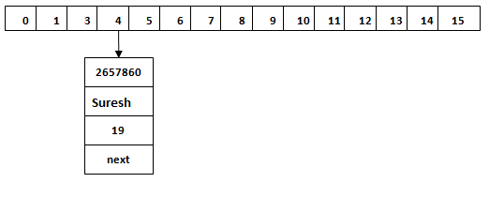
Index = hashcode(Key) & (n-1)

Slide 13
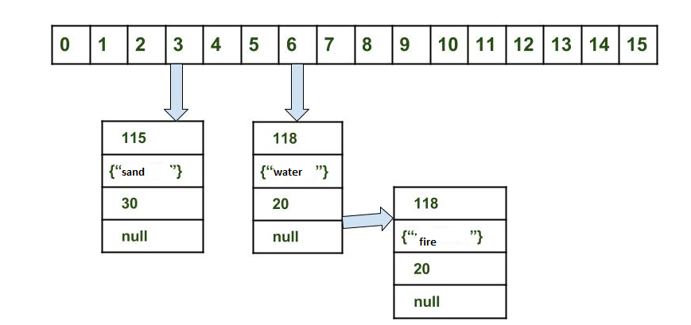

Slide 14
HashMap<String, Integer> hashMap = new HashMap<>(); hashMap.put("A",1); // hash("A")=69, indexFor(hash,table.length)=69&(16-1) = 5 hashMap.put("B",2); // hash("B")=70, indexFor(hash,table.length)=70&(16-1) = 6 hashMap.put("P",3); // hash("P")=85, indexFor(hash,table.length)=85&(16-1) = 5 hashMap.put("A",4); // hash("A")=69, indexFor(hash,table.length)=69&(16-1) = 5 hashMap.put("r", 4);// hash("r")=117, indexFor(hash,table.length)=117&(16-1) = 5

Slide 15
If index are different, new entry will add to table/bucket If index is same and hash is same, new value will update If index is same and hash is different, new entry will point to old entry (like a LinkedList). Then you know why Map.Entry have field next

Slide 16
Load Factor
The Load factor is a measure that decides when to increase the HashMap capacity to maintain the get() and put() operation complexity of O(1). The default load factor of HashMap is 0.75f (75% of the map size).

Slide 17
There are two factors which affect the performance of the hashmap.
Initial Capacity
Load Factor
HashMap hm=new HashMap(int initialCapacity, float loadFactor);

Slide 18
The initial capacity of hashmap is=16 The default load factor of hashmap=0.75 According to the formula as mentioned above: 16*0.75=12

Slide 19
When the load factor ratio (m/n) reaches 0.75 at that time, hashmap increases its capacity.
Where,
m is the number of entries in a hashmap.
n is the total size of hashmap.

Slide 20
equals(): It checks the equality of two objects. It compares the Key, whether they are equal or not. It is a method of the Object class. It can be overridden. If you override the equals() method, then it is mandatory to override the hashCode() method.
hashCode(): This is the method of the object class. It returns the memory reference of the object in integer form. The value received from the method is used as the bucket number. The bucket number is the address of the element inside the map. Hash code of null Key is 0.
Buckets: Array of the node is called buckets. Each node has a data structure like a LinkedList. More than one node can share the same bucket. It may be different in capacity.

Slide 21
get() method in HashMap
get() method is used to get the value by its Key. It will not fetch the value if you don't know the Key. When get(K Key) method is called, it calculates the hash code of the Key.

Slide 22
It generates the hash code as Eg 2657860. Now calculate the index value of 2657860 by using index formula.
Index = hashcode(Key) & (n-1)
The index value will be 4, as we have calculated above. get() method search for the index value 4. It compares the first element Key with the given Key.
If both keys are equal, then it returns the value else check for the next element in the node if it exists. In our scenario, it is found as the first element of the node and return the value 19.

Slide 23
The hash code of the Key “Suresh" is 63281940. The calculated index value of 63281940 is 4,
Index = hashcode(Key) & (n-1)
as we have calculated for put() method. Go to index 4 of the array and compare the first element's Key with the given Key. It also compares Keys.
In our scenario, the given Key is the second element, and the next of the node is null. It compares the second element Key with the specified Key and returns the value 29. It returns null if the next of the node is null.

Slide 24
This is the case when the calculated index value is the same for two or more Keys. Let's calculate the hash code for another Key "Sunny." Suppose the hash code for "Sunny" is 63281940. To store the Key in the memory, we have to calculate index by using the index formula.

Slide 25
Working of Hashset
Whenever we create a HashSet, it internally creates a HashMap and if we insert an element into this HashSet using add() method, it actually call put() method on internally created HashMap object with element you have specified as it’s key and constant Object called “PRESENT” as it’s value.

Slide 26
If map.put(key, value) returns null, then the statement “map.put(e, PRESENT) == null” will return true and element is added to the HashSet(internally HashMap).
If map.put(key, value) returns old value of the key, then the statement “map.put(e, PRESENT) == null” will return false and element is not added to the HashSet(internally HashMap)

Slide 27
Internal working of HashMap
Hashing is a process of converting an object into integer form by using the method hashCode(). Its necessary to write hashCode() method properly for better performance of HashMap
hashCode() method is used to get the hash Code of an object. hashCode() method of object class returns the memory reference of object in integer form

Slide 28
Calculate hash code of Key {“vishal”}. It will be generated as 118.
Calculate index by using index method it will be 6.
Create a node object as :

Slide 29
Place this object at index 6 if no other object is presented there.
In this case a node object is found at the index 6 – this is a case of collision.
In that case, check via hashCode() and equals() method that if both the keys are same.
If keys are same, replace the value with current value.
Otherwise connect this node object to the previous node object via linked list and both are stored at index 6.

Slide 30
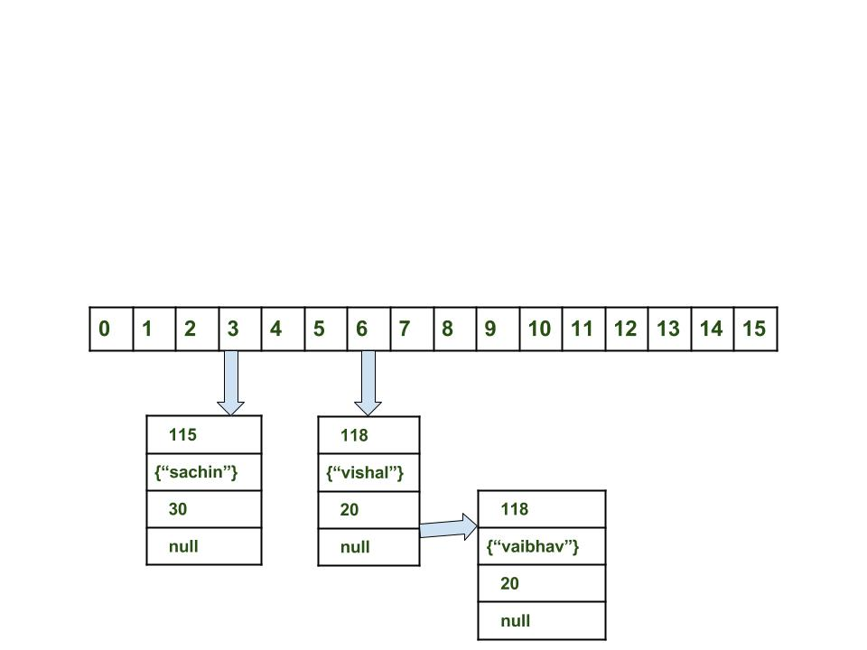

Slide 31
HashMap internally stores mapping in the form of Map.Entry object which contains both key and value object
When you want to retrieve the object, you call the get() method and again pass the key object. This time again key objects generate the same hash code (it's mandatory for it to do so to retrieve the object and that's why HashMap keys are immutable e.g. String) and we end up at the same bucket location. If there is only one object then it is returned and that's your value object which you have stored earlier

Slide 32
String, Integer, and other wrapper classes are natural candidates of the HashMap key, and String is the most frequently used key as well because String is immutable and final, and overrides equals and hashcode() method. Other wrapper class also shares similar property.

Slide 33
Immutability also allows caching their hashcode of different keys which makes the overall retrieval process very fast and suggests that String and various wrapper classes e.g. Integer very good keys in Java HashMap.

Slide 34
If we try to retrieve an object from this linked list, we need an extra check to search for the correct value, this is done by the equals() method. Since each node contains an entry, HashMap keeps comparing the entry's key object with the passed key using equals() and when it returns true, Map returns the corresponding value.

Slide 35
Since searching inlined list is an O(n) operation, in the worst case hash collision reduces a map to a linked list. This issue is recently addressed in Java 8 by replacing the linked list to the tree to search in O(logN) time

Slide 36
Since the internal array of HashMap is of fixed size, and if you keep storing objects, at some point in time hash function will return the same bucket location for two different keys, this is called collision in HashMap. In this case, a linked list is formed at that bucket location and a new entry is stored as the next node

Slide 37
map.get(new Key("sachin"));
Using get method()
Calculate hash code of Key {“sachin”}. It will be generated as 115.
Calculate index by using index method it will be 3.
Go to index 3 of array and compare first element’s key with given key. If both are equals then return the value, otherwise check for next element if it exists.
In our case it is found as first element and returned value is 30.

Slide 38
map.get(new Key("vaibhav"));
Calculate hash code of Key {“vaibhav”}. It will be generated as 118.
Calculate index by using index method it will be 6.
Go to index 6 of array and compare first element’s key with given key. If both are equals then return the value, otherwise check for next element if it exists.
In our case it is not found as first element and next of node object is not null.
If next of node is null then return null.
If next of node is not null traverse to the second element and repeat the process 3 until key is not found or next is not null.
Time complexity is almost constant for put and get method until rehashing is not done.
In case of collision, i.e. index of two or more nodes are same, nodes are joined by link list i.e. second node is referenced by first node and third by second and so on.
If key given already exist in HashMap, the value is replaced with new value.
hash code of null key is 0.
When getting an object with its key, the linked list is traversed until the key matches or null is found on next field.

Slide 39
HashSet
HashSet class is used to create a collection that uses a hash table for storage
HashSet stores the elements by using a mechanism called hashing
HashSet contains unique elements only
HashSet allows null value
HashSet class is non synchronized
HashSet doesn't maintain the insertion order. Here, elements are inserted on the basis of their hashcode
The initial default capacity of HashSet is 16, and the load factor is 0.75

