Slide 2
New: Whenever a new thread is created, it is always in the new state. For a thread in the new state, the code has not been run yet and thus has not begun its execution
Active: When a thread invokes the start() method, it moves from the new state to the active state. The active state contains two states within it: one is runnable, and the other is running

Slide 3
Runnable
Runnable: A thread, that is ready to run is then moved to the runnable state. In the runnable state, the thread may be running or may be ready to run at any given instant of time. It is the duty of the thread scheduler to provide the thread time to run, i.e., moving the thread the running state.

Slide 4
Running
When the thread gets the CPU, it moves from the runnable to the running state. Generally, the most common change in the state of a thread is from runnable to running and again back to runnable.

Slide 5
Blocked/Waiting
Blocked or Waiting: Whenever a thread is inactive for a span of time (not permanently) then, either the thread is in the blocked state or is in the waiting state.

Slide 6
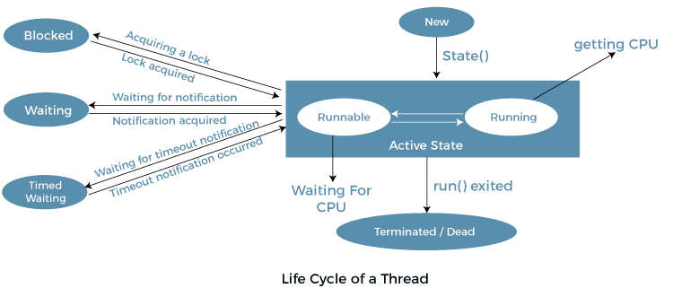

Slide 7
Wait
The java.lang.Object.wait() causes current thread to wait until another thread invokes the notify() method or the notifyAll() method for this object.
In other words, this method behaves exactly as if it simply performs the call wait(0).

Slide 8
Synchronized block
Synchronized block can be used to perform synchronization on any specific resource of the method.
Based on selective lines of code we can synchronize the resource
If we put all the codes of the method in the synchronized block, it will work same as the synchronized method.

Slide 9
Synchronized block is used to lock an object for any shared resource
System performance may degrade because of the slower working of synchronized keyword.

Slide 10
Object Lock
Object Level Lock
Object-level lock: Every object in java has a unique lock.
Whenever we are using a synchronized keyword, then only the lock concept will come into the picture.
If a thread wants to execute then synchronized method on the given object.
Step1->First, it has to get a lock-in that object.
Step2->Once the thread got the lock then it is allowed to execute any synchronized method on that object.
Step 3->Once method execution completes automatically thread releases the lock.
Acquiring and release lock internally is taken care of by JVM and the programmer is not responsible for these activities

Slide 11
Class Lock
Class Lock
Every class in Java has a unique lock which is nothing but a class level lock.
If a thread wants to execute a static synchronized method, then the thread requires a class level lock.
Once a thread got the class level lock, then it is allowed to execute any static synchronized method of that class.
Once method execution completes automatically thread releases the lock

Slide 12
Static Synchronization
The Synchronized method may lose its behavior of getting an ordered output.
When there are more objects of a class, It acquires only the lock of the particular instance/OBJECT.
To maintain the Synchronized behavior, we need a class-level lock rather than an instance-level lock/object level lock which can be achieved by Static Synchronization.

Slide 13
Decimal ----------- Binary
2 0010
8 1000
6 110
1 1

Slide 14
Rectangle Thread1 ,
Thread2
A
B
C
D

