Slide 2
Start() and run()
Extending Thread class and Runnable interface In both the approaches, we override the run() function, but we start a thread by calling the start() function
The purpose of start() is to create a separate call stack for the thread. A separate call stack is created by it, and then run() is called by JVM.

Slide 3
Life cycle of thread
Thread in Java at any point of time exists in any one of the following states. A thread lies only in one of the shown states at any instant:
New
Runnable
Blocked
Waiting
Timed Waiting
Terminated

Slide 4
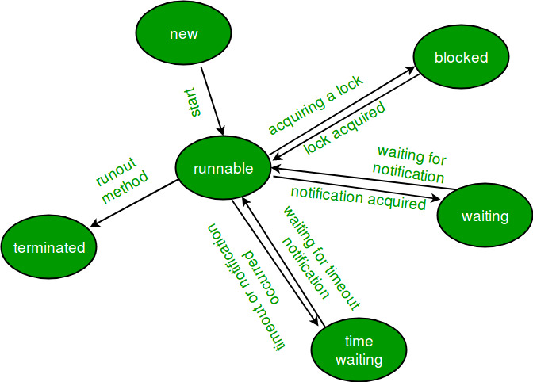

Slide 5
New Thread: When a new thread is created, it is in the new state. The thread has not yet started to run when the thread is in this state
Runnable State: A thread that is ready to run is moved to a runnable state. In this state, a thread might actually be running or it might be ready to run at any instant of time
Blocked/Waiting state: When a thread is temporarily inactive, then it’s in one of the following states:
Blocked
Waiting

Slide 6
Timed Waiting: A thread lies in a timed waiting state when it calls a method with a time-out parameter. A thread lies in this state until the timeout is completed or until a notification is received
Terminated State: A thread terminates because of either of the following reasons: Because it exits normally. This happens when the code of the thread has been entirely executed by the program

Slide 7
Inter Thread Communication
Inter-thread communication or Co-operation is all about allowing synchronized threads to communicate with each other.
another thread is allowed to enter (or lock) in the same critical section to be executed.It is implemented by following methods of Object class

Slide 8
Wait() method
method or the notifyAll() methodThe wait() method causes current thread to release the lock and wait until either another thread invokes the notify() for this object, or a specified amount of time has elapsed

Slide 9
Notify()
The notify() method wakes up a single thread that is waiting on this object's monitor. If any threads are waiting on this object, one of them is chosen to be awakened

Slide 10
Notifyall()
Wakes up all threads that are waiting on this object's monitor.

Slide 11
Wait and sleep method difference
wait()
The wait() method releases the lock.
It is a method of Object class
sleep()
The sleep() method doesn't release the lock.
It is a method of Thread class

Slide 12
DeadLock and Prevention
Deadlock can occur in a situation when a thread is waiting for an object lock, that is acquired by another thread and second thread is waiting for an object lock that is acquired by first thread. Since, both threads are waiting for each other to release the lock, the condition is called deadlock
A deadlock may also include more than two threads. The reason is that it can be difficult to detect a deadlock

Slide 14
Object-level lock
Every object in java has a unique lock. Whenever we are using a synchronized keyword, then only the lock concept will come into the picture.
If a thread wants to execute then synchronized method on the given object. First, it has to get a lock-in that object.
Once the thread got the lock then it is allowed to execute any synchronized method on that object. Once method execution completes automatically thread releases the lock.
Acquiring and release lock internally is taken care of by JVM and the programmer is not responsible for these activities

Slide 15
Class level lock
:Every class in Java has a unique lock which is nothing but a class level lock.
If a thread wants to execute a static synchronized method, then the thread requires a class level lock.
Once a thread got the class level lock, then it is allowed to execute any static synchronized method of that class.
Once method execution completes automatically thread releases the lock

Slide 16
Constructors in thread class
Thread()
Thread(Runnable target)
Thread(Runnable target, String name)
Thread(String name)
Thread(ThreadGroup group, Runnable target)
All allocates new thread object

Slide 17
Thread Join
java.lang.Thread class provides the join() method which allows one thread to wait until another thread completes its execution. If t is a Thread object whose thread is currently executing, then t.join() will make sure that t is terminated before the next instruction is executed by the program.
join(): It will put the current thread on wait until the thread on which it is called is dead. If thread is interrupted then it will throw InterruptedException
In the above example we can see clearly second thread t2 starts after first thread t1

Slide 18
Concurrent modification
Concurrent Modification: Concurrent Modification in programming means to modify an object concurrently when another task is already running over it
in Java to modify a collection when another thread is iterating over it. Some Iterator implementations (including those of all the general purpose collection implementations provided by the JRE) may choose to throw ConcurrentModificationException

Slide 19
Fail fast
Iterators in java are used to iterate over the Collection objects.Fail-Fast iterators immediately throw ConcurrentModificationException if there is structural modification of the collection. Structural modification means adding, removing any element from collection while a thread is iterating over that collection. Iterator on ArrayList, HashMap,Map, List classes are some examples of fail-fast Iterator.

Slide 20
Fail-Safe iterators
Fail-Safe iterators don’t throw any exceptions if a collection is structurally modified while iterating over it. This is because, they operate on the clone of the collection, not on the original collection and that’s why they are called fail-safe iterators. Iterator on CopyOnWriteArrayList, ConcurrentHashMap classes are examples of fail-safe Iterator.

Slide 21
Fail fast and modCount
flag called modCount which is updated each time a collection is modified.Fail-fast iterators checks the modCount flag whenever it gets the next value (i.e. using next() method), and if it finds that the modCount has been modified after this iterator has been created, it throws ConcurrentModificationException.

Slide 22
The major difference is fail-safe iterator doesn’t throw any Exception, contrary to fail-fast Iterator.
This is because they work on a clone of Collection instead of the original collection and that’s why they are called as the fail-safe it

Slide 24
Ist 11.am today thread
Account 600+2000-500+5000-1000+10000
Branch by self 10000 th
Withdraw 500 th
Depositing money through 5000 friends or relative th
Online transfer 2000 th
EMI debit 1000 th

Slide 25
IRCTC Website. Tatkal reservtion

