Slide 1
Fundamentals

Slide 2
Packages: Names should be in lowercase. With small projects that only have a few packages it's okay to just give them simple (but meaningful!) names
Classes: Names should be in CamelCase. Try to use nouns because a class is normally representing something in the real world:
Interfaces: Names should be in CamelCase. They tend to have a name that describes an operation that a class can do:
Methods: Names should be in mixed case. Use verbs to describe what the method does:
Variables: Names should be in mixed case. The names should represent what the value of the variable represents:
Class AddionValue
{ }
Public void getValue()
{ }
Int numberValue =10;

Slide 3
Comments
Single line comments. //
Multi – line comments. /*
*/
Documentation comments
/**Comment start * *
*data valie
*/

Slide 4
/**
* This method is used to find average of three integers.
* @param numA This is the first parameter to findAvg method
* @param numB This is the second parameter to findAvg method
* @param numC This is the second parameter to findAvg method
* @return int This returns average of numA, numB and numC.
*/

Slide 5
Statements
Expression Statements
Declaration Statements
Control Statements

Slide 6
Identifier
The only allowed characters for identifiers are all alphanumeric characters([A-Z],[a-z],[0-9]), ‘$‘(dollar sign) and ‘_‘ (underscore).For example “jam@” is not a valid java identifier as it contain ‘@’ special character.
Identifiers should not start with digits([0-9]). For example “123geeks” is a not a valid java identifier.
Java identifiers are case-sensitive.
There is no limit on the length of the identifier but it is advisable to use an optimum length of 4 – 15 letters only
Reserved Words can’t be used as an identifier. For example “int while = 20;” is an invalid statement as while is a reserved word. There are 53 reserved words in Java.

Slide 7
Keywords
break , case, boolean, assert,
Case, catch,
Continue
If
While, do while, static, super switch.
Requires-Java 9
Etc….

Slide 8
Contd…
Transient-Comes in serialization
Native-serialization
Volatile- serialization
Synchronized- multithreading
Throw -exception
Throws-exception

Slide 9
Literals
Integer Literal
Character Literal
Boolean Literal
String Literal
Floating Point Literal

Slide 10
Integral Literals
An integer literal is of type long if it ends with the letter L or l;
otherwise it is of type int.
It is recommended that you use the upper case letter L because the lower case letter l is hard to distinguish from the digit 1.

Slide 11
Floating Point Literals
A floating-point literal is of type float if it ends with the letter F or f; otherwise its type is double and it can optionally end with the letter D or d.
The floating point types (float and double) can also be expressed using E or e (for scientific notation), F or f (32-bit float literal) and D or d (64-bit double literal; this is the default and by convention is omitted).
double d1 = 123.4;
double d2 = 1.234e2;
float f1 = 123.4f;
Forms of floating point decimal
->Simple decimal forms
->Scaled decimal forms
->Hexadecimal forms

Slide 12
Simple decimal Forms
Simple decimal forms
0.0 // this denotes zero
.0 // this also denotes zero
0. // this also denotes zero
3.14159 // this denotes Pi, accurate to (approximately!) 5 decimal places.
1.0F // a `float` literal
1.0D // a `double` literal. (`double` is the default if no suffix is given)
1F // means the same thing as 1.0F

Slide 13
Digital values 0 & 1
Analog value=1234567900
Microprocessor, logic to delay the blinking
Eb/230volts
5volts
lights

Slide 14
Digital analog/decimal
0000 => 0
0001 => 1
0010 => 2
0100 => 3
1000 =>

Slide 15
Scaled Decimal Form
1.0E1 // this means 1.0 x 10^1 ... or 10.0 (double)
1E-1D // this means 1.0 x 10^(-1) ... or 0.1 (double)
1.0e10f // this means 1.0 x 10^(10) ... or 10000000000.0 (float)

Slide 16
Hexa Decimal Form- Java 6
0x0.0p0f // this is zero expressed in hexadecimal form (`float`)
0xff.0p19 // this is 255.0 x 2^19 (`double`)

Slide 17
Primitive data type and range
Data Type Size Description
1 | byte | 1 byte | Stores whole numbers from -128 to 127
2 | short | 2 bytes | Stores whole numbers from -32,768 to 32,767
3 | int | 4 bytes | Stores whole numbers from -2,147,483,648 to 2,147,483,647
4 | long | 8 bytes | Stores whole numbers from -9,223,372,036,854,775,808 to 9,223,372,036,854,775,807
5 | float | 4 bytes | Stores fractional numbers. Sufficient for storing 6 to 7 decimal digits
6 | double | 8 bytes | Stores fractional numbers. Sufficient for storing 15 decimal digits
7 | boolean | 1 bit | Stores true or false values
8 | char | 2 bytes | Stores a single character/letter or ASCII values

Slide 18
-2
2
3
0
infinitve
infitive
-3
-1
1

Slide 19
Default Values
Data TypeDefault Value (for fields)
byte 0
short 0
int 0
long 0L
float 0.0f
double 0.0d
char '\u0000‘
String (or any object) null
Boolean false

Slide 20
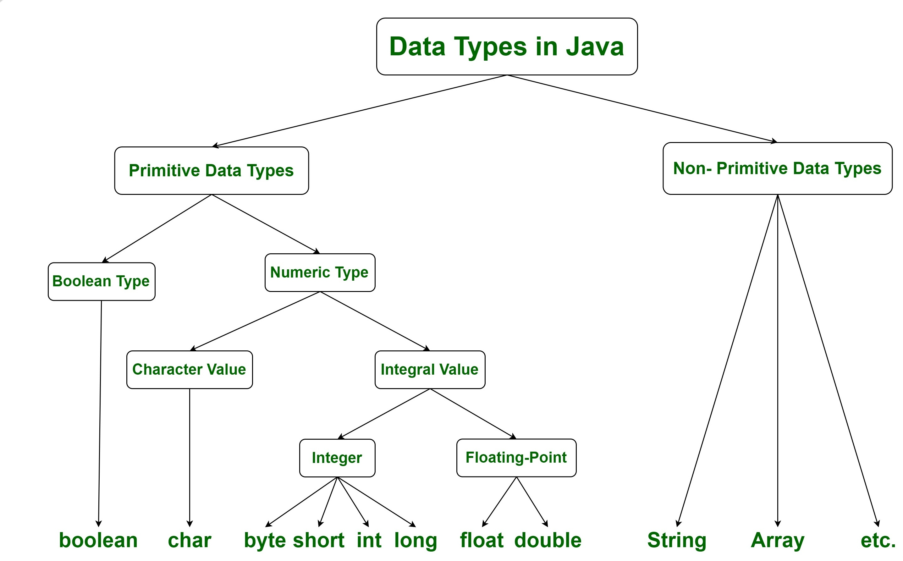

Slide 21
Unicode System
Unicode is a universal international standard character encoding that is capable of representing most of the world's written language
Before Unicode, there were many language standards:
ASCII (American Standard Code for Information Interchange) for the United States.
ISO 8859-1 for Western European Language.
KOI-8 for Russian.
GB18030 and BIG-5 for chinese, and so on.

Slide 22
Lowest unicode & Highest
lowest value:\u0000
highest value:\uFFFF

Slide 23
User defined data types/Reference/Non Primitive
The Reference Data Types will contain a memory address of variable values because the reference types won’t store the variable value directly in memory
They are strings, objects, arrays

Slide 24
Examples
String
Class-> A class is a user-defined blueprint or prototype from which objects are created, It represents the set of methods that are common to all objects of one type.
Object-> It is a basic unit of Object-Oriented Programming and represents real-life entities. A typical Java program creates many objects, which as you know, interact by invoking methods->State, Behaviour, Identity
Arrays->An array is a group of like-typed variables that are referred to by a common name

Slide 25
Reference Variable
When we create an object (instance) of class then space is reserved in heap memory
Vehicle abc= new Vehicle();
Heap Memory
Whenever object created , A space is created in Heap

Slide 26
Heap
Object of Vehicle

Slide 27
Heap
Vehicle A1 = new Vehicle();
Vehicle A2 = new Vehicle();
Vehicle A3 = new Vehicle();
Vehicle A4 = new Vehicle();
A1
A2
A3
A4
Stack

Slide 28
The value of a reference variable is a reference. When we attempt to print the value of a reference variable, the output contains the type of the variable and the hash code created for it by Java

Slide 29
Backslash Literals
Java supports some special backslash character literals known as backslash literals. They are used in formatted output
\b: It is used for blank space
\n: It is used for a new line
\t : it is used for tab space

Slide 30
Primitive
It cannot be null. It always has value.
The size of a primitive type depends on the data type.
All primitive type begins with a lowercase letter
Primitive types are predefined (already defined) in Java.
new keyword isn't used when initializing a variable of a primitive type. Primitive types are special data types built into the language; they are not objects created from a class

Slide 31
Non Primitive data
Examples of reference data types are class, Arrays, String, Interface, etc.
It can be null
Non-primitive types are created by the programmer and is not defined by Java (except for String).

Slide 32
int myNum = 5; // integer (whole number)
float myFloatNum = 5.99f; // floating point number
char myLetter = 'D'; // character
boolean myBool = true; // boolean

Slide 33
Primitive to Wrapper
boolean Boolean
byte Byte
char Character
float Float
int Integer
long Long
short Short
double Double

Slide 34
Primitive values
Cannot be null
It will start from small letters
It have a default value and range
You cannot create object
Wrapper
It can be null
You ca create object for wrapper

Slide 35
Auto-Boxing and Un-Boxing
The conversion of primitive type to reference type/wrapper is called autoboxing and the conversion of reference type/wrapper to primitive type is called unboxing Java 1.5
<Autoboxing>
int a=50;
Integer a2=new Integer(a)
System.out.println();
<Unboxing>
Integer i=new Integer(50);
Int a=i;

Slide 36
Variables
local variable
*instance variable
*static variable
A variable declared inside the body of the method is called local variable. You can use this variable only within that method and the other methods in the class aren't even aware that the variable exists.
A variable declared inside the class but outside the body of the method, is called an instance variable. It is not declared as static
A variable that is declared as static is called a static variable. It cannot be local. You can create a single copy of the static variable and share it among all the instances of the class. Memory allocation for static variables happens only once when the class is loaded in the memory.

Slide 37
Operators
Arithmetic operators
Assignment operators
Comparison operators
Logical operators
Bitwise operators

Slide 38
Arithmetic
% Modulus
++Increment
--Decrement

Slide 39
Type Casting
Type casting is when you assign a value of one primitive data type to another type
Widening Casting (automatically) - converting a smaller type to a larger type size byte -> short -> char -> int -> long -> float -> double
Narrowing Casting (manually) - converting a larger type to a smaller size type double -> float -> long -> int -> char -> short -> byte

Slide 40
Wide Casting
int myInt = 10;
double myDoubled = myInt; // Automatic casting:
System.out.println(myInt); System.out.println(myDouble);

Slide 41
Narrow Casting
double myDouble = 9.78d;
int myInt = (int) myDouble; // Manual casting: double to int
System.out.println(myDouble); // Outputs 9.78
System.out.println(myInt);

Slide 42
Arithmetic operators(+,-,/,%,++,--)
Assignment operators (=)
Comparison operators(<,>)
Logical operators(!,&&,||)
Bitwise operators

Slide 43
addition assignment
int x = 10;
x += 5;
System.out.println(x);

Slide 44
Asighnment Operator
Operator Example Inference
= x = 5 x = 5
+= x += 3 x = x + 3
-= x -= 3 x = x - 3
*= x *= 3 x = x * 3
/= x /= 3 x = x / 3
& x &= 3 x = x & 3
%= x %= 3 x = x % 3
|= x |= 3 x = x | 3
^= x ^= 3 x = x ^ 3
>>= x >>= 3 x = x >> 3
<<= x <<= 3 x = x << 3

Slide 45
Comparison Operators
>
<
==
!=
>=
<=

Slide 46
Logical Operators
&&
||
!

Slide 47
Pre and Post Increment/Decrement
If ++ precedes the variable, it is called pre-increment operator and it comes after a variable, it is called post-increment operator.
Post-Increment (i++) _>we use i++ in our statement if we want to use the current value, and then we want to increment the value of i by 1
Pre-Increment(++i)->We use ++i in our statement if we want to increment the value of i by 1 and then use it in our statement

Slide 48
Control structures
The while loop is used to iterate a part of the programe repeatedly until the specified Boolean condition is true.
When the Boolean condition becomes false, the loop automatically stops.
The while loop is considered as a repeating if statement.
If the number of iteration is not fixed, it is recommended to use the while loop

Slide 49
Do -while
Java do-while loop is called an exit control loop. Therefore, unlike while loop and for loop, the do-while check the condition at the end of loop body

Slide 50
Switch
The Java switch statement executes one statement from multiple conditions
Each case statement can have a break statement which is optional. When control reaches to the break statement
The case value can have a default label which is optional

Slide 51
Break
When a break statement is encountered inside a loop, the loop is immediately terminated and the program control resumes at the next statement following the loop
It breaks the current flow of the program at specified condition
In case of inner loop, it breaks only inner loop

Slide 52
Continue
The Java continue statement is used to continue the loop. It continues the current flow of the program and skips the remaining code at the specified condition

Slide 53
Break | Continue
It will terminate the execution of the for loop when the condition meet | It will continue the execution of the loop when the condition meet it will skip that condition only

