Slide 1

TransE on GPU
CISC 830 Final Project
Presented By: Beshani Weralupitiya

Slide 2
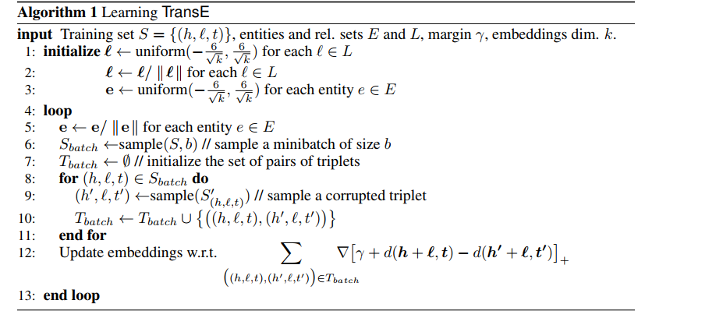
What is TransE?
  Popular Link Prediction model to predict missing triples (Head, Relations, Tail) in knowledge graphs.
  It's designed to learn continuous vector representations (embeddings) of entities and relations in a knowledge graph.
https://proceedings.neurips.cc/paper_files/paper/2013/file/1cecc7a77928ca8133fa24680a88d2f9-Paper.pdf

Slide 3
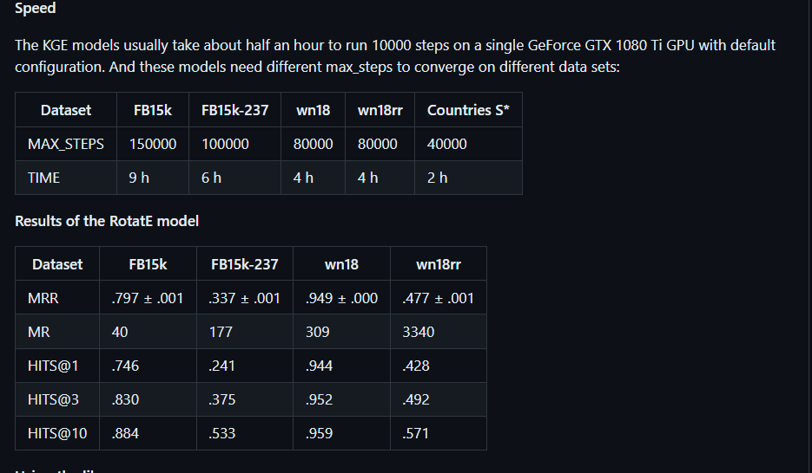
https://github.com/DeepGraphLearning/KnowledgeGraphEmbedding

Slide 4
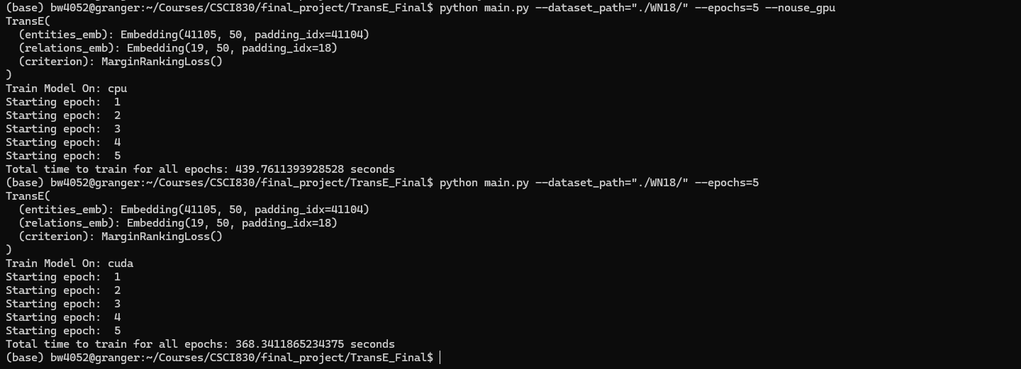
Performance

Slide 5
Memory Issue
torch.cuda.OutOfMemoryError: CUDA out of memory. Tried to allocate 502.00 MiB. GPU 0 has a total capacity of 7.43 GiB of which 160.00 MiB is free. Process 4036367 has 382.00 MiB memory in use. Process 1929004 has 106.00 MiB memory in use. Process 496737 has 4.08 GiB memory in use. Process 2977710 has 2.43 GiB memory in use. Including non-PyTorch memory, this process has 288.00 MiB memory in use. Of the allocated memory 156.50 MiB is allocated by PyTorch, and 15.50 MiB is reserved by PyTorch but unallocated. If reserved but unallocated memory is large try setting PYTORCH_CUDA_ALLOC_CONF=expandable_segments:True to avoid fragmentation. See documentation for Memory Management (https://pytorch.org/docs/stable/notes/cuda.html#environment-variables)

Slide 6
THANK YOU!

