Slide 1


Testing Ng!

Slide 2
Assumptions
You want to test
You know some Angular
services, controller, …
DI, $q, $http

Slide 3
Automated Testing Challenges
Controlling dependencies
Asynchronous code
Browser interactions

Slide 4
Dependencies testability == control over dependencies

Slide 5
Dependency Chain
controller
dataservice
config, $http

Slide 6
Test Spectrum
Spectrum
Pure Unit Tests
Integration Tests
End-to-End (E2E)
“midway” tests
Process boundary
Dependencies
Fake all
Fake some
Fake “none”

Slide 7
Dependencies can’t test if you can’t fake

Slide 8
Dependency Injection
The essential creation pattern

Slide 9
Dependency Chain in
controller
dataservice
config, $http
var basics = angular.module('basics', []);
basics.controller('controller', function (dataservice) {...});
basics.factory('dataservice', function (config, $http) {...});
basics.value('config', {...}

Slide 10
Dependencies alter, mock, replace

Slide 11
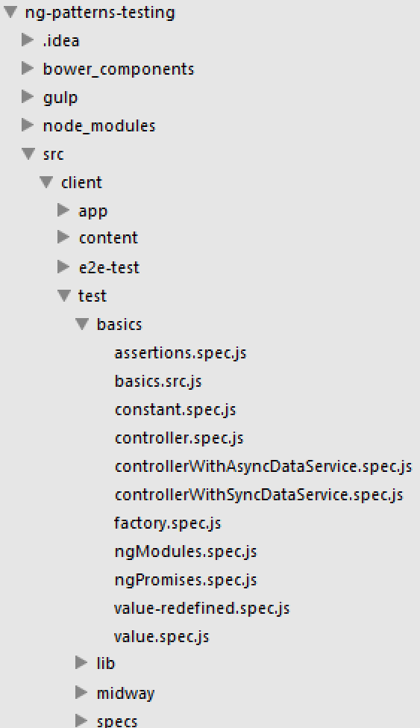
ng-patterns-testing structure
The SPA
“specs”

Slide 12
Karma config
frameworks: ['mocha', 'chai', 'sinon', 'chai-sinon'],
// list of files & patterns to load in the browser
files: [
'./node_modules/ng-midway-tester/src/ngMidwayTester.js',
'./bower_components/jquery/dist/jquery.js',
'./bower_components/angular/angular.js',
'./bower_components/angular-mocks/angular-mocks.js',
// .. More 3rd party libs
/* the app to test */
'./src/client/app/app.module.js',
'./src/client/app/**/*.module.js',
'./src/client/app/**/*.js',
/* spec helpers + specs*/
'./src/client/test/lib/specHelper.js',
'./src/client/test/lib/mockData.js',
'./src/client/test/basics/**/*.src.js',
'./src/client/test/basics/**/*.spec.js',
'./src/client/test/**/*.spec.js'

Slide 13
angular-mocks support testing

Slide 14
angular-mocks
Facilitates angular testing
Ease setup of SUT
Mock tricky async services
ngMock - mocked versions of some angular core services
mock.module – define test module
mock.inject – get components from test module
angular.module('ngMock', ['ng']).provider({
$browser: angular.mock.$BrowserProvider,
$exceptionHandler: angular.mock.$ExceptionHandlerProvider,
$log: angular.mock.$LogProvider,
$interval: angular.mock.$IntervalProvider,
$httpBackend: angular.mock.$HttpBackendProvider,
$rootElement: angular.mock.$RootElementProvider
})

Slide 15
Module is a container
of component definitions
controllers, services, filters, directives, etc

Slide 16
$injector creates and retrieves object instances defined in a module

Slide 17
Modules
controllers, services, filters, directives, etc
module per functional area
The ‘app’ module is the top module and all of its dependent modules
The ‘test’ module is the same thing
angular.module('app', [
'app.core',
'app.widgets',
'app.avengers',
'app.dashboard',
'app.layout'
]);
beforeEach(module('basics'));

Slide 18
Module as a cookbook
recipes for creating component instances
can keep adding/revising recipes until “loaded”
“loaded” when create the $injector
once loaded, module is closed to modification
var injector = angular.injector(['ng', 'myModule'])
Error: Injector already created, can not register a module!

