Slide 1
Pulse Width Modulation
Introduced by: Beshoy Mamdouh

Slide 2
OverView
-PWM drawer works as a mini oscilloscope that is responsible for printing the frequency and the waveform of the generated PWM signal.
-(PWM) is a modulation technique that generates variable-width pulses to represent the amplitude of an analog input signal. The output switching transistor is on more of the time for a high-amplitude signal and off more of the time for a low-amplitude signal.

Slide 3
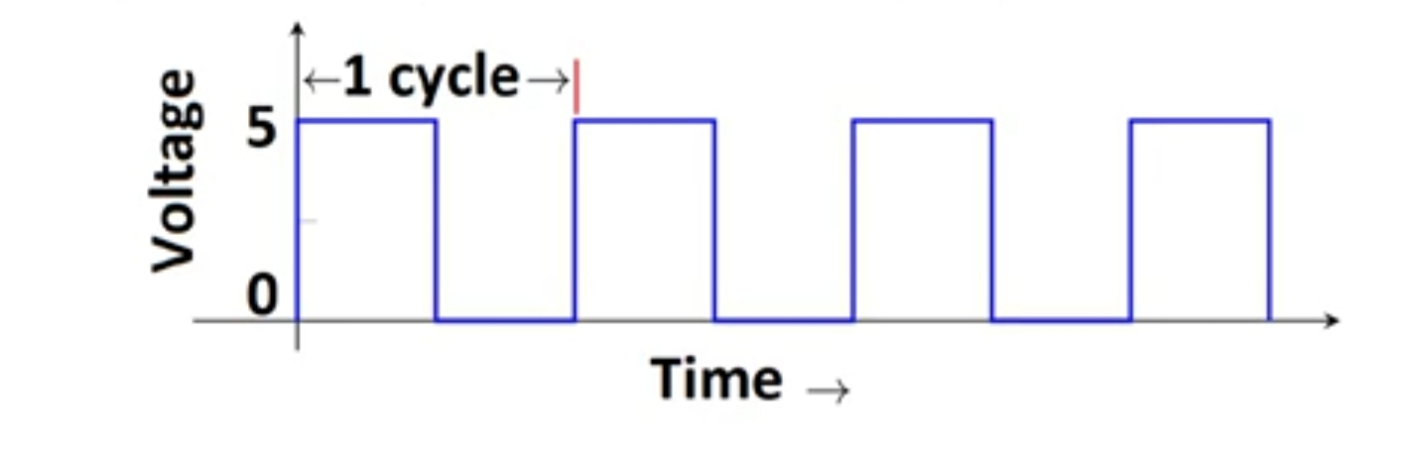
- period of a pulse consists of an ON cycle (5V) and an OFF cycle (0V). The fraction for which the signal is ON over a period is known as the duty cycle.
Frequency signals, or other waves, expresses the number of cycles of the repetitive waveform per second.
Duty Cycle (In %) = Ton /total period *100

Slide 4
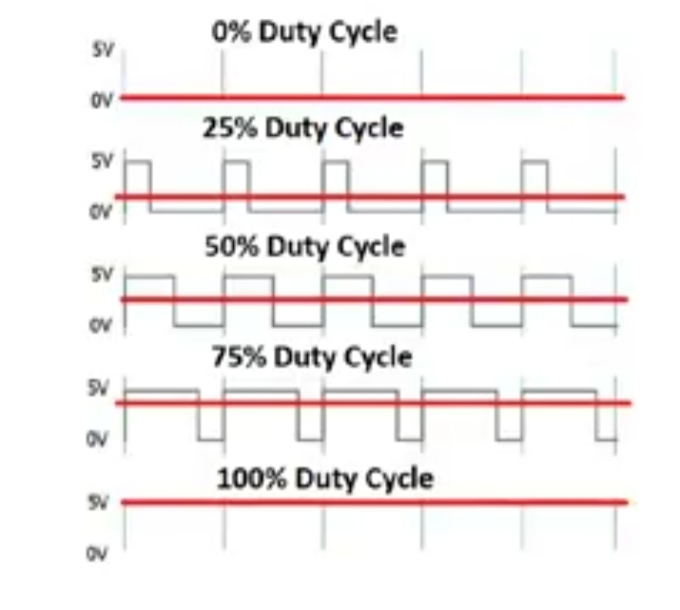

Slide 5
Finally, we can use PWM in many applications, ranging from communications to power control and conversion For example, the PWM is commonly used to control the speed of electric motors, the brightness of lights, ultrasonic cleaning applications, and many more.

Slide 6
Thank u

