Slide 1
Boston AQI Analysis
Hongwei Hu
Guangnan Liang

Slide 2
workflow
Data Preprocess
EDA
Flask API

Slide 3
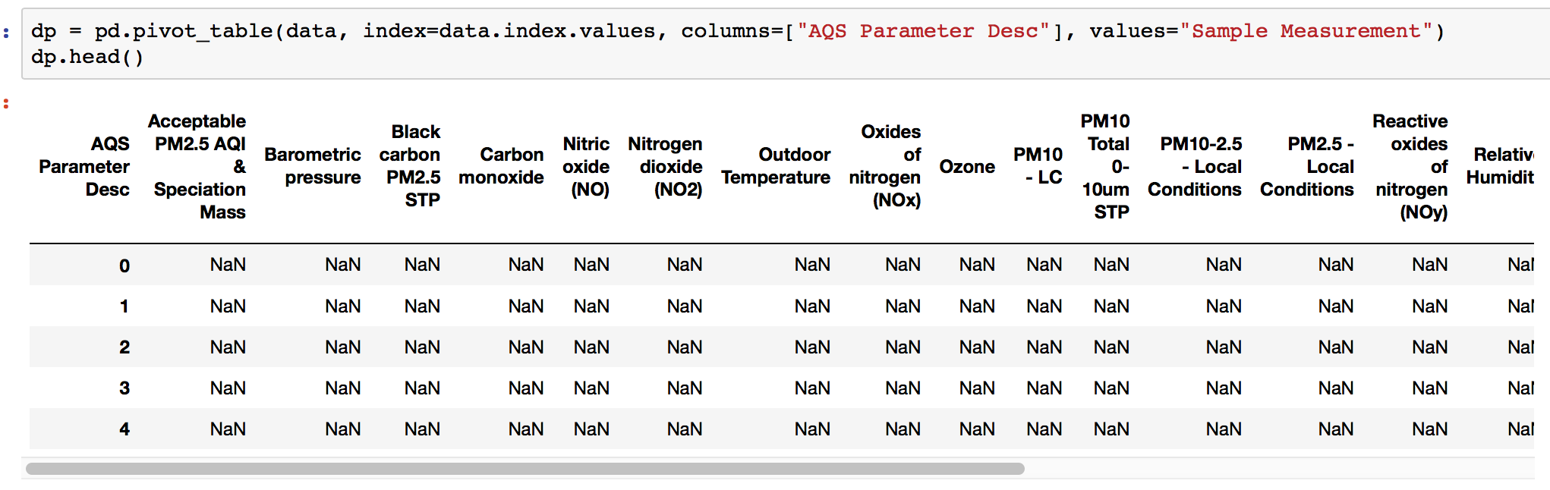
1. Data Preprocess
Convert the “AQS Parameter Desc” and “Sample Measurement” columns from long to wide

Slide 4
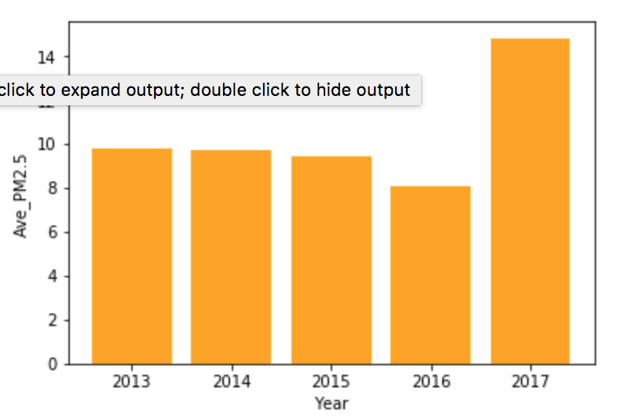
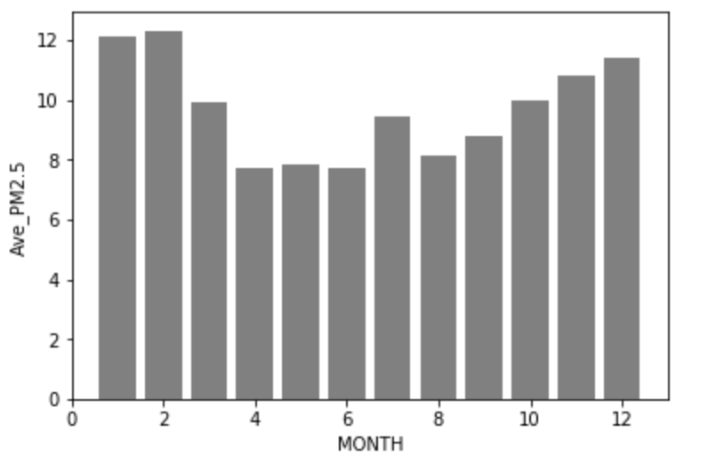
2. EDA – PM 2.5

Slide 5
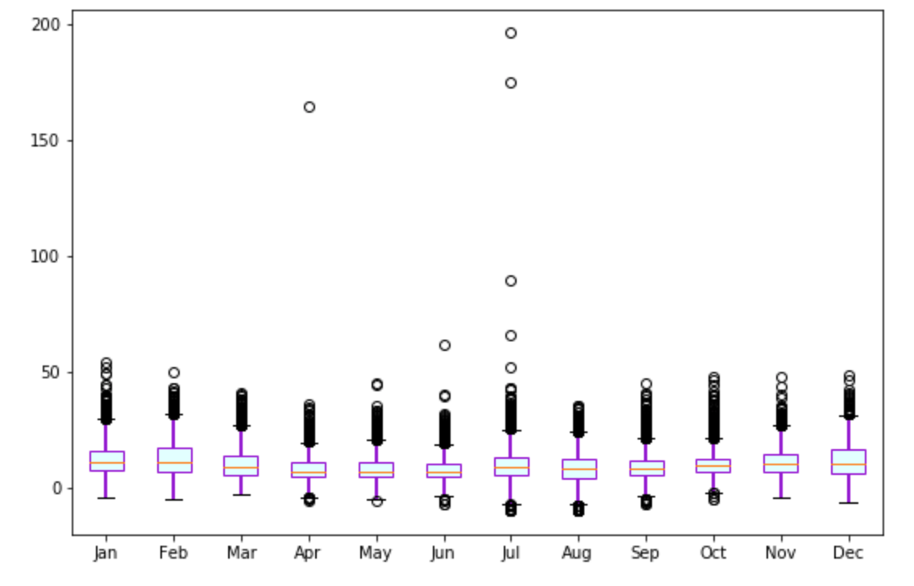
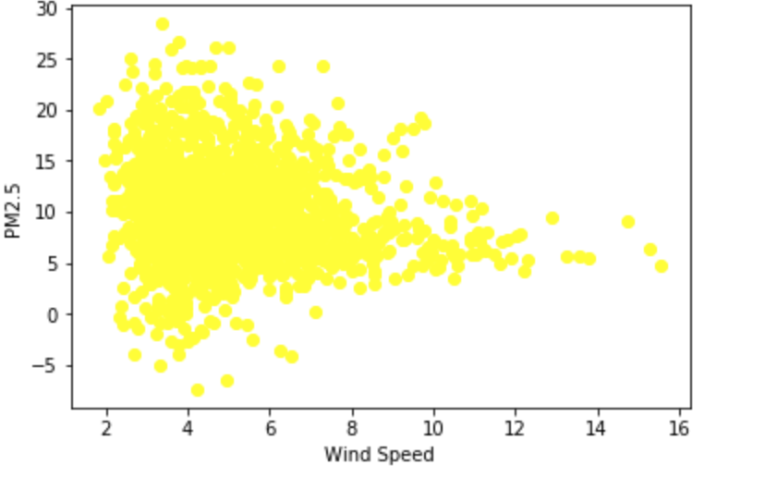
2. EDA – PM 2.5

Slide 6
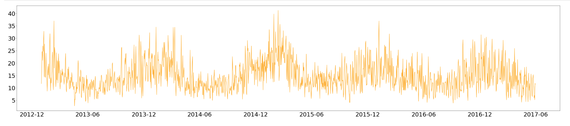
2. EDA – NO2

Slide 7
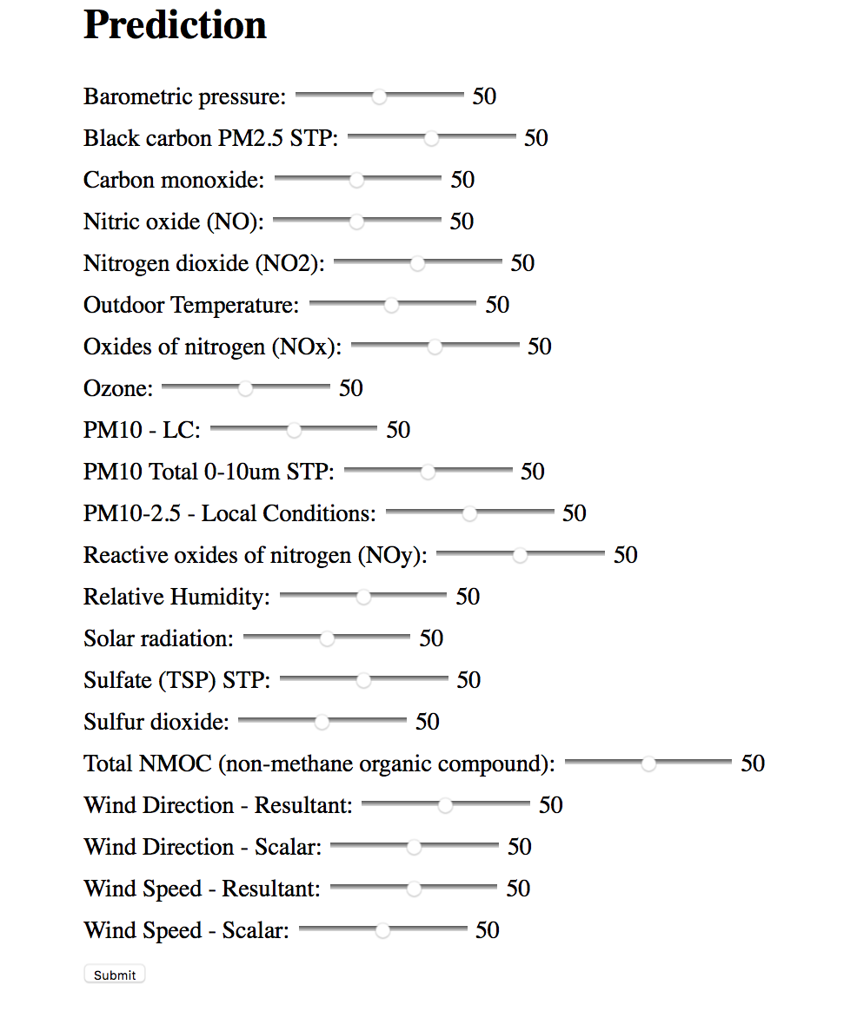
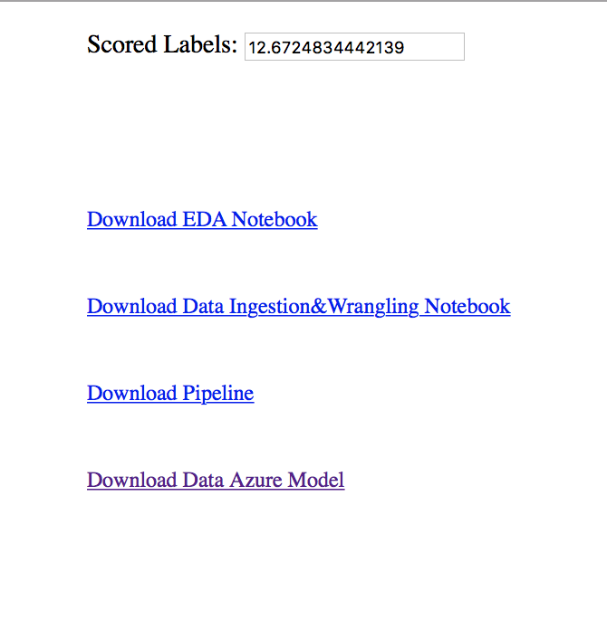
3. Flask API

