Slide 1
Code Generation and Templating
INFO 7390

Slide 2
Team 3
Hongwei Hu
Guangnan Liang

Slide 3
Template Engine
Template engines allow developers to generate desired content types, such as HTML, while using some of the data and programming constructs such as if-else and for loops to manipulate the output.
Template files that are created by developers and then processed by the template engine consist of prewritten markup and template tag blocks where data is inserted.
The template engine would generate the HTML output response when an HTTP request comes in for a particular URL.

Slide 4
Jinja2
Jinja, also known and referred to as "Jinja2", is a popular Python template engine written as a self-contained open source project.

Slide 5
Features:
Template inheritance makes it possible to use the same or a similar layout for all templates.
Powerful automatic HTML escaping system for cross site scripting prevention.
High performance with just in time compilation to Python bytecode. Jinja2 will translate your template sources on first load into Python bytecode for best runtime performance.
Easy to debug with a debug system that integrates template compile and runtime errors into the standard Python traceback system.
…

Slide 6
Installation
$ pip install Jinja2

Slide 7
Demo 1: Python API
By creating an instance of Template you get back a new template object that provides a method called render().
Call render() with a dict or keyword arguments to fill the template. The dict or keywords arguments passed to the template are the so-called “context” of the template.

Slide 8
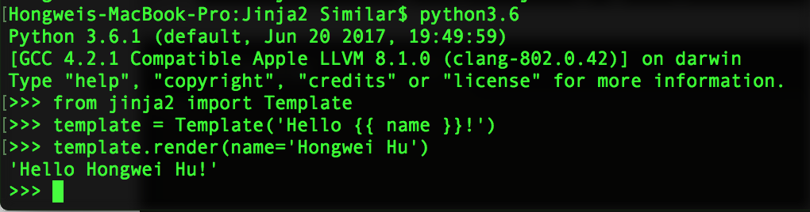
Demo 1: Python API

Slide 9
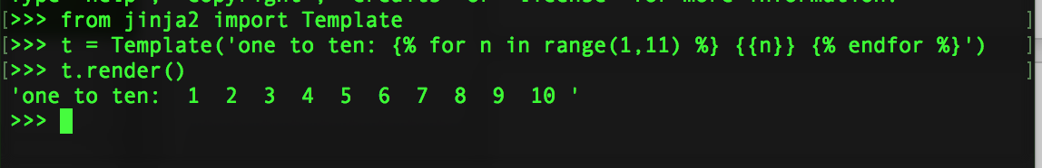
Demo 1: Python API
We can also use for loops OR if-else in a template

Slide 10
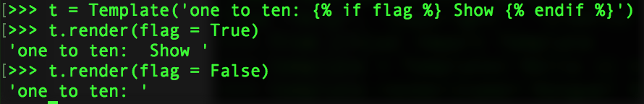
Demo 1: Python API
We can also use for loops OR if-else in a template

Slide 11
Rules
{% ... %} for Statements
{{ ... }} for Expressions to print to the template output
{# ... #} for Comments not included in the template output
# ... ## for Line Statements

Slide 12
Demo 2: Flask
Docker Images: besimilar/advanced-data-analysis:template
Run Flask REST API:
$ python3.5 run.py

Slide 13
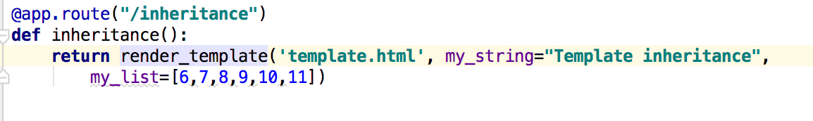
Demo 2: Flask
Docker Images: besimilar/advanced-data-analysis:template
Run Flask REST API:
$ python3.5 run.py

Slide 14
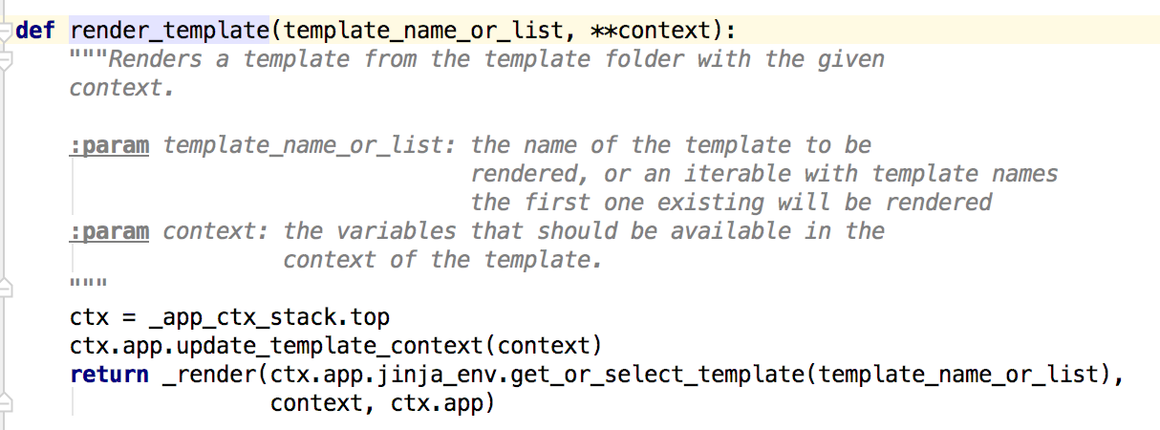
Demo 2: Flask
Docker Images: besimilar/advanced-data-analysis:template
Run Flask REST API:
$ python3.5 run.py

Slide 15
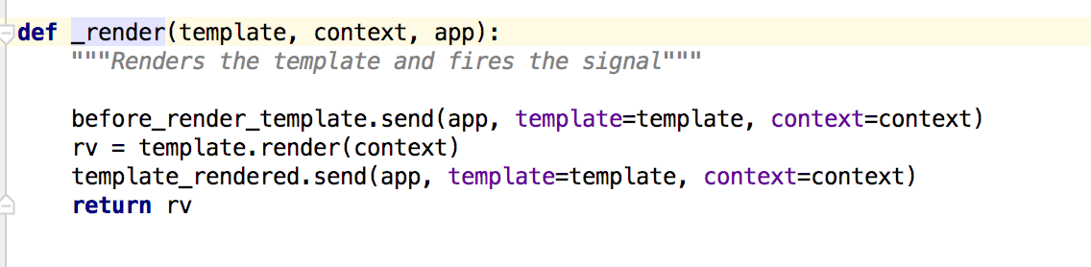
Demo 2: Flask
Docker Images: besimilar/advanced-data-analysis:template
Run Flask REST API:
$ python3.5 run.py

Slide 16
Demo 2: Flask
Create a layout (“layout.html”)
https://github.com/Besimilar/Code-Generation-And-Templating/blob/master/Jinja2/demo/Flask-demo/templates/layout.html

Slide 17
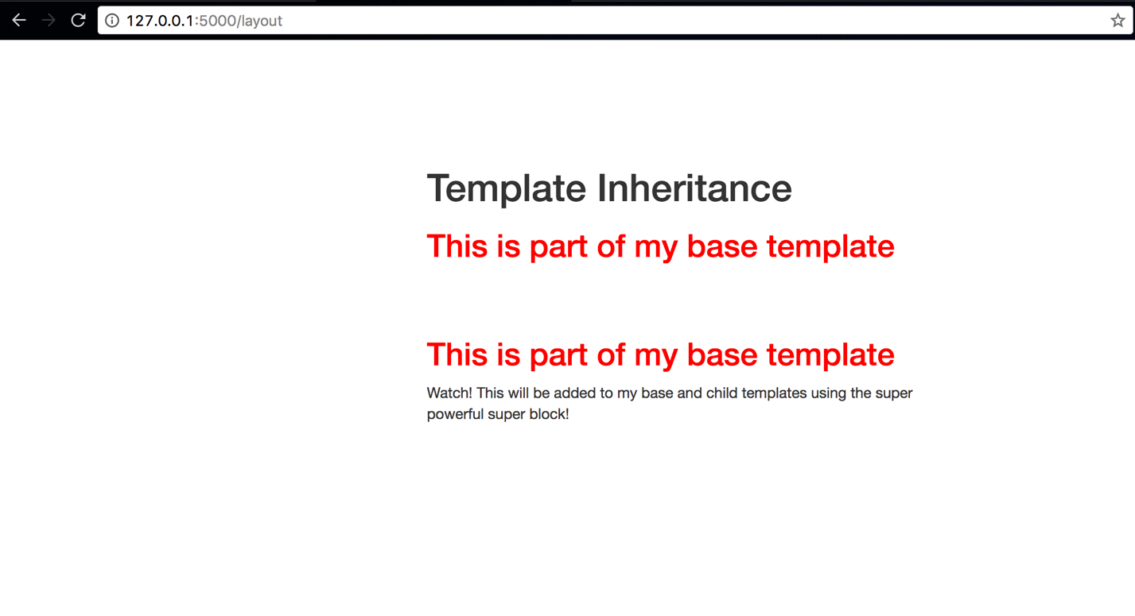
Demo 2: Flask
Create a layout (“layout.html”)

Slide 18
Demo 2: Flask
Create a child template to inherit the layout using {% extends %} (“template.html”)
https://github.com/Besimilar/Code-Generation-And-Templating/blob/master/Jinja2/demo/Flask-demo/templates/template.html

Slide 19
Demo 2: Flask
Pass values to the template

Slide 20
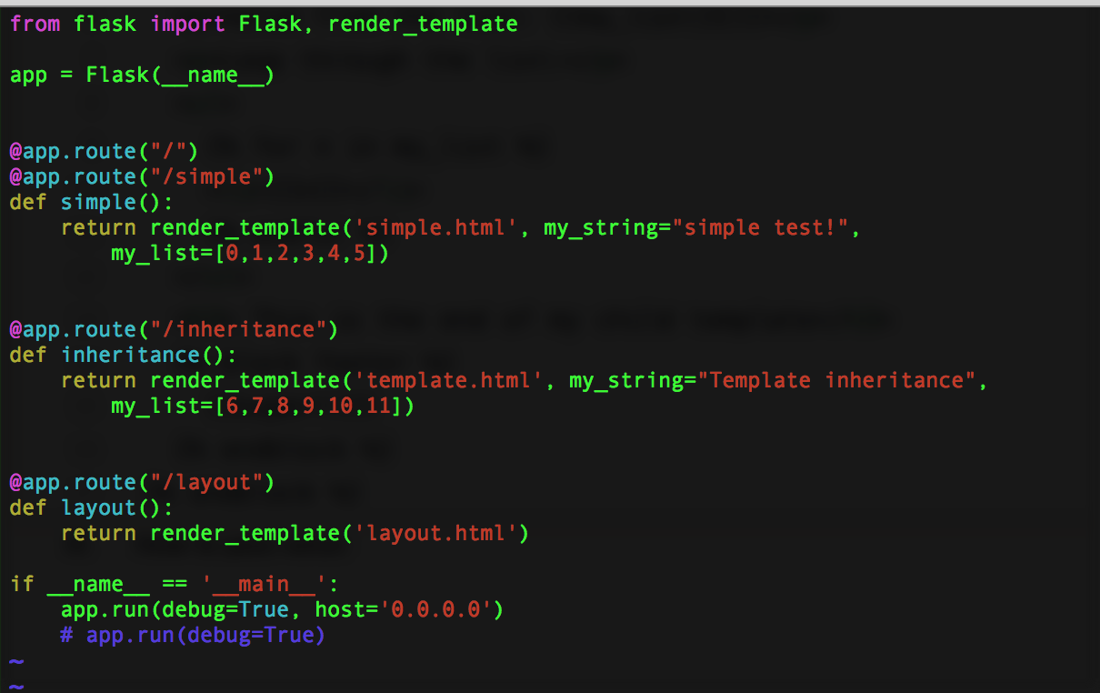
Demo 2: Flask
Pass values to the template

Slide 21
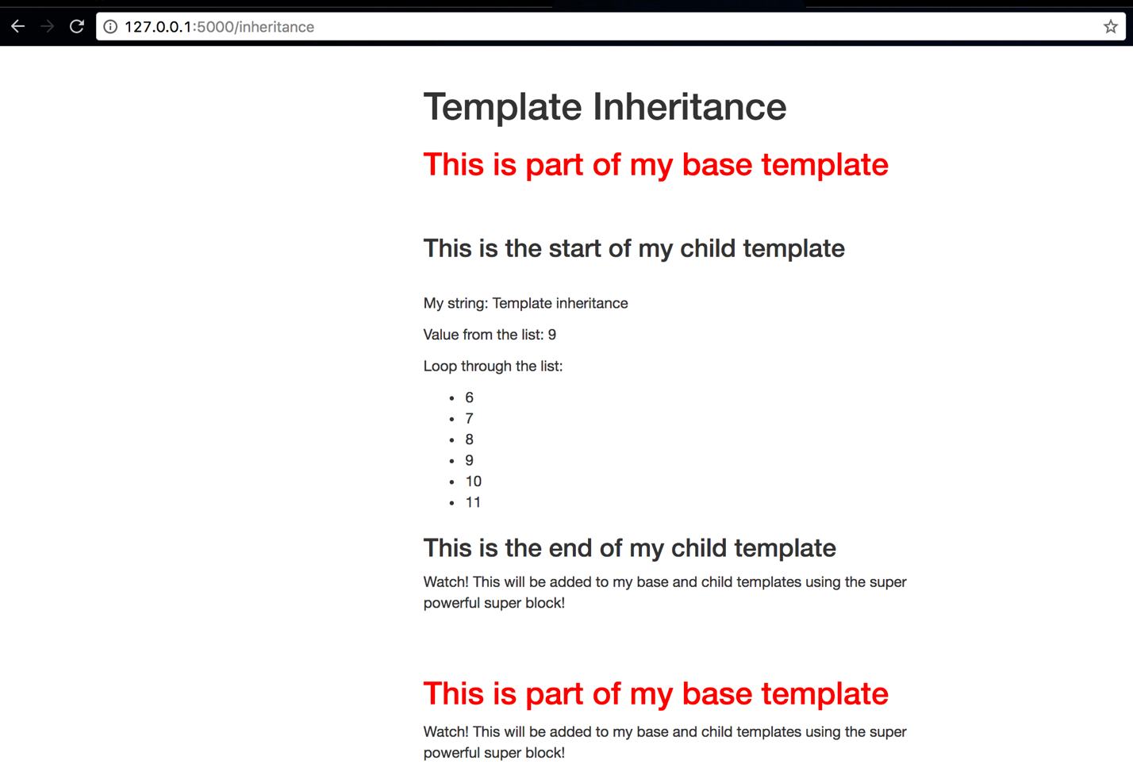
Demo 2: Flask
Create a child template to inherit the layout using {% extends %} (“template.html”)
https://github.com/Besimilar/Code-Generation-And-Templating/blob/master/Jinja2/demo/Flask-demo/templates/template.html

Slide 22
Other Demos
https://github.com/Besimilar/Code-Generation-And-Templating
https://www.fullstackpython.com/jinja2.html

Slide 23
Thank you

