Slide 1
Code Generation and Templating
INFO 7390

Slide 2
Team 3
Hongwei Hu
Guangnan Liang

Slide 3
Template Engine
Mako: default templating engine for the Pylons web
Cog: a file generation tool. It lets you use pieces of Python code as generators in your source files to generate whatever text you need

Slide 4
Mako - Features
Super-simple API
from mako.template import Template
print(Template("Welcome to ${city}!").render(city="Beijing"))
Super fast:
extremely efficient: compiled into Python bytecode
close in speed to Jinja2

Slide 5
Mako - Features
Standard template features
control structures constructed from real Python code (i.e. loops, conditionals)
straight Python blocks, inline or at the module-level
plain old includes

Slide 6
Mako - Features
Callable blocks
can access variables from their enclosing scope as well as the template's request context
can be nested arbitrarily
can specify regular Python argument signatures
outer-level callable blocks can be called by other templates or controller code (i.e. "method call")

Slide 7
Cog
Cog transforms files in a very simple way: it finds chunks of Python code embedded in them, executes the Python code, and inserts its output back into the original file. The file can contain whatever text you like around the Python code.

Slide 8
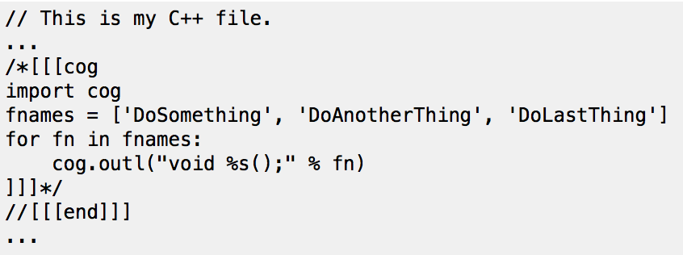
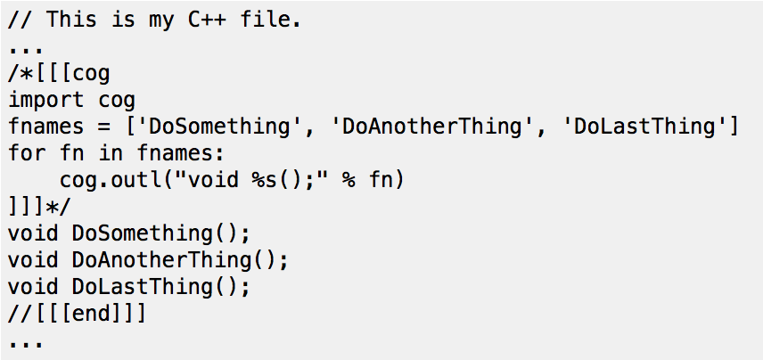
Cog

Slide 9
COG -features
Easy to run
Cog files can be checked into source control without some worries – marker lines accommodate any language syntax, markers can hide the cog Python code from the source file
Use the full power of Python for text generation, without a templating system dumbing down your tools for you

