Slide 1
PSO: TRAVEL IN AMERICA
Hongwei Hu
001677683

Slide 2
TRAVEL IN AMERICA
Shortest Route?
Visit all states (capital cities)
Start from Boston
Back to Boston
Not going to Alaska(AK)
Not going to Hawaii(HI)

Slide 3
PSO
v[] = w*v[] + c1*rand()*(pbest[]-present[]) + c2*rand()*(gbest[]-present[])
Inertia: w*v[]
Cognition: c1*rand()*(pbest[]-present[])
Social: c2*rand()*(gbest[]-present[])

Slide 4
PSO to my problem
One particle represents one route → (v[]): similar to GA (a chromosome).
Inertia: keep (w)% of the route unchanged → (w*v[])
Cognition(pBest): randomly pick up (c1)% of pBest to substitute original route in same indexes → c1*rand()*(pbest[]-present[])
Social: (gBest): randomly pick up (c2)% of gBest to substitute original route in same indexes → c2*rand()*(gbest[]-present[])

Slide 5
Learning Process (Particle.java)
Step 1: Self-adjustment: learnFromSelf(w):
Keep part (w) of Route unchanged.
Find which part is better: pick same number of cities from both front and rear of the route, compare them and keep the better part unchanged.
Shuffle the rest route.

Slide 6
Boston
City 1
City 3
City 4
City 5
City 2
City 6
Boston
City 1
City 2
City 6
City 5
City 3
City 4
Original
After

Slide 7
Learning Process (Particle.java)
Step 2: learnFromExperience(pBest, c1):
Pick part (c1) from pBest.
Delete same elements from original route.
Insert this piece (c1) of route to original route in same index.

Slide 8
Learning Process (Particle.java)
Step 3: learnFromSocial(gBest, c2):
Pick part (c2) from gBest.
Delete same elements from original route.
Insert this piece (c2) of route to original route in same index.

Slide 9
Boston
City 1
City 3
City 4
City 5
City 2
City 6
Boston
City 1
City 2
City 6
City 5
City 3
City 4
Original
pBest(gBest)

Slide 10
Boston
City 1
City 2
City 5
City 6
City 3
City 4

Slide 11
Learning Process
IsConverge:
If learning result is worse than (valMax * currentRoute), give up the learning result.
Always become kind of better after learning
IsParallel:
parallelStream()

Slide 12
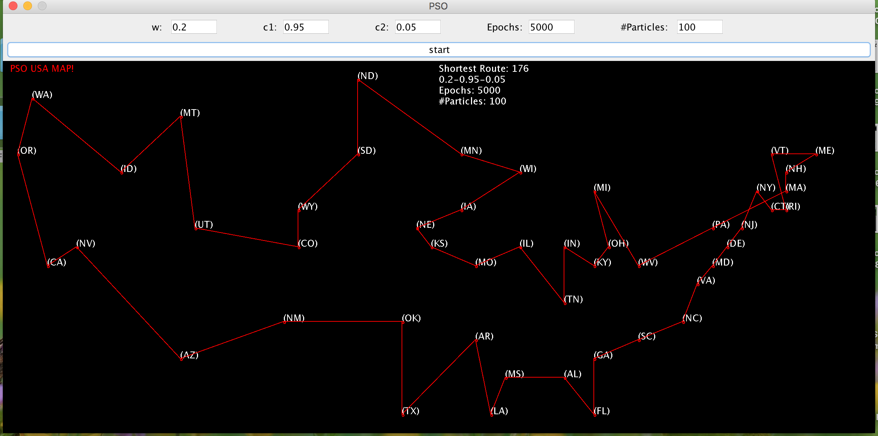
Shortest Route I found

Slide 13
Not short enough?
Choice of (w, c1, c2, valMax) should be based on size of problems.
For 10 cities: 0.1 – 0.3 – 0.4(0.3)
For 48 cities: 0.1 – 0.85 – 0.05 / 0.6 – 0.8 - 0.05
For #cities: try different combinations: similar to tune Hyperparameters of ANN
The parameter combinations significantly affect results.

Slide 14
Challenges or Bugs?
1. Parallel:
Collections.shuffle() will degrade the performance of parallelStream()
When w is low (shuffle more), parallel calculation will be hardly improved.
However, for a higher w (keep more part unchanged), running time will be reduced significantly by using parallel approach.

Slide 15
Challenges or Bugs?
Learn from Social:
The route is a circle.
gBest could start from both sides of the circle.
It’s hard for a route starting from one side to learn a gBest starting from the other side. The learning result could be worse.
That’s why for all good parameter combinations, c2 is always a small value.

Slide 16
What’s better
Better for:
Starting point is different from the Destination.
The route is not a circle
Improvement:
Improve shuffle method
Use other way to do parallel calculation

Slide 17
End
Thanks!!!

