Slide 1
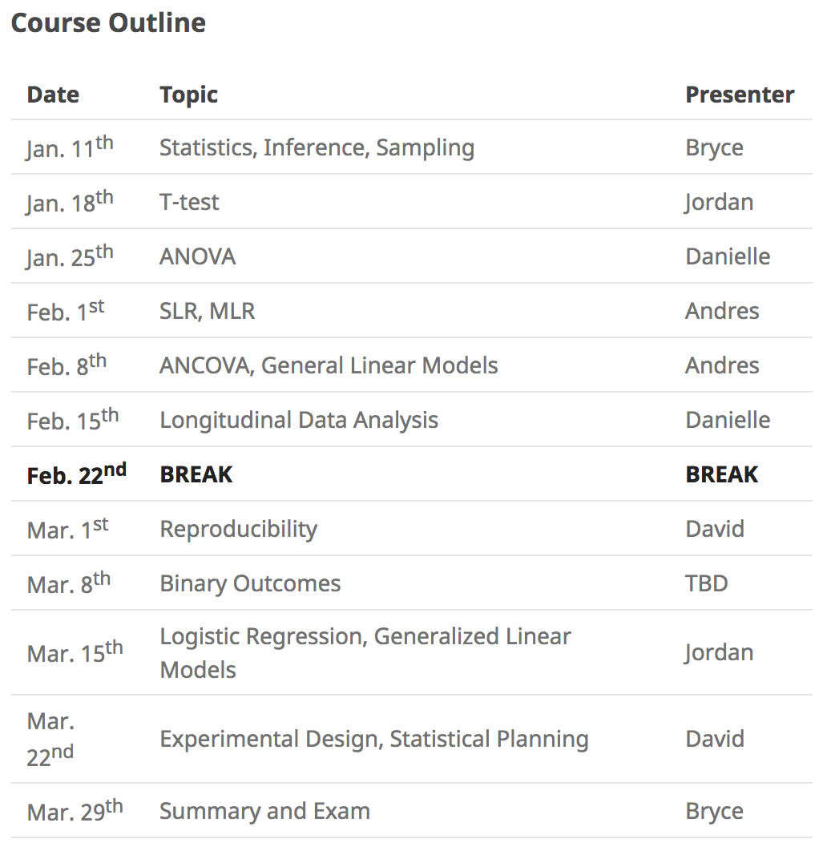
House Keeping
https://besler.github.io/McCaigStatisticsGroup/
Webage, Google Calendar
Same room, same time (except for Easter break)
Sign in Sheet

Slide 3
Example 1: GSA
The Graduate Student Association (GSA) offers workshops on scholarship writing for students. They are interested in how effective these workshops are at helping students secure funding. In the last 5 years, 2198 students applied to national funding (NSERC,CIHR, SSHRC). Of those students, 916 attended a workshop on scholarship writing. The GSA is able to attain the amount of money each student was awarded in national funding. They discover that students who attend the scholarships workshop secure an average of $5,680 more than their peers who do not attend the workshop. They conclude that workshops are extremely effective at helping students secure funding.

Slide 4
Example 2: MTC
The MTC is interested in increase the number of scholarships McCaig trainees are awarded. The MTC randomly funds 41 trainees to attend a workshop on scholarship writing. The remaining 40 trainee do not attend the workshop. All trainees apply for national funding and report their award value to the MTC. The MTC finds that there is no difference in the amount of funding secured by trainees who attended the workshop compared to those who do attend. The MTC find that scholarship workshops have no effect on funding success and stops financially supporting the workshop.

Slide 5
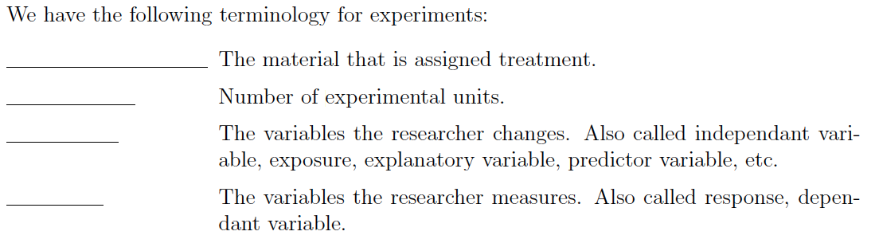
Terminology
Sample Size, Experimental Units, Treatment, Outcome

Slide 7
Summary
What is the difference between an observational study and a randomized experiment?
What is confounding variable?
What is the difference between a parameter and a statstic?
What is a sampling distribution?

