Slide 1
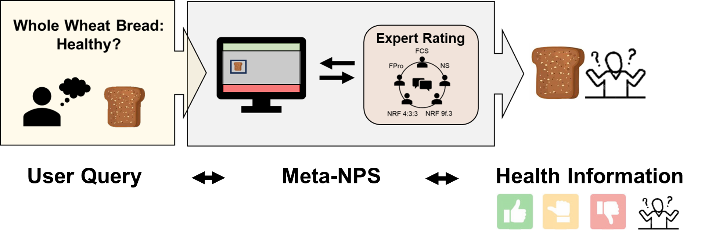
Meta-nutritional profiling system (meta-NPS):
Bridge between science and health information

Slide 2
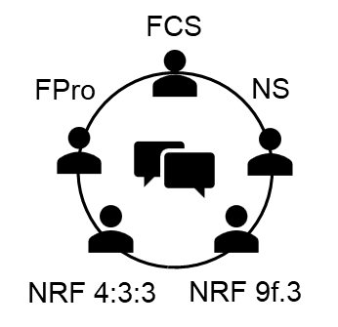




Meta-nutritional profiling system (meta-NPS):
Bridge between science and health information
Whole Wheat Bread:
Healthy?
Expert Rating
User Query
Meta-NPS
Nutritional
Profiling
System
Health Information

Slide 3

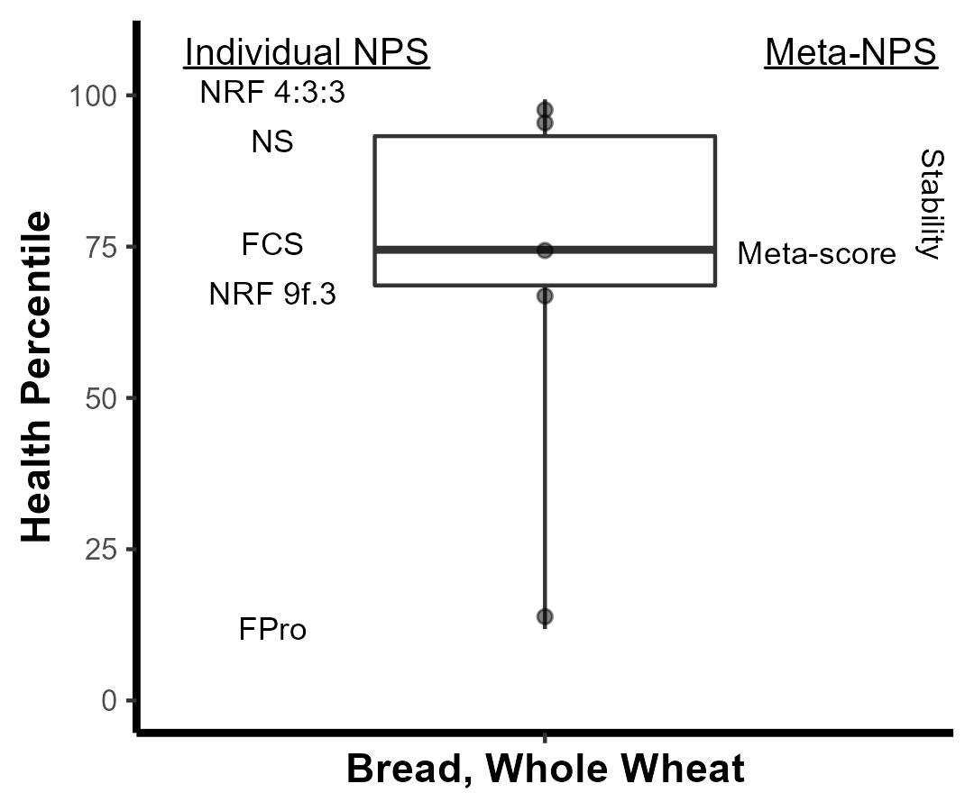
Experts individually say:
Healthy or Unhealthy…
…
NRF 4:3:3
FPro
Healthy
Unhealthy
…depending on who you trust?…

Slide 4
The meta-NPS collectively says:
Likely Healthy or Uncertain…
Stability_{IQR}
Uncertain
Meta score ↑ = health ↑
Stability_{IQR} ↓ = consensus ↓ = uncertain
Stability_{range} ↓ = consensus ↓ = uncertain
Stability_{range}

Slide 5
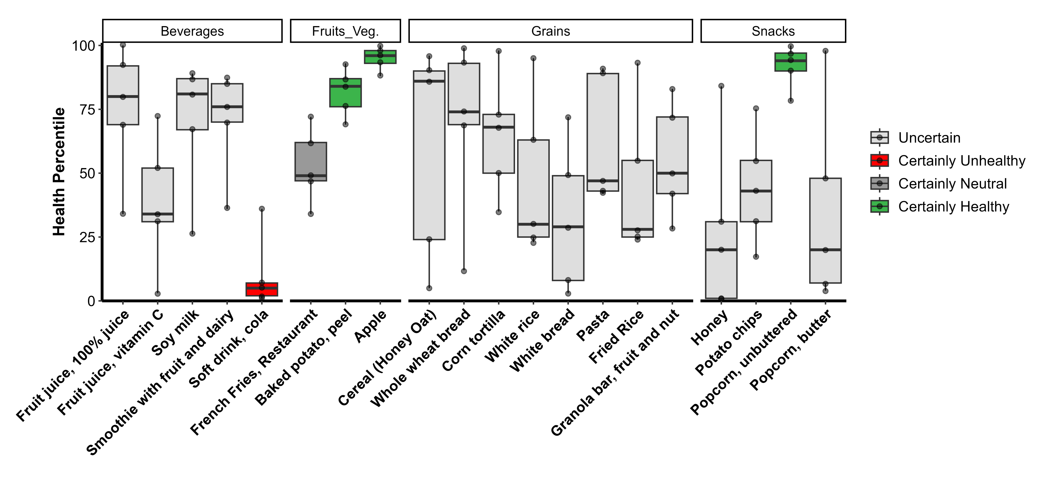
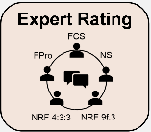


Let’s take a look at more foods other than just whole wheat bread
15 (75%) foods received Expert Classification of “Uncertain”
***4 (20%) foods identified as a priority***
Notes:
Now we’re looking at a zoomed in and expanded version of the “Uncertain” label for experts-only, layered in with food groupings, and ordered in the same manner as the misalignment results. All of ths information is derived from the meta-NPS more details can be found on the previous 2 videos.
On the y-axis we have Health percentile as the harmonization basis across independent nutrient profiling systems. For each food, the boxplot shows the distribution of health ratings across 5 expert systems – each reflected as a point. The boxplots are colored by expert classification – uncertain is light gray, unhealthy is red, neutral is dark gray, and healthy is green.
So looking at this first food, 100% fruit juice, as an example, the meta-NPS is saying that experts ranked this food ranging from the 30th the 100th percentile of healthfulness – a difference of 70 – which is why this is food is considered as Uncertainly Healthy. And importantly, the overall distribution of 100% juice is shifted towards being more healthy relative to fruit juice with vitamin C.
I really like this figure because it showcases that expert agreement is possible while contexualizing the extend of disagreement for these carb-rich foods. And if you recall – these more detailed food level results are aligned with our insights from the 2nd youtube video showing that grains were the most problematic overall in terms of agreement.

Slide 6
Apple, Baked potato are healthy, Fries are neural, and soda is unhealthy
*
15 (75%) foods received Expert Classification of “Uncertain”
***4 (20%) foods identified as a priority***
Notes:
Now we’re looking at a zoomed in and expanded version of the “Uncertain” label for experts-only, layered in with food groupings, and ordered in the same manner as the misalignment results. All of ths information is derived from the meta-NPS more details can be found on the previous 2 videos.
On the y-axis we have Health percentile as the harmonization basis across independent nutrient profiling systems. For each food, the boxplot shows the distribution of health ratings across 5 expert systems – each reflected as a point. The boxplots are colored by expert classification – uncertain is light gray, unhealthy is red, neutral is dark gray, and healthy is green.
So looking at this first food, 100% fruit juice, as an example, the meta-NPS is saying that experts ranked this food ranging from the 30th the 100th percentile of healthfulness – a difference of 70 – which is why this is food is considered as Uncertainly Healthy. And importantly, the overall distribution of 100% juice is shifted towards being more healthy relative to fruit juice with vitamin C.
I really like this figure because it showcases that expert agreement is possible while contexualizing the extend of disagreement for these carb-rich foods. And if you recall – these more detailed food level results are aligned with our insights from the 2nd youtube video showing that grains were the most problematic overall in terms of agreement.

Slide 7
The meta-NPS uncovers large disagreements within harmonized expert ratings across foods
*
*
*
*
15 (75%) foods received Expert Classification of “Uncertain”
***4 (20%) foods identified as a priority***
Notes:
Now we’re looking at a zoomed in and expanded version of the “Uncertain” label for experts-only, layered in with food groupings, and ordered in the same manner as the misalignment results. All of ths information is derived from the meta-NPS more details can be found on the previous 2 videos.
On the y-axis we have Health percentile as the harmonization basis across independent nutrient profiling systems. For each food, the boxplot shows the distribution of health ratings across 5 expert systems – each reflected as a point. The boxplots are colored by expert classification – uncertain is light gray, unhealthy is red, neutral is dark gray, and healthy is green.
So looking at this first food, 100% fruit juice, as an example, the meta-NPS is saying that experts ranked this food ranging from the 30th the 100th percentile of healthfulness – a difference of 70 – which is why this is food is considered as Uncertainly Healthy. And importantly, the overall distribution of 100% juice is shifted towards being more healthy relative to fruit juice with vitamin C.
I really like this figure because it showcases that expert agreement is possible while contexualizing the extend of disagreement for these carb-rich foods. And if you recall – these more detailed food level results are aligned with our insights from the 2nd youtube video showing that grains were the most problematic overall in terms of agreement.

