Slide 1
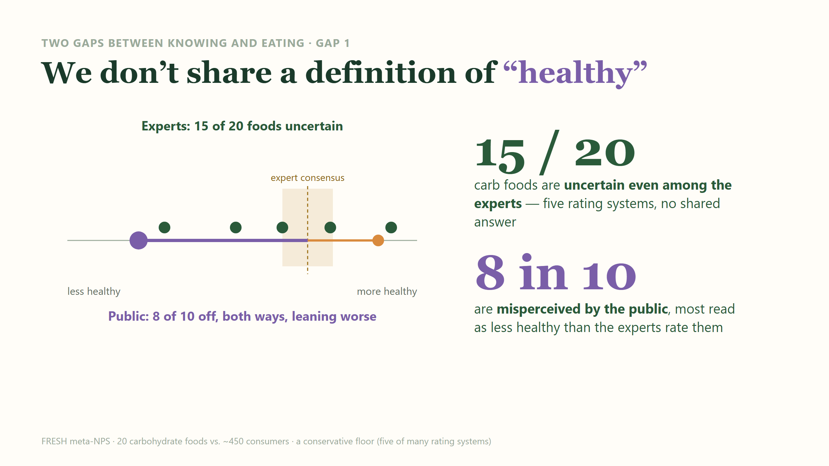
Notes:
Gap 1 - the KNOWING gap. 'Uncertain' is the meta-NPS verdict when the five expert rating systems disagree: 15 of 20 carbohydrate foods. The public then misses on more than 8 in 10 foods. The miss leans pessimistic (foods read as less healthy than experts rate them), but about 70% of foods are actually misperceived in BOTH directions - honey and a sugary 'vitamin C' drink, for instance, read as healthier. Caveat: a conservative floor - five of many published rating systems, one set of cutoffs.

Slide 2
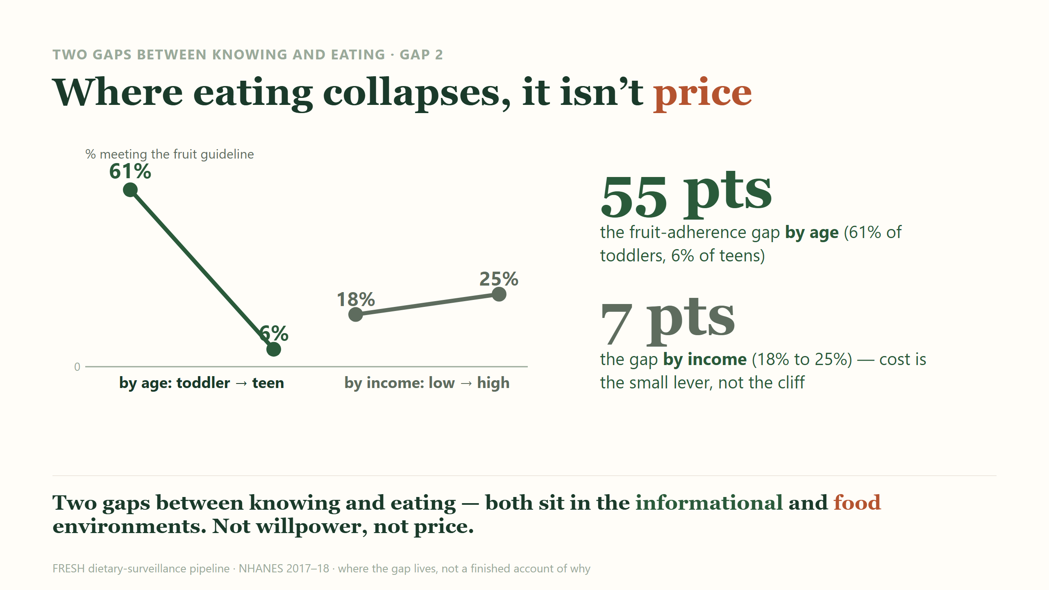
Notes:
Gap 2 - the DOING gap. Fruit-guideline adherence falls from ~61% in toddlers to ~6% in teens (NHANES 2017-18, NCI usual-intake method): a 55-point cliff the single national figure (~23% of children) averages away. The income gradient is only 18% to 25%, about 12 cents on the dollar of the age effect; the highest-adherence kids (Mexican-American, 31%) are not the richest. USDA's own report finds health-concern and nutrition-knowledge behaviors outweigh income and price. Honest limit: this is WHERE the gap lives, not WHY - fruit intake recovers in adulthood, so it is not a simple autonomy/market story. Close: both gaps sit in the informational and food environments; willpower and price are the small dials.

