Slide 1
BESSEMER TECH CATALYST · AI / ML TRACK
The Odyssey
An autonomous test orchestration agent.
Give it a URL. It explores the application, writes a test plan, grades its own plan, generates real Playwright tests whose every selector it proved on the live page, runs them, works out whether each failure is a broken test or a broken app, repairs the broken tests, refuses to repair the broken app, and reports what it did not test — and what that is worth.
No human between any two of those stages.
Autonomous Test Orchestration Agent · Problem statement by Aivar Innovations
Notes:
One URL in, a working test suite and an honest report out. The sub-agents are table stakes; the orchestrator is the product.

Slide 2
THE PROBLEM
Testing's cost is not execution. It is decision-making.
Figuring out what to test. Judging whether the right things were tested. Knowing whether a red test means a broken application or a broken script. Those three judgments are what a team pays a QA engineer for, and they are the three an AI testing tool hands straight back.
FROM THE BRIEF
“The core problem is not execution — it is decision-making: figuring out what to test, evaluating whether the right things were tested, and knowing when a failure reflects a real defect versus a broken script.”
What to test
1
Coverage is decided by whoever has time, and nobody measures what was left out.
“What they do not do is orchestrate these capabilities end to end — deciding when to plan, when to generate, when to heal, and when to escalate — without a human directing each step.”
Was it enough?
2
A plan is approved by the person who wrote it, against no stated bar.
Red — but why?
— the problem statement, §1 and §2
3
Every failure costs a human triage before anyone knows if it is a bug.
Notes:
The brief itself says the gap is orchestration, not the sub-agents.

Slide 3
WHY THIS IS NOT SOLVED ALREADY
Playwright already ships all three
npx playwright init-agents installs a Planner, a Generator and a Healer today. The brief names those three word for word. So the sub-agents are table stakes — and Playwright's own documentation tells you what to do with them:
after PLAN
after GENERATE
after HEAL
a human reviews the plan
a human reviews the tests
a human reviews the patch
HUMAN GATE
HUMAN GATE
HUMAN GATE
The Odyssey deletes those three humans and replaces them with machine judgment that shows its working.
Four decisions the pipeline makes on its own: whether its plan is good enough, whether a plan that cannot be built should be re-planned, whether a failure is the application's fault, and whether a proposed patch is honest. Each one emits its rationale, its confidence and the evidence it cites.
Notes:
Anyone can wire three agents in a row. The judgment between them is the product.

Slide 4
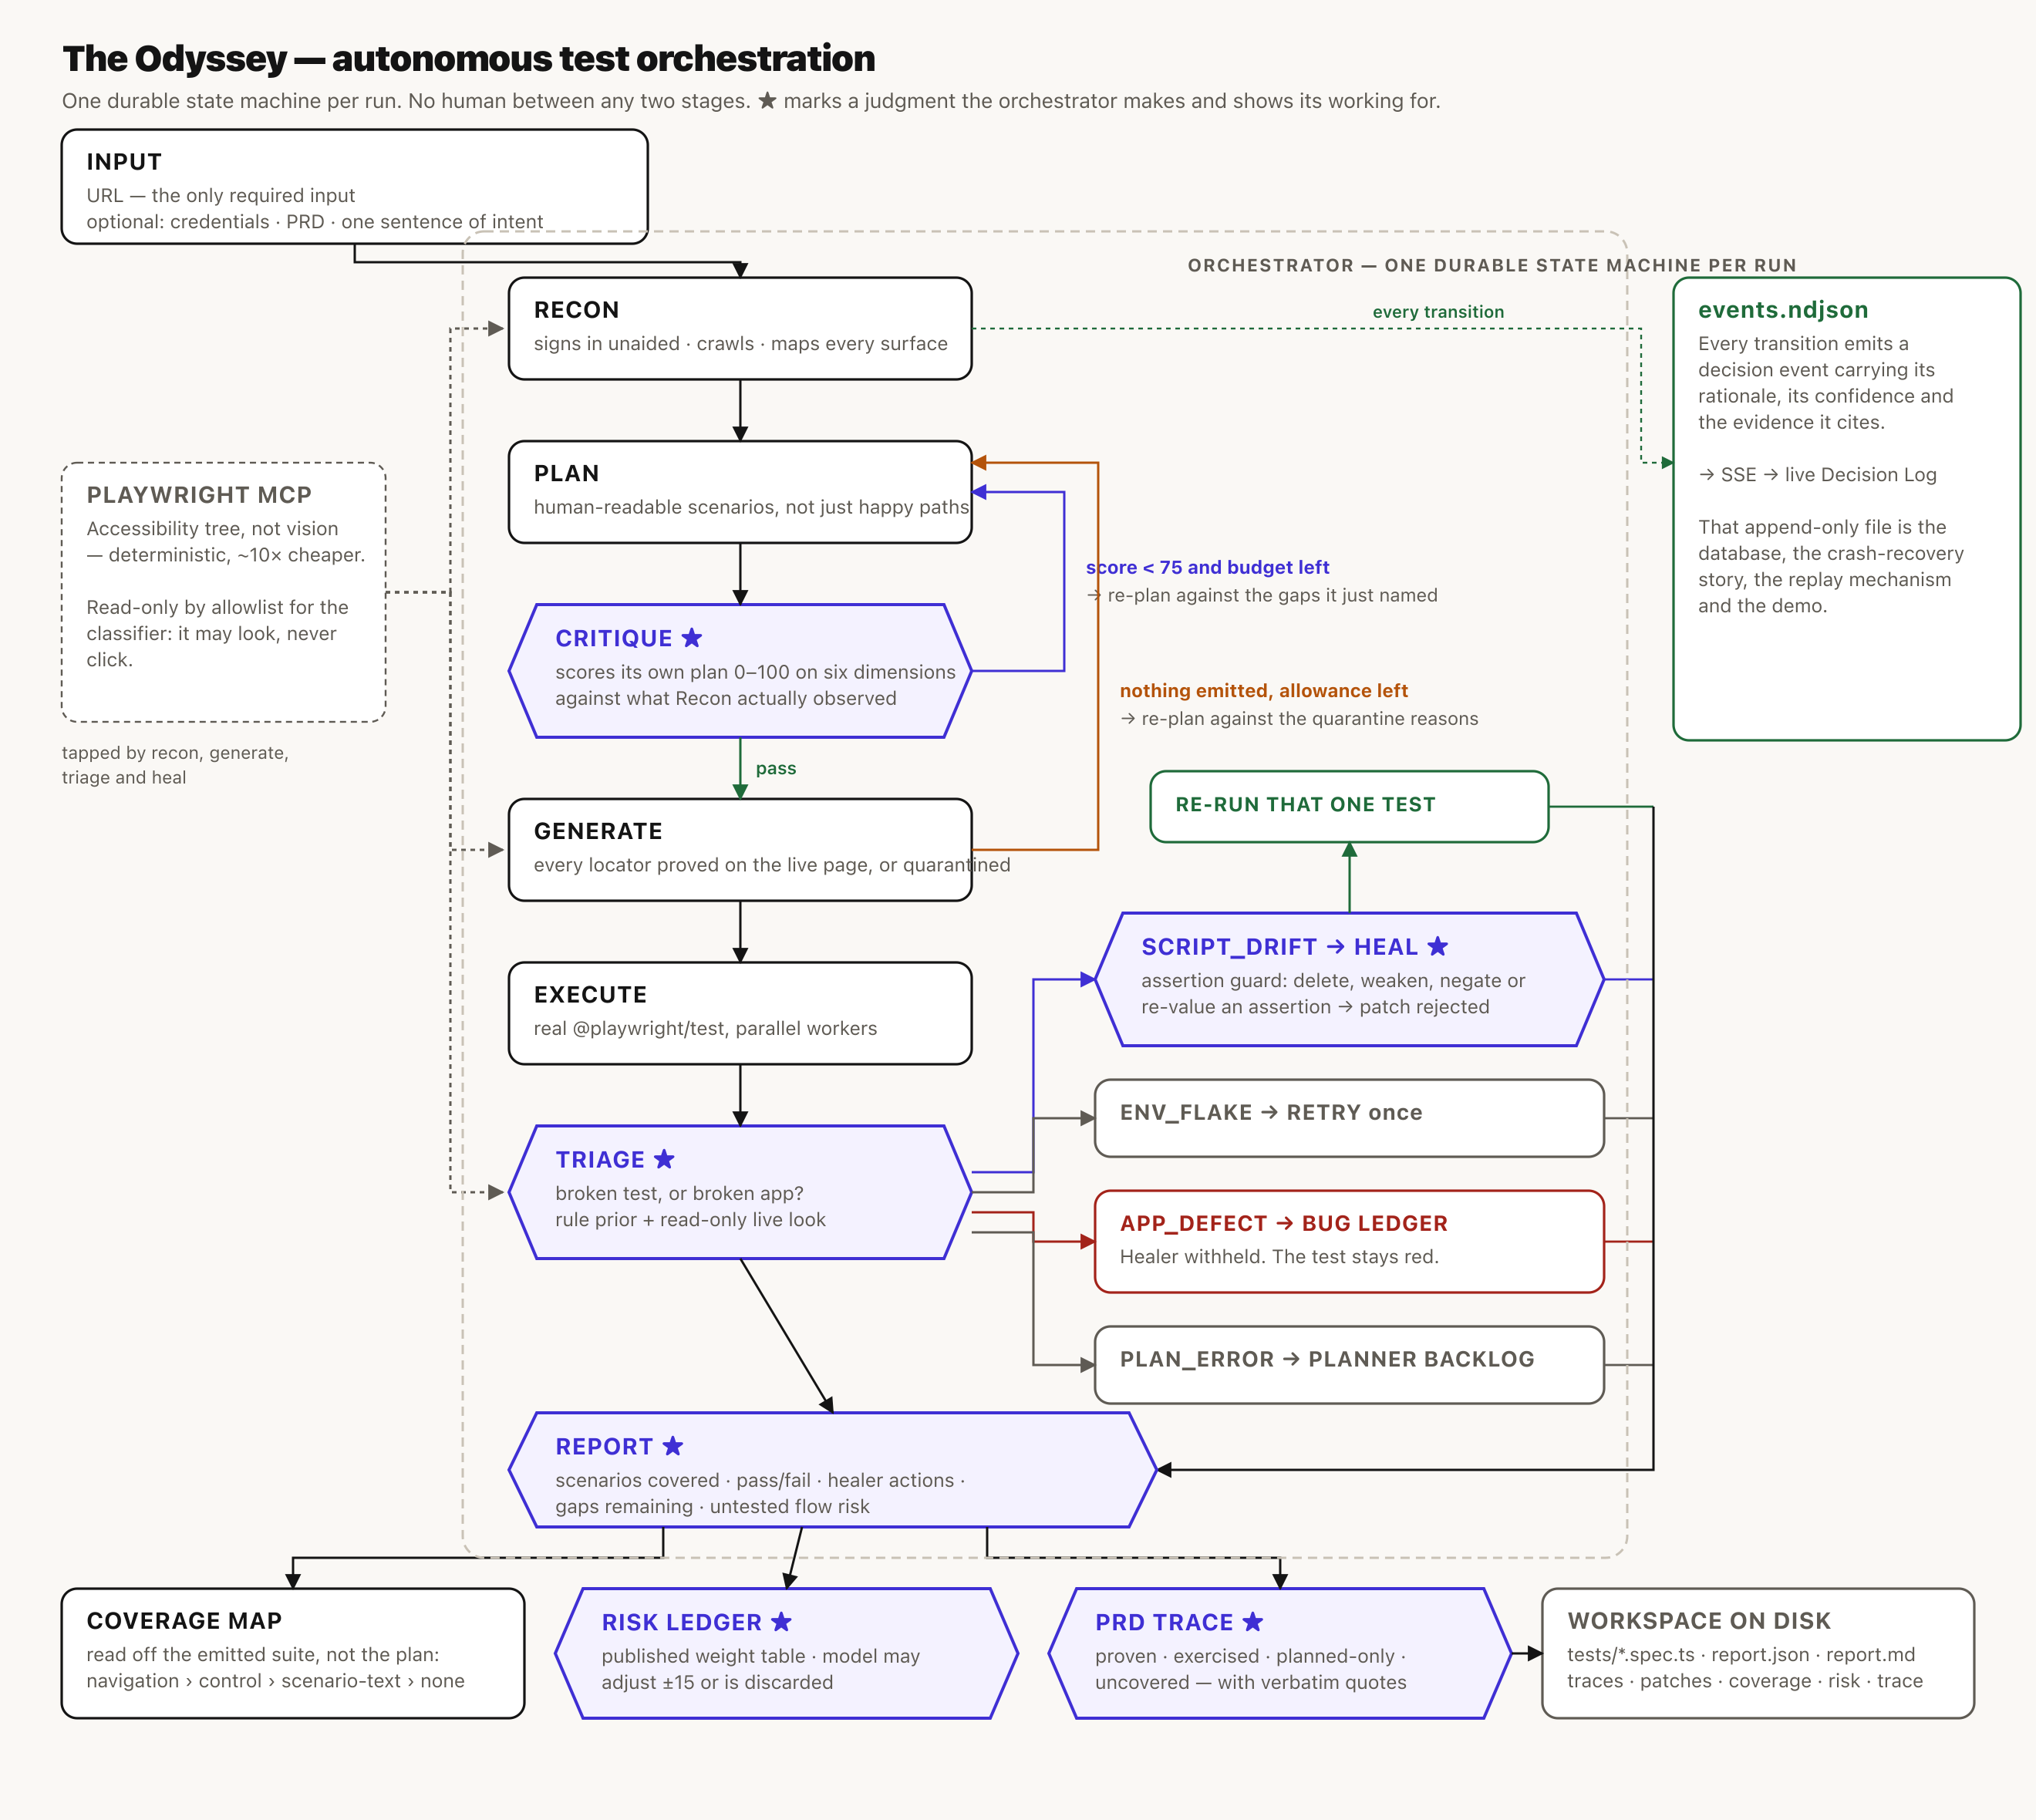
ARCHITECTURE
One durable state machine per run
★
APP_DEFECT
A judgment, not a step. Each emits its rationale, its confidence and the evidence it cites.
never reaches the Healer. The bug is filed and the test stays red.
↺
Coverage
Two re-plan loops: one when the plan scores badly, one when it cannot be built at all.
is read off the emitted suite, never off the plan's word for it.
MCP
events.ndjson
Accessibility tree, not vision. Deterministic and about ten times cheaper.
is the database, the crash-recovery story and the live console.
Notes:
Recon, Plan, Critique, Generate, Execute, Triage, Heal, Report. The starred stages are the judgments. Every transition is appended to one event log, which is the database, the crash recovery story, the replay mechanism and the live console.

Slide 5
THE APPROACH
Four judgments, and none of them is a prompt
★
It grades its own plan
★
It will not write a selector it has not proven
Six dimensions, scored 0–100 against what Recon actually observed. Below 75 it rejects its own plan and re-plans against the gaps it named. Live: 62 → seven gaps → 82.
A ledger of every locator Playwright itself resolved this session, checked mechanically against the emitted file. Unprovable scenarios are quarantined with a reason.
★
It knows a broken test from a broken app
★
The Healer is not allowed to cheat
A rule prior from Playwright's error text and the locator ledger, then a read-only live look — console errors, 5xx, is the control there under a new name.
The assertion set is diffed before and after every patch. Delete, weaken, negate or re-value one and the patch is rejected and the test escalates.
All four are mechanical checks rather than instructions to a model — and each has already overruled the model in a live run.
Notes:
Each of these is mechanical. The assertion guard has already caught a patch whose own summary claimed no assertions changed.

Slide 6
THE DEMO
Break the app while it is watching
ShopLite ships with the repo and has two switches. Flip one between GENERATE and EXECUTE, tell the pipeline nothing, and watch what it decides. It is the only honest way to test a classifier.
THE SWITCH
THE VERDICT, UNPROMPTED
WHAT THE ORCHESTRATOR DOES
Rename "Basket" to "Bag"
SCRIPT_DRIFT
Re-prove the control, patch the test, re-run it green.
The control is renamed. The application is perfectly healthy.
Break order history
APP_DEFECT 0.94
File the bug. Withhold the Healer. The test stays red.
GET /api/shoplite/orders returns 500. The order still saves.
A tool that heals everything it can heal papers over the second one and deletes the finding.
Notes:
run_8b37144b did exactly this with no human in between, and had a third patch rejected by the assertion guard.

Slide 7
WHAT MAKES THE REPORT TRUSTWORTHY
Measured, not asserted
A route counts as exercised when a test that actually ran contains that path. The report prints which signal made each attribution, so a weak claim looks weak — and that produces a third state between covered and uncovered.
navigation
control
scenario-text
none
the emitted code contains the path
it got there by clicking
only the plan names it
nothing reached it
planned-only
PUBLISHED WEIGHT TABLE
The plan covers this surface and no test ever ran. Intent without evidence — worse news than a surface nobody thought of, and scored accordingly.
The naive version of this feature ticks that row and tells a team their PRD is covered about a flow nothing ever loaded.
Touches credentials or account recovery
22
Handles money or personal data
20
Destructive or privileged action
18
Named in the supplied PRD
18
The plan covered it and no test ran
18
Reachable in ≤2 segments
12
The model may adjust a score by ±15 — and an adjustment citing nothing the factors missed is discarded, not damped. None of this scoring needs a model, so the ledger is real with no API key at all.
Notes:
Arithmetic anyone can recompute, calibrated by a unit test against the product's own worked example.

Slide 8
TRADE-OFFS WE WOULD DEFEND
Six decisions, and what each one cost
Accessibility tree, not vision
A visible browser, one worker
Deterministic and ~10× cheaper. Cost: a purely visual defect is invisible to it.
Watching it hunt for a locator is half of what makes a run legible. Cost: parallelism, until ODYSSEY_HEADLESS=1.
Files on disk, no database
Quarantine over volume
Every artifact is where Playwright's own tooling expects it, and a run survives a crash. Cost: one run at a time.
Twelve proven tests and eight reasons beat forty tests of which thirty-eight are red. Cost: a smaller headline number.
Judgment in the FSM, labour in the agents
A demo target we can break on command
Every branch is inspectable and unit-testable without a key. Cost: prompts cannot fix an orchestration bug.
A classifier is only demonstrable against a defect you introduce deliberately. Cost: it is our app, not theirs.
Notes:
Each of these is a real cost, and each is stated in the README rather than implied away.

Slide 9
BUSINESS IMPACT
What it replaces, and what it costs
$0.16 – $0.35
8 – 12 min
0
100%
a measured run against a live target, end to end
URL in, suite and report out, unattended
human approval gates between stages
of test code produced by the pipeline
Where the hours actually go
The line a QA lead cares about
Authoring an equivalent four-scenario suite with selectors proven against a live application is most of a day for one engineer. Keeping it green as the UI drifts is the recurring cost, and it is the one that quietly kills suites: a locator renamed on Tuesday is a red build on Wednesday and a deleted test on Friday.
This repairs drift automatically, refuses to repair a genuine defect, and says which it did.
“/forgot-password — 78/100, critical. Touches credentials. Named in your PRD. One segment from the landing page. The plan covers it and no test ever ran.”
No coverage tool says this today. Percentage coverage tells you what you touched; it never tells you what the gap is worth. That sentence is what turns a report into a decision about where to spend the next hour.
Notes:
Costs are measured from real runs in this repo, not estimated. The authoring comparison is an estimate and is stated as one.

Slide 10
WHAT IS NOT FINISHED
Stated, rather than implied away
The storage-state hand-off carries the agents' own side effects into the suite.
If Recon creates a record while crawling, the suite starts with it present. ShopLite shows what an immune application looks like — its basket lives in sessionStorage — which routes around the problem rather than solving it.
The classifier cannot know which session the suite ran with.
A failure caused by an unexpected storage state is harder for it to attribute than one caused by a 500.
The console's fleet pages are seeded, and say so on the page.
Overview, Coverage, Defects, Schedule and Targets describe the product around a single run. Every number inside a run is measured by that run.
This repo distinguishes “the code exists” from “a real run produced it”, and the README says which is which, stage by stage.
Notes:
Every phase in this repo was marked done once before it had ever run, and running it found defects each time. So the labels are earned, not assumed.

Slide 11
IN ONE SENTENCE
One URL in. A suite whose every selector was proven, a bug we refused to heal, a patch we rejected for weakening an assertion, and an honest account of what we did not test.
No human between any two of those stages.
SUBMISSION.md
docs/DEMO.md
pnpm verify
every requirement → the file that implements it
the run of show, and what to say when it breaks
typecheck, lint, 123 assertions, ~2 seconds
Notes:
Thank you. Questions.

