Slide 1
Density Matrix Prediction
with Equivariant Networks
An Application of ML in Computational Chemistry
Kecai Xuan
May 8, 2025

Slide 2
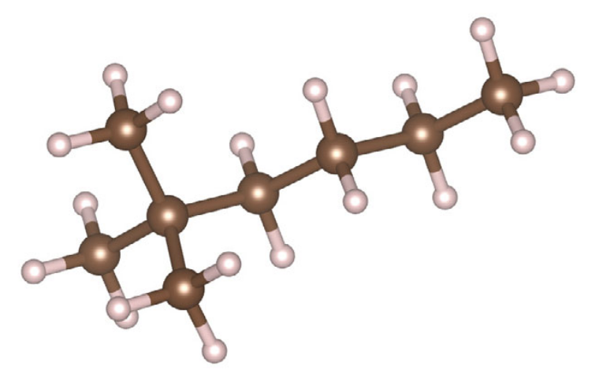
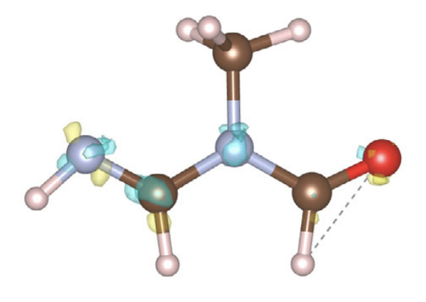
Dataset: QM9
134k small molecules with atom types & atom coordinates, take 5000
C₃H₆N₂O
C₈H₁₈
Ramakrishnan, R., Dral, P., Rupp, M. et al. Quantum chemistry structures and properties of 134 kilo molecules. Sci Data 1, 140022 (2014).

Slide 3
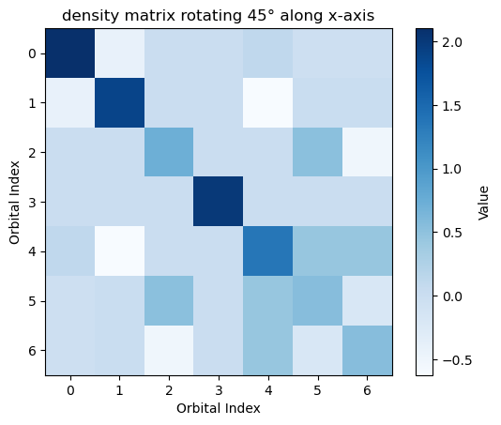
Background: Density Matrix
To Describe the Density of Electrons by Density Matrix
input: molecule structure
output: density matrix
Computational chemistry
temperature: scalars
current: vectors
density of electrons: matrices

Slide 4
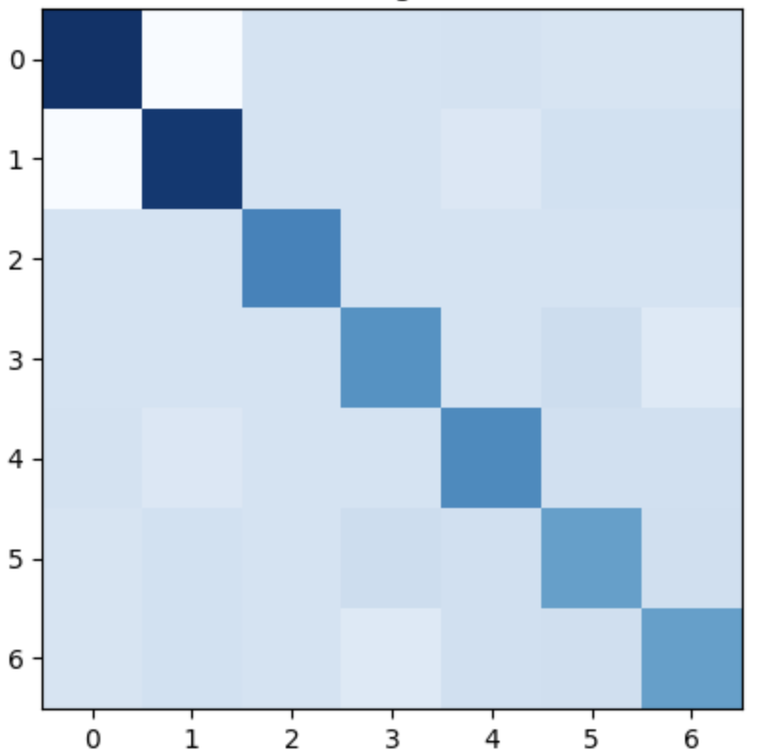
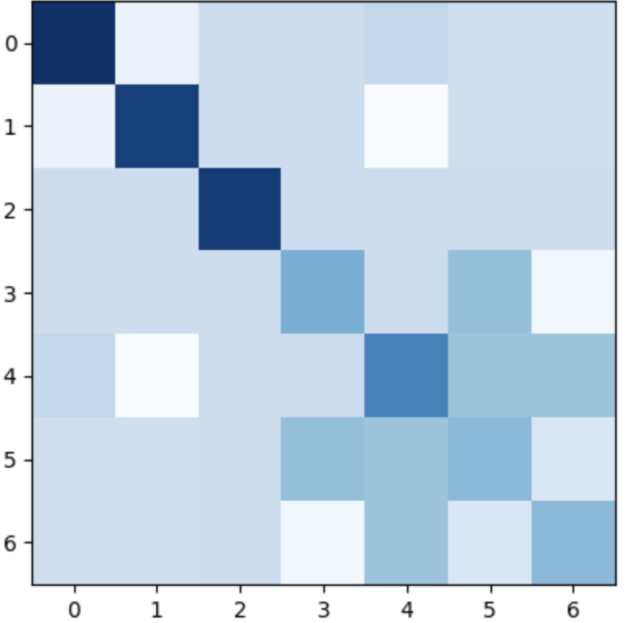
Background: Computational Chemistry
What is happening: Large Scale Matrix Iteration
Initial Guess
Convergence
Real Physics
CPU, Time, Energy
Consuming
more money for more Accuracy

Slide 5
A New Hope: Bypass the Iteration
ML Model
Initial Guess
Convergence
Model
GPU, Fast, Accurate
FEATURE
one model scalable for all
LABEL

Slide 6
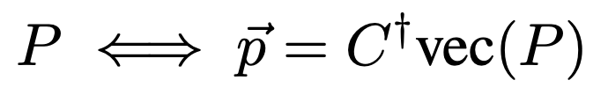
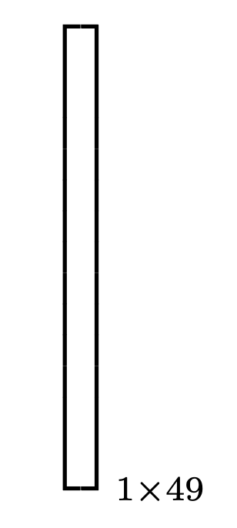
Preprocess: Symmetry (Equivariance)
Equivariant Factor Extraction:
matrix C is constant (called Clebsch–Gordan coefficients)
Irreducible Representation Decomposition
Vague Symmetry
Clear Symmetry
https://en.wikipedia.org/wiki/Irreducible_representation

Slide 7
Model: E3NN TensorProductBlock
Carbon-Carbon Block in Density Matrix
Linear Embedding
Learnable TensorProduct
Activation
Linear Embedding
https://docs.e3nn.org/en/latest/

Slide 8
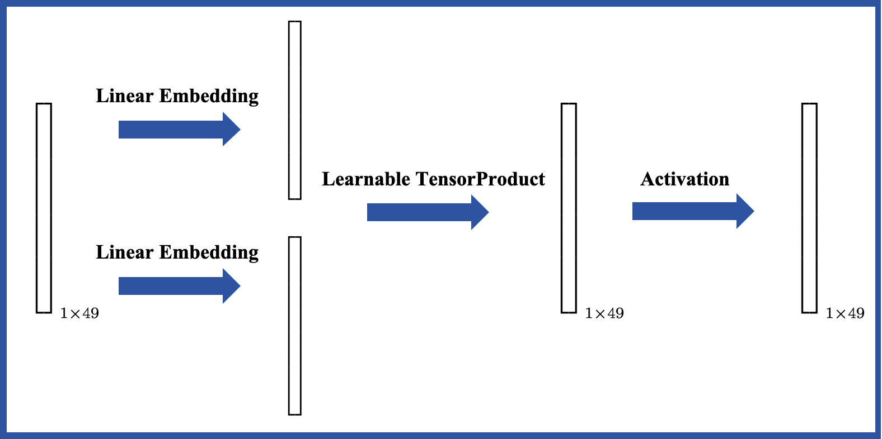
Model: Deep Model
Carbon-Carbon Block in Density Matrix
TensorProductBlock
TensorProductBlock
Feature
Number of Learnable Parameters: 8000
Label
https://docs.e3nn.org/en/latest/

Slide 9
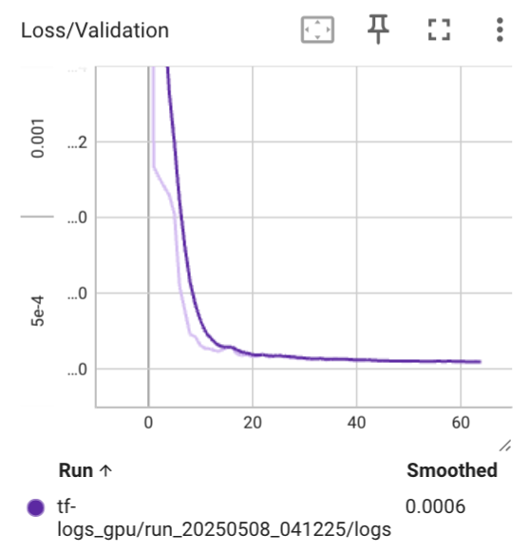
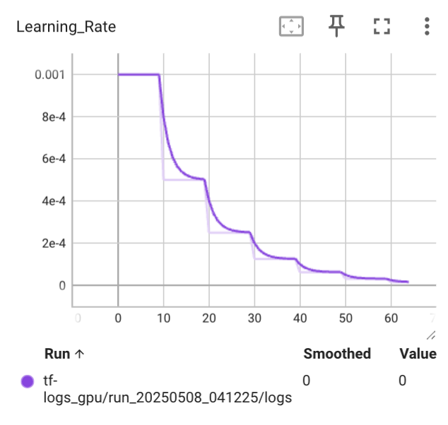
Learning Curve
Loss Function: nn.MSELoss
Carbon-Carbon Block in Density Matrix
Validation Loss
Learning Rate Decay
Loss Convergence: 0.0006

Slide 10
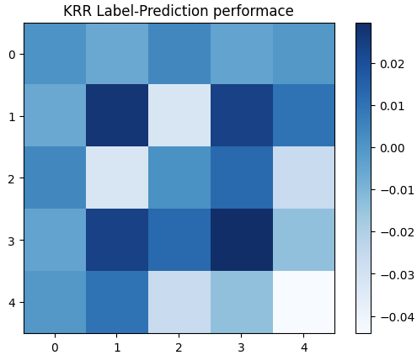
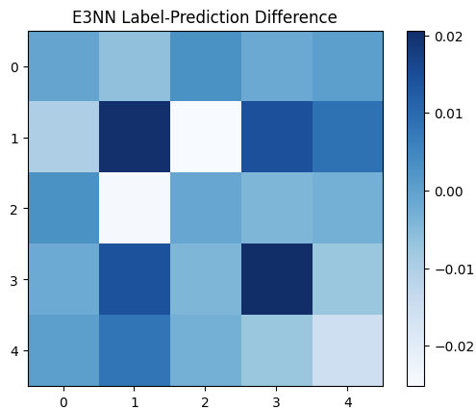
Compare to Kernel Ridge Regression
Loss Function: nn.MSELoss
Carbon-Carbon Block in Density Matrix
nearly the same performance compared to traditional ML

Slide 11
Future Plan
1. Expand to Graph Neural Networks
2. Predict the Whole Density Matrix
https://github.com/Bessgendre/AOSC650-Final-2025

