Slide 1

Note: the font is smaller than usual here so it fits nicely.
Setting up your optimization problem
Numerical approximation
of gradients
deeplearning.ai
Notes:
1.梯度检验
检测back propagation

Slide 2

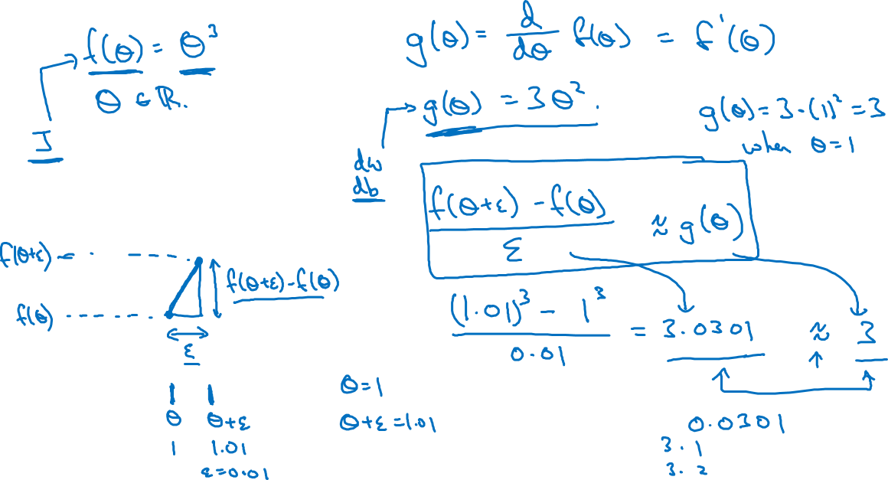
Checking your derivative computation
$$f$$
Notes:
2.

Slide 3
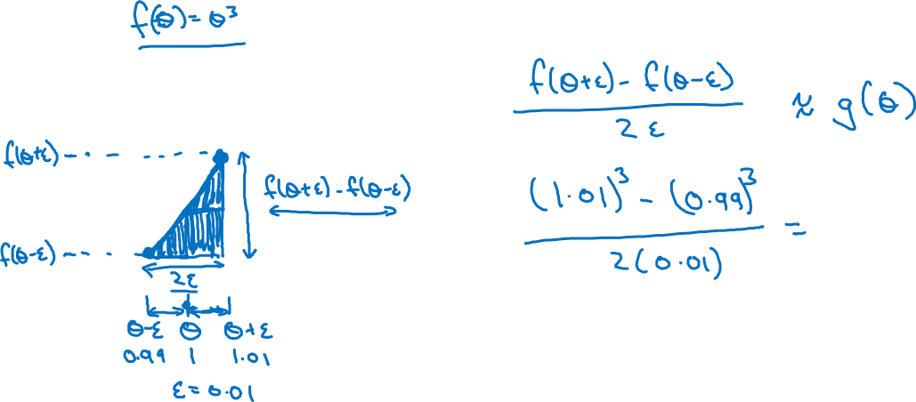
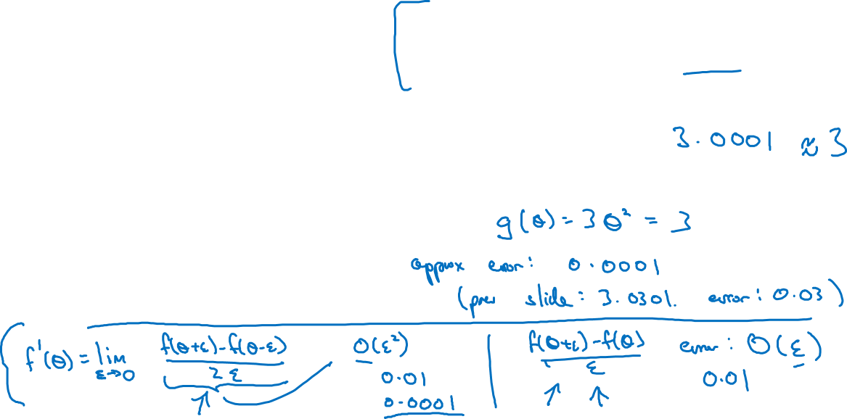
Checking your derivative computation
$$f$$
Notes:
我也不知道为啥要讲这个
总之，这一页的误差，比上一页的要小
就是说双侧误差要更小

