Slide 1

Optimization Algorithms
Adam optimization
algorithm
deeplearning.ai

Slide 2
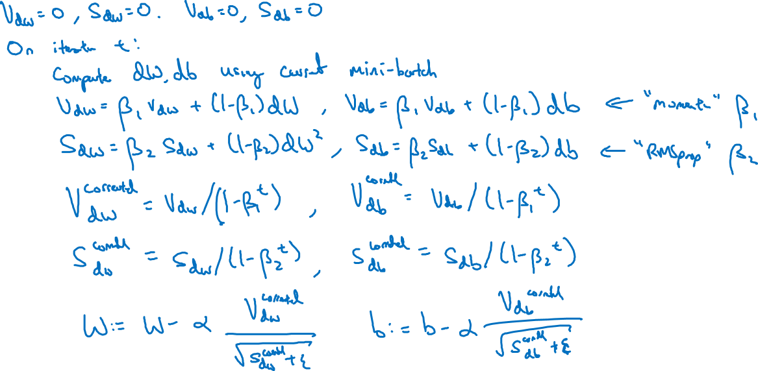
Adam optimization algorithm
yhat = np.array([.9, 0.2, 0.1, .4, .9])
Notes:
1.有很多人设计出了新的算法，用于 a few problem
但是却不是generalized的方法
但是今天说的Adam方法，确实少见的stood up and has been shown to work well across a wide range of deep learning architecture.
2.momentum+RMS方法就是adam

Slide 3

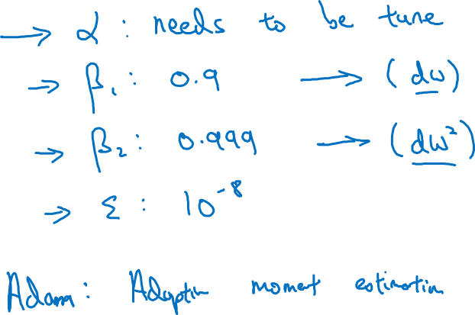
Hyperparameters choice:
Adam Coates
Notes:
1.Common choice of beta1 is 0.9
2. Common choice of beta 2 is 0.9
Adam:
Adaptive moment estimation.
和Adam这个人没关系啊！

