Slide 1

Basics of Neural Network Programming
Vectorization
deeplearning.ai

Slide 2
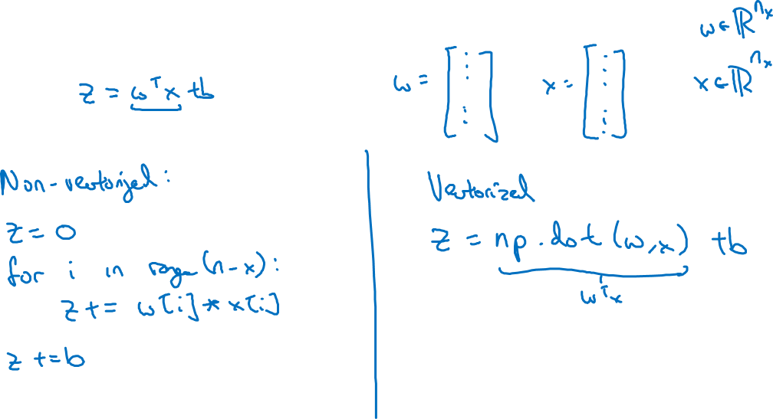
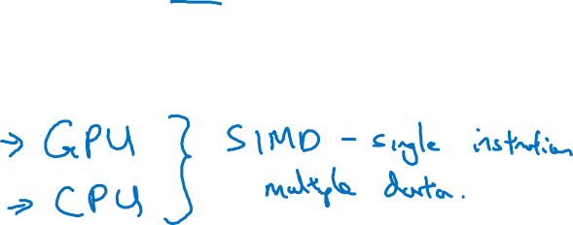
What is vectorization?
Notes:
Vectorization只需要1.5ms
但是for loop需要480ms
True or false. Vectorization can be done without a GPU, like CPU
Np.dot()用的是parallel computation

Slide 3
Basics of Neural Network Programming
More vectorization
examples
deeplearning.ai

Slide 4
Neural network programming guideline
Whenever possible, avoid explicit for-loops.

Slide 5
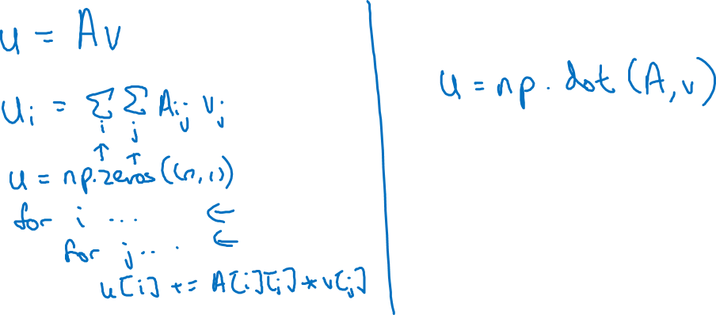
Neural network programming guideline
Whenever possible, avoid explicit for-loops.
Notes:
左边是for loop的写法：
老师写的是np.zero((n,1)) #意思是一共n个样本
左边写了两个for loop
右边只需要一个np.dot()就好了

Slide 6
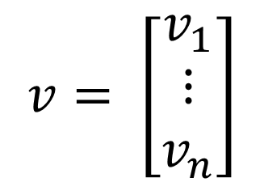
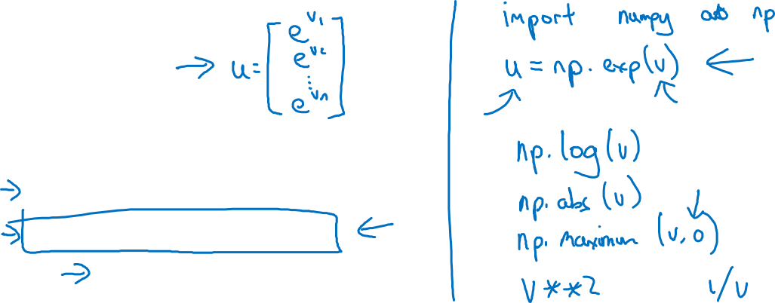
Vectors and matrix valued functions
Say you need to apply the exponential operation on every element of a matrix/vector.
$$v= \left[\begin{matrix}v_{1} \\ ⋮ \\ v_{n}\end{matrix}\right]$$
u = np.zeros((n,1))
for i in range(n):
u[i]=math.exp(v[i])
Notes:
这一页目的是想把v1变成e^v1
左边的for loop是每个元素遍历一次
右边是用numpy
一句就搞定了：把全部元素加了一个e
然后np.log(v)也是，把全部元素加了一个log

Slide 7
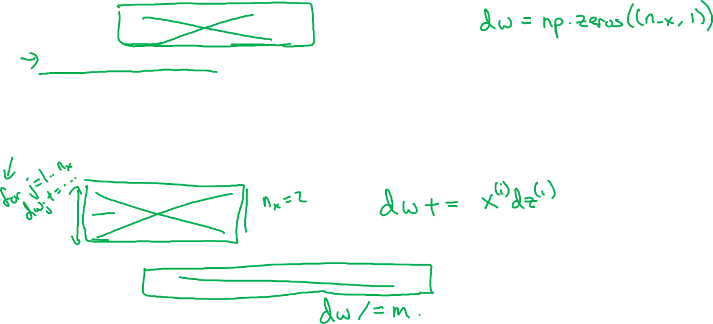
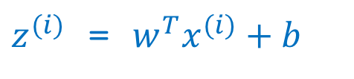
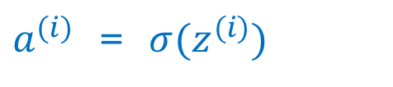
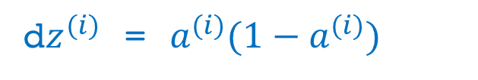
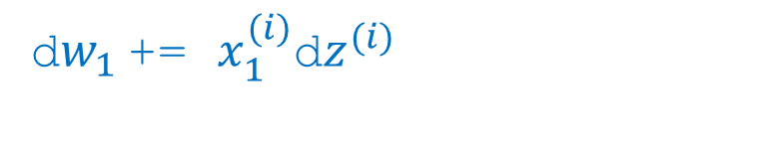
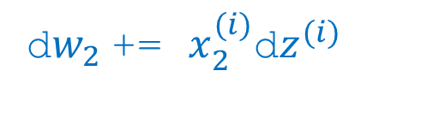

Logistic regression derivatives
J = 0, dw1 = 0, dw2 = 0, db = 0
for i = 1 to n:
$z^{(i)}$ = $w^{T}x^{(i)}+b$
$a^{(i)}$ = $σ{(z}^{(i)})$
$J$+= $−\left[y^{(i)} \log{{\hat{y}}^{\left(i\right)}+({1−y}^{\left(i\right)})\log{(1 −{\hat{y}}^{\left(i\right)})}}\right]$
d$z^{(i)}$ = $a^{(i)}{(1−a}^{(i)})$
d${w_{1}}^{ }$+= $x_{1}^{(i)}\text{d}z^{(i)}$
d${w_{2}}^{ }$+= $x_{2}^{(i)}\text{d}z^{(i)}$
db += d$z^{(i)}$
J = J/m, d$w_{1}$ = d$w_{1}$/m, d$w_{2}$ = d$w_{2}$/m, db = db/m
Notes:
首先都不需要dw1, dw2 = 0了
直接上手：如果有个n_x个样本
就dw = np.zeros((n_x,1))
然后不能省略的是for i from 1 to n:
就是的确是每个案例都要遍历一次
但是单独案例里面，就可以直接使用vecterization了
例如矩阵的乘法：
Dw += x(i)dz(i)

