Slide 1

Basics of Neural Network Programming
Vectorizing Logistic
Regression
deeplearning.ai

Slide 2
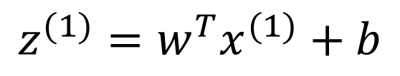

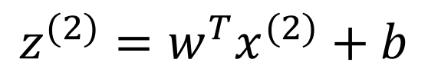
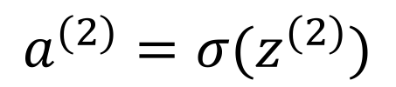
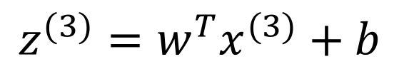

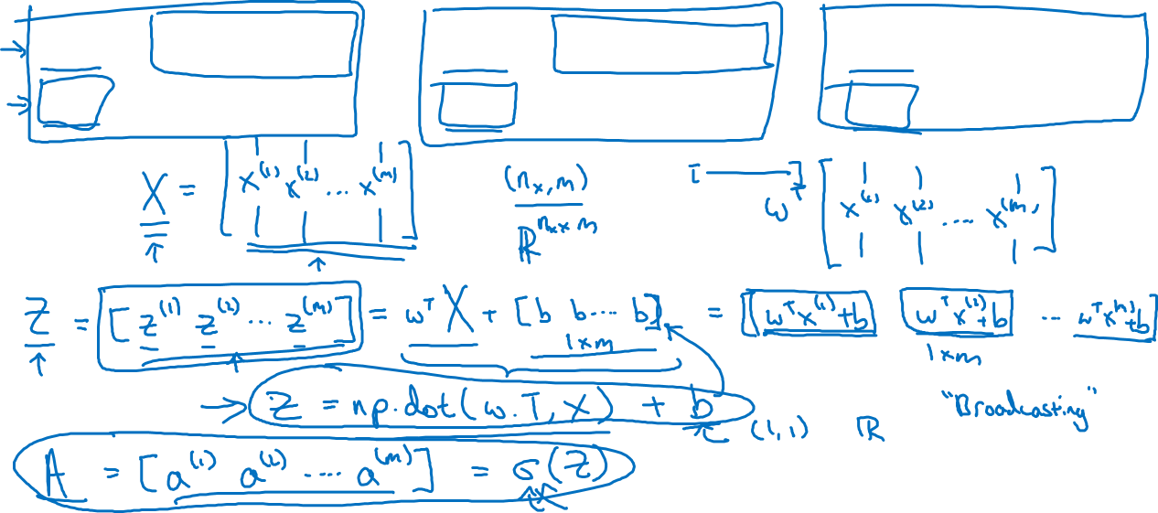
Vectorizing Logistic Regression
$$z^{(1)}=w^{T}x^{(1)}+b$$
$$z^{(2)}=w^{T}x^{(2)}+b$$
$$z^{(3)}=w^{T}x^{(3)}+b$$
$$a^{(1)}={σ(z}^{(1)})$$
$$a^{(2)}={σ(z}^{(2)})$$
$$a^{(3)}={σ(z}^{(3)})$$
Notes:
注意了
这里的b虽然只是一个数字
但是计算的时候,python会扩展到1*m
这就是broadcasting

Slide 3
Basics of Neural Network Programming
Vectorizing Logistic
Regression’s Gradient
Computation
deeplearning.ai

Slide 4
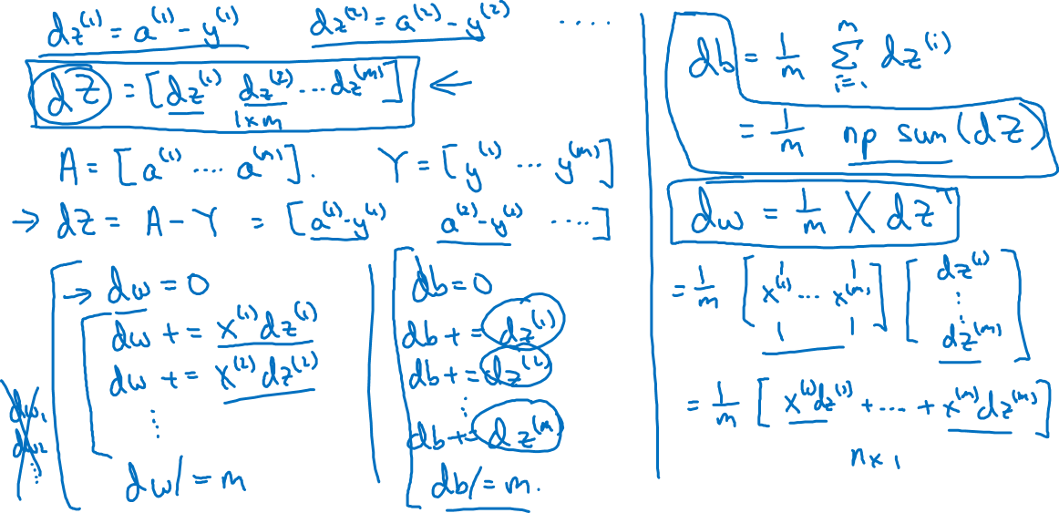
Vectorizing Logistic Regression
Notes:
注意了dw = 1/m * X * dZ^T

Slide 5
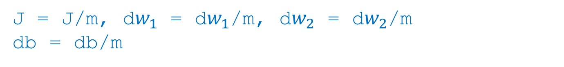
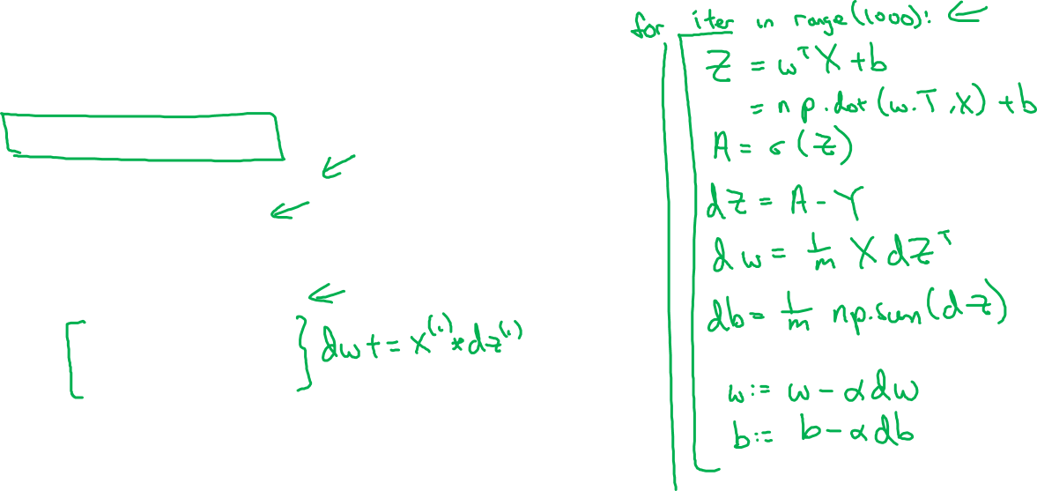
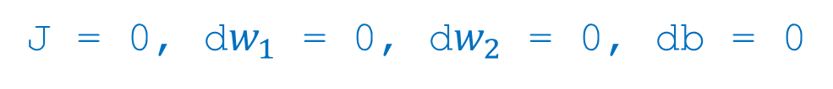
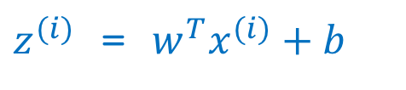
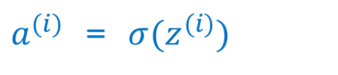
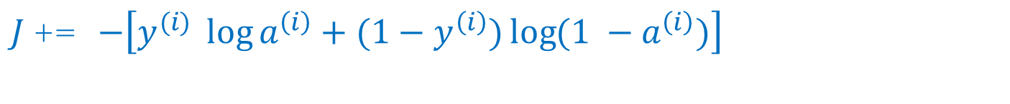
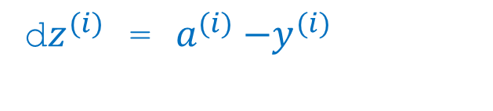

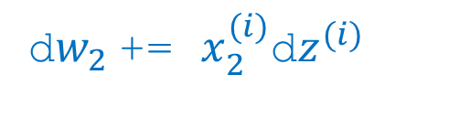

Implementing Logistic Regression
J = 0, d$w_{1}$ = 0, d$w_{2}$ = 0, db = 0
for i = 1 to m:
$z^{(i)}$ = $w^{T}x^{(i)}+b$
$a^{(i)}$ = $σ{(z}^{(i)})$
$J$+= $−\left[y^{(i)} \log{a^{\left(i\right)}+({1−y}^{\left(i\right)})\log{(1 −a^{\left(i\right)})}}\right]$
d$z^{(i)}$ = $a^{(i)}{−y}^{(i)}$
d${w_{1}}^{ }$+= $x_{1}^{(i)}\text{d}z^{(i)}$
d${w_{2}}^{ }$+= $x_{2}^{(i)}\text{d}z^{(i)}$
db += d$z^{(i)}$
J = J/m, d$w_{1}$ = d$w_{1}$/m, d$w_{2}$ = d$w_{2}$/m
db = db/m
Notes:
loop是走的步子数量
一直到走到optimal点
但是对于单一一步，我们没有loop

