Slide 1
One hidden layer
Neural Network
Derivatives of
activation functions

Slide 2
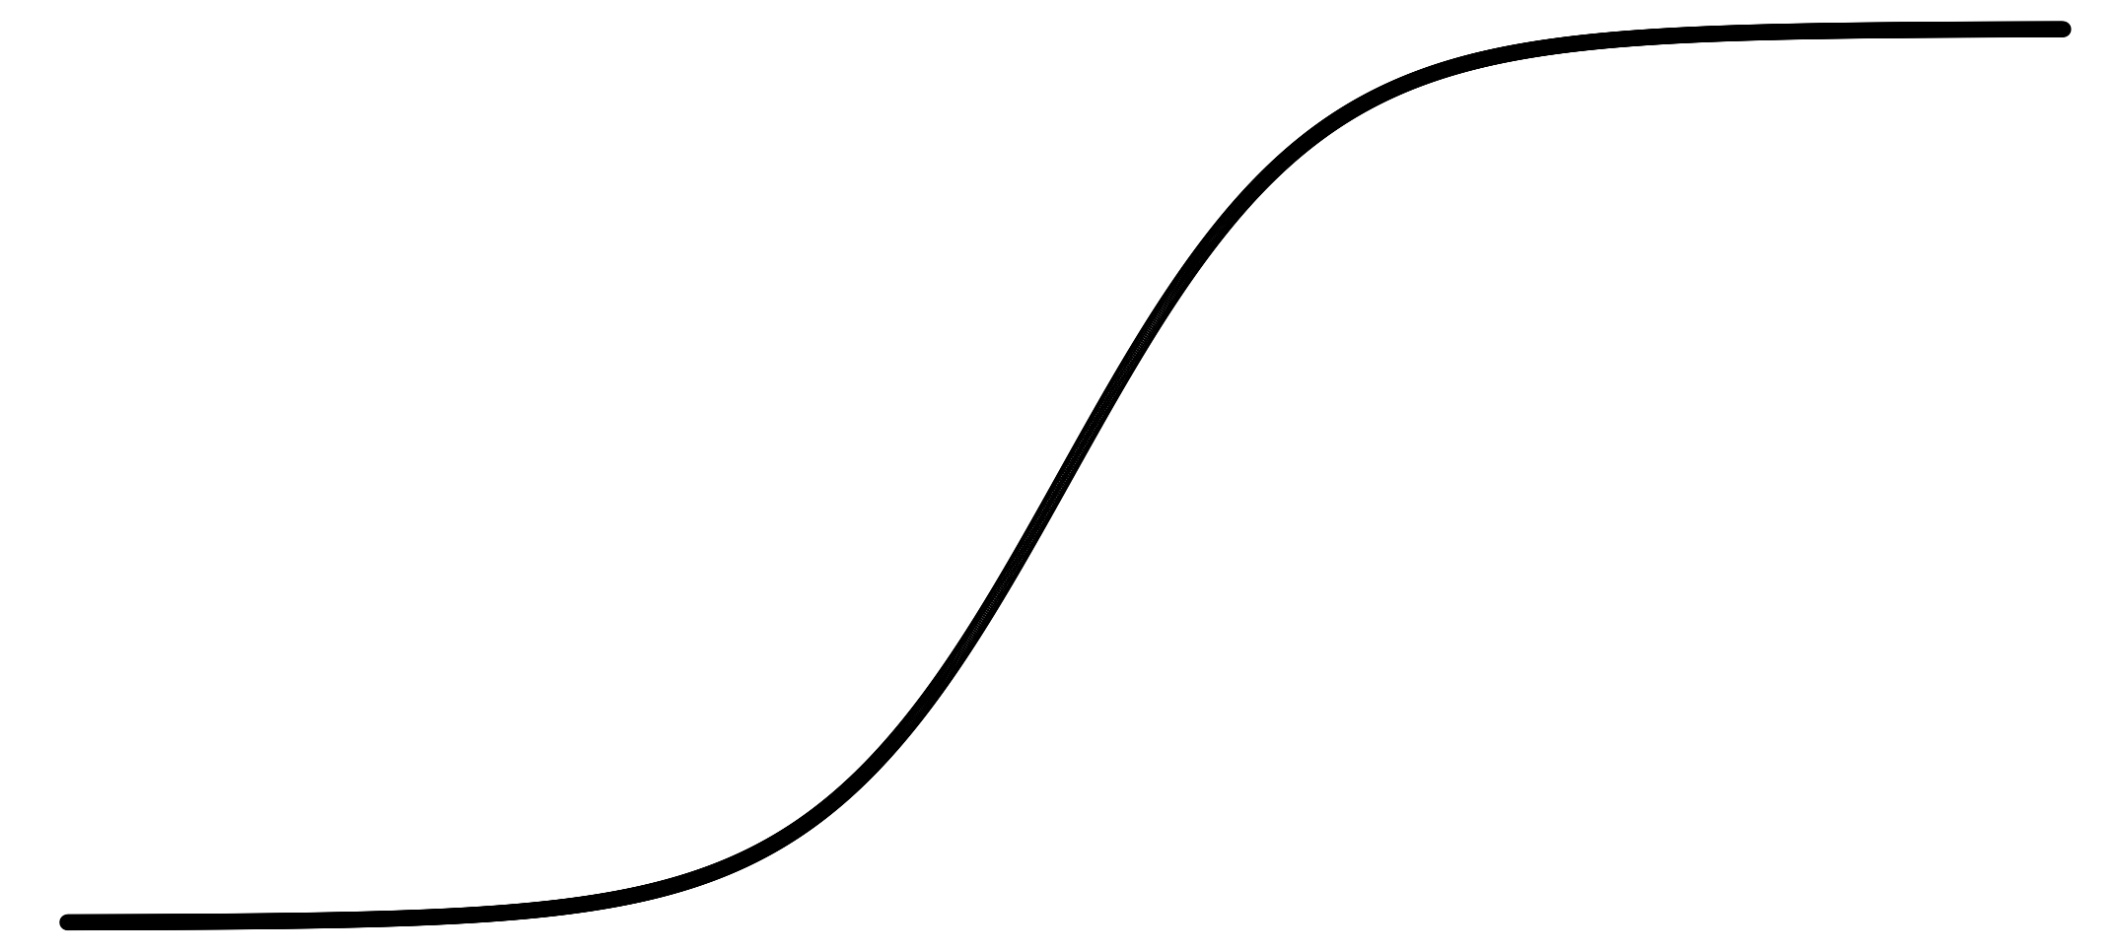
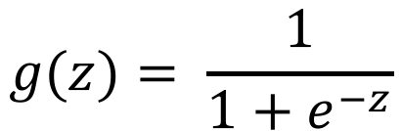
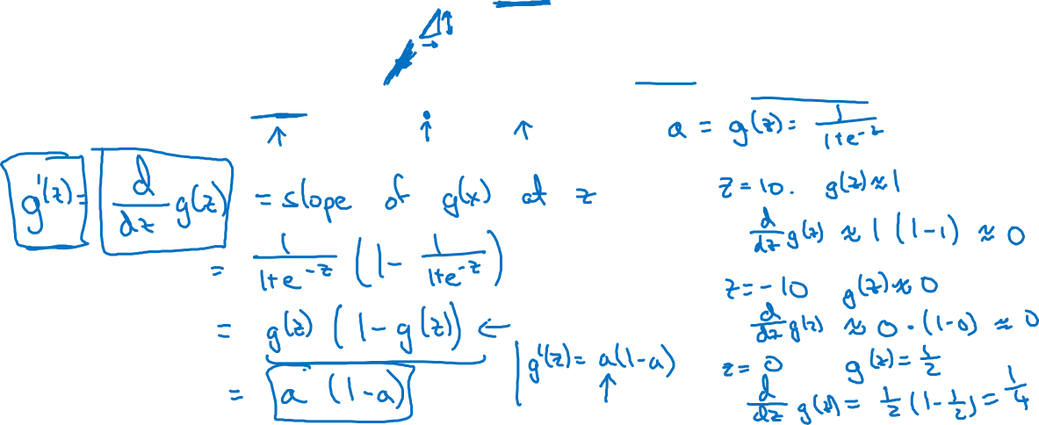
Sigmoid activation function
a
$$g(z)= \frac{1}{1+e^{−z}}$$
z
Notes:
1.很简单，简单到我都不想说了 it cannot be easier as much as I don’t want to write
就是推到sigmoid的导数，我之前干过
然后老师举例 z = 10，z = -10， z = 0来验证导数的大小

Slide 3

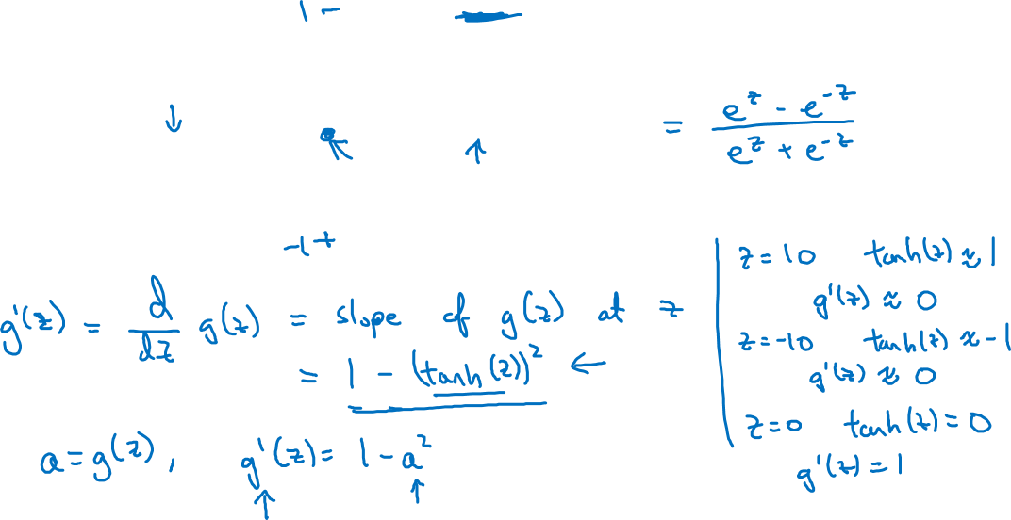
Tanh activation function
a
$$g(z)=tanh(z){ }$$
z

Slide 4
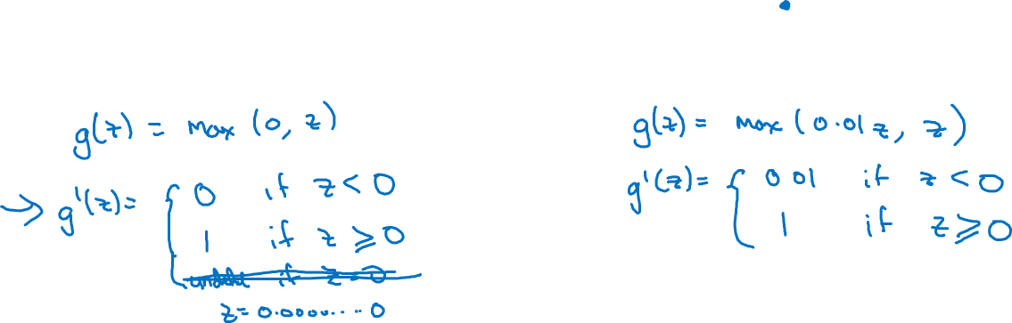
ReLU and Leaky ReLU
a
a
z
z
ReLU
Leaky ReLU

