Slide 1

Setting up your goal
Single number
evaluation metric
deeplearning.ai

Slide 2

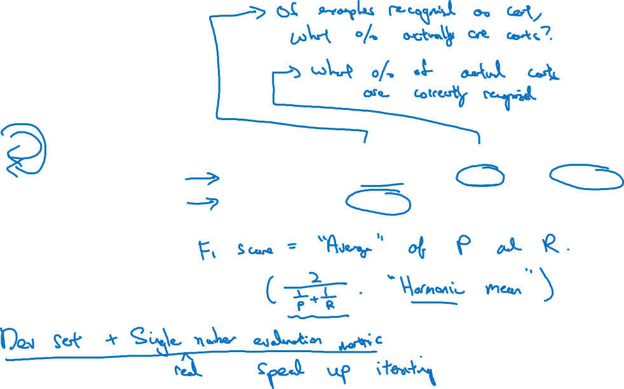
Using a single number evaluation metric
Idea
Classifier | Precision | Recall | F1 Score
A | 95% | 90% | 92.4%
B | 98% | 85% | 91.0%
Experiment
Code
Notes:
So what I found for
a lot of machine learning teams is that having a well-defined dev set,
which is how you're measuring precision and recall, plus a single number
evaluation metric, sometimes I'll call it single row number.
Evaluation metric allows you to quickly tell if classifier A or
classifier B is better, and therefore having a dev set plus single
number evaluation metric distance to speed up iterating.

Slide 3
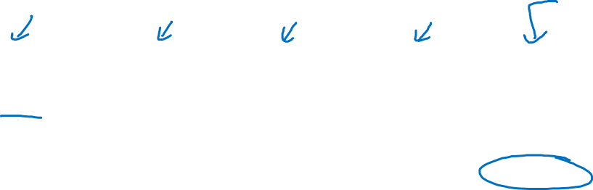
Another example
Algorithm | US | China | India | Other | Average
A | 3% | 7% | 5% | 9% | 6%
B | 5% | 6% | 5% | 10% | 6.5%
C | 2% | 3% | 4% | 5% | 3.5%
D | 5% | 8% | 7% | 2% | 5.25%
E | 4% | 5% | 2% | 4% | 3.75%
F | 7% | 11% | 8% | 12% | 9.5%
Notes:
Let’s say that your two classifiers achieve different errors in data from these four different geographies.
So algorithm A achieves 3% error on pictures submitted by US users and so on.

