Slide 1

Setting up your goal
Satisficing and
optimizing metrics
deeplearning.ai

Slide 2
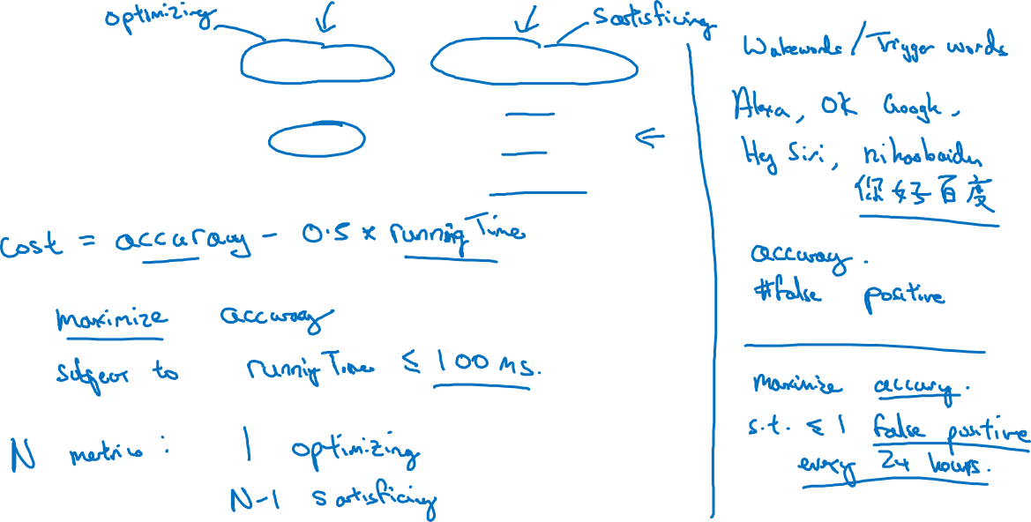
Another cat classification example
Classifier | Accuracy | Running time
A | 90% | 80ms
B | 92% | 95ms
C | 95% | 1,500ms
Notes:
if you have N matrix that you care
about it's sometimes reasonable to pick one of them to be optimizing.
So you want to do as well as is possible on that one.
And then N minus 1 to be satisficing,
And subject to that,
you have at most one false positive every 24 hours
of operation, right?
So that your device randomly wakes up only once
per day on average when no one is actually talking to it

