Slide 1

Setting up your goal
Train/dev/test
distributions
deeplearning.ai
Notes:
The way you set up your training dev,
or development sets and test sets,
can have a huge impact on how rapidly you or
your team can make progress on building machine learning application

Slide 2
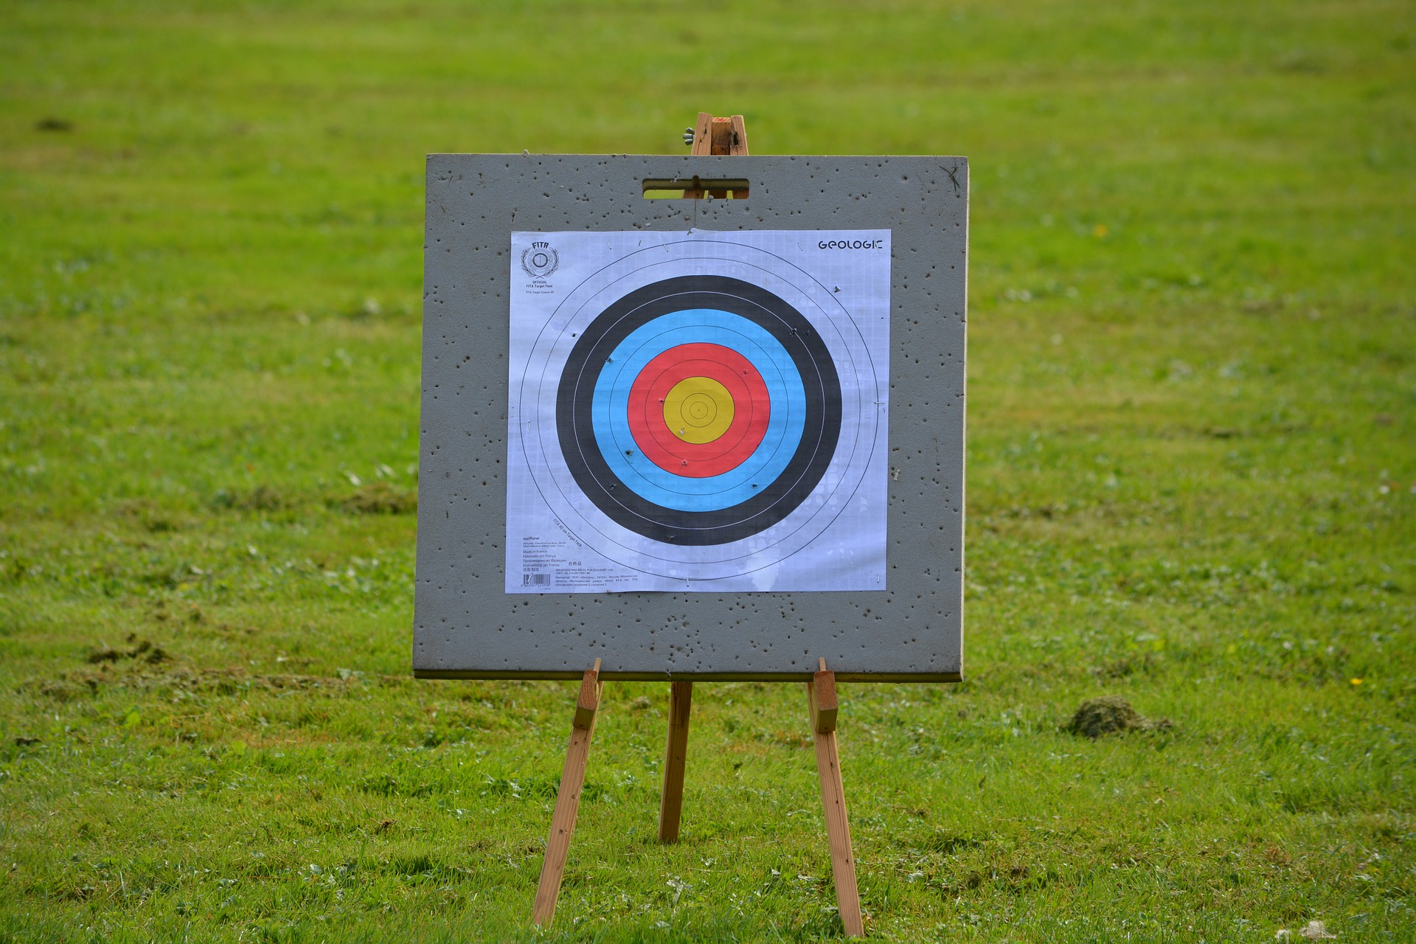

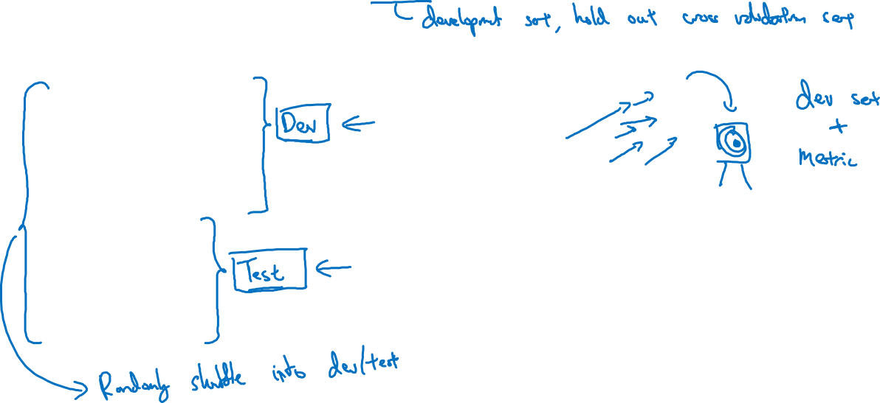
Cat classification dev/test sets
Regions:
US
UK
Other Europe
South America
India
China
Other Asia
Australia
Idea
Experiment
Code
Notes:
your team might spend months innovating to do well on the dev set only to realize that,
when you finally go to test them on the test set,
that data from these four countries or these four regions at the bottom,
might be very different than the regions in your dev set.
So, you might have a nasty surprise and realize that
Well,
why did you make us spend months optimizing for a different bull's eye when suddenly,
you can move the bull's eye to a different location somewhere else?
,
what I recommend instead is that,
you take all this randomly shuffled data into the dev and test set.
So that, both the dev and test sets have data from all eight regions
and that the dev and test sets really come from the same distribution,
which is the distribution of all of your data mixed together.

Slide 3
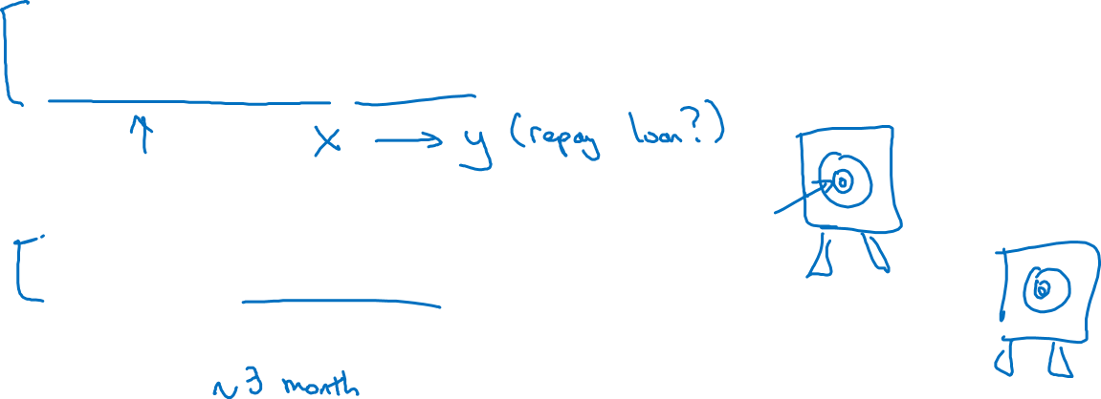
True story (details changed)
Optimizing on dev set on loan approvals for medium income zip codes
Tested on low income zip codes

Slide 4
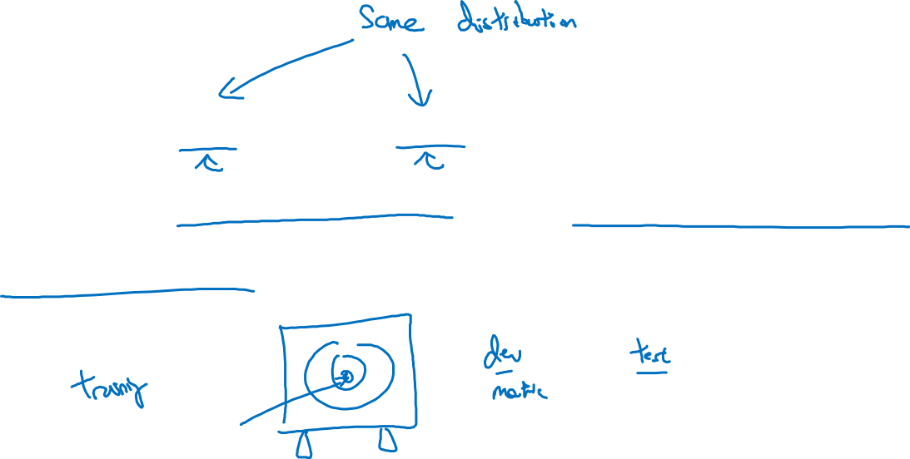
Guideline
Choose a dev set and test set to reflect data you
expect to get in the future and consider important
to do well on.
Notes:
in particular, the dev set and the test set here,
should come from the same distribution.
So, whatever type of data you expect to get in the future,
and once you do well on,
try to get data that looks like that.

