Slide 1

Setting up your goal
Size of dev
and test sets
deeplearning.ai

Slide 2
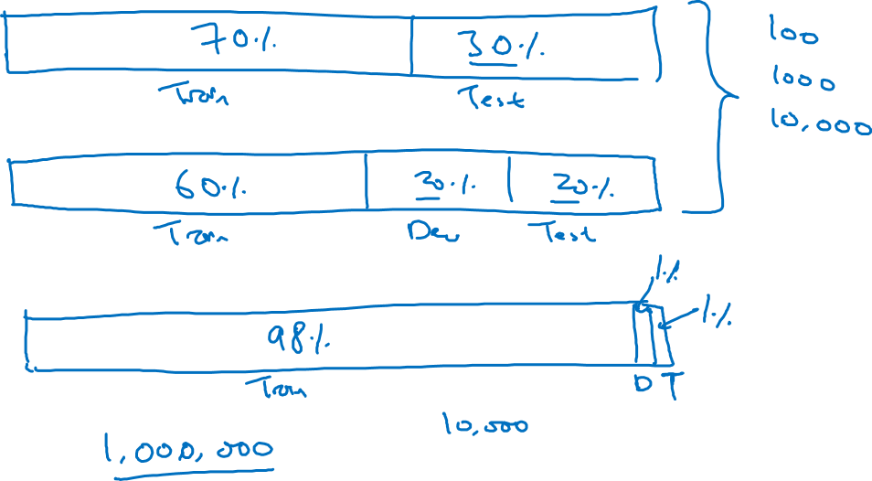
Old way of splitting data

Slide 3
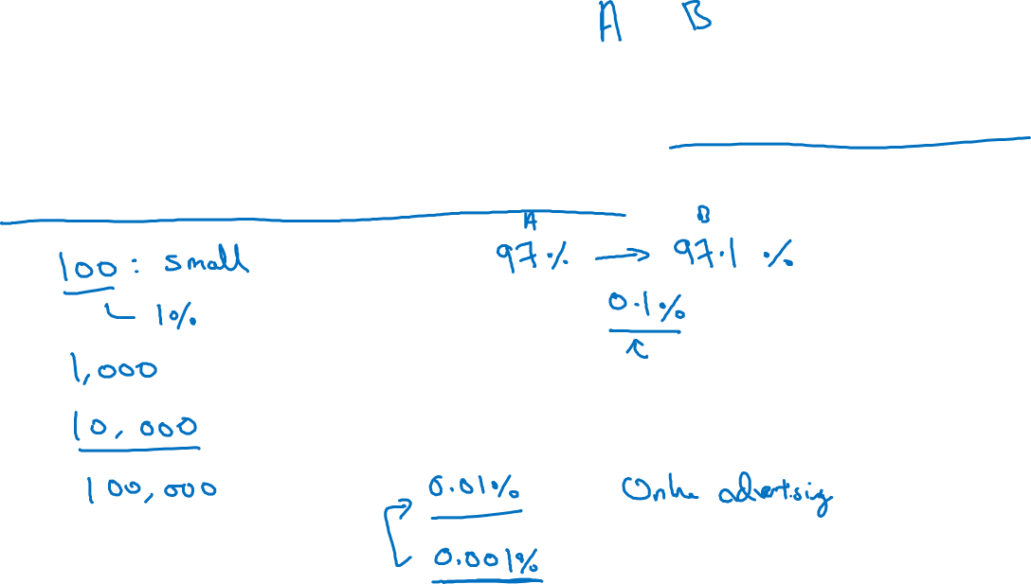
Size of dev set
Set your dev set to be big enough to detect differences in
algorithm/models you’re trying out.

Slide 4
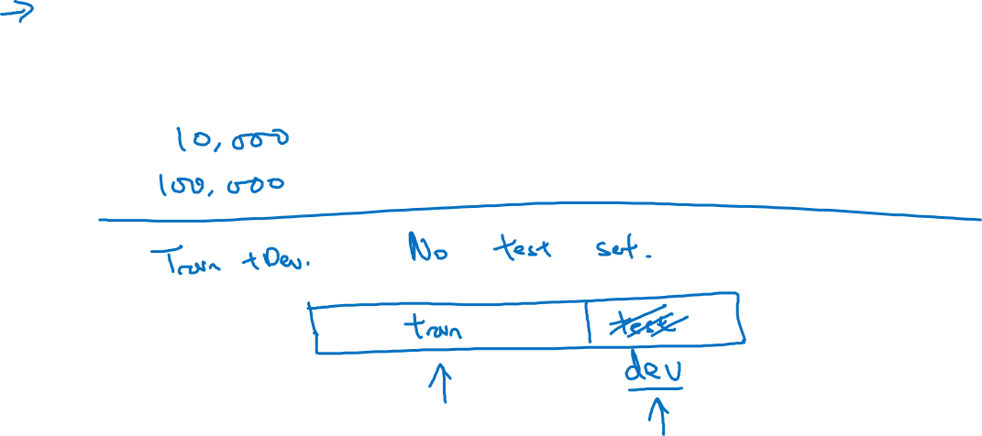
Size of test set
Set your test set to be big enough to give high confidence
in the overall performance of your system.
Notes:
取决于自己想要的置信区间
说了好多test set不应该叫test set
应该叫 dev set
就应该承认自己没有test set
然后我们是需要有test set的
然后
Dev set设置到能够满足判断哪个algo好
test set需要尽可能大
And the rule of thumb is really to try to set the dev set to big enough for its purpose,
which helps you evaluate different ideas and pick this up from AOP better.
And the purpose of test set is to help you evaluate your final cost buys

