Slide 1

Comparing to human-level performance
Why human-level
performance?
deeplearning.ai

Slide 2
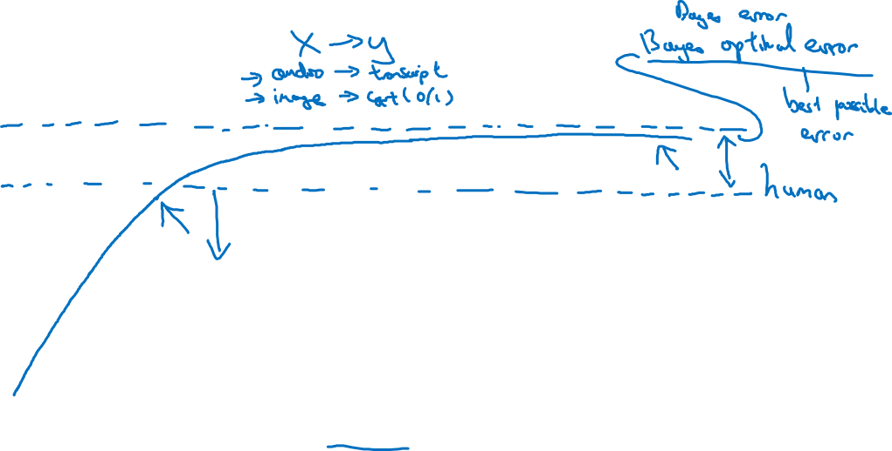
Comparing to human-level performance
accuracy
time
Notes:
Bayes optimal error: best possible error
No way to surpass it.
例如有些声音audio实在是太嘈杂了，真的听不出来说啥了
有些image太模糊了，实在看不来是不是猫
为什么超过了human
为什么accuracy就开始变慢了？
1. One reason is that human level performance is for
many tasks not that far from Bayes' optimal error.
People are very good at looking at images and telling if there's a cat or
listening to audio and transcribing it.
So, by the time you surpass human level performance maybe there's not that much
head room to still improve.
2.
the second reason is that so long as your performance is worse than human level
performance, then there are actually certain tools you could use to improve
performance that are harder to use once you've surpassed human level performance.
解释第二个原因，下一页

Slide 3
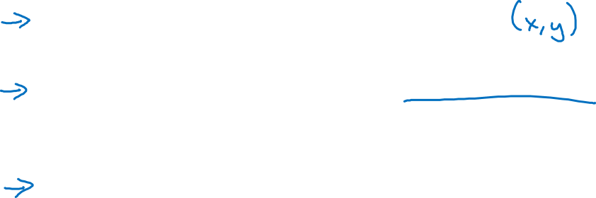
Why compare to human-level performance
Humans are quite good at a lot of tasks. So long as ML is worse than humans, you can:
Get labeled data from humans.
Gain insight from manual error analysis: Why did a person get this right?
Better analysis of bias/variance.
Notes:
1.一些人类擅长的，机器不擅长的。
让人类去label，提供数据

