Slide 1

Comparing to human-level performance
Surpassing human- level performance
deeplearning.ai

Slide 2
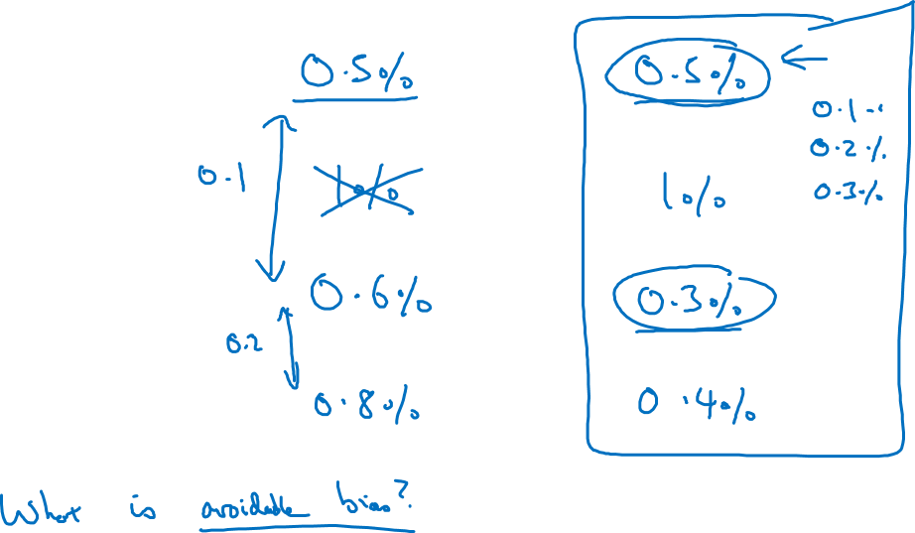
Surpassing human-level performance
Team of humans
One human
Training error
Dev error
Notes:
左边的例子：Avoidable bias = 0.6% - 0.5% = 0.1%
右边的例子：Avoidable bias 无法判断。
一旦机器超过了人类的0.5%，那么机器能做的进步就小了，没有了clear direction.

Slide 3
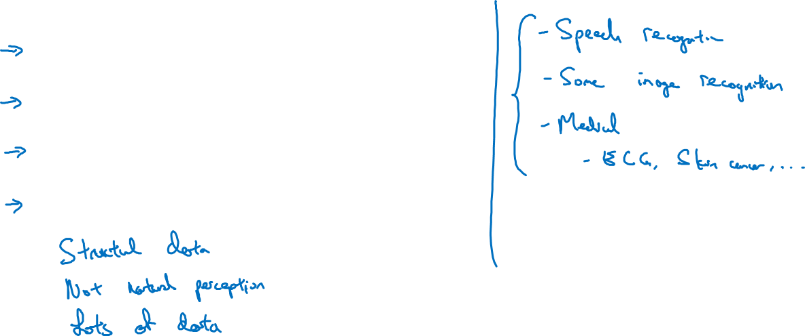
Problems where ML significantly surpasses human-level performance
Online advertising
Product recommendations
Logistics (predicting transit time)
Loan approvals
Notes:
1.这些机器做的好的：
共同点：
是就够数据
不是自然感知（人类擅长的是自然感知:识图，读懂语言）
很多数据
2.还有其他的机器做得好的：
Speech recognition
Some image recognition
Medical …(skin cancer… ECG…)

