Slide 1

Error Analysis
Carrying out error
analysis
deeplearning.ai

Slide 2
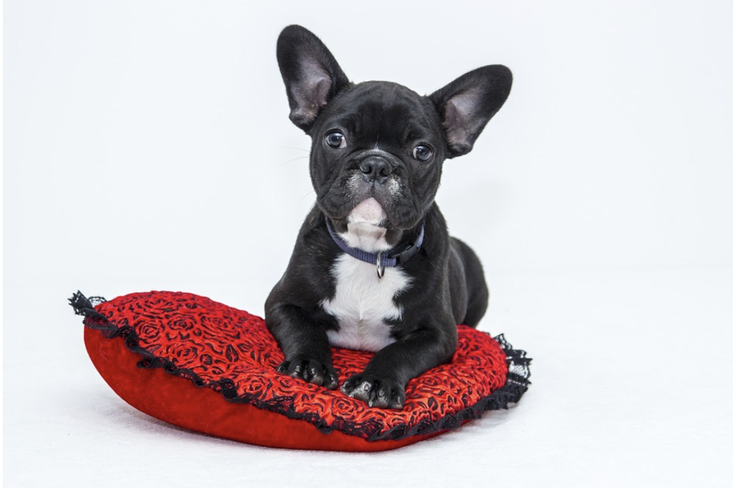
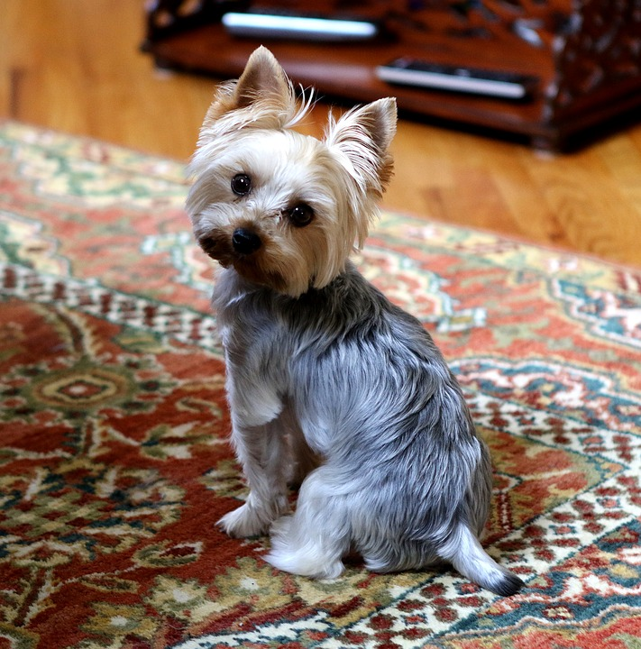
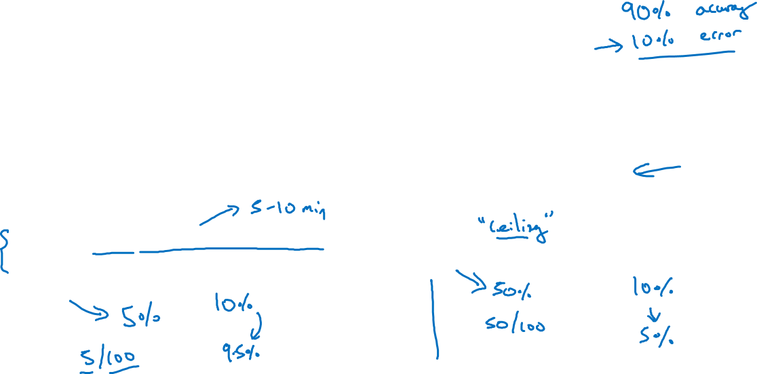
Look at dev examples to evaluate ideas
Should you try to make your cat classifier do better on dogs?
Error analysis:
Get ~100 mislabeled dev set examples.
Count up how many are dogs.

Slide 3
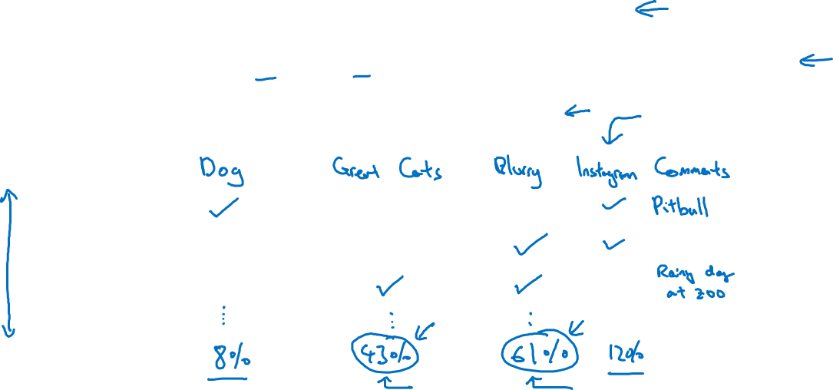
Evaluate multiple ideas in parallel
Ideas for cat detection:
Fix pictures of dogs being recognized as cats
Fix great cats (lions, panthers, etc..) being misrecognized
Improve performance on blurry images
Image
1
2
3
% of total
.
.
.
Notes:
So to summarize, to carry out error analysis, you should find a set of
mislabeled examples, either in your dev set, or in your development set.
And look at the mislabeled examples for false positives and false negatives.
And just count up the number of errors that fall into various
different categories.
During this process, you might be inspired to generate new categories of errors,
like we saw.
If you're looking through the examples and you say gee, there are a lot of Instagram
filters, or Snapchat filters, they're also messing up my classifier.
You can create new categories during that process.
But by counting up the fraction of examples that are mislabeled in
different ways, often this will help you prioritize.

