Slide 1

Error Analysis
Build your first system
quickly, then iterate
deeplearning.ai

Slide 2
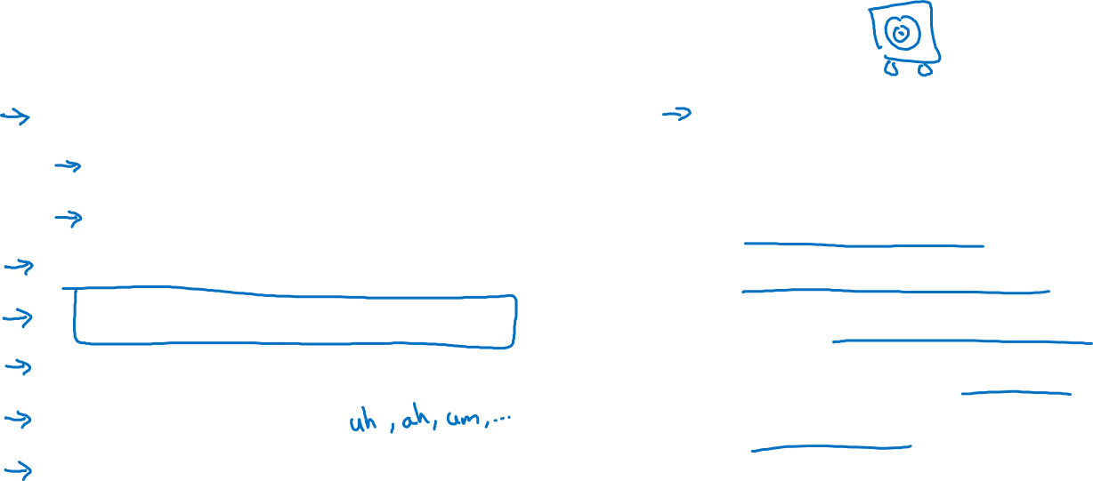
Speech recognition example
Noisy background
Café noise
Car noise
Accented speech
Far from microphone
Young children’s speech
Stuttering
…
Set up dev/test set and metric
Build initial system quickly
Use Bias/Variance analysis & Error analysis to prioritize next steps.
Guideline:
Build your first system quickly, then iterate
Notes:
if you are tackling a new problem for the first time,
then I would encourage you to really not
overthink or not make your first system too complicated.
Well, just build something quick and dirty and then use that
to help you prioritize how to improve your system

